Slide 1




Digital Locks: Enhancing Security and Convenience in the Modern Age — My Digital lock

Slide 2

My Digital Lock
My Digital Lock expert in Gateman, KEYWE Smart Home, EPIC & Samsung Digital Lock with installation of EC Condo & HDB Fire Rated Main Door in Singapore.

Slide 3
My President Mattress OEM mattress that is supplied to most of the top hotel and endorsed by more than 50 famous celebrities in Singapore My President Mattress have sold more than 10,000 pieces of mattress at factory price so that everyone could afford a luxurious and comfortable sleep In My President Mattress, we also customize luxurious storage bed frame to fit all mattress height at factory price with free installation Visit our 3 major showrooms today
My President Hotel Quality Mattress

Slide 4
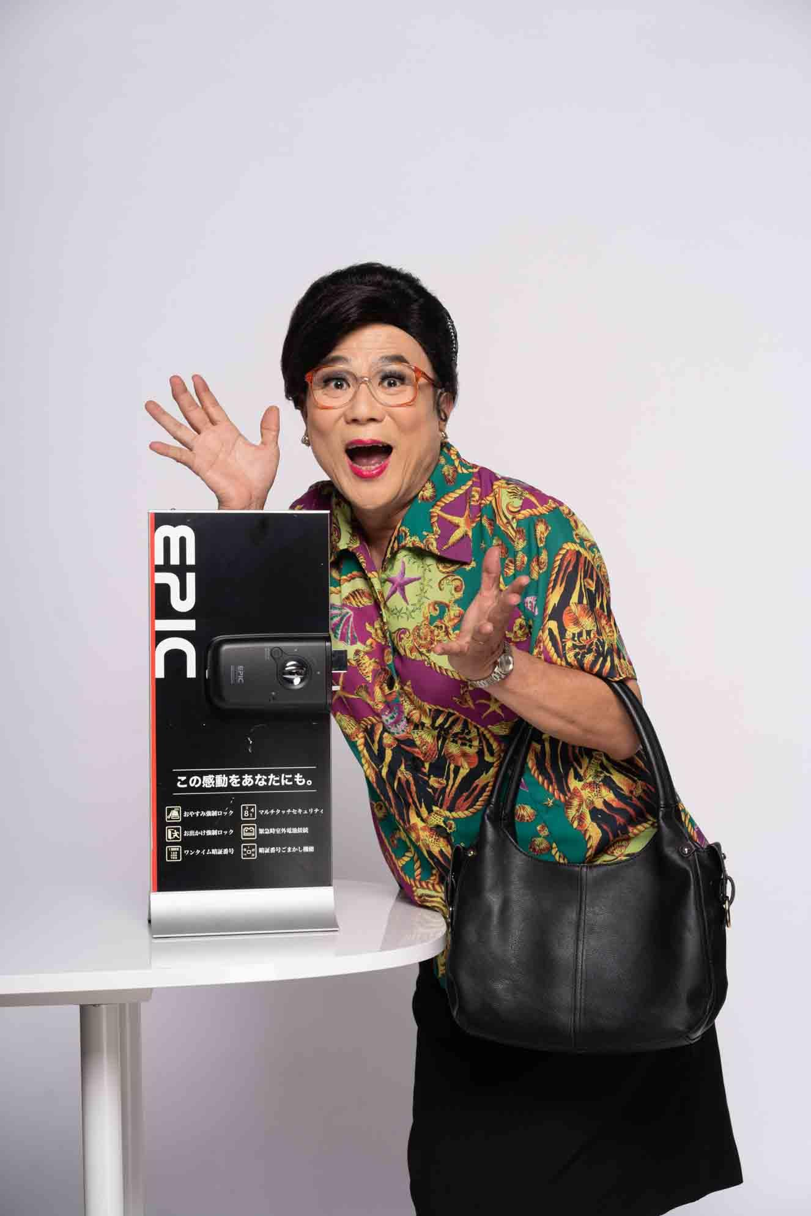
Digital Locks: Enhancing Security and Convenience in the Modern Age — My Digital lock
In an era where technology reigns supreme, digital locks have emerged as a vital solution for enhancing security and convenience in both residential and commercial spaces. Unlike traditional mechanical locks, digital locks utilize electronic components to control access. They offer a range of authentication methods such as PIN codes, key cards, biometrics, or even smartphone apps, providing users with diverse and customizable access options. One of the main advantages of digital locks is their enhanced security features. They often come equipped with built-in alarms, tamper detection, and audit trails, enabling owners to monitor access history and potential breaches.

Slide 5
Moreover, since PIN codes can be easily changed, there’s no need for lock replacements if security is compromised. Digital locks also offer unparalleled convenience. No more fumbling for keys in the dark or carrying a bulky keychain. With digital locks, users can swiftly access their premises with a simple code or a tap on their smartphones. As technology evolves, digital locks continue to adapt, integrating with smart home systems and virtual assistants. These innovative locks are undoubtedly the way forward, bridging security and convenience seamlessly for the modern world.
Website : https://www.mydigitallock.com.sg

Slide 6
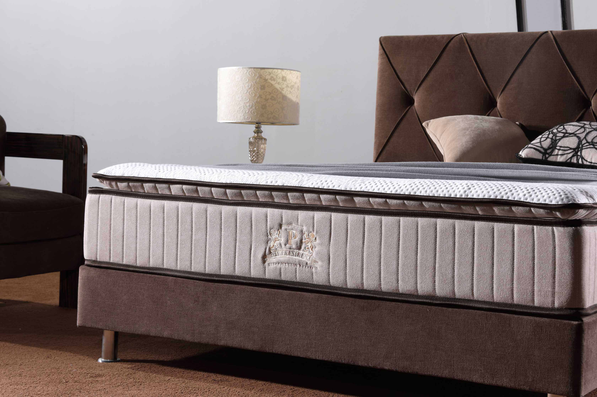

Slide 7
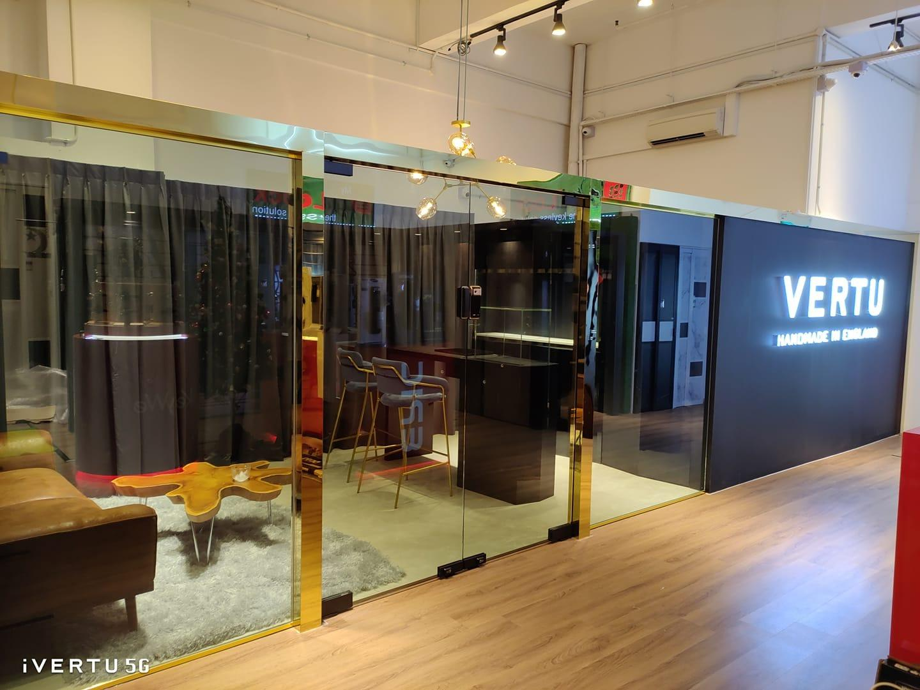
Visit our Showroom (By invitation only)
10 Arumugam Road #08-01,
LTC Building A,
Singapore 409957
(Formerly Lion Industrial Building)
OPERATING HOURS:
Daily: 10AM to 8PM

Slide 8
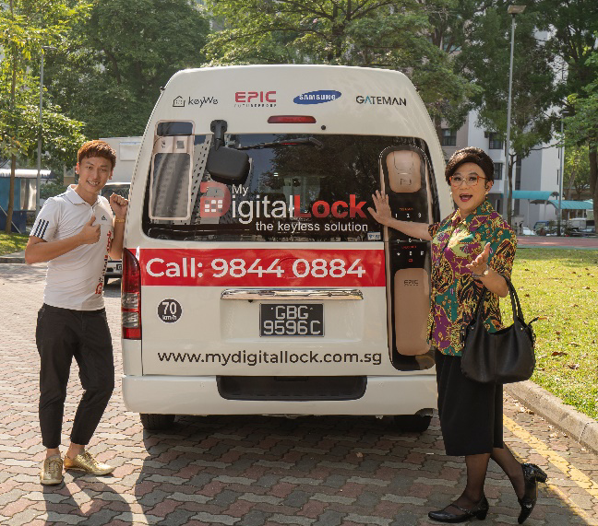
Call our Mobile Showroom 98440884 & We will drive down to show you the EPIC Gate Digital Lock Order Now and Get it Today!!!

Slide 9

GRAB & TAXI REBATE
Flag a TAXI or Call Grab to our SHOWROOM and get DOUBLE the amount REBATE on your purchase with your taxi receipt.

