Slide 1
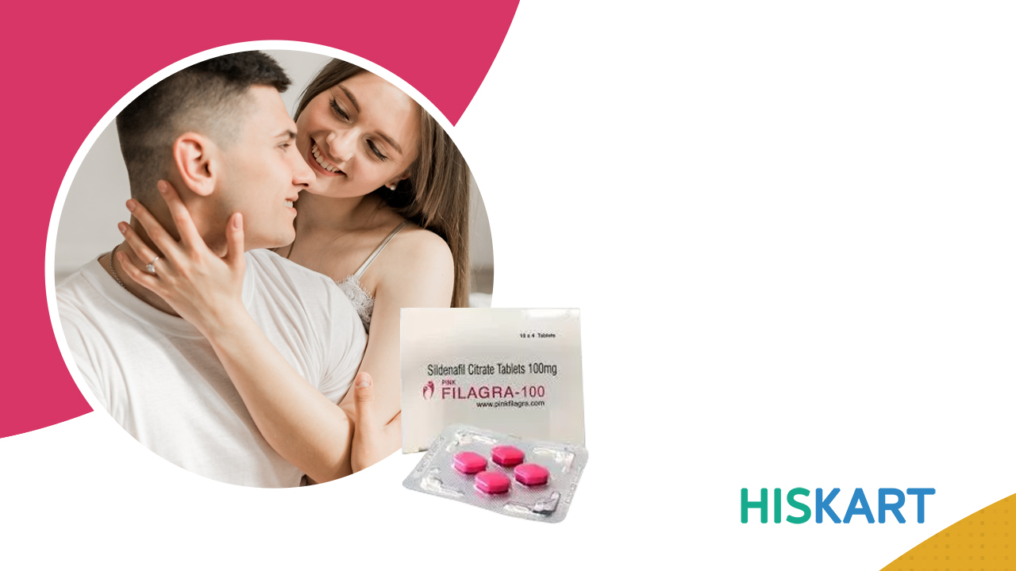
Filagra Super Active:
A Generic Medicine for ED

Slide 2

About Filagra Super Active
Filagra Super Active contains sildenafil citrate, an active drug, which is FDA approved.
Available in soft gel capsules that work faster to show efficient results.
Men who cannot swallow hard pills can use Filagra Super Active for easy consumption.
Filagra Super Active acts exceedingly by helping you perform well in bed.
The drug is also known to enhance men’s overall sexual performance, helping them to live a healthy and happy romantic life.

Slide 3
Working of Filagra Super Active
Filagra Super Active is actively filled with a PDE5 inhibitor medication that stops the degradation of cGMP; it acts for blocking the PDE5 enzyme.
Sildenafil Citrate is the active component for increasing blood to the phallus.
Nitric oxide levels and cGMP levels increase and work for dilating the blood vessels and boosting blood flow.
Erection is attained under the influence of sexual stimulation.

Slide 4
Common side effects of Viagra Super Active
Headache
Muscle Ache
Back Pain
Runny Nose/Stuffed Nose
Flushing

Slide 5

Contact US :
https://www.hiskart.com/
+1-866-230-0898
customersupport@hiskart.com

Slide 6


