Slide 1
Desert Safari Dubai with Best Desert Ride Experience

Slide 2
Dubai is best for the rundown of global travel objections as the city has a couple of the world's most discussed spots of interest. From a man-made island to the most impressive pinnacle and a submerged zoo, it brings various inspiring things to the table.

Slide 3
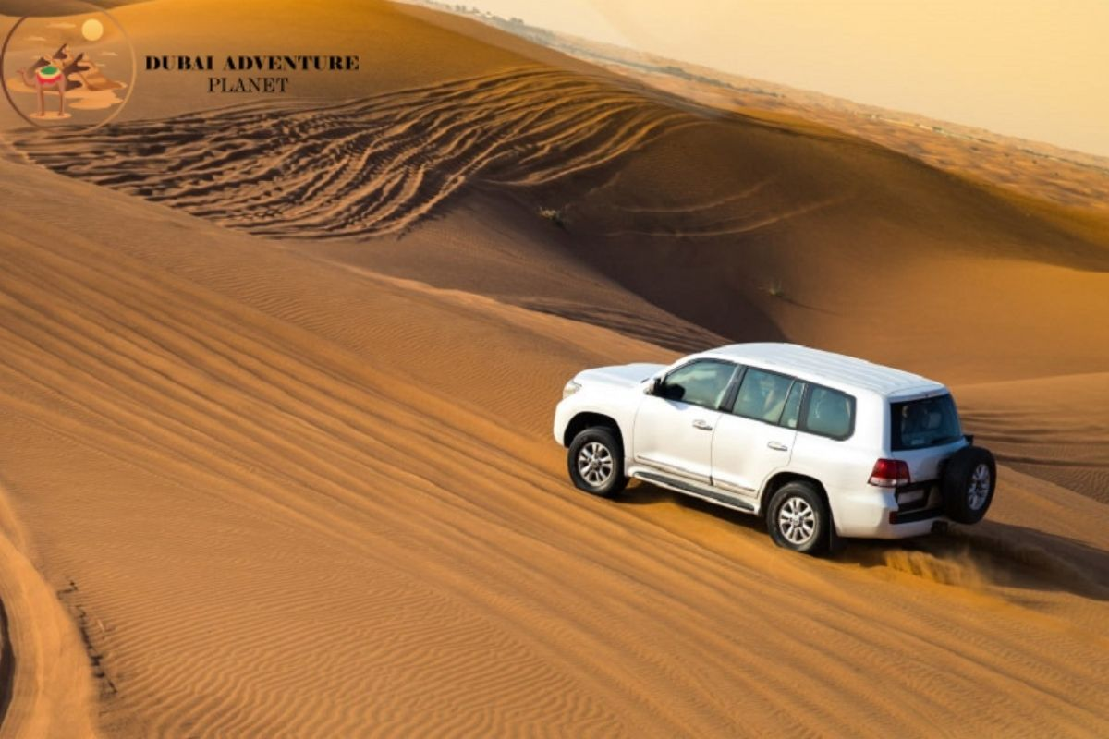

Slide 4
Moreover, the inciting Arabian Dubai Desert Safari is accepted to be one of the most lovely deserts on the planet. A visit through Dubai is minced without meeting the epitome of this Safari Desert Dubai. Nothing can be more heroic than a Desert Safari.

Slide 5
However, here is the Best Desert Safari you can admire the cool breeze with unlisted music and pursuit and like Arabian frills over supper. The Safari Dubai Deals initiates with the aspect of a high torque Land cruiser, getting the visitors in the late early afternoon. It requires around 45 minutes to enter the meeting point of the safari. While the autos are preparing for hill bashing in the Desert in Dubai and guard to gather, you might get down and take selfies.

Slide 6
Similarly, the rise bashing and another desert drive will have a lot of selfie minutes in Dubai Safari Desert, including on the most striking ridge with the sunset as the setting, where you will get a fantastic aspect of the desert. After this, the Desert Safari Tour proceeds to the camel ranch. At long last, the caravan arrived at our Bedouin-roused legacy camping area of Cheapest Desert Safari Deals.

Slide 7
Desert safaris are accessible in varied actions and with various offices such as Adventure Planet Tourism From pocket-friendly to a grand one and from group to solo, you can select Safari Deals as per your desire. The visit officials give morning, evening, and, surprisingly, short-term timings to suit your Dubai Desert Safari requests. Whether you are a solitary voyager or with loved ones, there are desert safari Deals for everybody.
Book Desert Safari: dubaidesertsafaris.com

