Slide 1

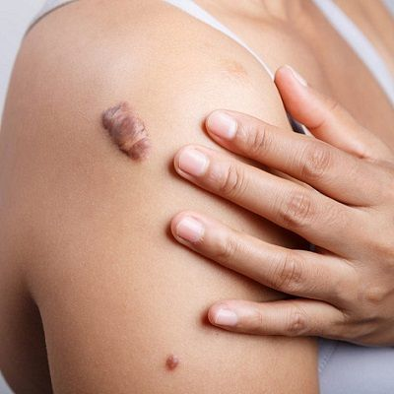
Keloid Treatment in Dubai
Explore advanced keloid treatment in Dubai. Find expert dermatologists and specialized clinics offering effective therapies for keloid management. Discover personalized care in Dubai's leading medical facilities.

Slide 2
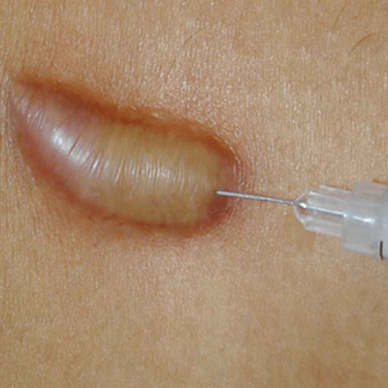
Painless Solutions: Keloid Treatment Advances in Dubai
Freezing Keloids for Lasting Relief
Cryotherapy, another groundbreaking advancement, involves freezing the keloid using liquid nitrogen.
Silicone Gel Sheets: Non-Invasive Management
For those seeking non-invasive options, silicone gel sheets have proven to be an effective tool in managing keloids.
Personalized Treatment Plans
One of the key strengths of keloid treatment in Dubai is the emphasis on personalized care.

Slide 3
CONTACT US:
WhatsApp : +971 544015744
Landline : +971 4333 0708
Email : info@royalclinicdubai.com
Address : Villa 1089, Al Wasl Road, Al Manara Area (On the junction of AlThanya & Al Wasl Road)

