Slide 1
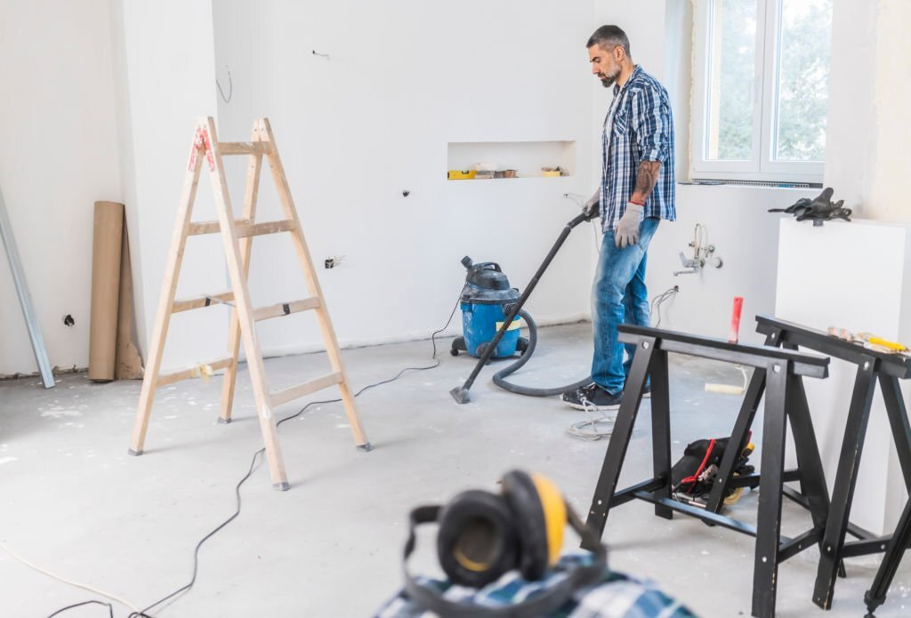
Engage Experts for After Builders Cleaning in Reading

Slide 2
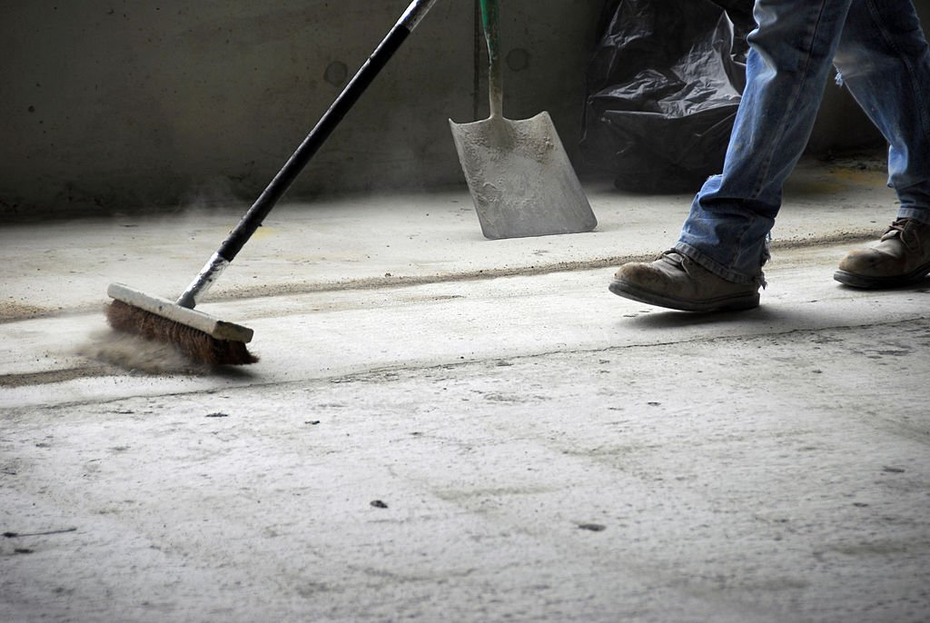
After builders cleaning is a term used to define the process carried out after the builders have left the construction site, this is usually done to ensure that the site is clean and safe for the occupants. The process usually involves cleaning the floors, walls, ceilings, windows, and doors.

Slide 3
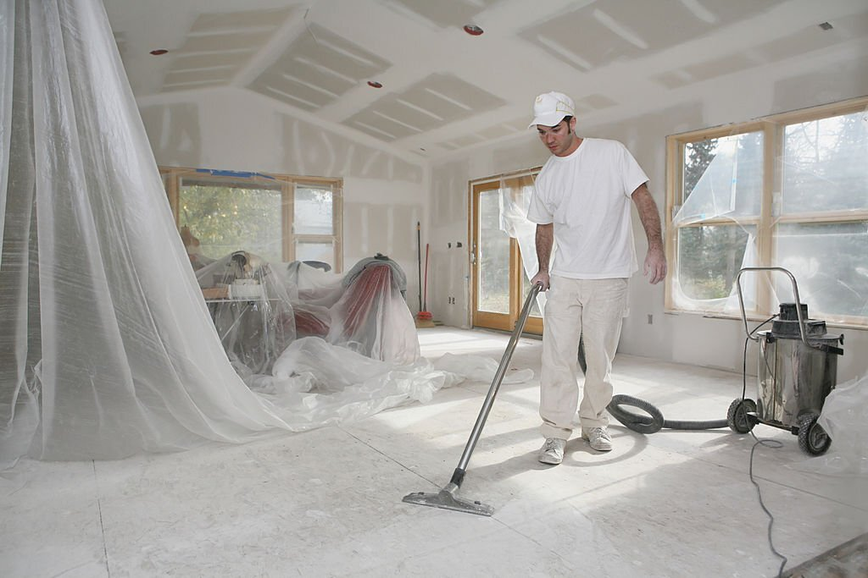
Builders cleaning services are designed to clean your house after builders have completed the construction work. Professionals remove any dirt or debris that might have been left behind. Professional cleaners assisting after builders cleaning in Hertfordshire will also clean and polish all surfaces to ensure that your home is in pristine condition.

Slide 4
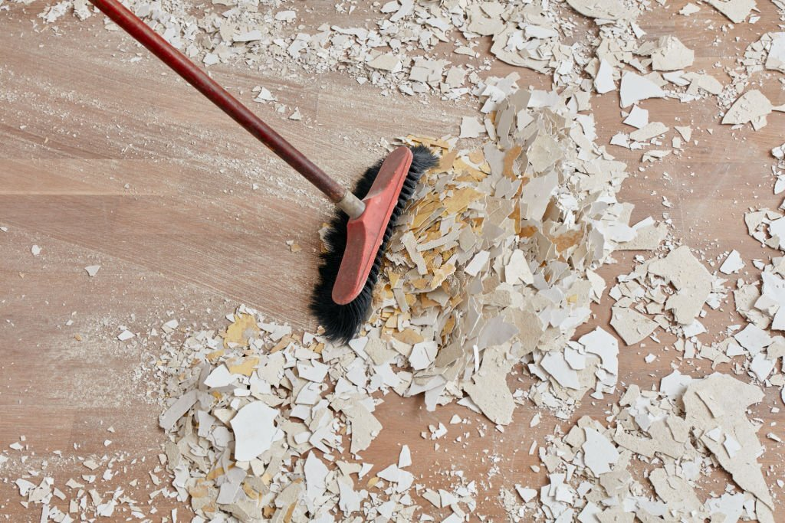
After builders cleaning services are provided by professional cleaners, who know how to clean up your property, they can handle even the most challenging situation. These cleaners have the experience and expertise to clean any building.

Slide 5
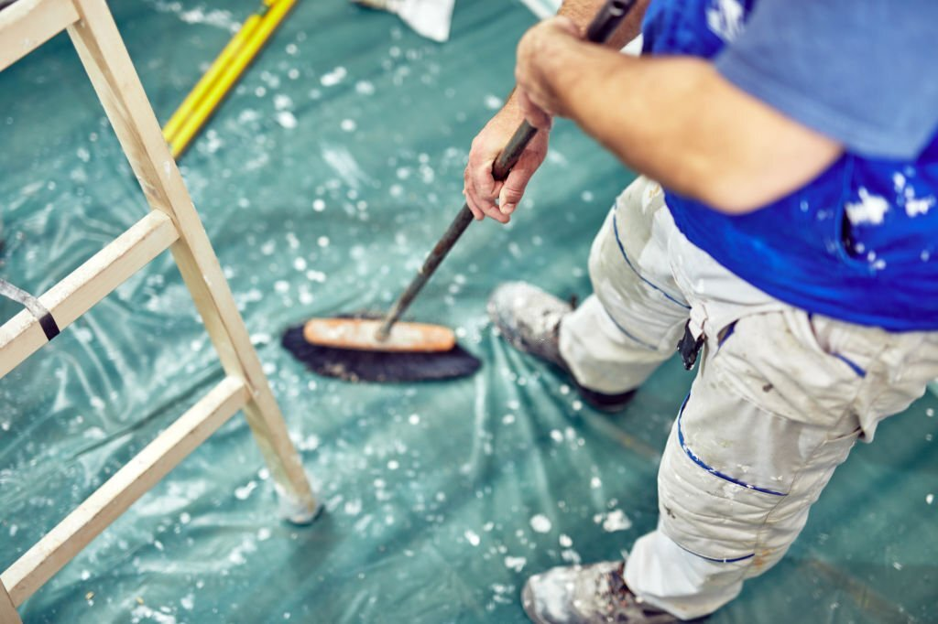
After builders cleaning services are essential, they can make your home look new again. With their attention to detail and commitment to customer service, professionals can help to make your home look spick and span.

Slide 6
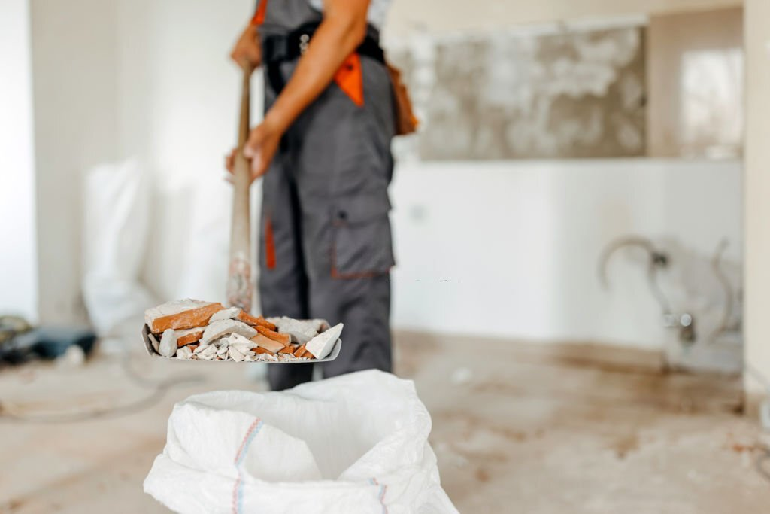
When the after-builder cleaners have completed their somewhat chaotic work, your newly renovated home will look like a model home in a magazine. The inside of your home will shine, the carpets will smell fresh, and the windows will be so clean that you'll be able to see your reflection.

Slide 7
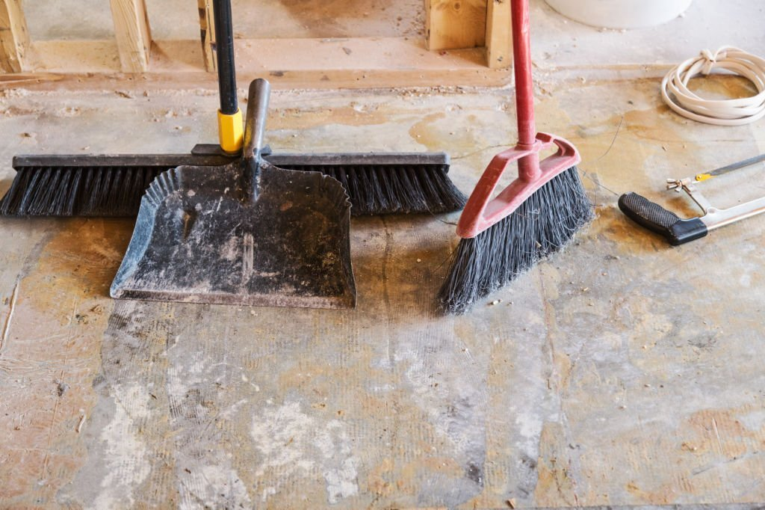
But before you can start inviting all your friends and family over to show off your new home, you need to complete a final deep clean by engaging experts for after builders cleaning in Reading.

Slide 8
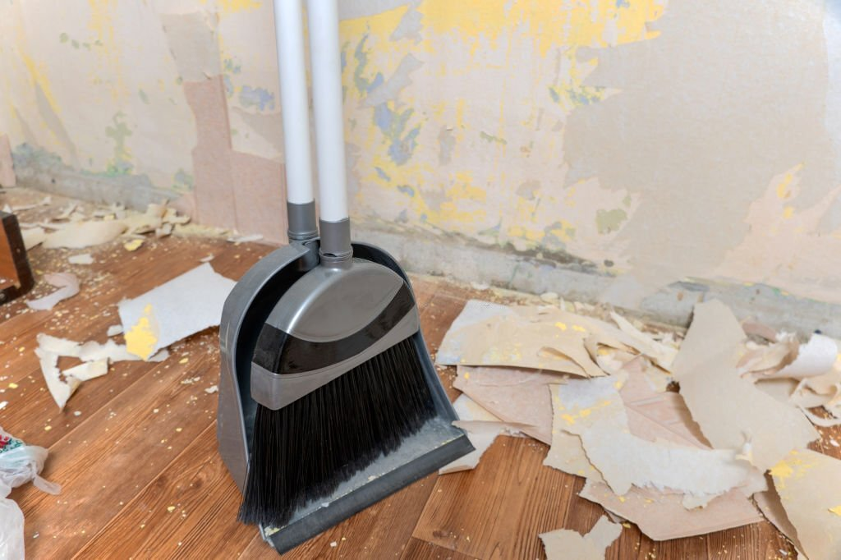
Garden clearance is a procedure by which garden owners tidy up their gardens and make them look cleaner. Garden clearance is usually carried out by gardeners or by professional garden clearance companies. Many people choose to clear their gardens for several reasons.

Slide 9
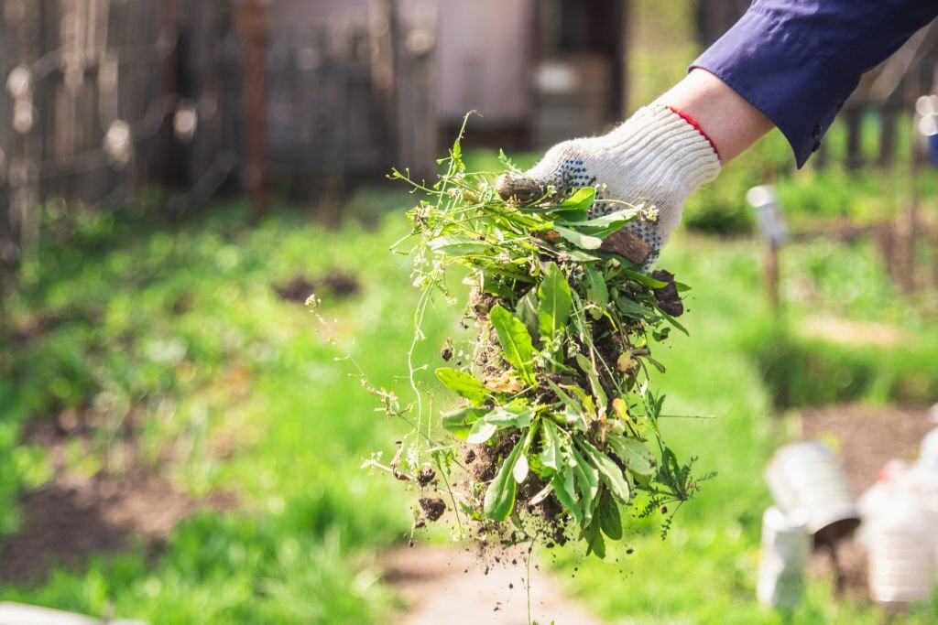
They might be moving house, want to make a good impression on potential buyers, or are sick of looking at an untidy garden. Whatever the reason, garden clearance can seem like a daunting task. But you can ease the process by getting professional help for garden clearance in Hertfordshire.

Slide 10
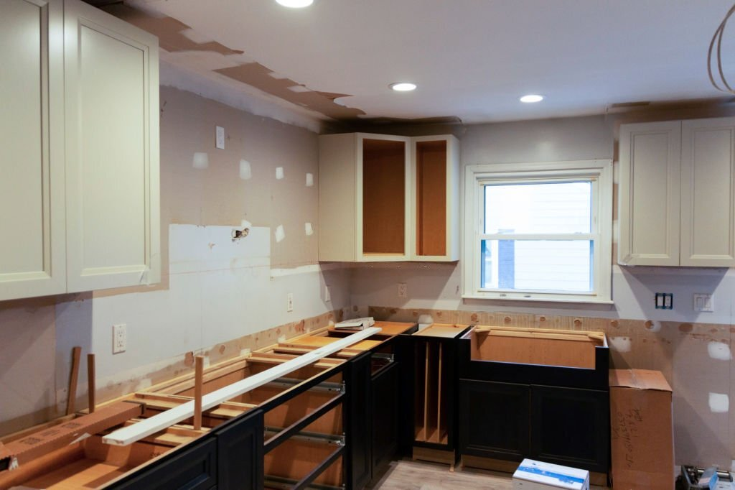
Home refurbishment in Cambridgeshire is the process of making additions and improvements to your home. It can be as simple as painting the walls or as significant as adding an extension. It can be done to repair the damage, make your home more comfortable or stylish, or increase its resale value.

Slide 11
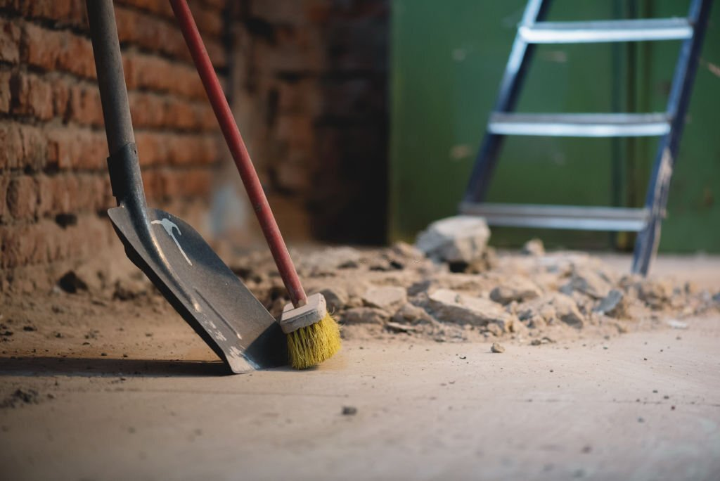
Refurbishing your home can be a big job, but it's also advantageous. After a new building is constructed, builders' cleaning is necessary to ensure that every part of the building is free of construction debris. Hiring professionals for after builders cleaning in Manchester is essential for several reasons:

Slide 12
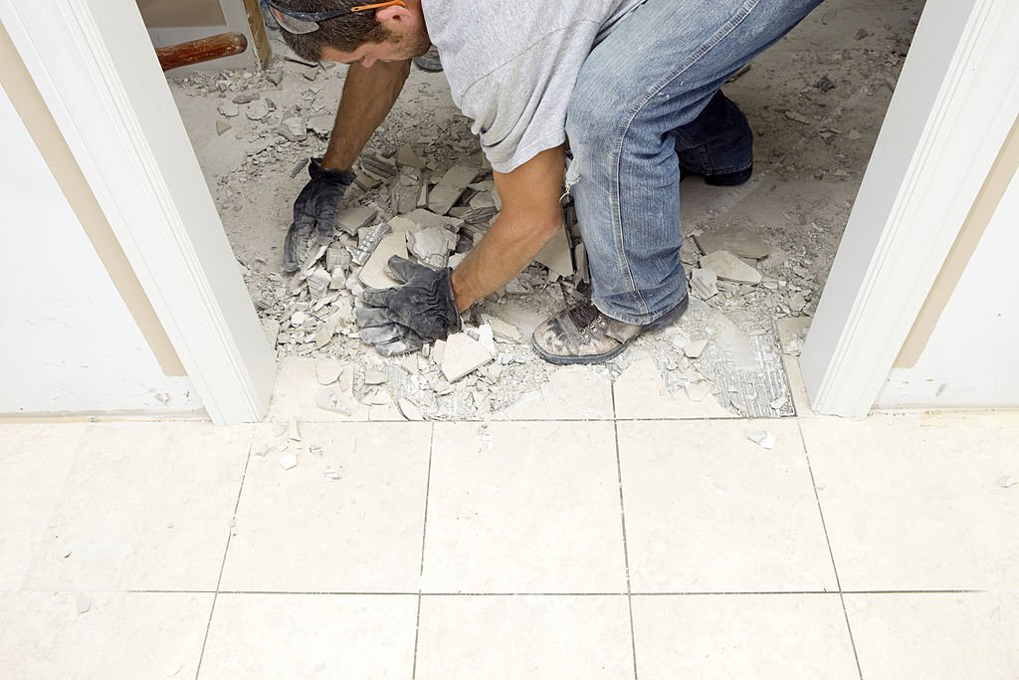
It helps to ensure the safety of the people occupying the building. Construction debris can pose a safety hazard, and it is vital to remove it before people begin using the facility.

Slide 13
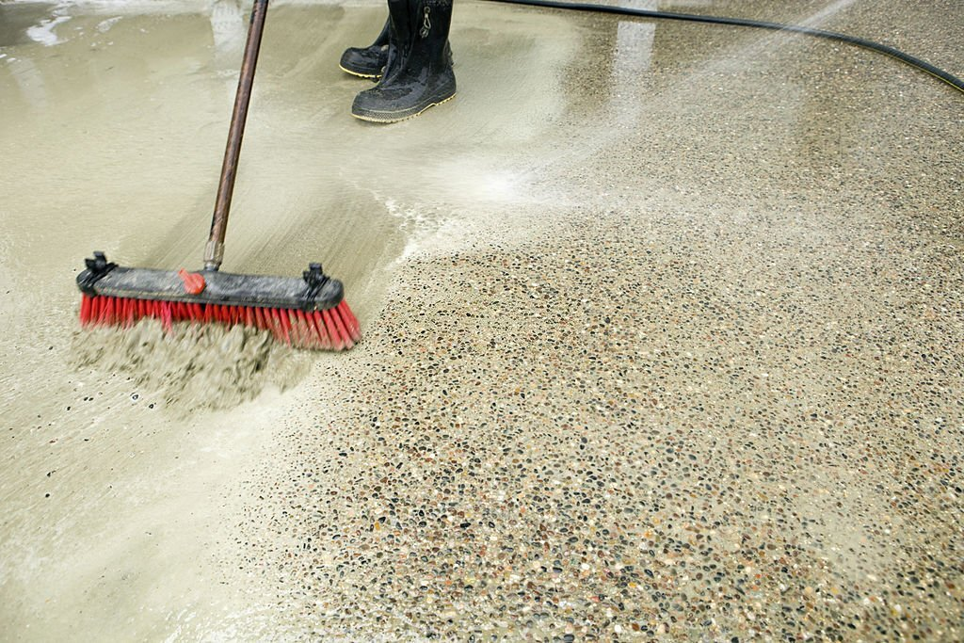
Builders' cleaning helps to improve the appearance of the building. A clean facility is more likely to be inviting and appealing to potential tenants or customers.

Slide 14
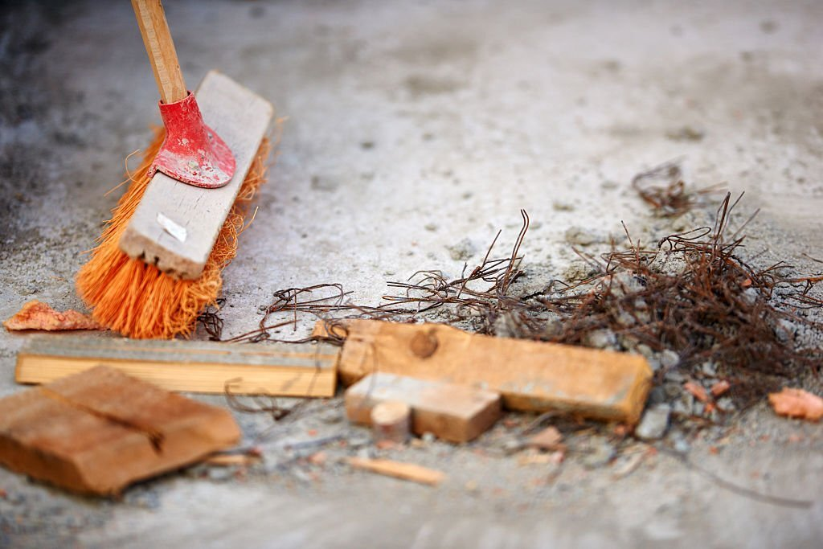
Builders cleaning with the help of Scenic Cleaning professionals can help to increase the value of the building. A clean facility is more likely to be well-maintained, which makes it more attractive to potential buyers.

Slide 15
Related Articles:
Get Professional Help for House Clearance in Buckinghamshire
Keep Your Home Organised with Deep Cleaning in Reading
Plan for Deep Cleaning in Reading with the Help of Professionals
Leave The Job Of Domestic Cleaning In Luton To Experts
Hire Expert Cleaners For Effective Deep Cleaning In Luton

Slide 16


