Slide 1
Most Inviting Desert Safari Dubai Trip

Slide 2
Glimpse mystical daybreak that could only be described as epic amid the desert leaving another day in the Arabic manner with the Desert Safari Dubai. Get up promptly toward the opening of your beautiful day to assemble for a startling Dubai Desert Safari. When our driver gets you from your doorstep you'll be driving off to the sunny sand Desert of Dubai where everything you can see is shades of gold with lines of sand ridges.

Slide 3
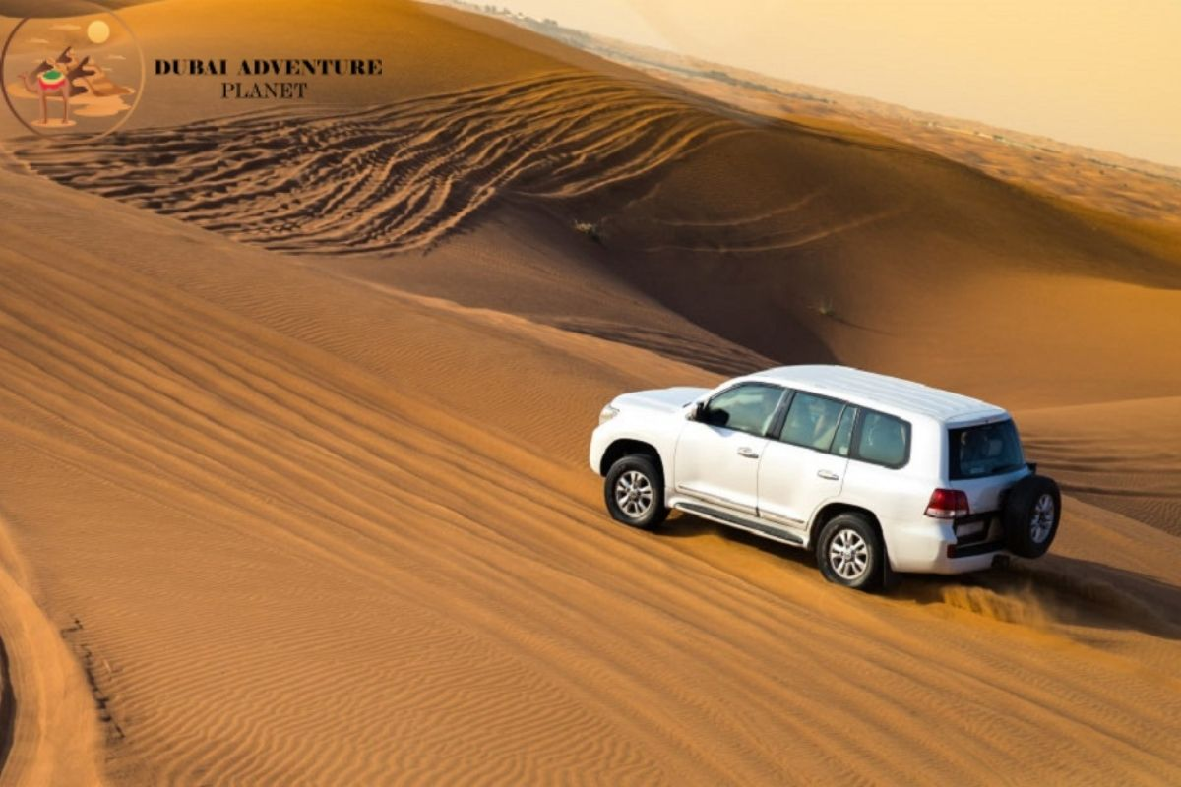

Slide 4
However, when you enter the Dubai Desert Safari, it will be an ideal opening to laud for staggering daybreak, snapping the shots of shining beams of the sun kissing the brilliant sand floor during your Safari Dubai Deals. Saturate yourself in the reviving cold breeze of a morning that moves right throughout you before you bounce on the car to go on a super-quick rise bashing meeting in the high desert.

Slide 5
Likewise, drive quick among the ridges of the Desert in Dubai and bang hard to sprinkle sand in the air as the encompassing of the Desert Safari Dubai gets hotter. Then, earlier today desert safari from Dubai will make a beeline for our camping area in the desert where you can dine in a lot of hijinks and provoking drills. At the campground of Morning Desert Safari, take a stab at riding on a camel has returned to observe the desert very much as the genuine desert men do.

Slide 6
Moreover, book your Best Safari Deals with rough terrain feats and take part in a suitable morning or Evening Safari experience. This Sunset Desert Safari Dubai is a striking encounter. The glare of the desert sun with the cool, and basic morning breeze will be the most satisfying experience of your life on the Safari Dubai Tour. The Morning Desert Safari starts with the overjoyed and exciting ridge bashing in vast rises of the desert.

Slide 7
You have a couple of hours in your grasp on Dubai Safari Tour however yet need to see its core, wish to like, admire and lose yourself in diverse exercises that we have foreseen you. Further, here with our Desert Safari Deals, you get the worth of every penny you choose to spend and will get the most oversaw, joint, and logical Safari Desert Dubai with a tasty breakfast.
Book Best Desert Safari Dubai

