Slide 1
Most Thrilling Rides In Desert Safari Dubai

Slide 2
Assuming you can't help thinking about how can it be to go for a desert safari in Dubai in the hot summer season? Here is the perfect solution for you. During summertime, the days in the Arabian desert in Dubai are insufferably warm. In any case, dusks and evenings are wonderful as well as the early mornings in the Desert, so the weather ailments scarcely impact the Dubai Desert Safari over time. You can feel it whenever of the year.

Slide 3
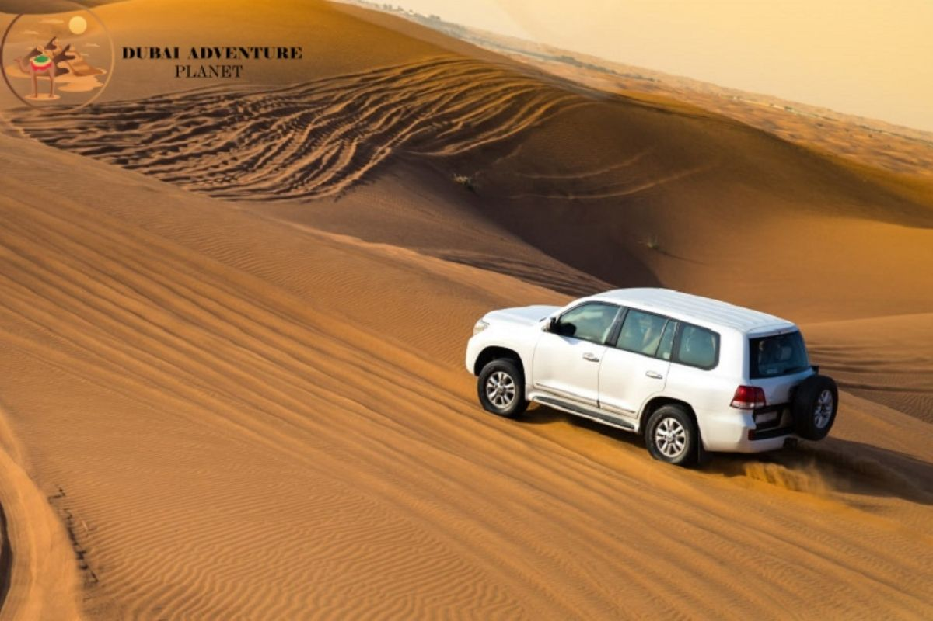

Slide 4
Desert Safari:
The Desert Safari Dubai gives never-ending tomfoolery and rush in the second-biggest desert and the most persona. As summer jaunts are leaning, you can predict the boldest Dubai Desert Safari on the planet during the get-aways. Travel organizers like Adventure Planet Tourism improve on the task as you can pre-book your Desert Safari Deals on the web. The site has total subtleties on the sort of bundles free, alongside online client care councils.
Book Desert Safari: www.desertsafaris-uae.com

Slide 5
Fun Activities - Dune Bashing:
When you arrive at the Dubai Safari Desert touring spot, be equipped for some, amazing rise bashing in desert experience. The able driver cum local area expert will take more time for a trip you will recollect for a lifetime. The quickly moving cars in Desert Safari from Dubai continuing on colossal hills of sand will bang your heart out ordinarily. You will shout in a rush and experience with your kindred travelers during this Desert Safari Tour.

Slide 6
Setting Up Camp:
After the amazingly exhilarating ridge bashing in safari, now is the perfect time to calm down on a wonderful camping area created in Bedouin topic of Safari Desert Dubai. The climate,insides, and realness will win your heart and love. Have a couple of tastes of a reviving beverage or kahwa tea according to your bias and be prepared for some more events outside the campground for some great quad trekking and sandboarding.

Slide 7
Cheapest Desert Safari Dubai Price:
The further bundles of the Dubai Safari Deals start from 700 to 3000 AED overall and will give you the all trims. The ticket costs of Desert Safari From Dubai are best handy in a couple of costs and on the off chance that you will get the bundle of your best Desert Safari to offer the entire tickets will be posted in those. The Arabian sands of the vast desert in Dubai are best a result of their use and they will give you a rush.
Book Evening Desert Safari: bestdesertsafaridubai.net

