Slide 1


RICHMOND POLICE DEPARTMENT
2017 TOWN HALL MEETING
Colonel Alfred Durham
Chief of Police
Levar M. Stoney Selena Cuffee-Glenn
Mayor Chief Administrative Officer

Slide 2
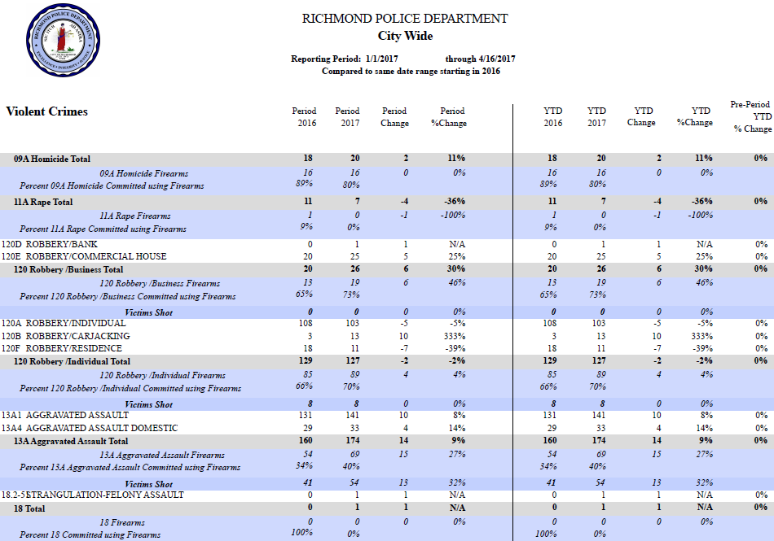
Citywide Crime, YTD
Richmond Police Department

Slide 3
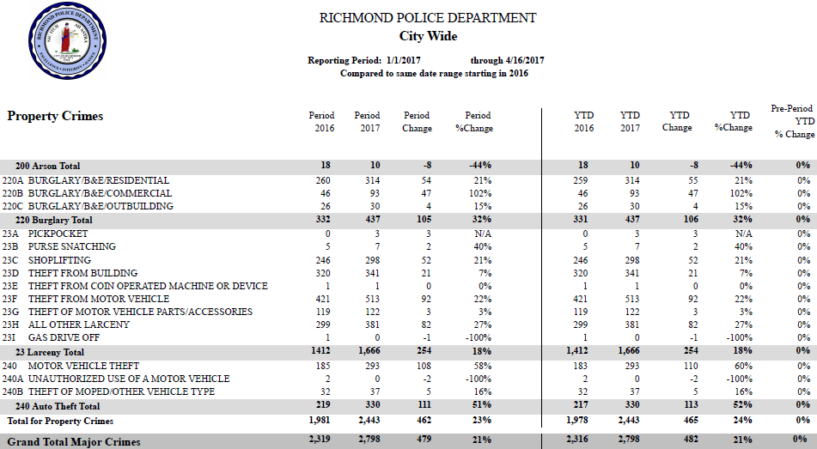
Citywide Crime, YTD
Richmond Police Department

Slide 4
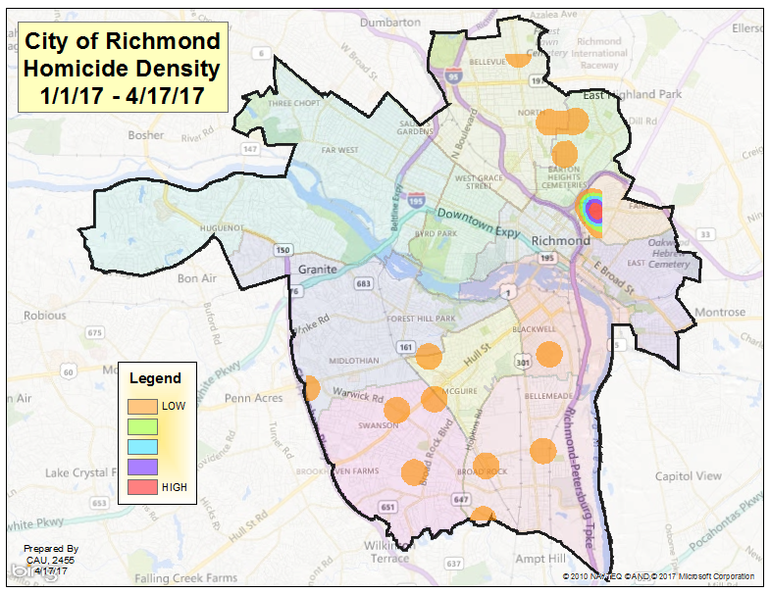
Richmond Police Department

Slide 5
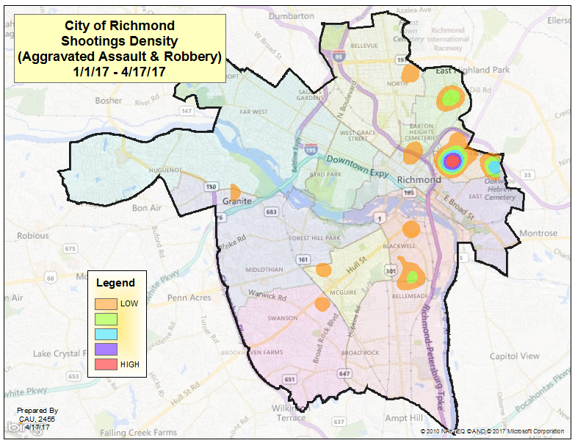
Richmond Police Department

Slide 6
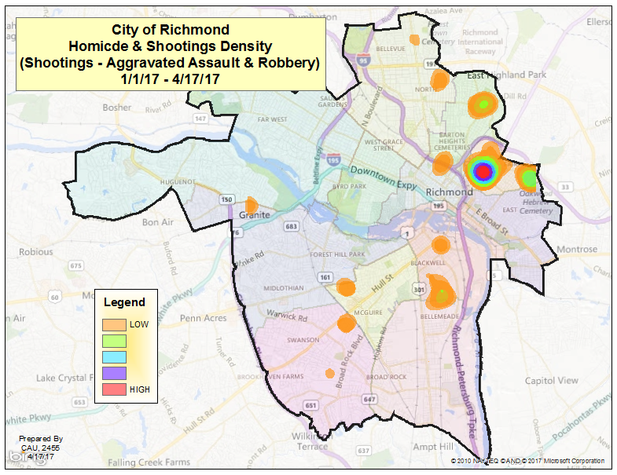
Richmond Police Department

Slide 7
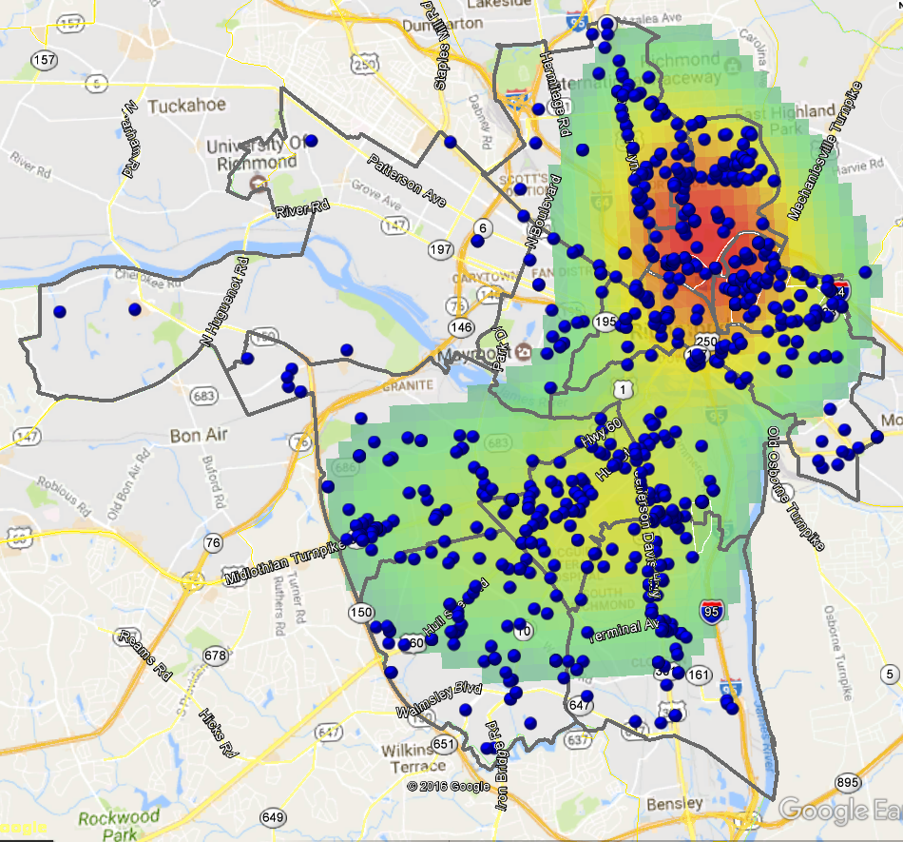

City of Richmond
Firearms Seized/Taken & Density
2016
Gilpin
Whitcomb
Fairfield
Mosby
Creighton
Hillside

Slide 8
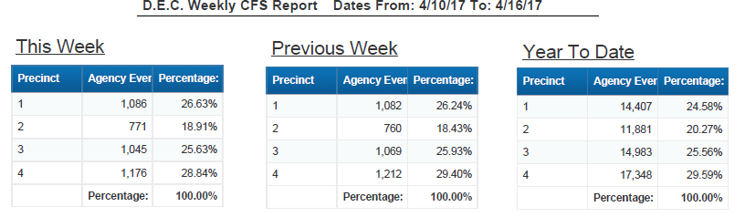
Citywide Calls for Service
More than 58,000 calls for service have been handled as of April 16, 2017.
558 calls per day, on average, citywide.
Richmond Police Department

Slide 9
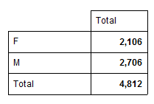
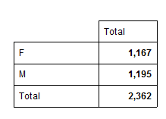
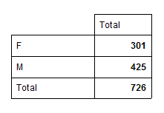
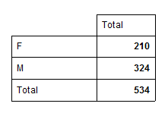
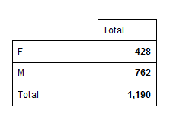
Arrests/Felony & Misdemeanor
Citywide Total of 3,056 arrests for 2017 (1/1 – 4/16)
Citywide Felony & Misdemeanor*
Felony & Misdemeanor by Precinct*
1st Precinct
2nd Precinct
3rd Precinct
4th Precinct
*Felony & Misdemeanor are based on charges.
Richmond Police Department

Slide 10
CURRENT STAFFING LEVELS
Authorized Strength 750
Current Sworn Strength (to include recruits) 719
Unavailable Sworn Personnel 31
Available Sworn Personnel 650
110th Basic Recruit Class (Injured) 1
113th Basic Recruit Class (Injured) 1
114th Basic Recruit Class (June Graduation) 18
115th Basic Recruit Class (August Graduation) 20
116th Basic Recruit Class (June academy start) 4
Total Vacancies 25
______________________________________________________________
Precinct Staffing
Precinct Authorized Actual Vacancies
1st 126 117 9
2nd 119 106 13
3rd 120 115 5
4th 132 115 17
TOTAL 497 453 44
Richmond Police Department

Slide 11
HIRING PRACTICES
New Recruit Graduates Since 2014
This highlights the importance of funding and filling all of our sworn positions in order to be prepared to face the challenges and continue to build safe neighborhoods throughout Richmond or we risk falling behind and being without adequate staffing.
It takes significant time to increase and build up
staffing for the future.
WE MUST:
RECRUIT & HIRE QUALIFIED CANDIDATES AND THEN
PREPARE THEM FOR THE JOB
See next slide
During the last four calendar years: 2014 to present
Class | Graduation Date | Number of Graduates
109 | August 21, 2014 | 28
110 | March 17, 2015 | 28
111 | August 21, 2015 | 30
112 | May 19, 2016 | 22
113 | January 28, 2017 | 17
114 | June 8, 2017 | 18 Pending
115 | September 7, 2017 | 20 Pending
Graduated 125 new officers
Lost 154 sworn members through attrition
Retirements, resignations, terminations, death, etc.
We have seen a net loss of 29 officers
CY 2017: 13 sworn separations (as of April 17)
10 resignations; 3 retirement
Last year at this time: 9 resignations; 1 retirement
Since 2013, largest group of resignations is officers with 5-10 years of service (citing: pay compression).
Richmond Police Department

Slide 12
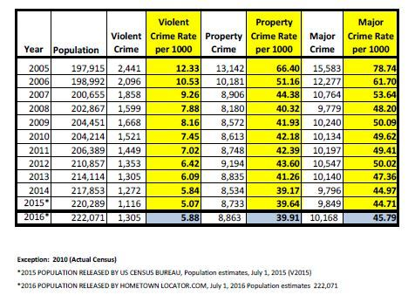
Richmond Police Department

Slide 13
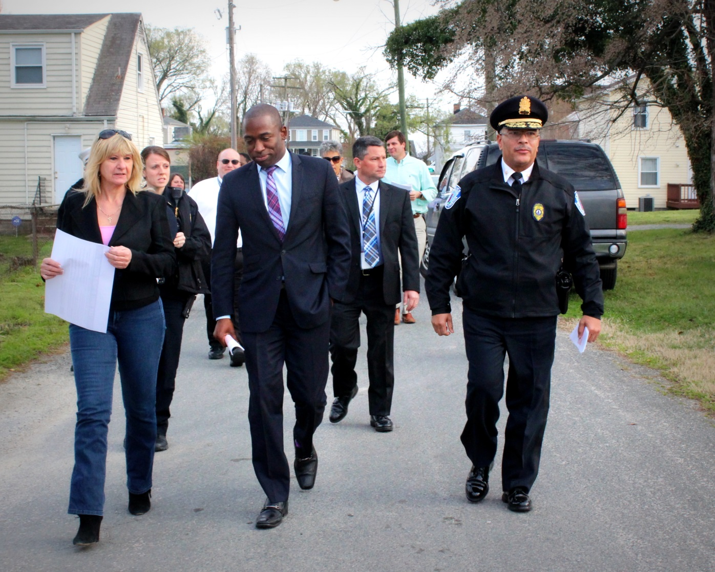
PARTNERSHIPS
Richmond Police Department

Slide 14
PARTNERSHIPS
Regional and federal partners –
Operation Blue Shield – a cross border joint operation involving Henrico, Chesterfield, State and Richmond Police to address crimes occurring along jurisdictional boundaries.
Violence Suppression Team partnered with State Police and ATF to address gun show illegal purchases to reduce illegal firearms from reaching the street
Community organizations –
Built partnership with owners of Rudd’s Trailer Park to reduce prostitution and robberies in area
Expanded involvement in Latino Community which has led to 18 month strategic plan
Increased involvement in Faith Leaders Group which has led to increased expectations and goals for year
Richmond Police Department

Slide 15
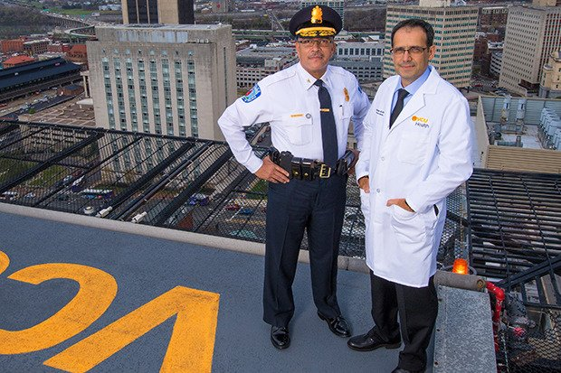
INNOVATIONS
Richmond Police Department

Slide 16
INNOVATIONS
First police agency internationally to involve news media in TASER training to increase awareness and understanding of police use of force
Virginia Recovery Foundation has increased awareness and provided alternatives to incarceration for persons with opiate addiction
Twenty-seven persons with addiction placed in treatment programs during first quarter of year
Developed partnership with ATF to increase firearm tracing and linking to crimes and offenders.
Seven firearms have been linked to 15 different crimes including one murder
Eight offenders have likewise been linked in this ongoing effort
Partnering with VCU Health in their Alternative Pathways and RPD Life Programs
Richmond Police Department

Slide 17
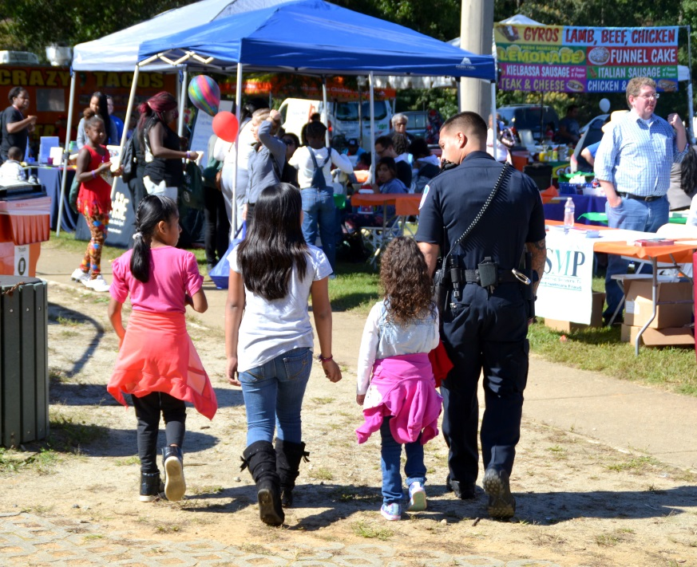

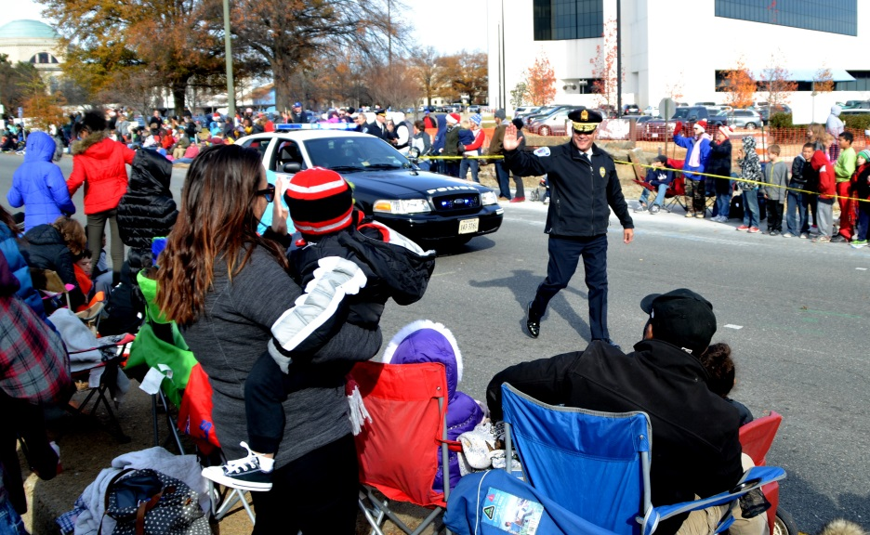
ACCOMPLISHMENTS
Richmond Police Department

Slide 18
ACCOMPLISHMENTS
Developed pay compression proposal to address continued attrition of personnel and presented to Council
113th Academy graduation – 17 new officers
100 local taxis inspected this quarter
PALFit Initiative begins, Feb. 2017 teaching youth importance of health and fitness through interactive classes with police officers
The RPD earned its second Advanced Law Enforcement reaccreditation and received the “Gold Standard With Excellence”, a distinction only awarded to 17 other agencies across the country
200 Body-worn Cameras were deployed department-wide with 18,850 hours of video recorded
Lethality Assessment Protocol providing resources to victims of domestic violence, was launched
Nineteen students successfully completed the third session of the LIFE program
Richmond Police Department

Slide 19
ACCOMPLISHMENTS
Successfully managed four major protests including the Inauguration Day and Immigration protests and demonstrations with no major disruptions or arrests during any protest.
Special Events include the Monument Avenue 10k, where 130 officers managed safety for more than 25k participants
Conducted joint operation with regional partners and DEA to arrest and seize major heroin/fentanyl dealer in Feb, 2017
As a result, non-lethal overdoses decreased from 44 in February to 15 in March, a 65% reduction
Conducted a violent crime Initiative along Midlothian Corridor resulting in a 56% reduction in violent crime through search warrants, knock and talk, and other interdiction methods; 62 firearms were seized
Richmond Police Department

Slide 20
ACCOMPLISHMENTS
More than 450 adults and youth participated in the MILO Use of Force Training during first quarter of 2017
Implemented new officer work schedule in conjunction with development of beats within sector – designed to create greater accountability and oversight of individual performance
Three command staff walks conducted the Oak Grave, Byrd Park, and Swansboro neighborhoods
RESET deployment in areas of violent crime
Implemented Patrol Rifle individual officer purchase program and protective rifle plate carrier systems department wide
Richmond Police Department

Slide 21
Gun 250
86 Tips
15 illegal firearms seized
10 arrests
$3,340 in rewards paid
Richmond Police Department

Slide 22


Lethality Assessment Protocol
Since March 1, 2016:
818 screenings conducted
438 assessed as ‘high-danger’
272 assessed as ‘non-high-danger’
108 chose not to participate
Richmond Police Department

