Slide 1
Desert Safari Dubai Deals

Slide 2
Desert Safari Dubai is the exciting and greatest tour junction for multiple people visiting Dubai yearly. Here, in the Dubai Desert Safari, you can dine in the very beautiful and admiring stance of the desert. Once you reach the Safari Dubai camp, you will be cheered with solace grins and truly necessary free drinks, and bites. Next to reviving yourself and resting for some time, make a beeline for the quad biking region right external the Dubai Safari Camp.

Slide 3
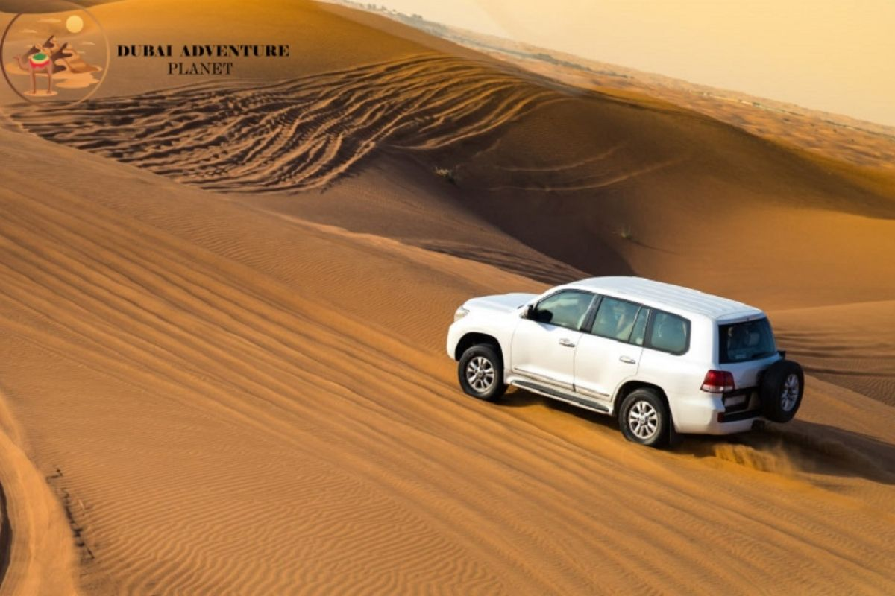

Slide 4
Around 20 mins into the Desert in Dubai ride the caravan of safari will stop for a brief time to chill their cars. It would be an ideal chance for you to click those critical selfies and all affecting pictures of the desert safari in Dubai. Try to get a picture with the amazing bird of prey Falcons that are hauled around by local people now. Likewise, after this stop of 15-minute, now is the right time to leave the Dubai Desert and go towards our Desert Camp.
Book Desert Safari: desertsafaris-uae.com

Slide 5
Bedouin Camp With Food:
For the Bedouin in Dubai Safari, the traveling way of life is a need. However, the camps of clans and the families moved at whatever point food and water ran out. The Bedouin saved the Arabian desert sometime before current regional lines were drawn, so moving to a stationary way of life and getting crucial motivators from the union was viewed as a fair trade for defying citizenship.

Slide 6
Super in Safari:
Plunk down to best supper underneath the stars in the desert rises with a cozy gathering of spouses. You'll travel in a safari ride to your Desert Safari Tour camp in the core of a nature hold where you can dine in social features, for instance, henna, a camel ride, and shisha before you plunk down to an expert six-course supper in Best Desert Safari Dubai Tour. With a little karma, you'll get a brief look at some areas of natural life while you feast.
Book Evening Desert Safari: bestdesertsafaridubai.net

