Slide 1
Quad Biking: Must try activity of desert safari Dubai:

Slide 2
Dubai, one of the seven emirates in the United Arab Emirates and popular tourist destination, is home to some fantastic attractions. Its world-famous Burj Khalifa skyscraper highlights the city's skyline, while Gold Souk welcomes shoppers looking for a bargain. But there's plenty more to explore in Dubai – including a desert safari experience on quad bikes!

Slide 3
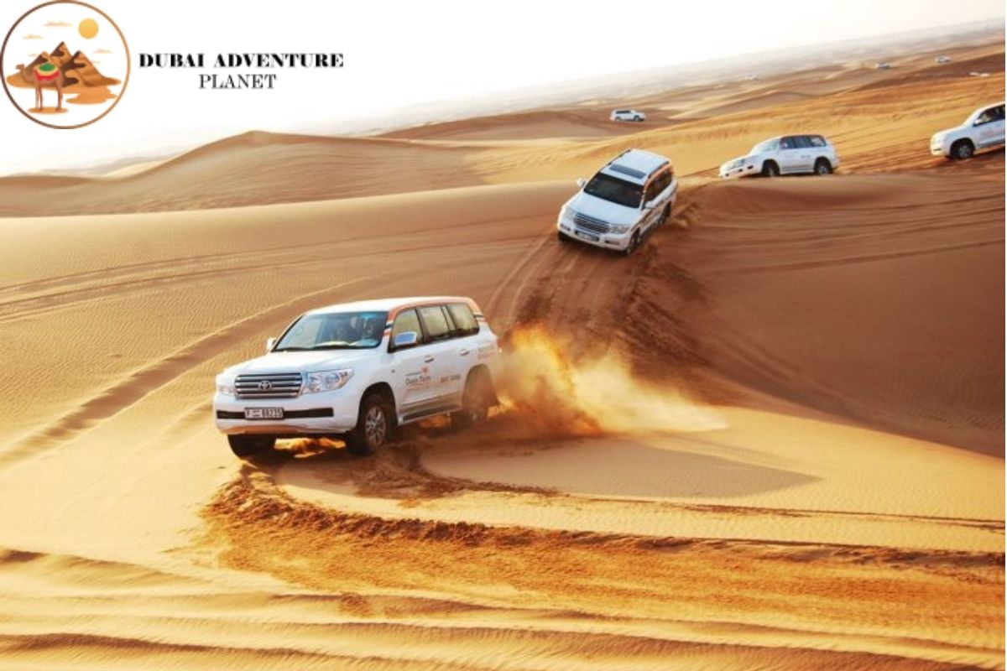

Slide 4
As a visitor to Dubai, be sure not to miss out on an Best Desert Safari Dubai adventure on quad bikes! Travel deep into the heart of the Arabian Desert and take in all the natural beauty that this unique landscape has to offer. Before taking a quad bike in the desert safari Dubai, here's everything you need to know. So, read the entire article to know about the popular activity of the Dubai desert safari.

Slide 5
Quad biking in desert safari Dubai is an adrenaline-pumping activity deep in the heart of the Arabian Desert. Quad bike is a four-wheeled all-terrain vehicle (ATV) specially designed for off-road driving.
On a quad bike safari in Dubai, you will travel through the dunes and desert valleys, taking in all the natural beauty that this unique landscape offers. It is an excellent activity for thrill-seekers and adventure-lovers and is the perfect way to experience the desert landscape.

Slide 6
Camel riding is another popular activity offered on a desert safari in Dubai. It involves riding a camel through the dunes and desert valleys. You can experience the desert landscape and get up close and personal with these fantastic animals through this activity. Camel riding is an excellent activity for groups and families, so it's the perfect option to experience with your family members.

Slide 7
How to select the quad biking package in desert safari Dubai?
Group Size: You should choose a package that is suitable for the size of your group. If you are travelling with a large group, you should choose a multiple quad bikes package.
Activity Duration: You should choose a package that includes the duration of the activity you are interested in. If you are only interested in quad biking, you should choose a package that includes this activity.
Price: You should choose a package that is within your budget. There are many different quad biking packages available, so you should be able to find one that suits your budget.
For More details visit website: https://www.desertsafaris-uae.com/

Slide 8
Quad biking in Dubai is a great activity that you must experience. It's a great way to get your adrenaline pumping and explore the desert landscape. In addition, there are many other activities that you can enjoy on a desert safari in Dubai.
So, there you have it – everything you need to know about quad biking in desert safari Dubai. So, what are you waiting for? Book your quad biking package today and experience the thrill of riding through the desert!

