Slide 2
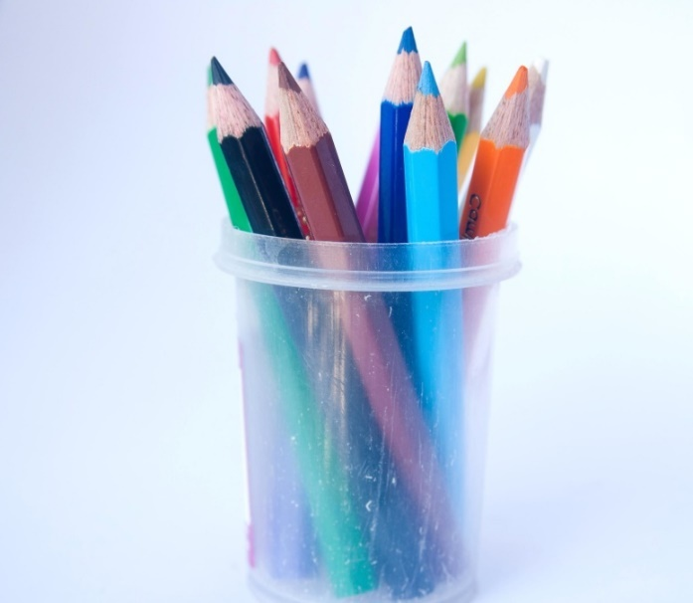
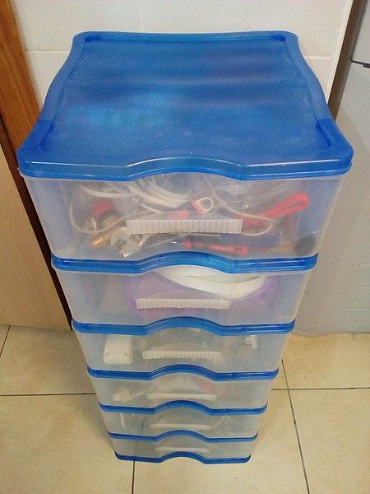
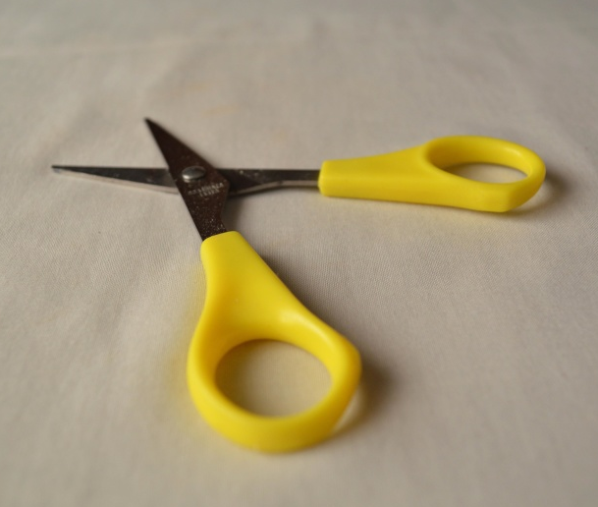
Plastic Here
Have a look around.
What can you see that is made of plastic?
Jot down or draw as many things as you can.
Click to show some examples
Photo courtesy of (@pixnio.com) - granted under creative commons licence – attribution
Photo courtesy of (@pixnio.com) - granted under creative commons licence – attribution
Photo courtesy of (@pixnio.com) - granted under creative commons licence – attribution

Slide 3
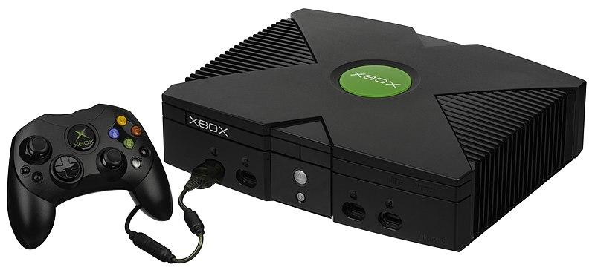
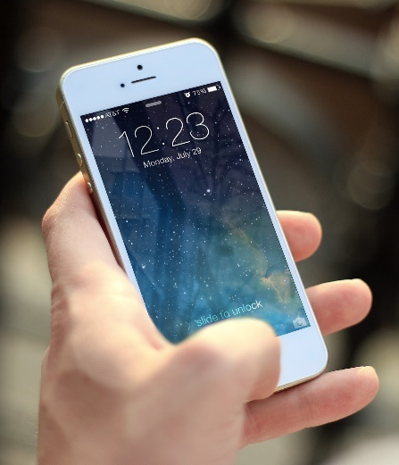
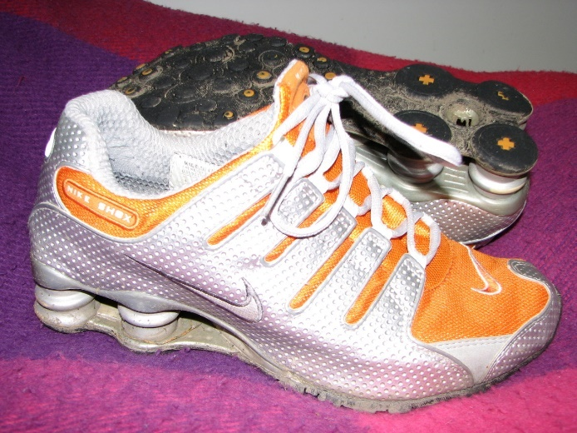
Plastic There
Now think about the things you use at home.
How many of them are made of plastic?
Click to show some examples
Photo courtesy of (@wikimedia.org) - granted under creative commons licence – attribution
Photo courtesy of (@pexels.com) - granted under creative commons licence – attribution
Photo courtesy of (@flickr.com) - granted under creative commons licence – attribution

Slide 4
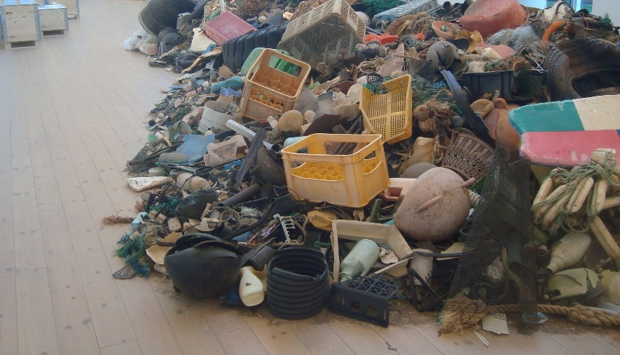
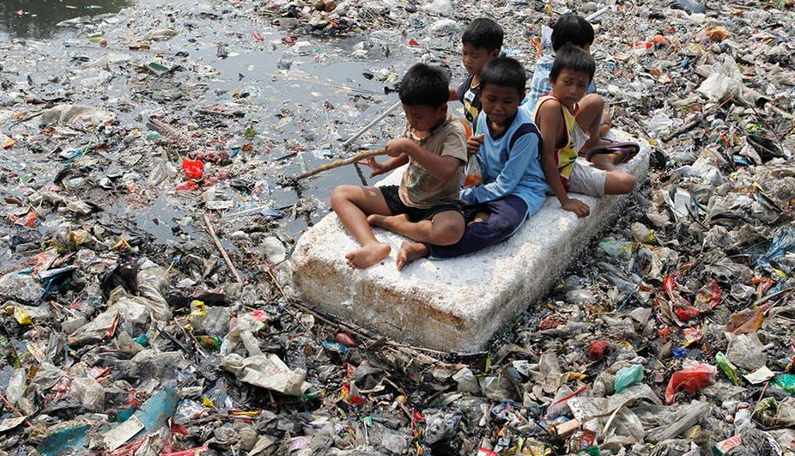
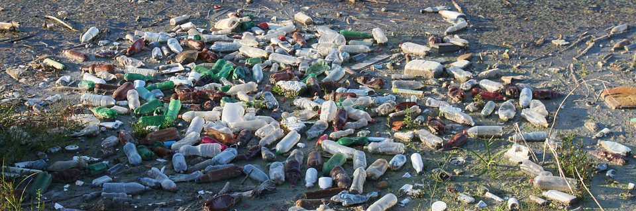
Plastic Everywhere
Photo courtesy of (@flickr.com) - granted under creative commons licence – attribution
Photo courtesy of (@theconversation.com) - granted under creative commons licence – attribution
Photo courtesy of (@pixabay.com) - granted under creative commons licence – attribution
Think about it
What do you think when you see these pictures?

Slide 5
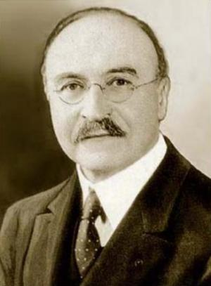
How It All Began
Plastic was first created by a British inventor called Alexander Parkes, in 1855.
He used some natural materials in his plastic.
In 1907, a Belgian man named Leo Baekeland invented Bakelite. This plastic was completely man-made and was used to make televisions, trays, jewellery, furniture and even toys.
Photo courtesy of (@wikimedia.org) - granted under creative commons licence – attribution
Leo Baekeland

Slide 6
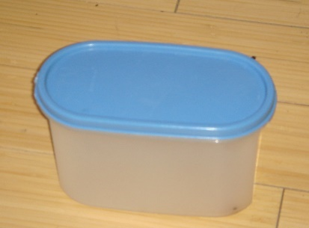
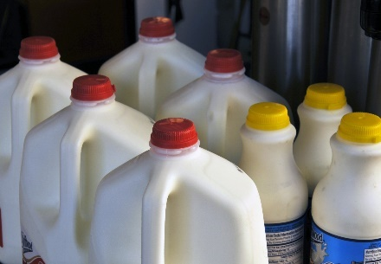
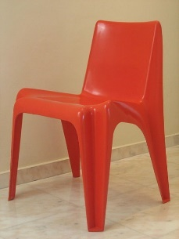
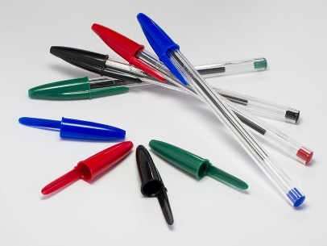
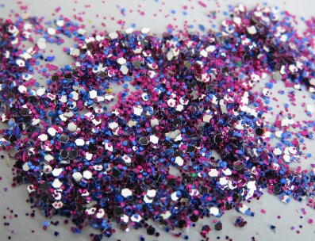
What Is Good about Plastic?
Plastic is so useful!
It keeps things airtight, which is great for keeping food fresh.
It keeps things watertight, so nothing leaks out.
It can be shaped and moulded into lots of different things from chairs to cars and pens to carpet tiles.
It can even look pretty!
Discuss it
Can you think of any other good things about plastic?
Photo courtesy of (@Wikimedia.org) - granted under creative commons licence – attribution
Photo courtesy of (@publicdomainpictures.net) - granted under creative commons licence – attribution
Photo courtesy of (@wikimedia.org) - granted under creative commons licence – attribution
Photo courtesy of (@wikimedia.org) - granted under creative commons licence – attribution
Photo courtesy of (@pxhere.com) - granted under creative commons licence – attribution

Slide 7
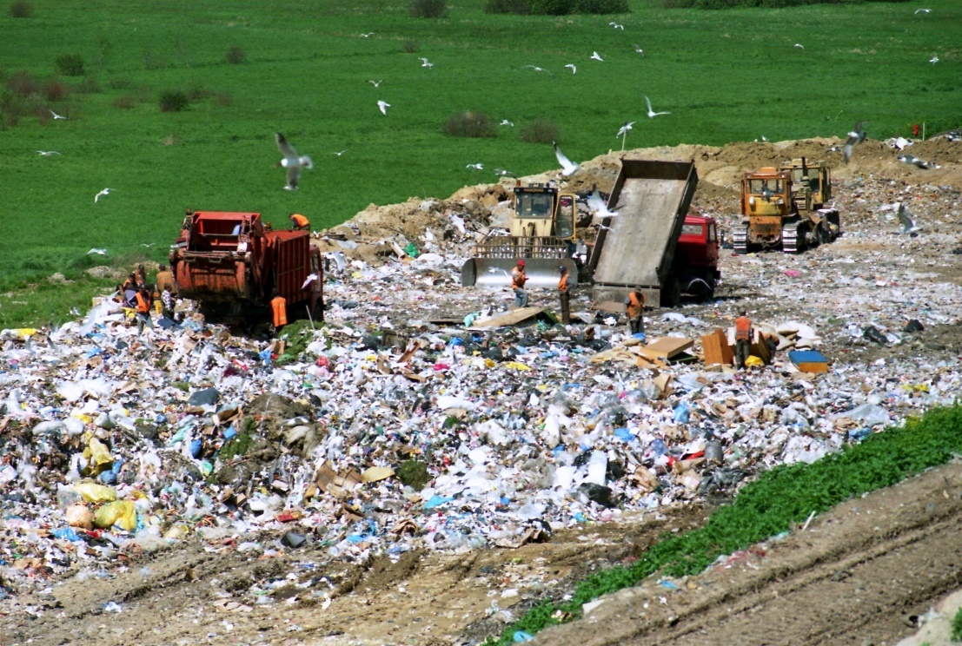
Problems with Plastic
Plastic is harmful to all living things.
The way plastic is made releases harmful gases into the air.
Plastic lasts for a very long time. It can not decompose like vegetables, fruit or meat.
If it is burnt, it releases harmful gases into the air and causes air pollution.
It is usually buried in huge landfill sites. This means we don’t see it, but it is still there and can last for many hundreds of years.
Photo courtesy of (@Wikimedia.org) - granted under creative commons licence – attribution

Slide 8
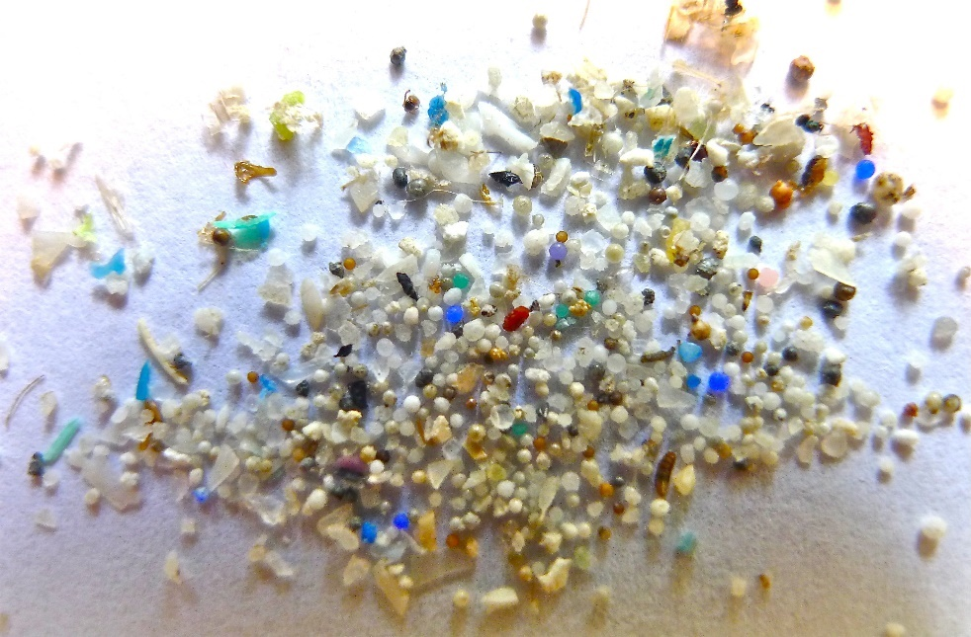
The Biggest Problem with Plastic
The biggest problem with unwanted plastic is the pollution and damage it does to the environment.
Plastic breaks into tiny pieces which then get blown around by the wind and the rain.
They end up in our streams, rivers and the seas.
Photo courtesy of (@flickr.com) - granted under creative commons licence – attribution
Plastic is toxic for the world’s water and land, causing harm to the fish, animals and birds. Even glitter is toxic for living things.
These microbeads are easily eaten by fish and other sea animals. It can make them very ill or even kill them.
They can make us ill if we eat the fish.
Discuss it!
Talk to the person beside you about your thoughts.

Slide 9
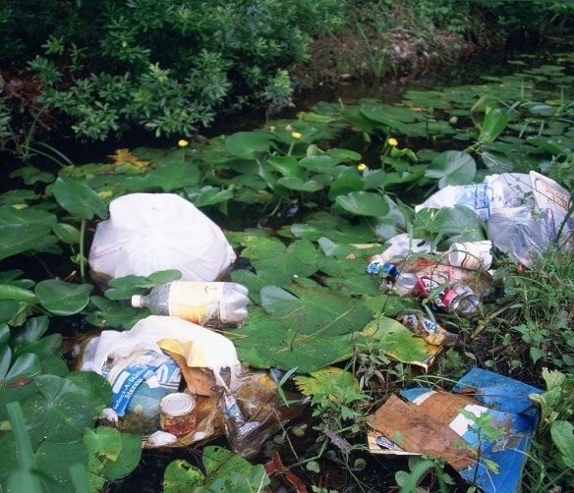
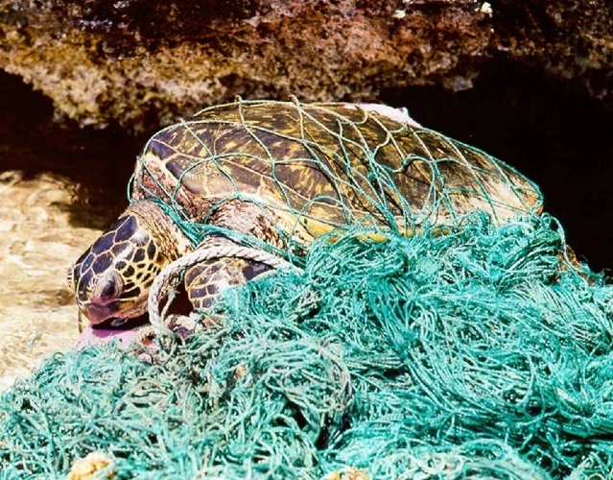
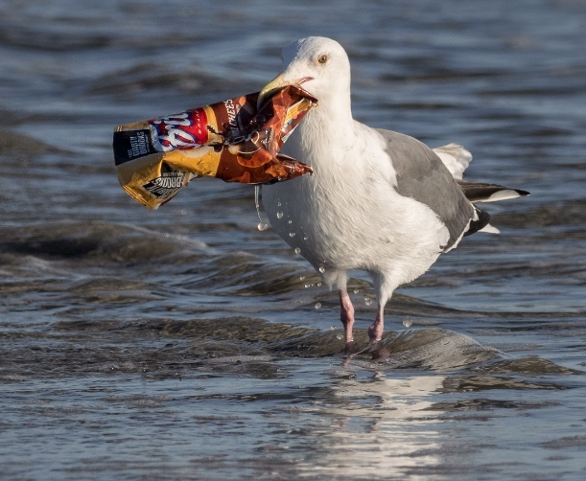
All Living Things
Photo courtesy of (@Wikipedia.org) - granted under creative commons licence – attribution
Photo courtesy of (@noaanews.noaa.gov) - granted under creative commons licence – attribution
Photo courtesy of (@flickr.com) - granted under creative commons licence – attribution
Think about it
What do you think about these pictures?
All living things should be able to live free from pollution and harm from plastics. So, what can we do?

Slide 10
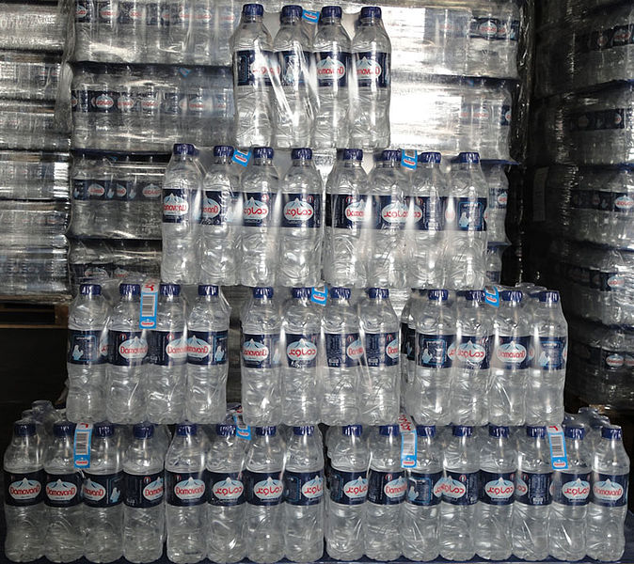
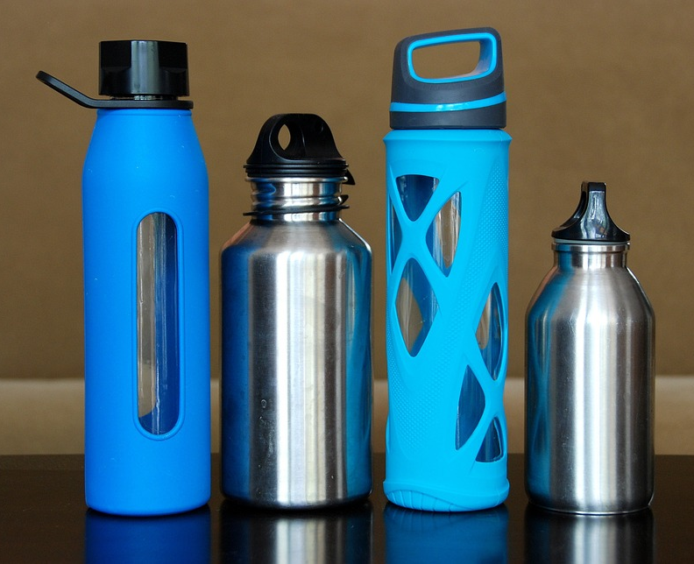

Make Your Choice
Look at these two pictures. Which do you think is the right thing to use, to help the environment?
Photo courtesy of (@Wikipedia.org) - granted under creative commons licence – attribution
Photo courtesy of (@pixabay.com) - granted under creative commons licence – attribution
Instead of using lots of water bottles and throwing them away, buy a reusable water bottle. It is cheaper too!

Slide 11
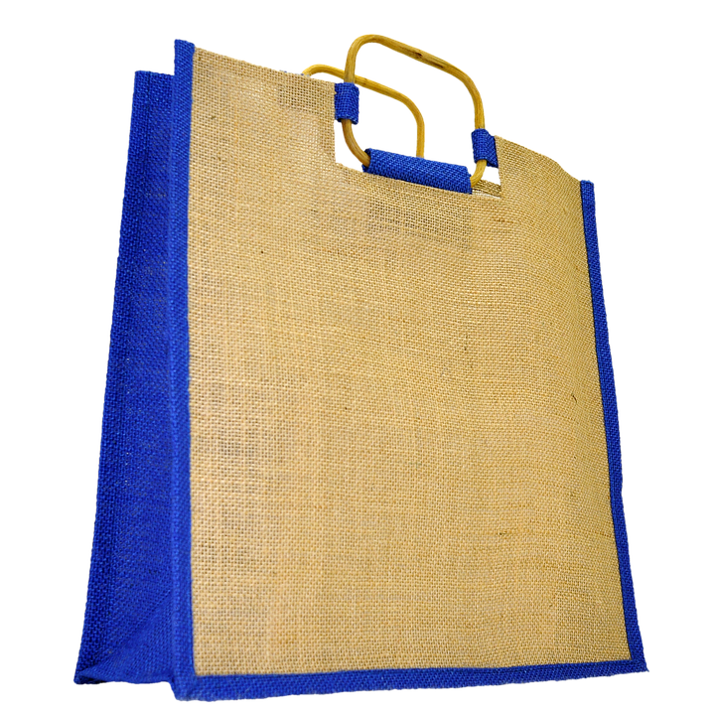
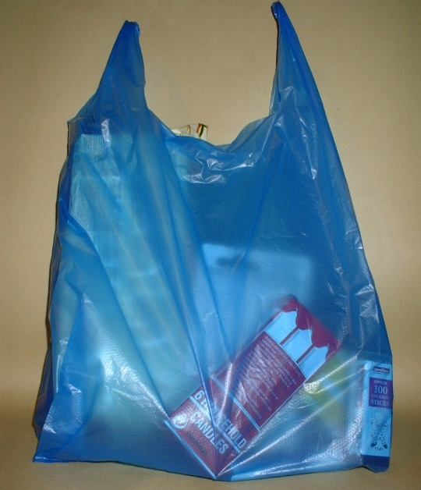
Make Your Choice
Look at these two pictures. Which do you think is the right bag to use, to help the environment?
Photo courtesy of (@flickr.com) - granted under creative commons licence – attribution
Photo courtesy of (@pixabay.com) - granted under creative commons licence – attribution
Instead of using thin plastic carrier bags and throwing them away, buy a bag for life and keep using it. It’s cheaper too!

Slide 12
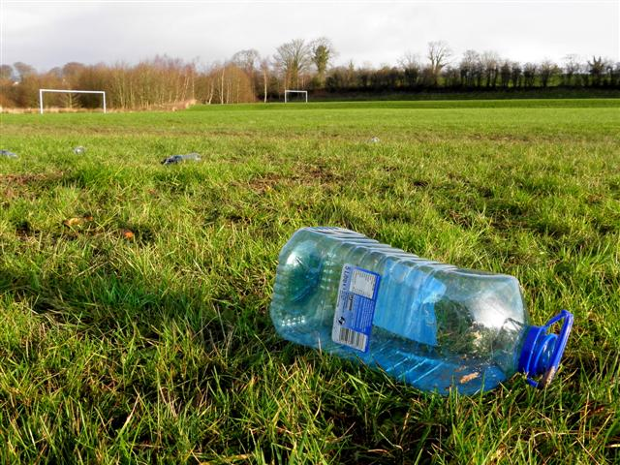
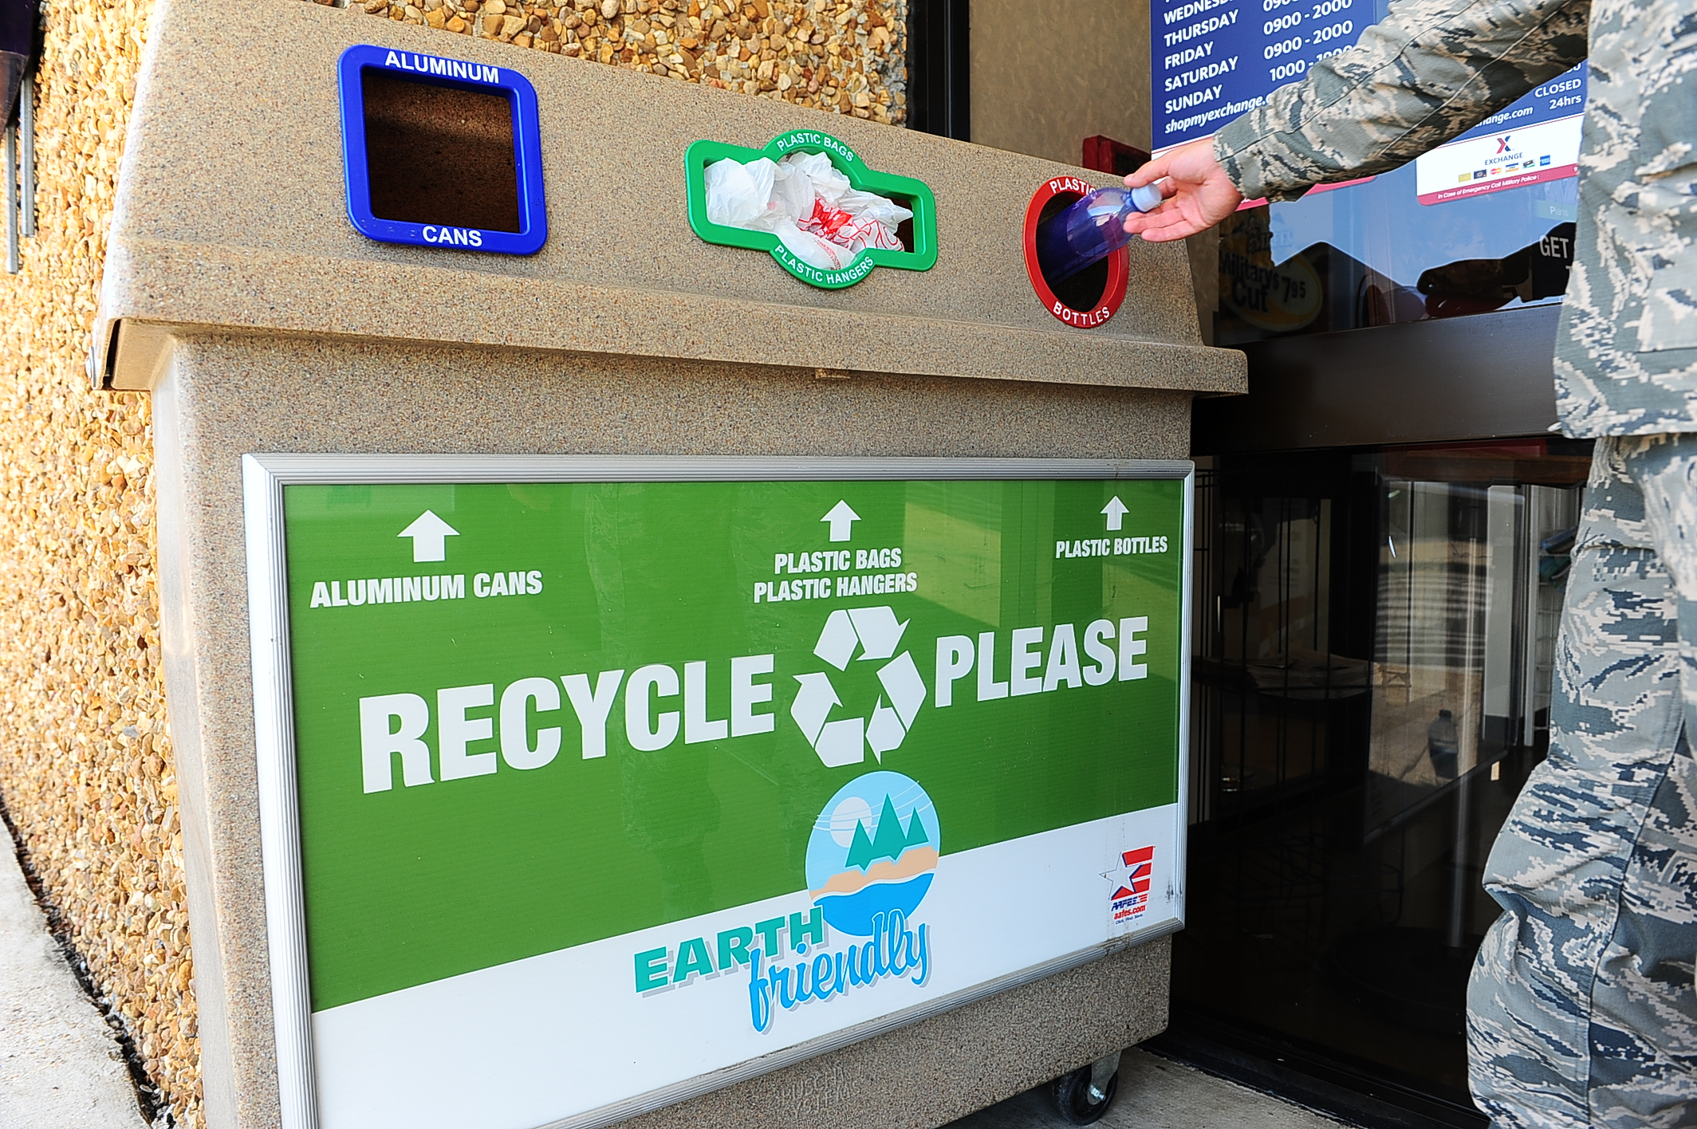

Make Your Choice
Look at these two pictures. Which do you think is the right to do, to help the environment?
Photo courtesy of (@geograph.ie) - granted under creative commons licence – attribution
Photo courtesy of (@Columbus.af.mil) - granted under creative commons licence – attribution
Instead of throwing plastic away, recycle it in the proper places.

Slide 13
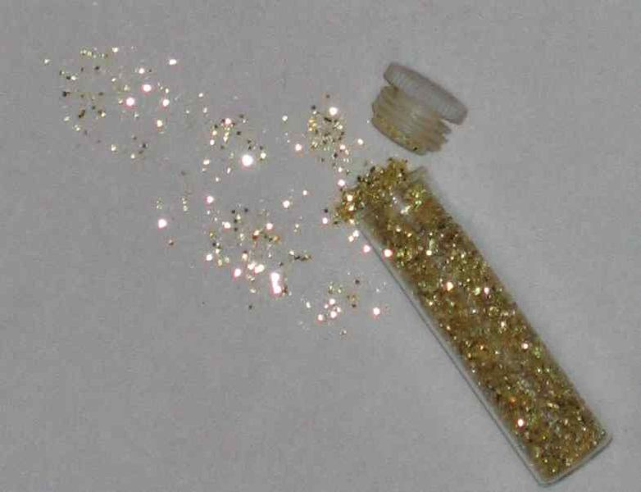
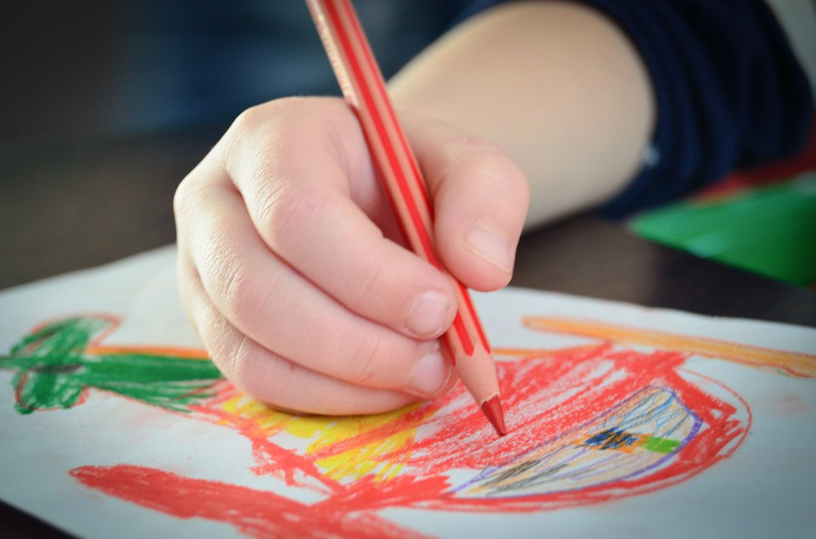
Make Your Choice
Look at these two pictures. Which do you think is the right to do, to help the environment?
Photo courtesy of (@commons.Wikimedia.org) - granted under creative commons licence – attribution
Photo courtesy of (@pixabay.com) - granted under creative commons licence – attribution
Instead of using glitter, which harms living creatures in land and sea, use colouring pencils.

Slide 14
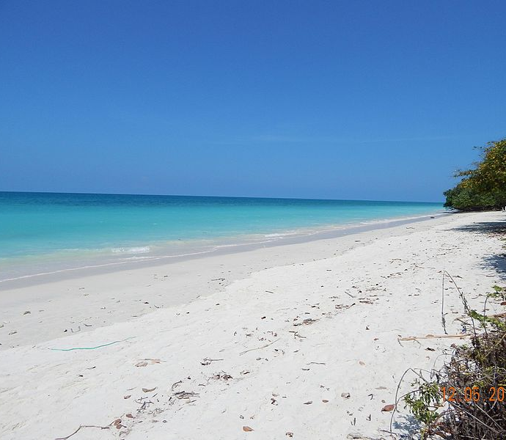
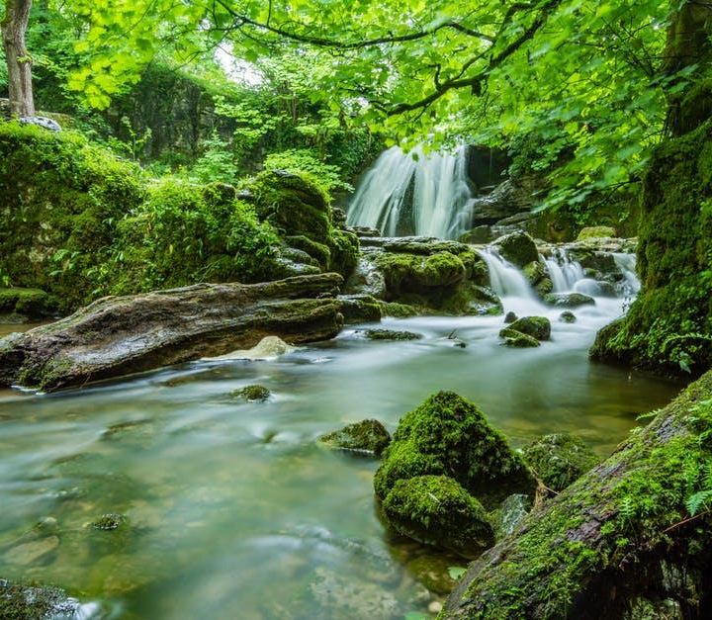
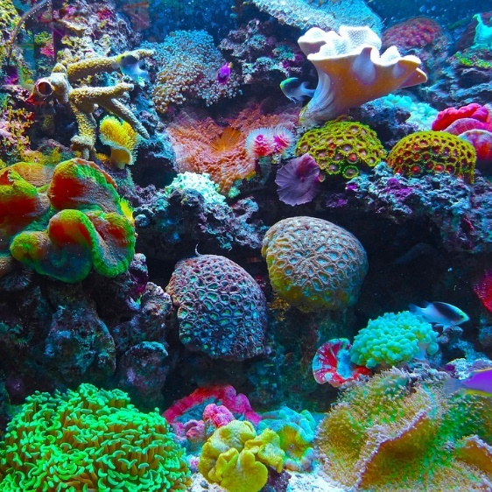
You Can Make a Difference
We can all help to clean up the planet, by making small changes.
You can make a difference just by making different choices.
Photo courtesy of (@commons.Wikimedia.org) - granted under creative commons licence – attribution
Photo courtesy of (@pexels.com) - granted under creative commons licence – attribution
Photo courtesy of (@pixabay.com) - granted under creative commons licence – attribution
Let’s all work together to make the earth a healthier and cleaner place for everything.

Slide 15
Glossary
air pollution
chemicals or rubbish that have a poisonous or harmful effect to the air
decompose
to break down
landfill sites
a place for burying waste
microbeads
tiny pieces of plastic
pollution
chemicals or rubbish that have a poisonous or harmful effect
toxic
poisonous and harmful

