Slide 1


KATALOG AVGUST 2020

Slide 2
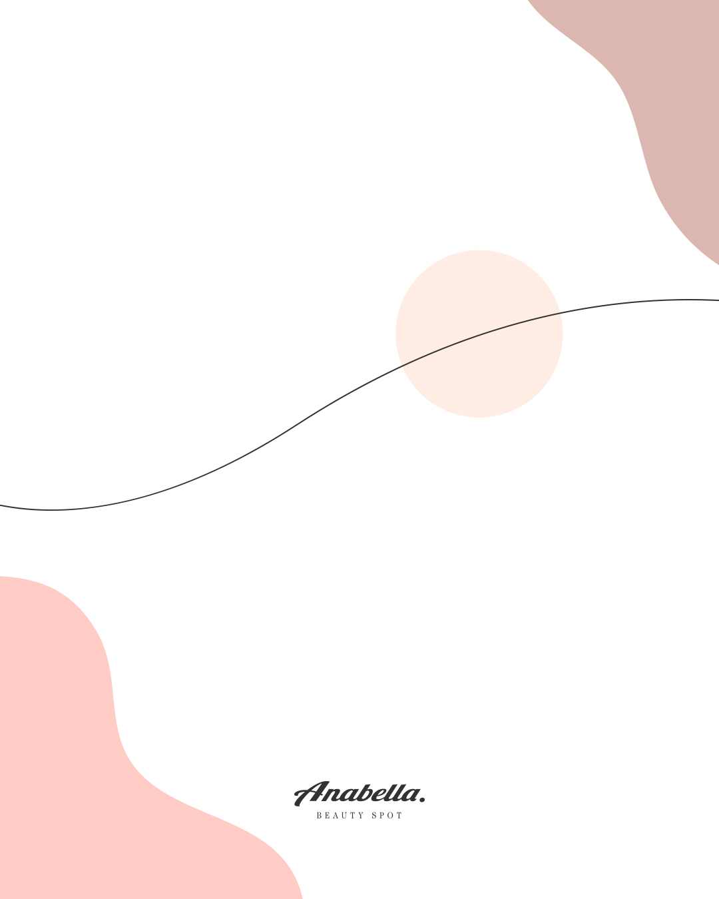
SADRŽAJ
I – ANABELLA NOVITETI
II - NEGA KOŽE
CLARINS
CLINIQUE
ELIZABETH ARDEN
ESTEE LAUDER
GLAM GLOW
LA MER
SENSAI
TONY MOLY
BOBBI BROWN
IV- PARFEMI
III - ŠMINKA
BVLGARI
CARTIER
JO MALONE
TOM FORD
BOBBI BROWN
CLARINS
CLINIQUE
ESTEE LAUDER
LA MAR
MAC
SMASHBOX
SENSAI
REAL TECNIQUES
V - NEGA KOSE

Slide 3

I – ANABELLA
NOVITETI
CLINIQUE
LA MER
BOBBI BROWN
JO MALLONE

Slide 4




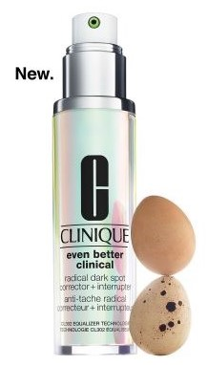
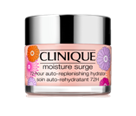
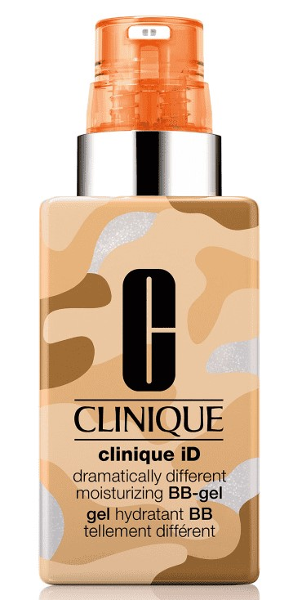
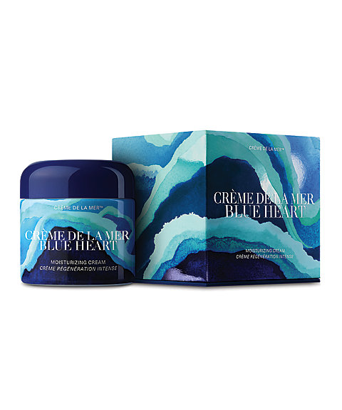
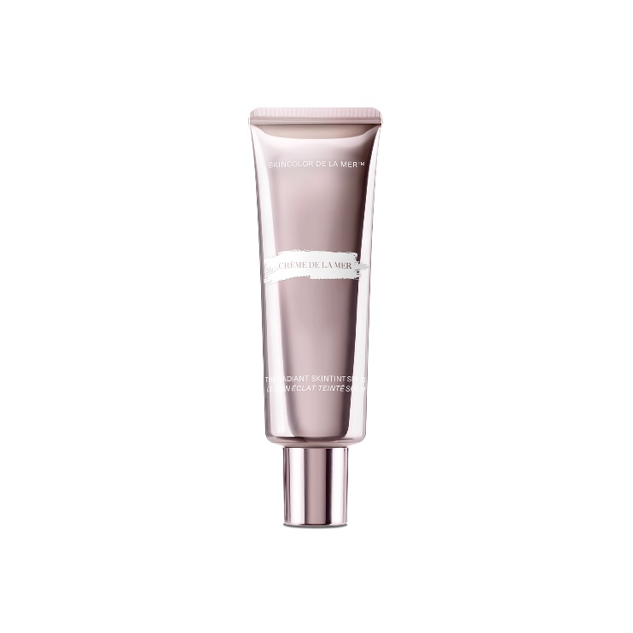

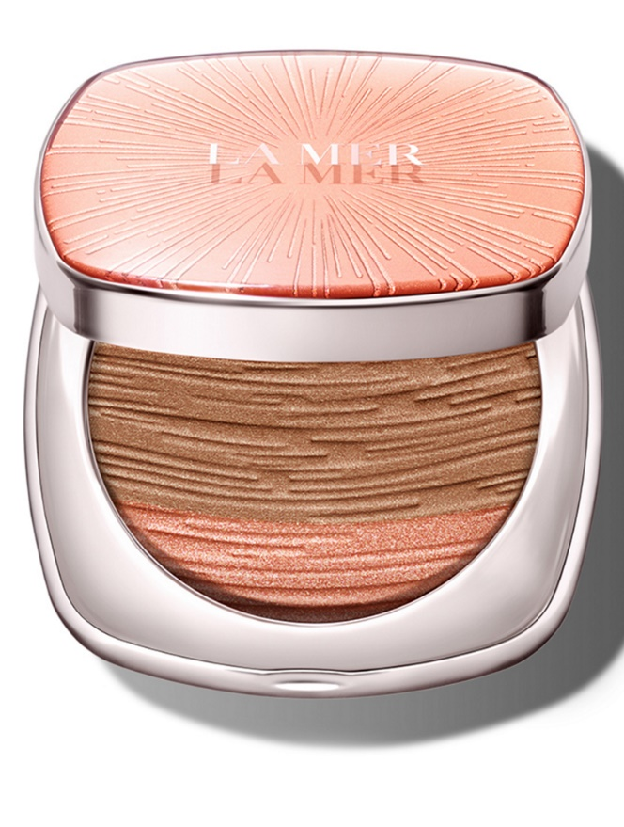
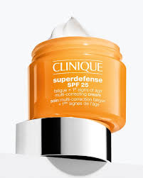
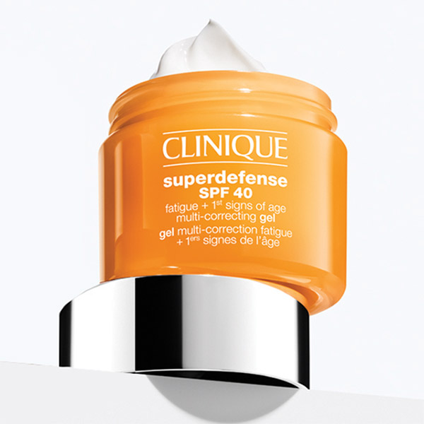
Even better clinical Radical dark spot corrector+interrupter
Cena:
50ml 14990rsd,
30ml 9040rsd
Clinique ID BB - gel
Cena: 4720rsd
Moisture surge 75ml
Cena: 5500rsd
Superdiffence SPF 25 Fatigue + 1st Signs of Age Multi-Correcting Cream
Cena: 30ml - 5500rsd
50ml – 8220rsd
Superdefense SPF 40
Fatigue + 1st Signs of Age Multi-Correcting Gel
Cena: 50ml - 8220rsd
LA MER
CREME DELLA MER BLUE HEART
Cena: 56.600,00
RADIANT SKINTINT
Cena: 11600,00rsd
THE BRONZING POWDER
Cena: 9600,00rsd

Slide 5
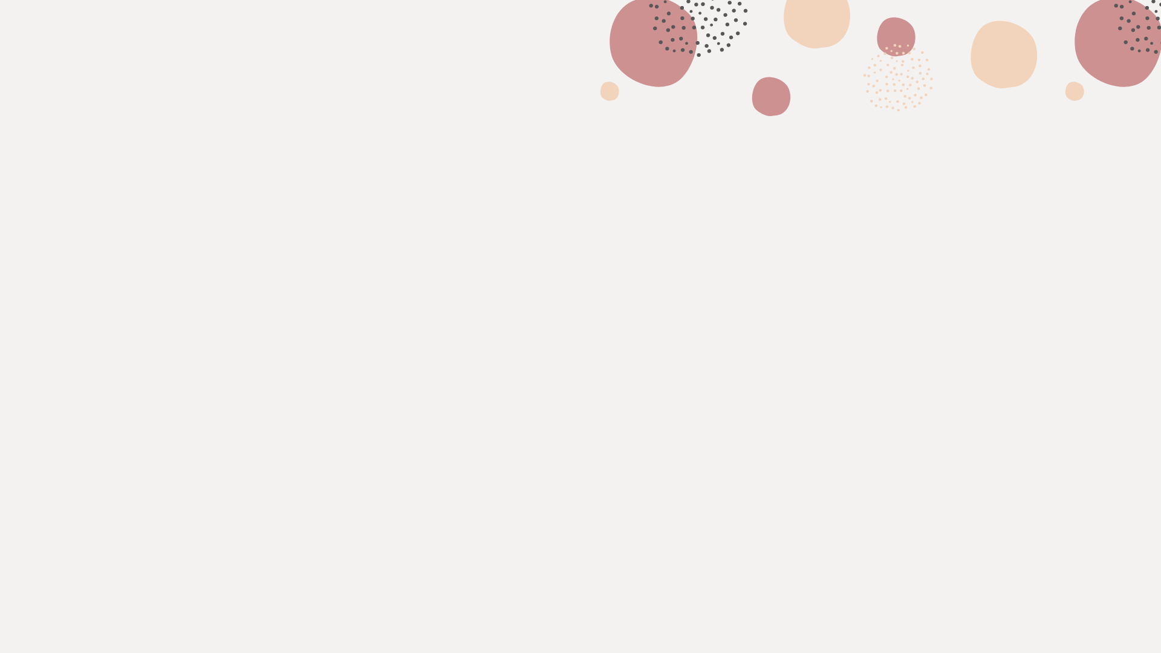


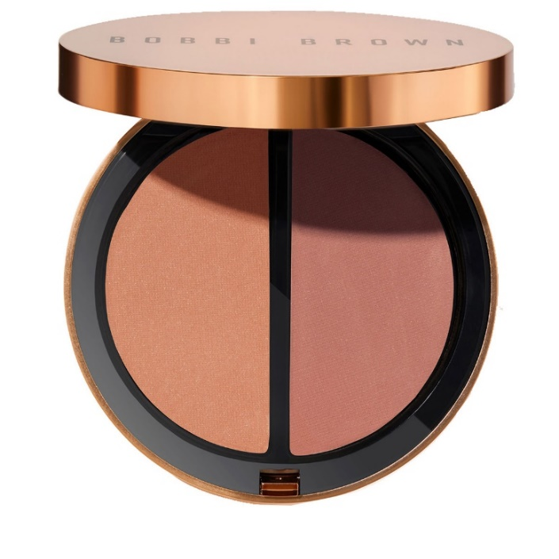
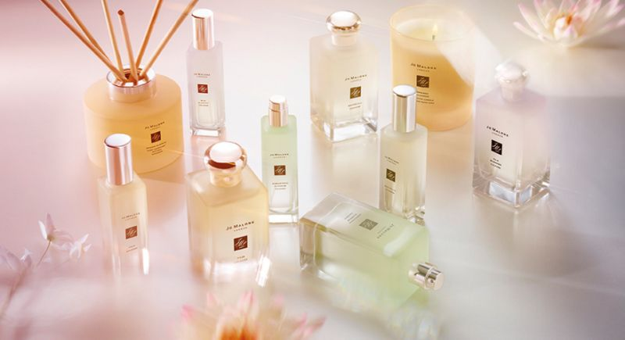
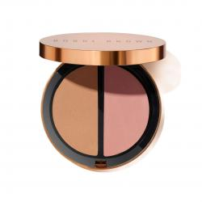
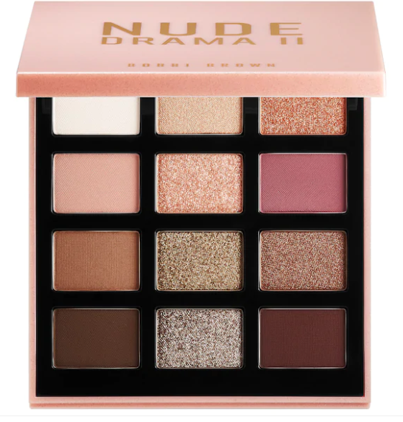
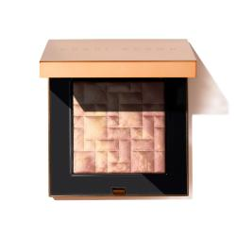
Bronzing Limited Collection
Bronzing Powder Duo Gold Bronzing
Bronzing Powder Duo Medium Bronzing
Cena: 6000rsd
BLOOSOM COLLECTION
WATERLILY COLOGNE
YUJA COLOGNE
OSMANTHUS BLOSSOM COLOGNE
Cena: 30ml 7800,00rsd
100ml 15030,00rsd
ORANGE BLOSSOM DIFFUSER 165ML
Cena: 10660,00rsd
ORANGE BLOSSOM HOME CANDLE
Cena:7660,00rsd
Nude drama II eye palette
Cena: 11240rsd
Bronzing Limited Collection
Highlighting Powder Bronzing
Cena: 7680rsd

Slide 6
I - NEGA KOŽE
CLARINS
CLINIQUE
ELIZABETH ARDEN
ESTEE LAUDER
GLAM GLOW
LA MER
SENSAI
TONY MOLY
BOBBI BROWN

Slide 7

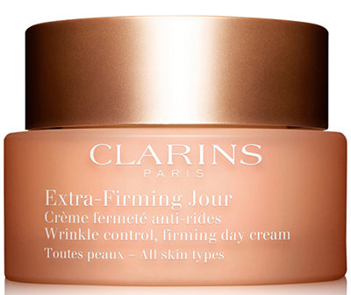
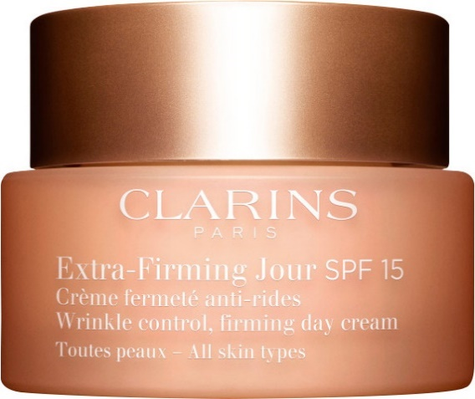
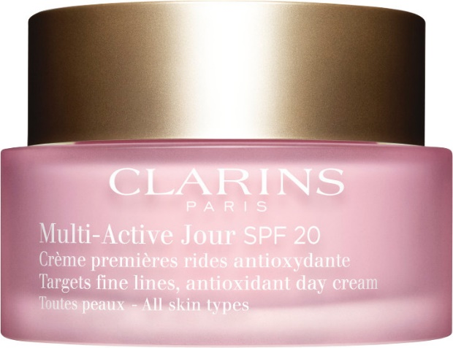
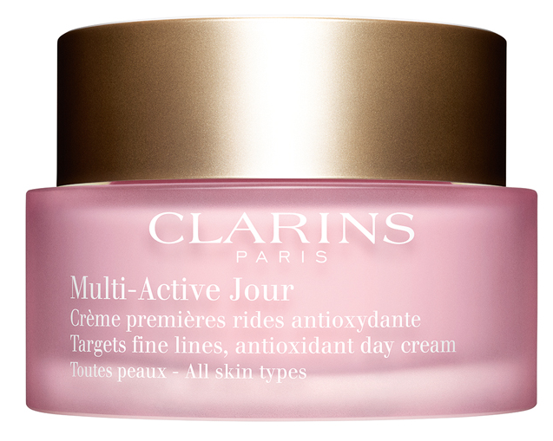
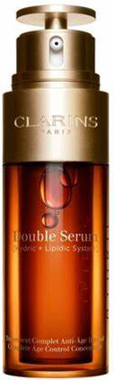
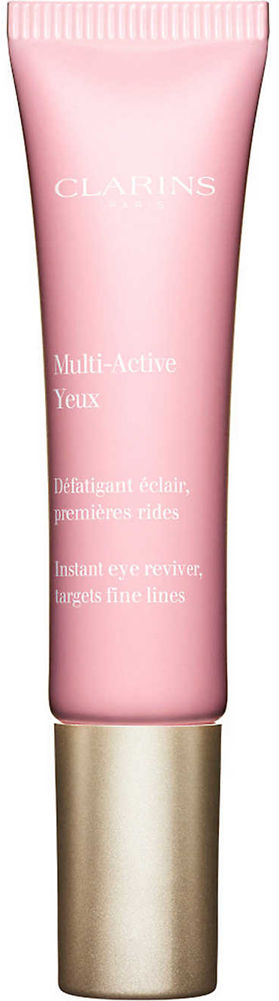
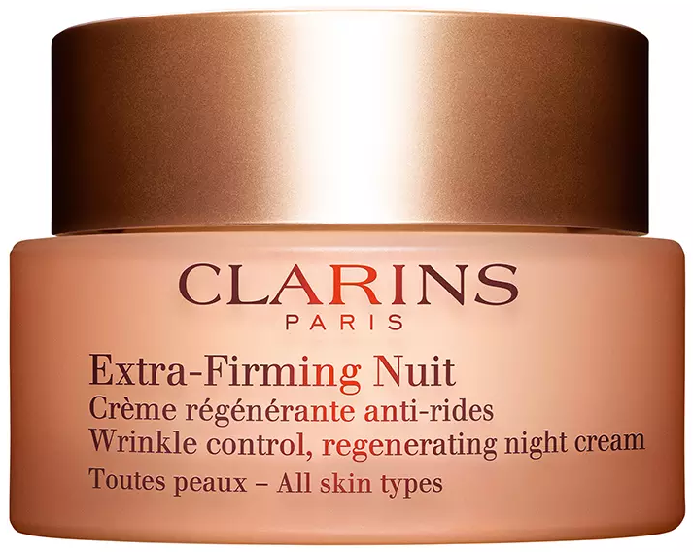
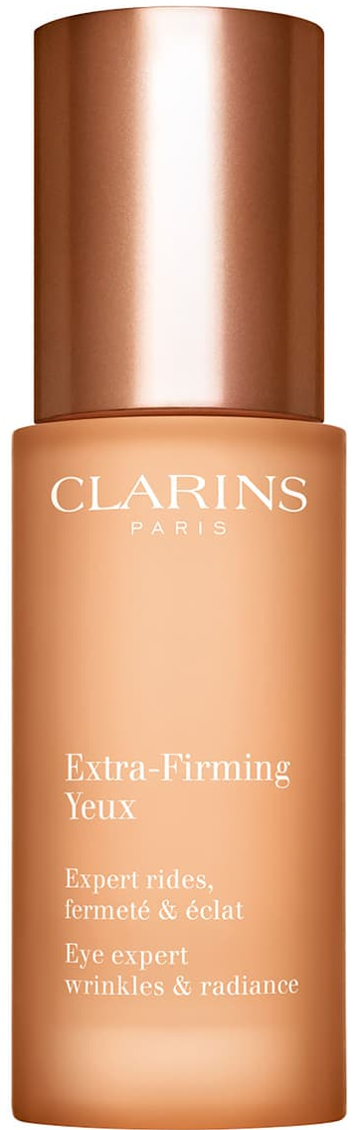
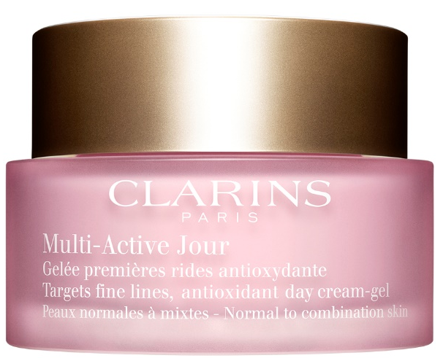
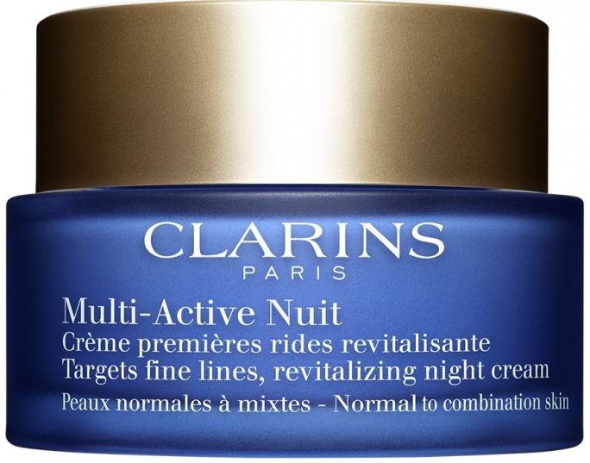
Double Serum
Cena:
30ml –11.370 rsd
50ml – 13.280 rsd
Extra-Firming linija
Multi-Active linija
Krema za predeo oko očiju
Cena:
15ml – 8.330 rsd
Dnevna krema
Cena:
50ml – 10.230 rsd
Dnevna krema SPF15
Cena:
50ml – 10.224 rsd
Dnevna krema SPF20
Cena:
50ml – 7.780 rsd
Dnevna krema
Cena:
50ml – 8.330 rsd
Krema za predeo oko očiju
Cena:
15ml – 6.550 rsd
Noćna krema
Cena:
50ml – 8.810 rsd
Gel krema
Cena:
50ml – 8.330 rsd
Noćna krema
Cena:
50ml – 8.770 rsd

Slide 8

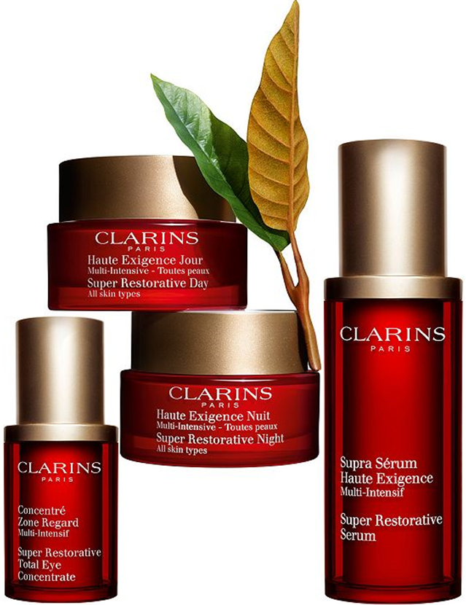
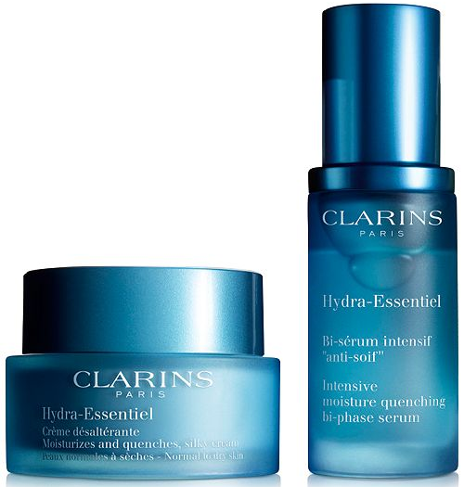
Super Restorative linija
Hydra-Essentiel linija
Dnevna krema
Cena:
50ml – 13.150 rsd
Krema za lice
Krema za lice SPF15
Gel krema za lice
Krema za suvu kožu
Cena:
50ml –6.230 rsd
Serum
Cena:
30ml –6.990 rsd
Koncentrat za predeo oko očiju
Cena:
15ml – 9.150 rsd
Noćna krema
Cena:
50ml – 13.920 rsd
Serum
Cena:
30ml – 15.500 rsd

Slide 9
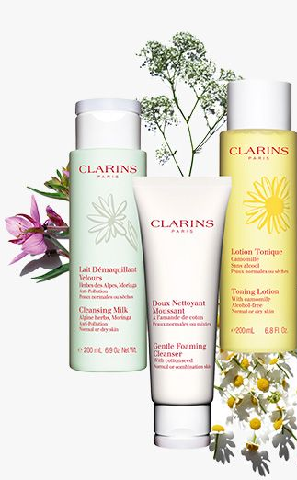
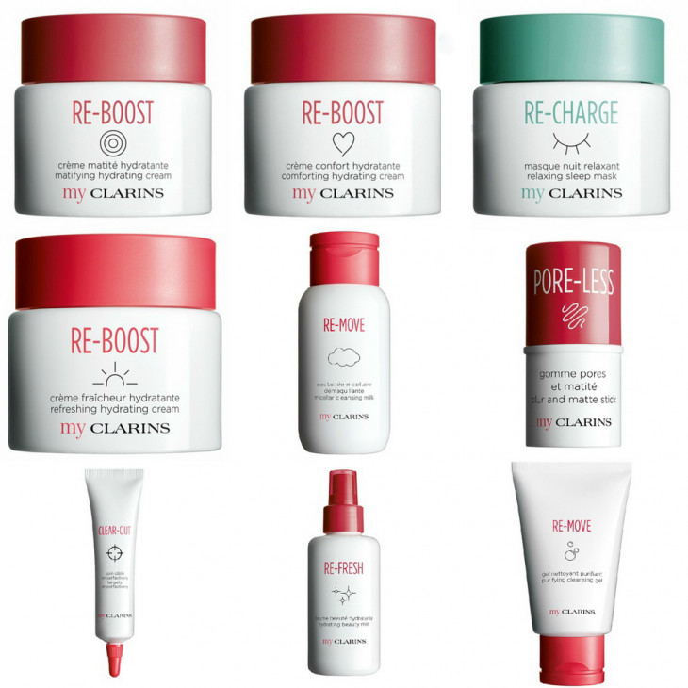
Toning Lotion
Cena:
200ml – 2.990 rsd
My Clarins
Cleansing Milk
Cena:
200ml – 2.990 rsd
Re-Boost krema
Cena:
50ml – 2.870 rsd
Re-Charge noćna maska
Cena:
50ml – 3.100 rsd
Re-Move Micellar
Cena:
200ml – 2.440 rsd
Pore-Less Stick
Cena:
1.950 rsd
Spot-Less Blemish
Cena:
1.950 rsd
Re-Move Cleasing Gel
Cena:
150ml – 2.440 rsd
Gentle Foaming Cleanser
Cena:
125ml – 3.240 rsd
Re-Fresh Beauty Mist
Cena:
100ml – 2.250 rsd

Slide 10
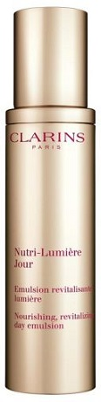
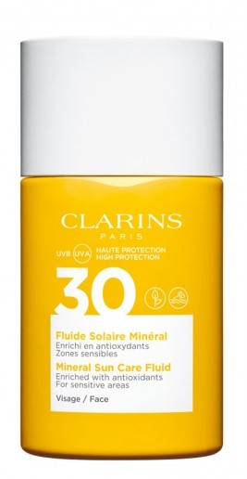
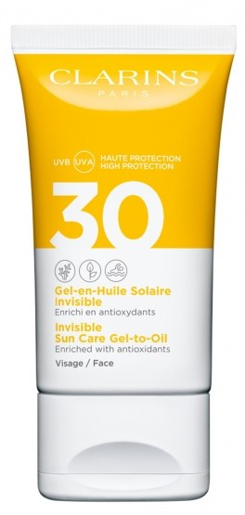
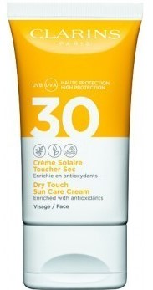
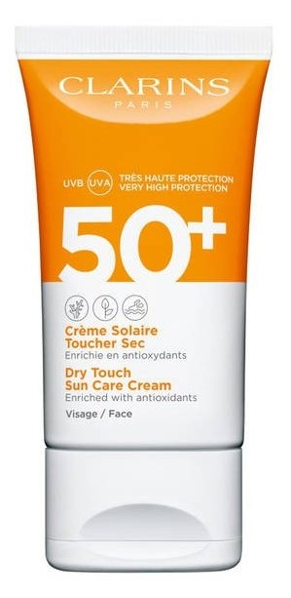
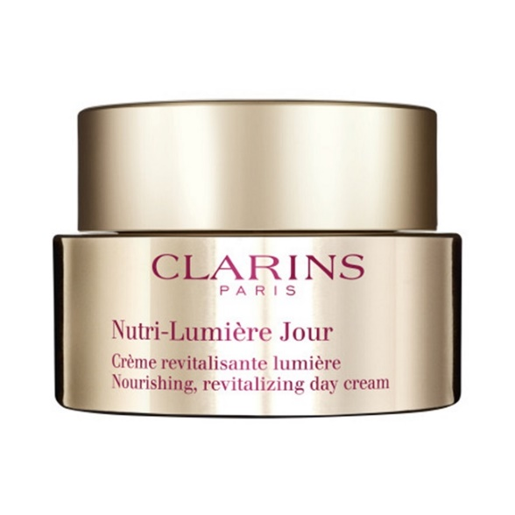
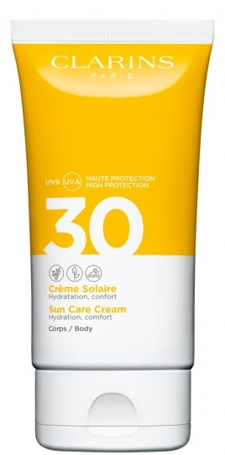
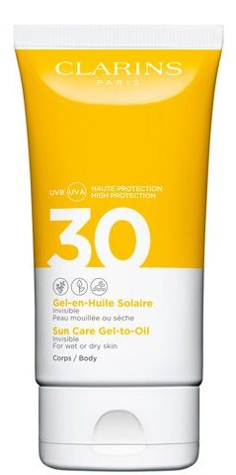
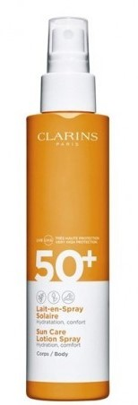
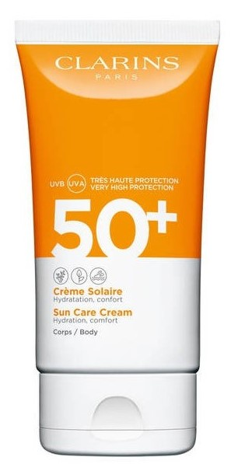

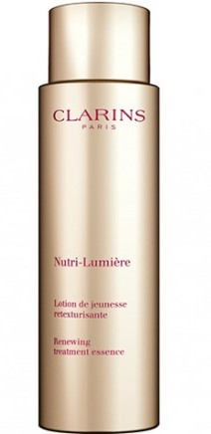
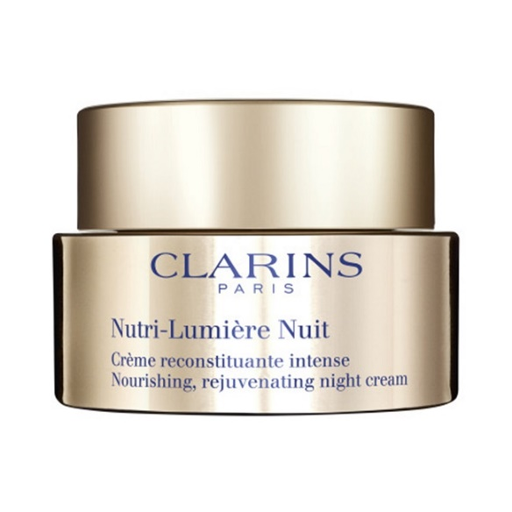
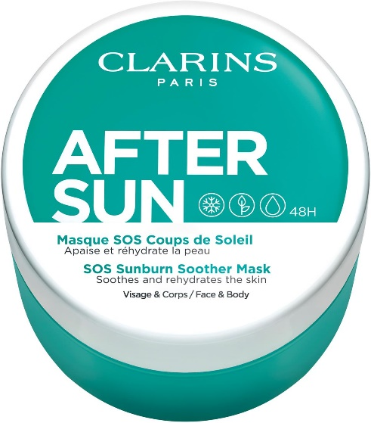
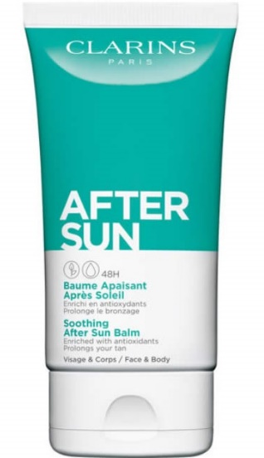
Sun care linija
Nutri-Lumiere linija
Lice:
Sun care face fluid spf 30
Cena: 2605 rsd
Sun care face gel spf 30
Cena: 2955 rsd
Sun care face cream spf 30
Cena: 2955 rsd
Sun care face spf 50
Cena: 2955 rsd
Telo:
Sun Care Cream spf 30
Cena: 3680 rsd
Sun Care Oil Mist spf 30
Cena: 3610 rsd
Sun Care Gel to Oil spf 30
Cena: 2955 rsd
Sun Care Lotion Spray spf 50
Cena: 3670 rsd
Sun Care Cream spf 50
Cena: 3750 rsd
Nutri – Lumiere Day Emulsion
Nutri – Lumiere day Cream
Cena: 13910 rsd
Nutri – Lumiere Night Cream
Cena: 14720 rsd
Nutri – Lumiere Lotion
Cena: 6150 rsd
After sun:
SOS Sunburn Soother Mask
Cena: 3416rsd
Soothing After Sun Balm
Cena: 2955rsd

Slide 11
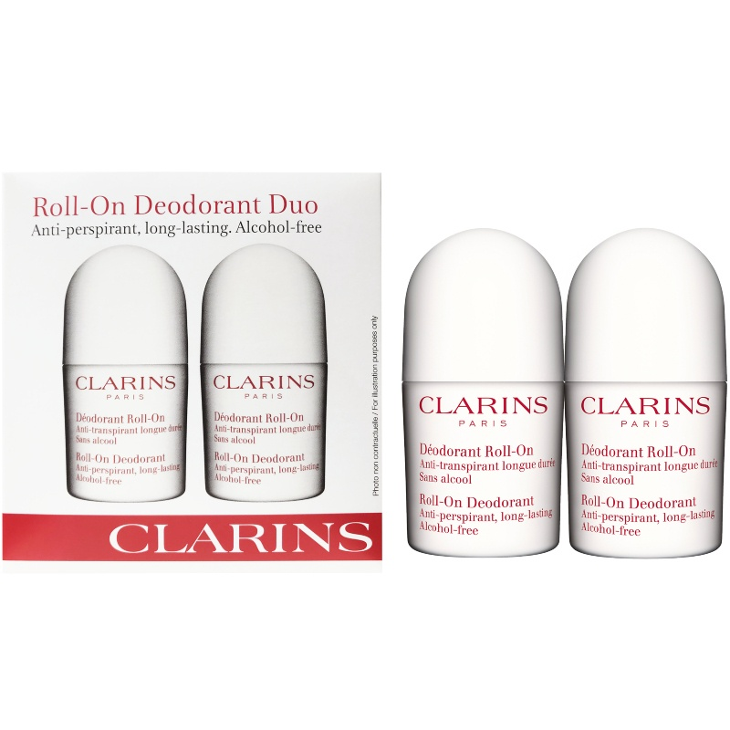
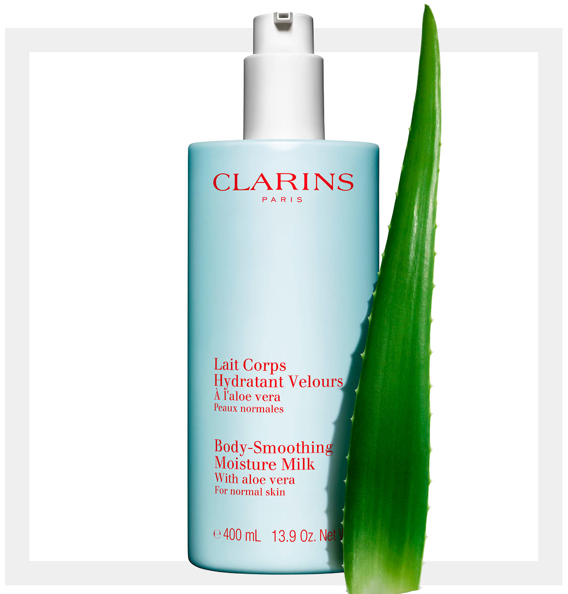
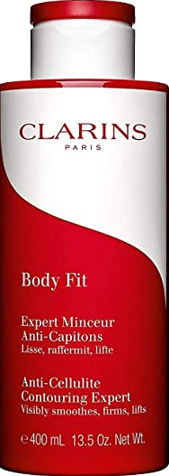
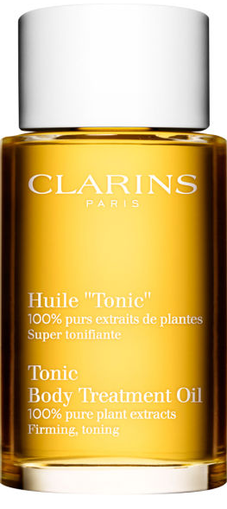
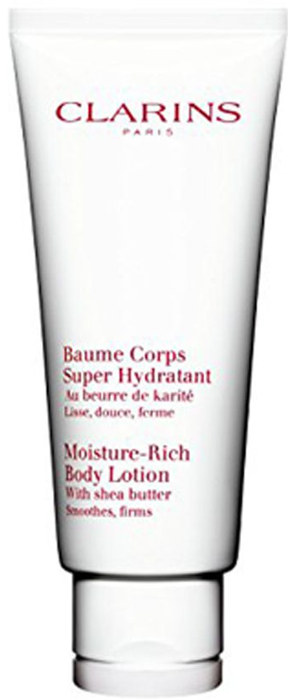

Moisture Body Milk With Aloe
Cena:
400ml – 3.120 rsd
Body Fit
Cena:
200ml – 6.420 rsd
Roll-On Deodorant Duo
Cena: 3.550 rsd
Tonic Body Oil
Cena:
100ml – 6.610 rsd
Moisture Rich Body Lotion
Cena:
200ml – 5.020 rsd

Slide 12

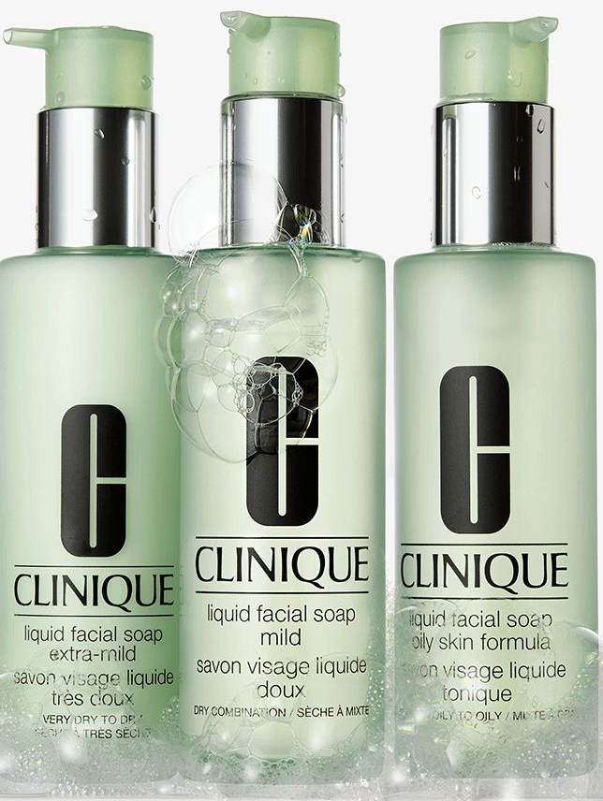
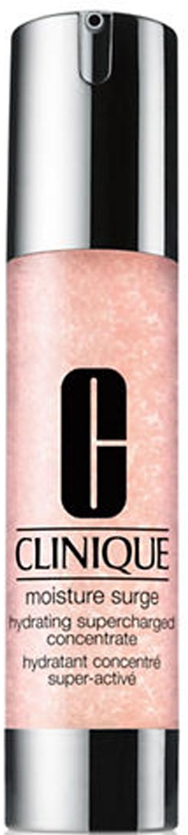



All About Eyes Rich
Cena:
15ml – 6.430rsd
Tečni sapun za čišćenje lica
Cena:
200ml – 3.550 rsd
Moisture Surge Hidratantni Koncentrat
Cena:
50ml – 4760rsd
Losion za lice 1 i 4
Cena:
200ml – 2.900 rsd
Losion za lice 2 i 3
Cena:
200ml – 2.900 rsd
400ml – 4.300 rsd
Moisture Surge 72h Hidratantna Krema
Cena:
30ml – 2.860 rsd
50ml – 4.500 rsd

Slide 13







Clinique ID Formula
Cena:
Baza (gel ili krema) 115ml – 4.720 rsd
Serum 10ml – 3.000 rsd
Baza + Serum 125ml – 7.720 rsd
Anti-Blamish linija
Smart Clinical linija
Losion za lice
Cena:
200ml – 3.490 rsd
Revolumizer
Cena:
50ml – 12.060 rsd
30ml – 7.230 rsd
Krema za lice
Cena:
50ml – 4.560 rsd
Blackhead piling za lice
Cena:
125ml – 3.730 rsd
MD Resculpte
Cena:
50ml – 12.060 rsd
MD DUO
Cena:
50ml – 12.060 rsd

Slide 14








CFM Maximum Hydrator 72H Hidratantna Krema
Cena:
50ml – 5570 rsd
CFM Super Energizer Serum za predeo oko očiju
Cena:
15ml – 5050 rsd
CFM Maximum Dark Spot Korektor
Cena:
30ml – 10515 rsd
CFM Anti-Age krema za predeo oko očiju
Cena:
15ml – 6080rsd
CFM Maximum Hydrator Eye Hidratantna krema za predeo oko očiju
Cena:
15ml – 5570 rsd
CFM Super Energizer Čistač za lice
Cena:
50g – 4.320 rsd

Slide 15







Great 8 Daily Defense Moisturizer
Cena:
45ml – 4.720 rsd
8H Cream Skin Protectant
Cena:
50ml – 4.500 rsd
White Tea Body Cream
Cena:
400ml – 3.900 rsd
Lip Protectant Stick SPF 15
Cena:
3.7g – 4.720 rsd
VD Replenishing HidraGel Complex
Cena:
75ml – 5.410 rsd
VD Refining Moisture Cream Complex
Cena:
75ml – 3.300 rsd

Slide 16






Advanced Night Repair Intense Reset Concentrate – koncentrovani serum za lice
Cena:
20ml – 12.390 rsd
Idealist – serum za umanjenje pora
Cena:
30ml – 10.180 rsd
50ml – 14.630 rsd
Advanced Night Repair – Ampule
Cena:
60 komada – 17.760 rsd
Perfectionst CP+R – serum za učvršćivanje kože
Cena:
30ml – 14.420 rsd
50ml – 19.810 rsd
Advanced Night Repair – Serum za lice
Cena:
20ml – 5.700 rsd
30ml – 10.150 rsd
50ml – 13.900 rsd

Slide 17







DayWear & DayWear Matte - krema za hidrataciju
Cena:
50ml – 6.600 rsd
Revitalizing Supreme + Anti-Aging krema
Cena:
30ml – 9.900 rsd
50ml – 14.700 rsd
Advanced Time Zone krema
Cena:
50ml – 13.920 rsd
Advanced Time Zone Night - noćna krema
Cena:
50ml – 14.900 rsd
NightWear Plus krema
Cena:
50ml – 10.270 rsd
Revitalizing Supreme Light+ Anti-Aging krema
Cena:
50ml – 15.430 rsd
Resilience Multi-Effect Tri-Peptide Face & Neck Creme
Cena:
50ml – 16.170 rsd

Slide 18






Advanced Night Repair Eye Concentrate Matrix
Cena:
15ml – 10.340 rsd
Revitalizing Supreme + Eye Global Anti-Aging Eye Balm
Cena:
15ml – 9.830 rsd
Advanced Time Zone Age Deffense Line/Wrinkle Eye Cream
Cena:
15ml – 9020 rsd
Advanced Night Repair Eye Serum
Cena:
15ml – 8.480 rsd
Resilience Multi-Effect Tri-Peptide Eye Cream
Cena:
15ml – 10460 rsd
Advanced Night Repair Eye Complex
Cena:
15ml – 9.740 rsd

Slide 19










Glowstarter Nude krema za lice
Cena: 15ml -2.700rsd
Glowstarter Barbie Lim edition
Cena: 50ml -6900rsd
Pink Gravitymud maska
Cena:
15g – 2.700 rsd
Moistertrip Imega-Rich krema za lice
Cena:
50g – 6.900 rsd
Supermud maska
Cena:
15g – 2.700 rsd
50g – 6.600 rsd
Thirstymud maska
Cena:
15g – 2.700 rsd
50g – 6.600 rsd
Gravitymud maska
Cena:
15g – 2.700 rsd
50g – 6.600 rsd
Youtmud maska
Cena:
50g – 6.900 rsd

Slide 20





SP Cleansing Oil – 1. korak
Cena:
150ml – 6.220 rsd
SP Milky Soap – 2. korak
Cena:
150ml – 6.220 rsd
SP Creamy Soap – 2. korak
Cena:
125ml – 6.220 rsd
SP Cmilk Soap – 2. korak
Cena:
150ml – 6.220 rsd

Slide 21






CP Lotion I
Cena:
125ml – 8.560 rsd
CP Emulsion I
Cena:
150ml – 12.600 rsd
CP Lotion II
Cena:
125ml – 8.560 rsd
CP Emulsion II
Cena:
150ml – 12.600 rsd
CP Emulsion III
Cena:
150ml – 12.600 rsd
Hydrachange Cream
Cena:
40ml – 17.570 rsd

Slide 22






AS Micro Mousse Treatment
Cena:
90ml – 19.930 rsd
AS Fluid
Cena:
80ml – 19.930 rsd
Eye Contour Cream
Cena:
15ml –12.750 rsd
AS Cream
Cena:
40ml – 19.930 rsd
SCP Cream 40ml
Cena:
80ml – 15.550 rsd
Eye Contour Balm
Cena:
15ml –12.750 rsd

Slide 23








Extra Intensive Eye Cream
Cena:
15ml – 21.340 rsd
Ultimate Eye Cream
Cena:
15ml – 45.090 rsd
Lifting Cream
Cena:
40ml – 22.860 rsd
Lifting Eye Cream
Cena:
15ml – 16.770 rsd
Wrinkle Repair Cream
Cena:
40ml – 24.390 rsd
Wrinkle Repair Eye Cream
Cena:
15ml – 18.290 rsd
Extra Intensive Cream
Cena:
40ml – 38.870 rsd
Ultimate Cream
Cena:
40ml – 93.270 rsd

Slide 24






THE MOISTURIZING SOFT LOTION
THE MOISTURIZING MATTE LOTION
CRÈME DE LA MER
Cena:
50ml –32.970 rsd;
Cena:
50ml – 33.250 rsd;
Cena:
30ml – 21.580 rsd;
60ml – 39.250 rsd
THE MOISTURIZING SOFT CREAM
Cena:
30ml – 21.580 rsd;
60ml – 38.780 rsd
THE MOISTURIZING GEL CREAM
Cena:
30ml – 21.580 rsd;
60ml – 39.250 rsd

Slide 25



THE EYE BALM INTENSE
Cena:
15ml – 24.950 rsd;
THE LIFTING EYE SERUM
Cena:
15ml – 33.940 rsd;
THE EYE CONCENTRATE
Cena:
15ml – 26.250 rsd;

Slide 26





THE LIFTING CONTOUR SERUM
Cena:
30ml – 44.740 rsd
THE TREATMENT LOTION
Cena:
150ml –14.780 rsd
THE CONCENTRATE
Cena:
30ml – 48.330 rsd
THE REGENERATING SERUM
Cena:
30ml –41.530 rsd
THE REVITALIZING HYDRATING SERUM
Cena:
30ml – 25.990 rsd
THE RENEWAL OIL
Cena:
30ml – 23.210 rsd

Slide 27







THE CLEANSING FOAM
Cena:
125ml – 13900 rsd
THE CLEANSING GEL
Cena:
200ml –14180 rsd
THE TONIC
Cena:
200ml –14.660 rsd
THE OIL ABSORBING TONICI
Cena:
200ml –14.660 rsd
THE CLEANSING LOTION
Cena:
200ml –14.180 rsd
THE REPLENISHING OIL EXFOLIATOR
Cena:
100ml – 15.670 rsd
THE MIST
Cena:
100ml –9.590 rsd

Slide 28














I’m Acerola
Sheet maska
Stara cena: 690rsd
Nova cena: 276rsd
I’m Pomegrante Sheet maska
Stara cena: 690rsd
Nova cena: 276rsd
I’m Real Cherry Blossom
Sheet maska
Stara cena: 690rsd
Nova cena: 276rsd
I’m Real Lemon Sheet maska
Stara cena: 690rsd
Nova cena: 276rsd
Cat’s Perfect Maska za oči
Stara cena: 690rsd
Nova cena: 276rsd
I’m Real Tea Tree
Sheet maska
Stara cena: 690rsd
Nova cena: 276rsd
I’m Real Charcoal
Sheet maska
Stara cena: 690rsd
Nova cena: 276rsd
I’m Real Aloe
Sheet maska
Stara cena: 690rsd
Nova cena: 276rsd
I’m Pearl
Sheet maska
Stara cena: 690rsd
Nova cena: 276rsd
Panda’s Dream Maska za oči
Stara cena: 690rsd
Nova cena: 276rsd

Slide 29







Vitamin Enriched Face Base
Cena:
50ml – 8.620 rsd
Makeup Melter & Cleanser
Cena:
200ml – 6.820rsd
Hydrating Eye Cream
Cena:
50ml – 6.860 rsd
Hydrating Water Fresh Cream
Cena:
50ml – 8.620 rsd
Instant Long-Wear Makeup Remover
Cena:
100ml – 3.960 rsd
Hydrating Face Cream
Cena:
50ml – 8.100 rsd
Extra Repair Moisture Cream
Cena:
50ml – 17.410 rsd

Slide 30
II - ŠMINKA
BOBBI BROWN
CLARINS
CLINIQUE
ESTEE LAUDER
LA MAR
SMASHBOX
SENSAI
REAL TECNIQUES

Slide 31











Intense Skin Serum Foundation SPF40
Cena:
30ml – 9.400 rsd
*dostupan u 8 nijasni
Bronzing Powder
Cena:
6.330 rsd
*dostupan u 6 nijasni
Skin Long-Wear Weightless Foundation SPF15
Cena:
30ml – 8.170 rsd
*dostupan u 14 nijasni
Nude Finish Illuminating Powder
Cena:
8.900rsd
*dostupan u 3 nijasne
Skin Long-Wear Fluid Powder Foundation SPF20
Cena:
40ml – 7.200 rsd
*dostupan u 8 nijasni
Instant Full Cover Concealer
Cena:
6ml – 5.530 rsd
*dostupan u 7 nijasni
Brightening Brick Blush & Bronzer
Cena:
8.650rsd
*dostupan u 2 nijasne
Shimmer Brick Compact
Cena:
8.100rsd
*dostupan u 3 nijasne
Skin Foundation Stick
Cena:
9g – 8.170 rsd
*dostupan u 11 nijasni
Creamy Concealer Kit
Cena:
5.330 rsd
*dostupan u 7 nijasni

Slide 32











Luxe Lip Color
Cena:
5.530 rsd
*dostupan u 8 nijasni
Crushed Lip Color
Cena:
4.320 rsd
*dostupan u 18 nijasni
Lip Pencil
Cena:
3.600 rsd
*dostupna u 10 nijasni
Smoky Eye Maskara
Cena:
4.810 rsd
Crushed Liquid Lip
Cena:
3.890 rsd
*dostupan u 12 nijasni
Luxe Matte Lip
Cena:
5.530 rsd
*dostupan u 12 nijasni
Crushed Oil-Infused Gloss
Cena: 3.890 rsd
*dostupan u 11 nijasni
Luxe Shine Intense
Cena:
5.530 rsd
*dostupan u 12 nijasni
Eye Opening Maskara
Cena:
4.810 rsd

Slide 33








Long-Wear Cream Shadow Stick
Cena:
6.180 rsd
*dostupna u 8 nijasni
Essential Pallete
Cena:
6.910 rsd
*dostupna u 2 nijasne
Nova cena:
4.830rsd
Jeweled Rose Eye Pallete – limited
Stara cena:
6.910 rsd
*dostupna u 2 nijasne
Nova cena:
4.830rsd
Long-Wear Gel Eyeliner
Cena:
3.870 rsd
*dostupan u 4 nijasne
Jeweled Highlighting Powder– limited
Cena:
6.910 rsd
*dostupna u 2 nijasne
Nova cena:
4.830rsd
Perfectly Defined Long Wear Brow Pencil
Cena:
5.890 rsd
*dostupna u 4 nijasne
Morag Myerscough - PLAY.DREAM.LOVE EYE PALETTE
Stara cena:
8.900 rsd
Nova cena:
6.230rsd
Natural Brow Shaper & Hair Touch Up
Cena:
3.700 rsd
*dostupan u 4 nijasne

Slide 34







Instant Smooth Perfecting Touch
Cena:
15ml – 3.619 rsd
Skin Illusion foundation
Cena:
30ml – 4.878 rsd
*dostupan u 10 nijansi
Everlasting Youth
Cena:
30ml – 5.396 rsd
*dostupan u 10 nijansi
Everlasting XL foundation
Cena:
30ml – 5.269 rsd
*dostupan u 10 nijansi
SOS Primer
Cena:
30ml – 4.149 rsd
Joli Blash
Cena:
5g – 4.015 rsd
Instant Concealer
Cena:
15ml – 3.799 rsd

Slide 35












Mascara Wonder Perfect 4D
Cena:
7ml – 3.220 rsd
Lip Comfort Oil
Cena:
6.5ml – 2.529 rsd
Natural Lip Perfector
Cena:
12ml – 2.219 rsd
Super Volume Mascara
Cena:
8ml – 3.499 rsd
Joli Laquer
Cena:
3g - 2.986 rsd
Joli Velvet
Cena:
3.5g - 3.169 rsd
Joli Rouge
Cena:
3,5g - 3.169 rsd
Milky Boost
Cena:
50ml – 4.350 rsd
Lip Milky Mousse
Cena:
10ml – 2.350 rsd
Instant Eye Make Up Remover
Cena:
125ml – 3.550 rsd

Slide 36







Blanded Face - Puder U Prahu Sa Četkicom
Cena:
35g – 5.200 rsd
*dostupan u 4 nijanse
Anti-Blemish Solution - Tečni Puder
Cena:
30ml – 5.260 rsd
* dostupan u 4 nijanse
Even Better – Tečni Puder
Cena:
30ml – 4.500 rsd
* dostupan u 12 nijansi
Superbalanced – Tečni Puder
Cena:
30ml – 4.990 rsd
* dostupan u 6 nijansi
Beyond Perfecting – Tečni Puder + Korektor
Cena:
30ml – 5.640 rsd
* dostupan u 6 nijansi
Beyond Perfecting - Korektor
Cena:
8g – 3.380 rsd
* dostupan u 3 nijanse
Stay Matte – kompaktni puder
Cena:
7.6g – 5.090 rsd
* dostupan u 4 nijanse

Slide 37








High Impact - Maskara
Cena:
8g– 3.500 rsd
Blashing Blash - Rumenilo
Cena:
6g– 5.090 rsd
*dostupno u 4 nijanse
Take The Day Off – Sredstvo za skidanje šminke
Cena:
125ml – 3.360 rsd
High Impact Curling- Maskara
Cena:
8g– 3.500 rsd
Dramatically Different – Ruž Za Usne
Cena:
3g– 3.750 rsd
*dostupan u 12 nijansi
Lip Pop Lipstick – Ruž Za Usne
Cena:
3.9g– 3.750 rsd
*dostupan u 11 nijansi
Take The Day Off – Balzam za skidanje šminke
Cena:
125ml– 4.450 rsd
Quickliner – Olovka za usne
Cena:
3.9g– 3.090 rsd
*dostupan u 8 nijansi

Slide 38










Double Wear Stay In Place
Cena:
30ml – 6.450 rsd
* dostupan u 14 nijansi
Envy Pure Color Blush
Cena:
6.870 rsd
*dostupno u 5 nijansi
Double Wear Light
Cena:
30ml – 6.450 rsd
* dostupan u 13 nijansi
Double Wear Stay In Place Flawless Wear Concealer
Cena:
4.500 rsd
* dostupan u 5 nijanse
Double Wear Stay In Place Matte Powder
Cena:
6.670 rsd
* dostupan u 6 nijansi
Double Wear Nude Water Fresh
Cena:
30ml – 6.900 rsd
* dostupan u 11 nijansi
Double Wear Brush-On Glow
Cena:
4.890 rsd
* dostupan u 3 nijanse
Double Wear Maximum Cover
Cena:
30ml – 6.690 rsd
* dostupan u 6 nijansi
Double Wear Instant Fix Concealer
Cena:
4.500 rsd
* dostupan u 3 nijanse

Slide 39









Perfectly Clean Multi action Cleanser
Cena:
4.910 rsd
Sumptuous Rebel Mascara
Cena:
4.500 rsd
Pure Color Love Lipstick
Cena:
4.190 rsd
* dostupan u 12 nijansi
Sumptuous Extreme Mascara
Cena:
4.500 rsd
Take It Away Gentle Eye & Lip Makeup Remover
Cena:
100ml – 5.210 rsd
Pure Color Envy Lipstick
Cena:
5.050rsd
* dostupan u 18 nijansi
Pure Color Desire Lipstick
Cena:
6.900 rsd
* dostupan u 13 nijansi
Double Wear Zero Smugde Mascara
Cena:
3.900 rsd
Advance Night Micro Cleansing Balm
Cena:
70ml – 6.030 rsd

Slide 40

THE SOFT FLUID LONG WEAR FOUNDATION SPF 20
THE SOFT FLUID LONG WEAR FOUNDATION SPF 20
Cena:
30ml – 16.520 rsd
*Dostupan u 12 nijansi

Slide 41







Supreme illuminator
Cena:
4g – 5.795 rsd
Design Duo Bronzer
Cena: 4.975 rsd
Flawless Satin Foundation
Cena:
30ml – 6.249 rsd
*dostupan u 7 nijansi
Luminous Sheer Foundation
Cena:
30ml – 6.249 rsd
*dostupan u 7 nijansi
Glowing Base
Cena:
30ml – 5.795 rsd
SEN Concealer
Cena: 4.880 rsd
*dostupan u 4 nijanse
Total Finish – puder u kamenu
Cena:
11g – 19.930 rsd
*dostupan u 8 nijansi

Slide 42






EC Palette 01
Cena:
3.7g – 8.120 rsd
Mascara Lash Volumiser 38C
Cena:
10ml – 4.570 rsd
Ruž za usne
Cena:
3.5g – 5.905 rsd
*dostupan u 15 nijansi
SEN Eyeliner
Cena4.430 rsd
*dostupan u 2 nijanse
EC Palette 02
Cena:
3.7g – 8.120 rsd
EC Palette 03
Cena:
3.7g – 8.120 rsd

Slide 43

Cena :
920 rsd
Čudotvorni sunđer - pakovanje od 2 komada
Cena: 1.830 rsd
Cena :
1.380 rsd
Čudotvorni sunđer za lice
Cena: 1.035 rsd
Cena:
1.491 rsd
Cena:
1.361 rsd

Slide 44
III- PARFEMI
BVLGARI
CARTIER
JO MALONE
TOM FORD

Slide 45







Slide 46






Slide 47


Bath & Body Program

Slide 48

Cologne

Slide 49

Cologne Intense
Limited Brit Spring 2020

Slide 50

Home program

Slide 51


Signature

Slide 52

Private Blend

Slide 53

NEGA KOSE

Slide 54




INVIGO BRILLIANCE
INVIGO ENRICH
Kombinacija moćnih sastojaka koja čini da se zadrži svežina i zaštiti bojena kosa
Hrani i zaglađuje suvu i osetljivu kosu do njene potpune vitalnosti
IME | ML | CENA RSD
WP ENRICH ŠAMPON ZA KOSU | 250 ML | 1.650
WP ENRICH KONDICIONER ZA KOSU | 200 ML | 1.650
WP ENRICH MASKA ZA KOSU | 150ML | 1.650
WP ENRICH NOURSHING SPREJ ZA KOSU | 150ML | 1.800
WP ENRICH FRIZZ CONTROL KREMA ZA KOSU | 150ML | 1.800
WP ENRICH WONDER BALM KONDICIONER ZA KOSU | 150ML | 1.800

Slide 55



VOLUME BOOST
BLONDE RECHARGE
BALANCE
Pruža kosi postojanost volumena i negovan izgled
Pomaže u uklanjanju neželjenih tonova kod plave kose
Sveže i čisto.
Linija koja brine o individualnim potrebama skalpa i kose.

Slide 56





FUSION LINIJA
OIL REFLECTION LINIJA
ELEMENTS LINIJA
Pomaže u zaštiti i prevenciji degradacije keratina
Pomaže u oporavku oštećene kose i zaštiti protiv lomljenja
Do 3 puta više zaglađena kosa i neverovatan sjaj, kolekcija dragocenih ulja

Slide 57



NUTRICURLS LINIJA
COLORMOTION+ LINIJA
Dugotrajna nega loknaste i talasaste kose
Linija za bojenu kosu koja utiče na:
-Zaštitu boje
-Intezivni sjaj
-Snažnu kosu

Slide 58
Dodatne informacije
Katalog je informativnog karaktera, ne sadrži celokupnu ponudu brendova i proizvoda parfimerije Anabella Beauty Spot
Proizvode iz kataloga možete poručiti putem:
Instagram stranice @anabella.beautyspot.srbija
Facebook stranice @anabelabeautyspotsrbija
Mail adrese anabella.rs@orbico.com
Rok isporuke je 5-7 radnih dana
Za sva dodatna pitanja u vezi sa asortimanom, cenama, kao i za konsultacije vezane za proizvode iz našeg asortimana, možete nas kontaktirati na jedan od tri gore pomenuta načina

