Slide 1
Liposuction - the Plain Truth
Liposuction in Dubai, Abu Dhabi & Sharjah is Best if you have been exercising and dieting with a goal of contouring the body but with no success? Sculpt your body with Liposuction.

Slide 2
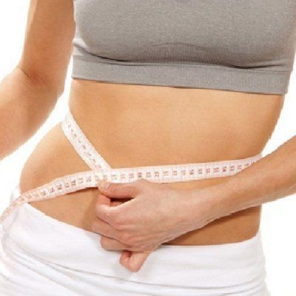

Slide 3
Liposuction - the Plain Truth
In case you're doing combating a lump that just won't move, liposuction medical procedure may have entered your thoughts. By eliminating undesirable stores of abundance fat, liposuction improves body appearance and smoothes sporadic or misshaped body shapes. Safe liposuction medical procedure requests a scrupulousness and care for the patient.
Liposuction, The Facts
The liposuction in Dubai system has changed significantly since it was first presented in 1979. The old medical procedures for fat and skin expulsion, for example, the "stomach fold", are essentially more hazardous than liposuction alone. Settling on an educated choice about having liposuction medical procedure necessitates that you have a sense of safety in your insight and comprehension of the methodology.
In the event that appropriately done, the liposuction recoils the skin and results in a sensibly decent lower mid-region shape, yet this requires an accomplished specialist. The best contender for liposuction are ordinary weight individuals with firm, versatile skin who have pockets of abundance fat in specific zones.
Most of liposuction medical procedures are performed on an outpatient premise. On the off chance that your specialist played out a huge volume liposuction (more than 5 liters) at that point you should remain in the clinic short-term for perception and secure.

Slide 4
Liposuction - the Plain Truth
Thigh liposuction is frequently acted related to butt cheek liposuction. Pits or wrinkling of the skin where the fat is eliminated may require another method to solidify the skin following liposuction.
Prior to medical procedure, the specialist may check circles and lines on the territories of your body to go through liposuction. Before the medical procedure an answer is injected into the zone of the liposuction.
You should see completely the pre-usable arrangements, the liposuction methodology, and the exact post-usable consideration. A liposuction cannula is a treated steel tube embedded through an entry point in the skin that is utilized to pull the fat. A little cut is first made where the instrument is embedded, so liposuction can be performed under neighborhood sedation.
A liposuction method may incorporate more than one site, for example, the midsection, back, and thighs all around the same time.

