Slide 1

How to Use Paula‘s Choice Anti-redness exfoliating solution (2% salicylic acid)

Slide 2

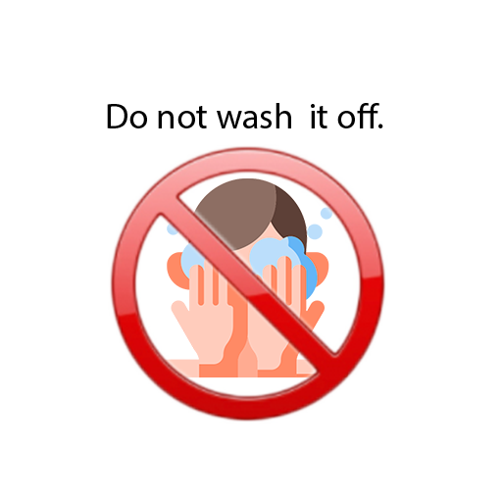
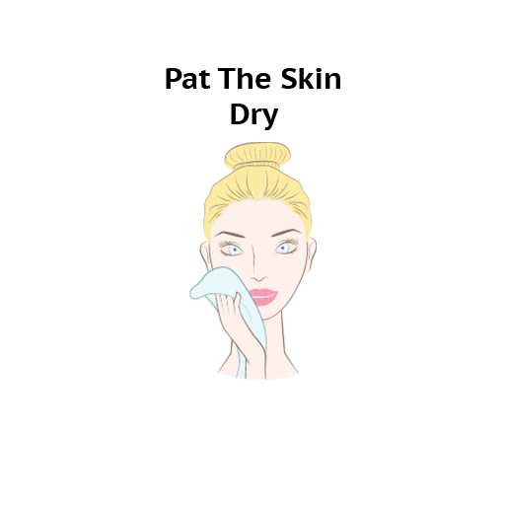
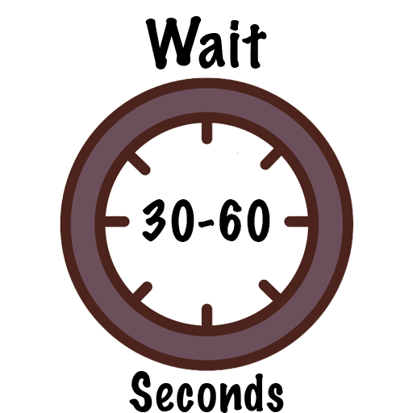
Morning/AM Routine
Examples:
Paula‘s Choice Softening Cream Cleanser (Dry to Very Dry Skin)
or
Paula‘s Choice Oil-Reducing Cleanser (Oily/Combination Skin) or Paula‘s Choice Pore Normalizing Cleanser (Blemish-Prone Skin)
Examples:
Paula’s Choice Skin Restoring Moisturizer with SPF 50 (Normal to Dry Skin) or
Paula’s Choice Youth Extending Daily Hydrating Fluid with SPF 50 (Normal to Combination/Oily Skin)
Examples:
Paula‘s Choice C 15 Super Booster or Paula‘s Choice 10% Niacinamide Booster or Paula‘s Choice 10% Azelaic Acid Booster
Examples:
Paula‘s Choice Enriched Calming Toner (Dry to Very Dry Skin) or
Paula‘s Choice Pore-Reducing Toner (Oily/Combination Skin)
Step 1. Gentle Cleanser |  | Step 2. (Optional) Toner |  | Step 3. (Optional) Serum(s)/Treatment(s) |  | Step 4. Moisturizer with SPF or ‘Regular’ Sunscreen
Cleanser: Dispense about a coin-sized amount of cleanser into the palm of your hand and apply it to wet skin, gently massage all over for 30-60 seconds, rinse and pat skin dry.
Toner: Pour some liquid on a cotton pad until it feels damp but not overly soaked,
or use about 5-8 drops in the palm of your hand and apply it across your face, neck, and décolletage (Avoiding eyelids). Do not rinse.
Serum(s)/Treatment(s): Use about 2-5 drops, 1-2 pumps or about a pea-sized amount and apply evenly over your face and neck. (Avoiding eyelids). Do not rinse.
Moisturiser with SPF or “Regular” Sunscreen: Apply half to full teaspoon of SPF 30 or greater broad-spectrum sunscreen to your face, neck, and décolletage. Do not rinse.
Note: Be sure to read the directions on your skincare products before applying them.
Info: Choose the skincare products best suited for your skin type and needs.

Slide 3
Morning/AM Routine
Examples:
Paula‘s Choice Softening Cream Cleanser (Dry to Very Dry Skin)
or
Paula‘s Choice Oil-Reducing Cleanser (Oily/Combination Skin) or Paula‘s Choice Pore Normalizing Cleanser (Blemish-Prone Skin)
Examples:
Paula’s Choice Skin Restoring Moisturizer with SPF 50 (Normal to Dry Skin) or
Paula’s Choice Youth Extending Daily Hydrating Fluid with SPF 50 (Normal to Combination/Oily Skin)
Examples:
Paula‘s Choice C 15 Super Booster or Paula‘s Choice 10% Niacinamide Booster or Paula‘s Choice 10% Azelaic Acid Booster
Paula‘s Choice Anti-Redness Exfoliating Solution
(Exfoliates the skin, which helps to reduce dullness, textured skin, uneven skin tone. It unclogs pores, regulates oiliness and has anti-inflammatory properties)
Examples:
Paula‘s Choice Enriched Calming Toner (Dry to Very Dry Skin) or
Paula‘s Choice Pore-Reducing Toner (Oily/Combination Skin)
Step 1. Gentle Cleanser |  | Step 2. (Optional) Toner |  | Step 3. BHA Exfoliant |  | Step 4. (Optional) Serum(s)/Treatment(s) |  | Step 5. Moisturizer with SPF or ‘Regular’ Sunscreen
Cleanser: Dispense about a coin-sized amount of cleanser into the palm of your hand and apply it to wet skin, gently massage all over for 30-60 seconds, rinse and pat skin dry.
Toner: Pour some liquid on a cotton pad until it feels damp but not overly soaked,
or use about 5-8 drops in the palm of your hand and apply it across your face, neck, and décolletage (Avoiding eyelids). Do not rinse.
BHA Exfoliant: Pour some liquid on a cotton pad until it feels damp but not overly soaked,
or use about 5-8 drops in the palm of your hand and apply it across your face, neck, and décolletage (Avoiding eyelids). Do not rinse.
Serum(s)/Treatment(s): Use about 2-5 drops, 1-2 pumps or about a pea-sized amount and apply evenly over your face and neck. (Avoiding eyelids). Do not rinse.
Moisturiser with SPF or “Regular” Sunscreen: Apply half to full teaspoon of SPF 30 or greater broad-spectrum sunscreen to your face, neck, and décolletage. Do not rinse.
Frequency of BHA Exfoliant: Start with every other day and adjust the frequency according to your skin's response.
Note: Be sure to read the directions on your skincare products before applying them.
Info: Choose the skincare products best suited for your skin type and needs.

Slide 4

Method 1: Regular Cleansing
To Remove Excess Sebum, Dirt, Water-Soluble Makeup and/or Sunscreen
Evening/PM Routine
Examples:
Paula‘s Choice Softening Cream Cleanser (Dry to Very Dry Skin)
or
Paula‘s Choice Oil-Reducing Cleanser (Oily/Combination Skin) or Paula‘s Choice Pore Normalizing Cleanser (Blemish-Prone Skin)
Example:
Paula‘s Choice Oil-Free Moisturizer (Blemish-Prone Skin)
Examples:
Paula‘s Choice C 15 Super Booster or Paula‘s Choice 10% Niacinamide Booster or Paula‘s Choice 10% Azelaic Acid Booster
Paula‘s Choice Anti-Redness Exfoliating Solution
(Exfoliates the skin, which helps to reduce dullness, textured skin, uneven skin tone. It unclogs pores, regulates oiliness and has anti-inflammatory properties)
Examples:
Paula‘s Choice Enriched Calming Toner (Dry to Very Dry Skin) or
Paula‘s Choice Pore-Reducing Toner (Oily/Combination Skin)
Step 1. Gentle Cleanser |  | Step 2. (Optional) Toner |  | Step 3. BHA Exfoliant |  | Step 4. (Optional) Serum(s)/Treatment(s) |  | Step 5. (Optional) Moisturizer
Cleanser: Dispense about a coin-sized amount of cleanser into the palm of your hand and apply it to wet skin, gently massage all over for 30-60 seconds, rinse and pat skin dry.
Toner: Pour some liquid on a cotton pad until it feels damp but not overly soaked,
or use about 5-8 drops in the palm of your hand and apply it across your face, neck, and décolletage (Avoiding eyelids). Do not rinse.
BHA Exfoliant: Pour some liquid on a cotton pad until it feels damp but not overly soaked,
or use about 5-8 drops in the palm of your hand and apply it across your face, neck, and décolletage (Avoiding eyelids). Do not rinse.
Serum(s)/Treatment(s): Use about 2-5 drops, 1-2 pumps or about a pea-sized amount and apply evenly over your face and neck. (Avoiding eyelids). Do not rinse.
Moisturizer: For the entire face and neck, use about 1 pea-sized amount of moisturizer or as needed and apply over face and neck. Do not rinse.
Frequency of BHA Exfoliant: Start with every other day and adjust the frequency according to your skin's response.
Note: Be sure to read the directions on your skincare products before applying them.
Info: Choose the skincare products best suited for your skin type and needs.

Slide 5
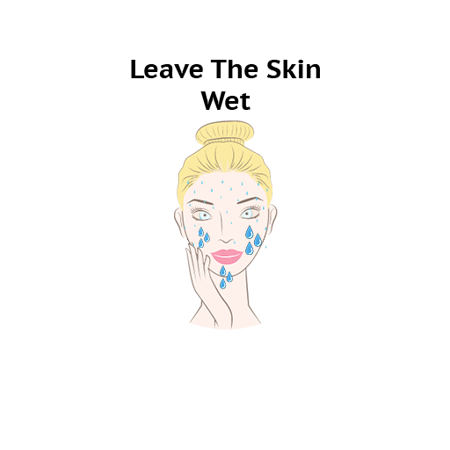
Evening/PM Routine
Method 2: Double Cleansing
To Remove Excess Sebum, Dirt, Stubborn & Waterproof Makeup and/or Sunscreen
Examples:
The Inkey List Oat Cleansing Balm (All Skin Types/Sensitive Skin) or Paula‘s Choice Omega + Complex Cleansing Balm (All Skin Types) or The Ordinary Squalane Cleanser (All Skin Types)
Example:
Paula‘s Choice Oil-Free Moisturizer (Blemish-Prone Skin)
Examples:
Paula‘s Choice C 15 Super Booster or Paula‘s Choice 10% Niacinamide Booster or Paula‘s Choice 10% Azelaic Acid Booster
Paula‘s Choice Anti-Redness Exfoliating Solution
(Exfoliates the skin, which helps to reduce dullness, textured skin, uneven skin tone. It unclogs pores, regulates oiliness and has anti-inflammatory properties)
Examples:
Paula‘s Choice Enriched Calming Toner (Dry to Very Dry Skin) or
Paula‘s Choice Pore-Reducing Toner (Oily/Combination Skin)
Examples:
Paula‘s Choice Softening Cream Cleanser (Dry to Very Dry Skin)
or
Paula‘s Choice Oil-Reducing Cleanser (Oily/Combination Skin) or Paula‘s Choice Pore Normalizing Cleanser (Blemish-Prone Skin)
Step 1. Balm/Oil Cleanser |  | Step 2. Gentle Cleanser |  | Step 3. (Optional) Toner |  | Step 4. BHA Exfoliant |  | Step 5. (Optional) Serum(s)/Treatment(s) |  | Step 6. (Optional) Moisturizer
Balm/Oil Cleanser: Dispense your oil or balm cleanser into the palm of your hand and apply it to wet skin; gently massage onto the skin,
including around the eyes, for 30–60 seconds, rinse and leave skin wet/damp.
Cleanser: Dispense about a coin-sized amount of cleanser into the palm of your hand and apply it to wet skin, gently massage all over for 30-60 seconds, rinse and pat skin dry.
Toner: Pour some liquid on a cotton pad until it feels damp but not overly soaked,
or use about 5-8 drops in the palm of your hand and apply it across your face, neck, and décolletage (Avoiding eyelids). Do not rinse.
BHA Exfoliant: Pour some liquid on a cotton pad until it feels damp but not overly soaked,
or use about 5-8 drops in the palm of your hand and apply it across your face, neck, and décolletage (Avoiding eyelids). Do not rinse.
Serum(s)/Treatment(s): Use about 2-5 drops, 1-2 pumps or about a pea-sized amount and apply evenly over your face and neck. (Avoiding eyelids). Do not rinse.
Moisturizer: For the entire face and neck, use about 1 pea-sized amount of moisturizer or as needed and apply over face and neck. Do not rinse.
Frequency of BHA Exfoliant: Start with every other day and adjust the frequency according to your skin's response.
Note: Be sure to read the directions on your skincare products before applying them.
Info: Choose the skincare products best suited for your skin type and needs.

Slide 6
Conflicts

Slide 7

Do NOT use Paula‘s Choice Anti-Redness Exfoliating Solution
with The Ordinary Peptide Serums
Examples:
Paula‘s Choice Softening Cream Cleanser (Dry to Very Dry Skin)
or
Paula‘s Choice Oil-Reducing Cleanser (Oily/Combination Skin) or Paula‘s Choice Pore Normalizing Cleanser (Blemish-Prone Skin)
Example:
Paula‘s Choice Oil-Free Moisturizer (Blemish-Prone Skin)
Examples:
The Ordinary Buffet or
The Ordinary Buffet + Copper Peptides 1% or The Ordinary Matrixyl 10% + HA or The Ordinary Argireline Solution 10%
Paula‘s Choice Anti-Redness Exfoliating Solution
Step 1. Gentle Cleanser |  | Step 2. BHA Exfoliant |  | Step 3. Peptide Serum(s) |  | Step 4. Moisturizer

Slide 8
What to avoid

Slide 9
Avoid using Paula‘s Choice Anti-Redness Exfoliating Solution with Retinol/Retinoids
Examples:
Paula‘s Choice Softening Cream Cleanser (Dry to Very Dry Skin)
or
Paula‘s Choice Oil-Reducing Cleanser (Oily/Combination Skin) or Paula‘s Choice Pore Normalizing Cleanser (Blemish-Prone Skin)
Example:
Paula‘s Choice Oil-Free Moisturizer (Blemish-Prone Skin)
Examples:
Paula‘s Choice 0,3% or 1% Retinol Treatments or The Ordinary 0,2% 0,5% or 1% Retinol in Squalane or Differin Gel (Adapalene)
Paula‘s Choice Anti-Redness Exfoliating Solution
Step 1. Gentle Cleanser |  | Step 2. BHA Exfoliant |  | Step 3. Retinoids |  | Step 4. Moisturizer

Slide 10
Avoid using Paula‘s Choice Anti-Redness Exfoliating Solution with potent Vitamin C (Ascorbic Acid) products.
Examples:
Paula‘s Choice Softening Cream Cleanser (Dry to Very Dry Skin)
or
Paula‘s Choice Oil-Reducing Cleanser (Oily/Combination Skin) or Paula‘s Choice Pore Normalizing Cleanser (Blemish-Prone Skin)
Examples:
Timeless 20% Vitamin C Serum or
The Inkey List 30% Vitamin C Serum or The Ordinary Vitamin C Suspension 23% + HA Spheres 2% or
Vitamin C Suspension 30% in Silicone
Paula‘s Choice Anti-Redness Exfoliating Solution
Step 1. Gentle Cleanser |  | Step 2. BHA Exfoliant |  | Step 3. Strong Vitamin C Formulations

Slide 11
Avoid using Paula‘s Choice Anti-Redness Exfoliating Solution
after AHA/BHA Exfoliating Acid cleansers
Step 1. Exfoliating Acid Cleanser |  | Step 2. BHA Exfoliant |  | Step 3. Moisturizer
Example:
Paula‘s Choice Oil-Free Moisturizer (Blemish-Prone Skin)
Paula‘s Choice Anti-Redness Exfoliating Solution
Examples:
La Roche Posay Effaclar Micro-Peeling Cleanser or CeraVe Acne Control Cleanser or The Inkey List Salicylic Acid Cleanser

Slide 12
Do NOT use Paula‘s Choice Anti-Redness Exfoliating Solution
after AHA/BHA Exfoliating Acid Masks
Step 1. Gentle Cleanser |  | Step 2. AHA/BHA Exfoliating Acid Masks |  | Step 3. BHA Exfoliant |  | Step 4. Moisturizer
Examples:
Paula‘s Choice Softening Cream Cleanser (Dry to Very Dry Skin)
or
Paula‘s Choice Oil-Reducing Cleanser (Oily/Combination Skin) or Paula‘s Choice Pore Normalizing Cleanser (Blemish-Prone Skin)
Example:
Paula‘s Choice Oil-Free Moisturizer (Blemish-Prone Skin)
Examples:
Paula‘s Choice 25% AHA + 2% BHA Exfoliant Peel
or
The Ordinary 2% Salicylic Acid Masque or
The Ordinary 30% AHA + 2% BHA Peeling Solution
Paula‘s Choice Anti-Redness Exfoliating Solution

Slide 13
Avoid using Paula‘s Choice Anti-Redness Exfoliating Solution with other AHA/BHA Leave-On Exfoliating Acids
Examples:
Paula‘s Choice Softening Cream Cleanser (Dry to Very Dry Skin)
or
Paula‘s Choice Oil-Reducing Cleanser (Oily/Combination Skin) or Paula‘s Choice Pore Normalizing Cleanser (Blemish-Prone Skin)
Example:
Paula‘s Choice Oil-Free Moisturizer (Blemish-Prone Skin)
Examples:
Paula‘s Choice 2% BHA Liquid Exfoliant or The Ordinary Glycolic Acid 7% Toning Solution or The Ordinary Lactic Acid 5% or 10% + HA
Paula‘s Choice Anti-Redness Exfoliating Solution
Step 1. Gentle Cleanser |  | Step 2. BHA Exfoliant |  | Step 3. AHA/BHA Exfoliant |  | Step 4. Moisturizer

Slide 14
