Slide 1
FRGB Instrument Lights
Group 25
Sponsored By:
Dr. Rick Leinecker
Notes:
Hello this will be the Final Presentation of the FRGB Instrument Lights, the project was sponsored by Dr. Rick Leinecker. The members include myself, Stefan Gonzalez, Anja Frohawk, Carson Warner, and Leith Rabah.

Slide 2
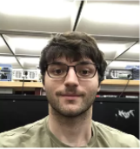

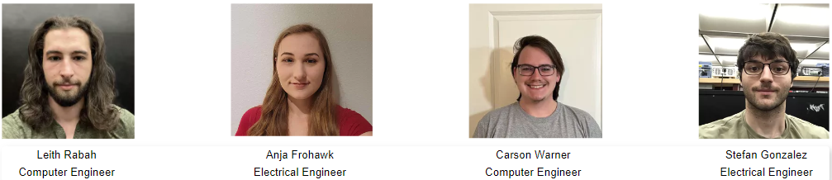
The Team
Notes:
Amongst the team designing the FRGB Instrument Lights we have two computer engineers and two electrical engineers. The computer engineers consisted of Leith Rabah and Carson Warner and were in charge of handling the software of the project. While the electrical engineers consists of Anja Frohock and myself, Stefan Gonzalez and were in charge of the hardware aspect of the project.

Slide 3
Introduction
Frequency-responsive RGB (FRGB) instrument lights are RGB lights that are designed for musical instruments. The LEDs are controlled by the frequency and volume of the instrument being played where the frequency determines the musical note which determines the color of the LED and the volume determines the brightness of the LED.
The main goal was to create an immersive visual element to musical performances in order to better captivate a wider audience.
Notes:
Our project is the Frequency-responsive RGB Instrument Lights, also known as FRGB Lights. These RGB LEDs are designed for musical instruments.
The LEDs are controlled by the frequency and volume of the instrument being played where the frequency determines the musical note which, in turn, determines the color of the LED, and the volume determines the brightness of the LED.
The main goal was to create an immersive visual element to musical performances in order to better captivate a wider audience.
These lights can be used for a wide variety of performances such as recitals, concerts, parties, and even for topics such as giving people a visual representation of a symptom of Synesthesia which is a visual disorder.
With this product, we hope to give the music genre a new advancement in the modern era that will bring in new audiences.

Slide 4
Specifications
Specification | Goal
Minimum SNR value | 25 dB
Minimum refresh speed | 5 iterations per second
Fully customizable note colors | Can customize the color associated with each note individually
Portability | ≤ 7x5x5 inches ≤ 3 lbs
Notes:
The Design Specifications of the FRGB Instrument Lights consisted of four main points.
Two hardware objectives and two software objectives.
For the hardware objectives the project needed to have a Signal - to - Noise Ratio value of 25 Decibels(dB) and the portability was predetermined to be under 3 lbs and under 7 by 5 by 5 inches.
Reason being is that the device has to be easily transportable and accessible to use on short notices, and with little setup time.
Continuing on with the specifications is the software objectives which are the Refresh rate being at least 5 iterations per second and to have a fully customizable setting for the musical notes and their colors.

Slide 5
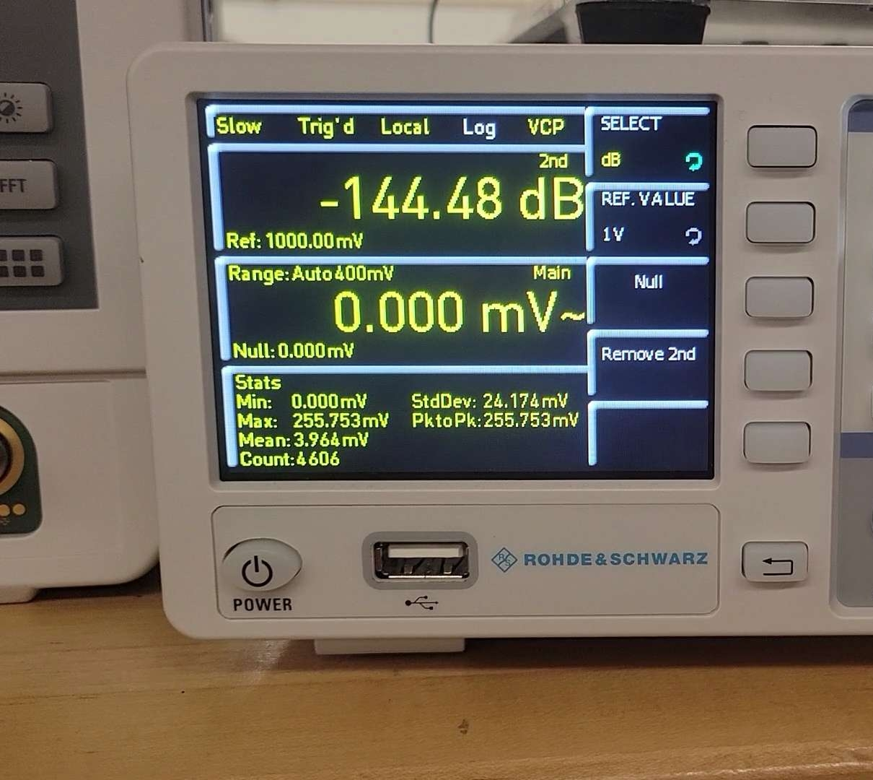
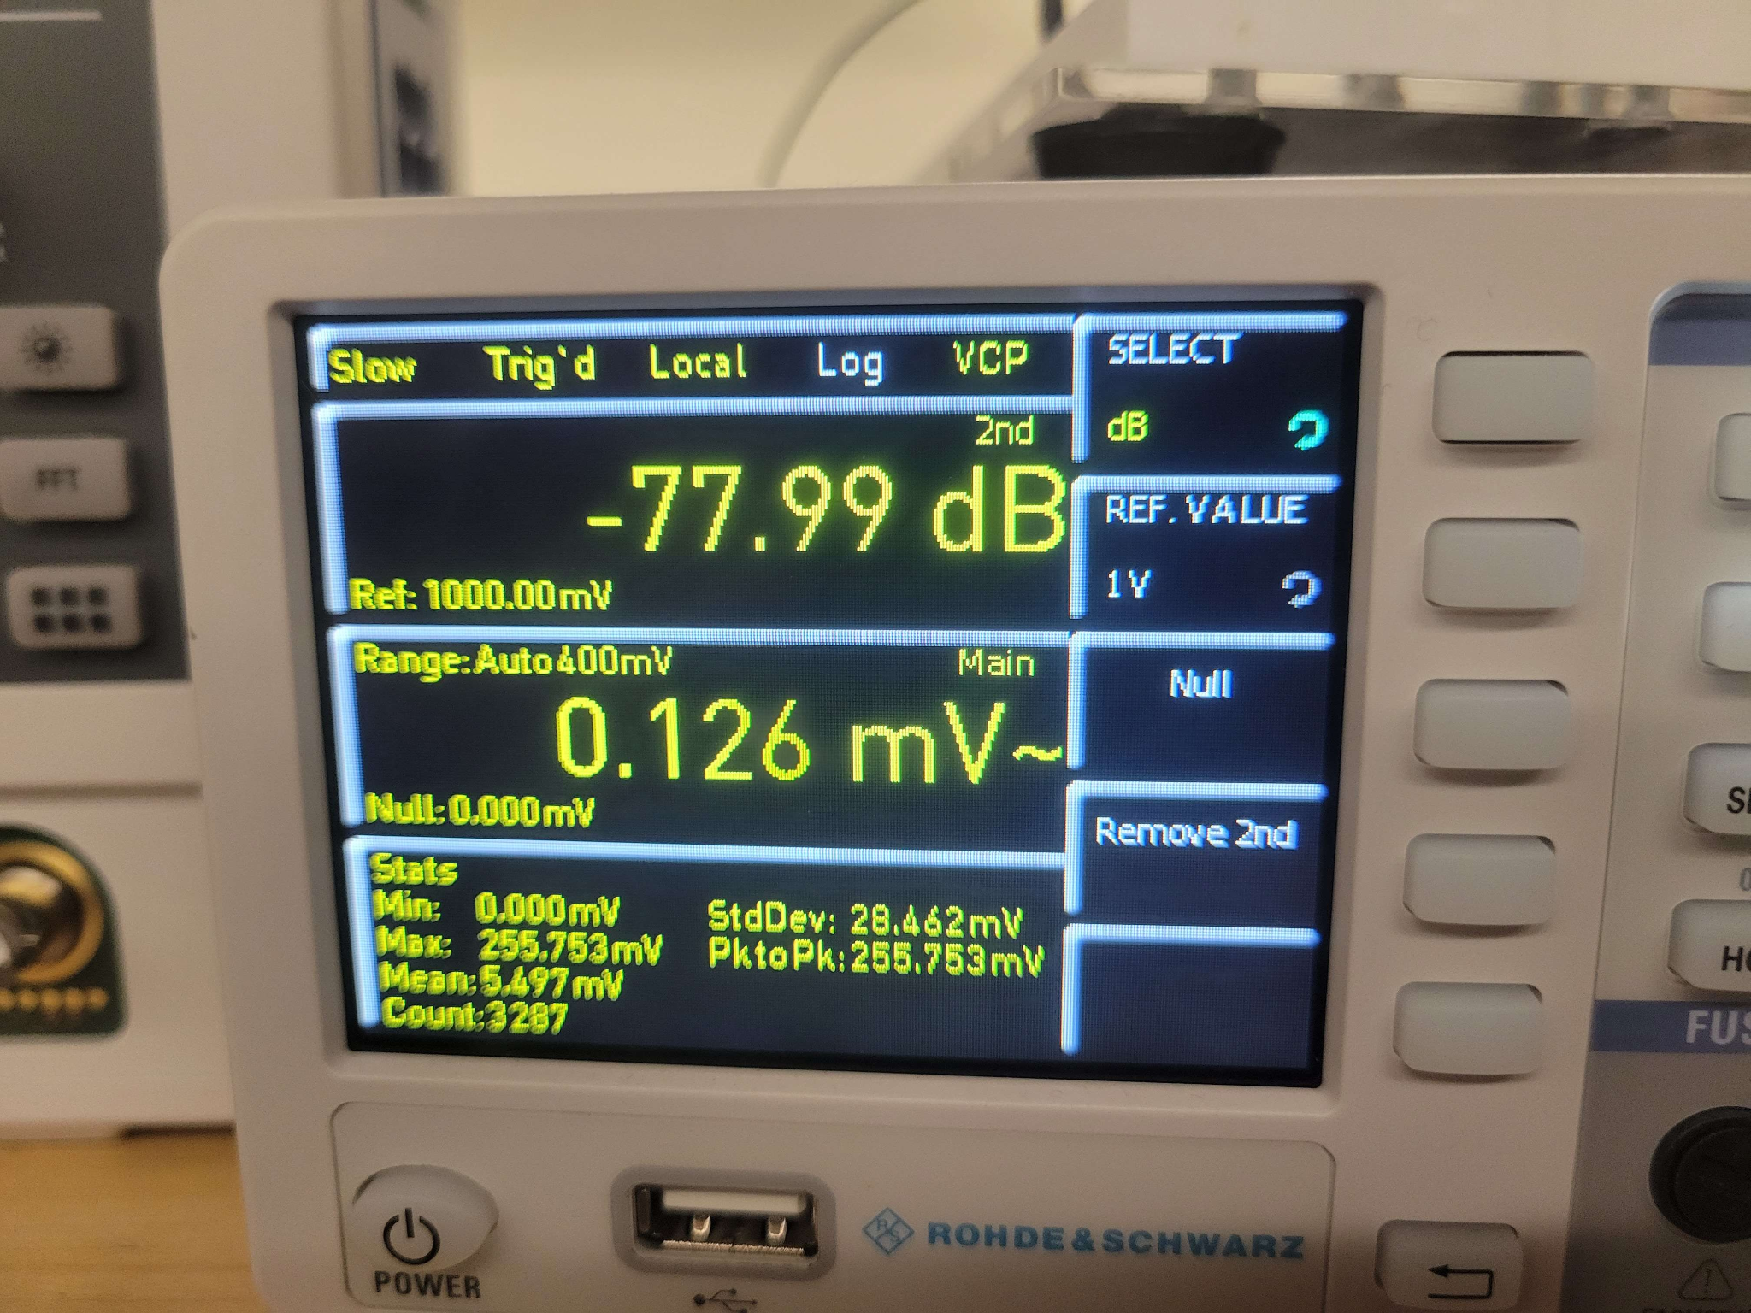
Signal-to-Noise Ratio
When calculating the SNR, the labs did not have the required equipment to accurately measure the values for the calculations.
Lab head David Douglas assisted with finding the values using the multimeter despite it not being as accurate as with a Decibal Reader
SNR values:
Signal: -78 dB
Noise: -144.5 dB
SNR = -78 - (-144.5) = 66.5 dB
Notes:
Having a Signal-to-Noise Ratio of at least 25 dB was a key specification for our printed circuit boards.
After receiving our PCBs, we attempted to calculate the SNR using a spectrum analyzer however we ran into trouble while trying to find the signal of our circuit as it would not display on the spectrum analyzer.
After consulting with the lab manager David Douglas, we were told the frequencies we were working with were too small to display on the analyzer and using it to find the SNR was not viable option under his expertise.
He then suggested we use a Decibal Reader, however, the labs did not have any DB Readers for us to use, which was a large hurdle as this meant we wouldn't be able to calculate the SNR which was the most important specification for our hardware.
Though, after further consulting with Mr. Douglas, he informed us of a method to find the SNR value by using the HMC8012 digital multimeters that were available in the lab. This method, albeit not as accurate, gave us a general idea of our SNR value.
With a noise value of -144.5 dB and a signal value of -78 dB, our signal-to-noise ratio resulted in a value of 66.5 dB.
This value is over 2 times the minimum value that we set as a goal at the beginning of the project. We would like to mention that we theorize that our actual signal-to-noise ratio is closer to 80-90 dB as that is what is stated on our 16-Bit ADCs datasheet specifications.
(~75s)

Slide 6

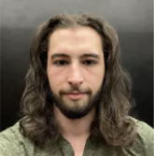
Refresh Rate
After testing we confirmed that the LEDs updated at a refresh rate of at least 5 color/brightness adjustments per second.
The example video shows 6 LED updates in the span of 1 second with a timer
Notes:
From the beginning of our research, we had intended to have a minimum refresh rate of 5 iterations per second for our program. Through various testing, and constant trial and error of various sample rates, we have achieved a sample rate well above what we had intended. Our stretch goal was a minimum of 10 iterations per second which we also achieved however, because the video does not clearly show every iteration, we will show proof of 6 iterations per second. The video on the right is an example video that clearly shows the 6 different iterations. The first three are changes in brightness with the first color, and then it displays 3 more iterations that are the changes in colors. This clip has more iterations such as when the lights are displaying the color blue, it goes through a couple changes in brightness, however, it is difficult to claim that they are iterations and not camera adjustments in the video. (~45s)

Slide 7
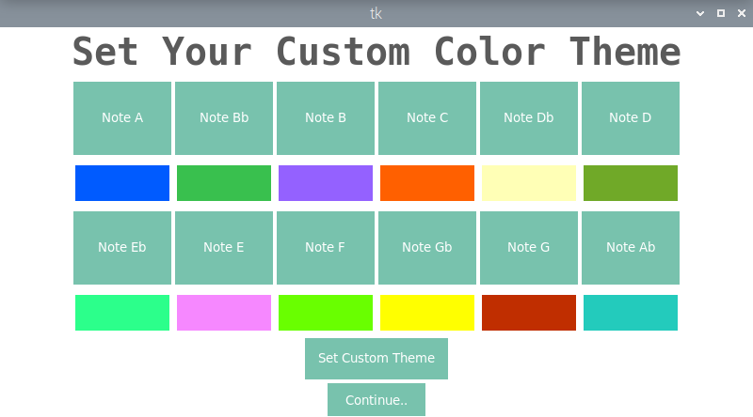
Fully Customizable Note Colors
Notes:
The biggest goal we had for the software was to give the user the ability to choose what color will go with each individual music note. We wanted the product to be fully customizable. By applying a bootstrap library into our python GUI, we managed to create 12 buttons, one for each musical note, that allows the user to select and set any color they desire from a popup rgb spectrum. The image displayed shows what our program looks like after having selected the colors of each note. As you can see, the program also displays the selected color under the button for each note. From here the user will simply set their custom theme and continue onto the next screen where they can begin their visualization. (~40s

Slide 8
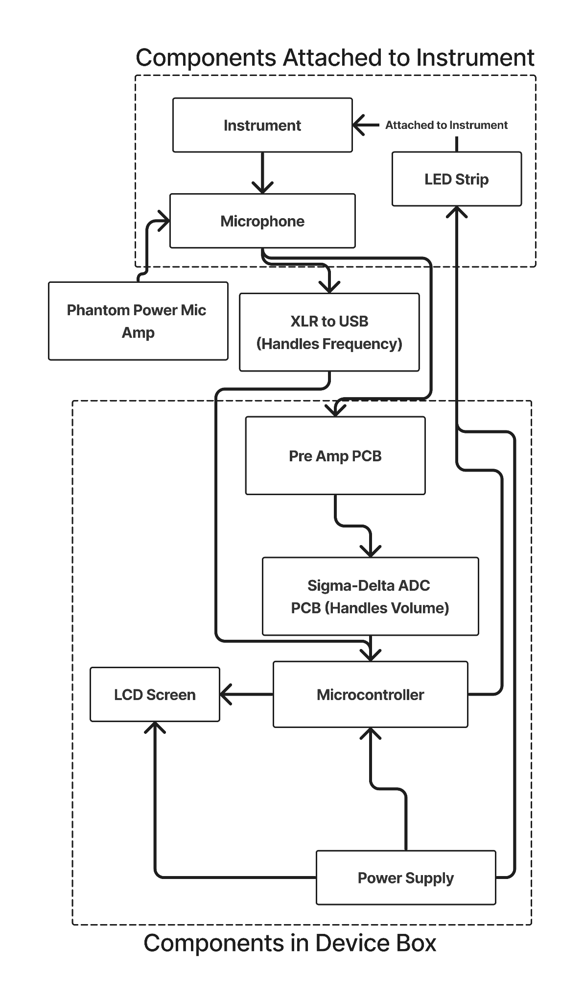
Hardware Block Diagram
We have three segments:
Components Attached to Instrument
Outside connections and components
Components in the Device Box
Notes:
For our hardware block diagram: We have three segments. First is the Instrument which has the LED lights attached to it and feeds input into the microphone, next is the amplifiers and connections, and the third is the box which contains the ADC, the LCD screen, the power supply, and microcontroller which receives n sends data and power throughout the block diagram.

Slide 9
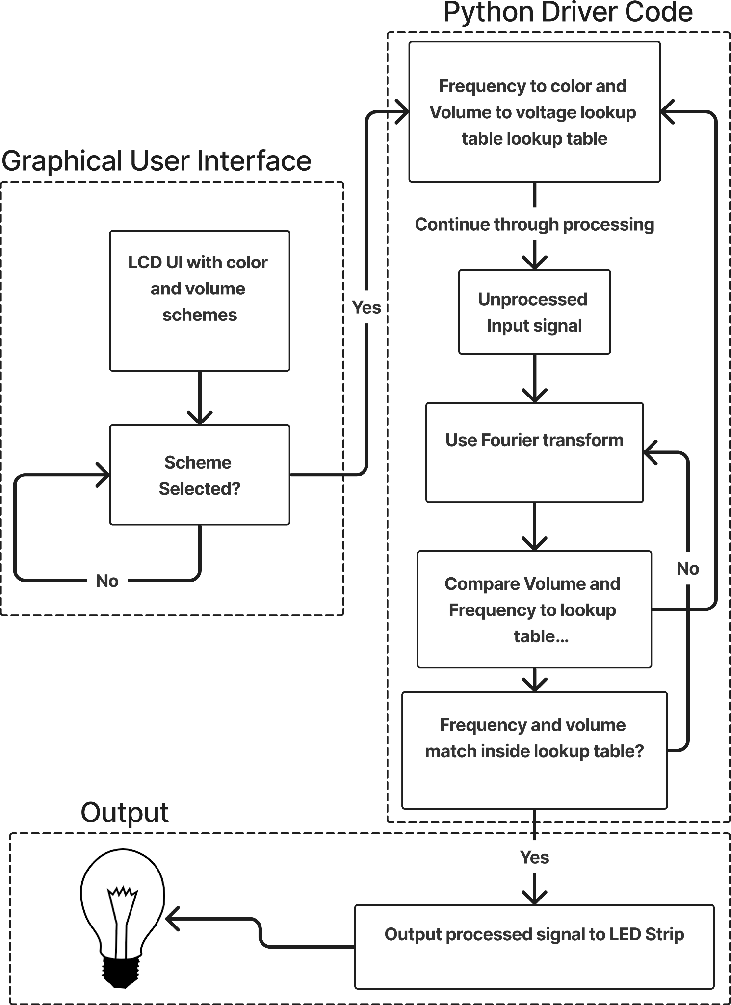
Software Block Diagram
We have three segments:
Python Driver COde
Graphical User Interface
Output
Notes:
For the software block diagram: We have three segments. The python driver code which reads the input signals, does all the mathematical calculations, then outputs the results to the LEDs to change their color and brightness, and the GUI which is displayed on the LCD screen for the users convenience.

Slide 10
Component Selection
Microcontroller
Analog-to-Digital Converter
LED Strips
Notes:
In this next section we are going to review the components that we chose for this project with the advantages and disadvantages of each component vs its alternative. These Components include the microcontroller, analog to digital converter and the led strips .

Slide 11
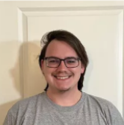
Microcontroller Comparisons
 | Raspberry Pi 4 | Raspberry Pi 3 | Nvidia Jetson Nano
Cost | $158 | $80 | $298
Processor Speed | Fast | 0.5x Pi 4 | 2x Pi 4
RAM | 2 GB | 1 GB | 4 GB
Size | 3.64”x2.76”x1.18” | 3.35”x2.2”x0.8” | 2.72”x1.77”x1.77”
Power Requirement | 5V DC | 5V DC | 5V DC
Notes:
Quad core Cortex-A72
quad-core Cortex A53 2014
Robust Quad-core ARM Cortex-A57

Slide 12
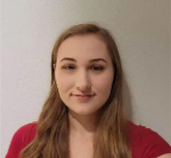
Analog-to-Digital Converter Comparisons
 | Dual Slope | Flash | Pipelined | Delta-Sigma | Successive Approximation
Cost | $46.94 | $154.70 | $78.61 | $6.66 | $21.52
Size (inches) | 2.07x.54 | 2.096x.62 | 0.3x0.3 | 0.2x0.12 | 0.2x0.12
Resolution | 15-bit | 16-bit | 16-bit | 16-bit | 16-bit
Throughput per second | 40 | 166,000 | 10,000,000 | 860 | 1,000,000
Noise | 30uVpp | 120uVpp | 150uVpp | 62.5uVpp | 47.3uVpp
Notes:
When looking at ADCs for this project there were multiple architectures considered especially since originally we were trying to design our own. For our application we needed to make sure it had at least 16-bit resolution since we were working with audio signals. Dual slope while it has the accuracy we wanted has a very low throughput due to the internal timer having to reach the max threshold and back to zero each cycle. Flash architecture for high accuracy applications is very expensive due to the fact that it has to have 2^16 comparators for 16-bit applications. Pipelined architecture while fast was quite expensive as it still requires 60 comparators for the resolution we required and added the most noise into the system. The delta sigma architecture was the most affordable for the resolution we needed and included noise shaping to reduce quantization noise. Successive Approximation architecture had low noise and higher throughput however was more expensive. This led us to choose the Delta-sigma ADC for this project.

Slide 13
LED Comparisons
 | SMD | COB
Quality of Light | Features glare | No glare Uniform light beam
Cost | ~5% higher | ~5% lower
Colors | Adjustable | Non-adjustable
Brightness | 50-100 lumens/watt | 80+ lumens/watt

Slide 14
Converting Music Into Color
Python program converts sound into frequency values.
Frequency ranges assigned to various notes.
Each note assigned a different color.
Visual representation of Chromesthesia.
Notes:
Chromesthesia is a type of synesthesia in which sound involuntarily evokes an experience of color, shape, and movement.[1][2] Individuals with sound-color synesthesia are consciously aware of their synesthetic color associations/perceptions in daily life.[3]

Slide 15
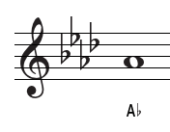
Note-to-Color Relationships
Relationship between specific notes with specific colors
Foundational level to be implemented
Represents sound-to-color visualization
Ex. The note A flat corresponds to the color Blue
=
Notes:
The basic idea behind how we will be assigning colors to music is illustrated in multiple levels with the most simple of them being single note to color relationships
With this we will assign all 12 notes in the chromatic scale a specific color, once that note is interpreted by the program the respective color will then be displayed
For example if we were to have the note Ab, we would correspond it to the color blue

Slide 16
Hardware Implementation
Analog-to-Digital Converter
Pre-amplifier
Raspberry Pi 4 Microcontroller
LCD screen
Notes:
For hardware for this project we used an analog-to-digital converter, Pre-amplifier, Raspberry Pi 4, and a LCD screen.

Slide 17
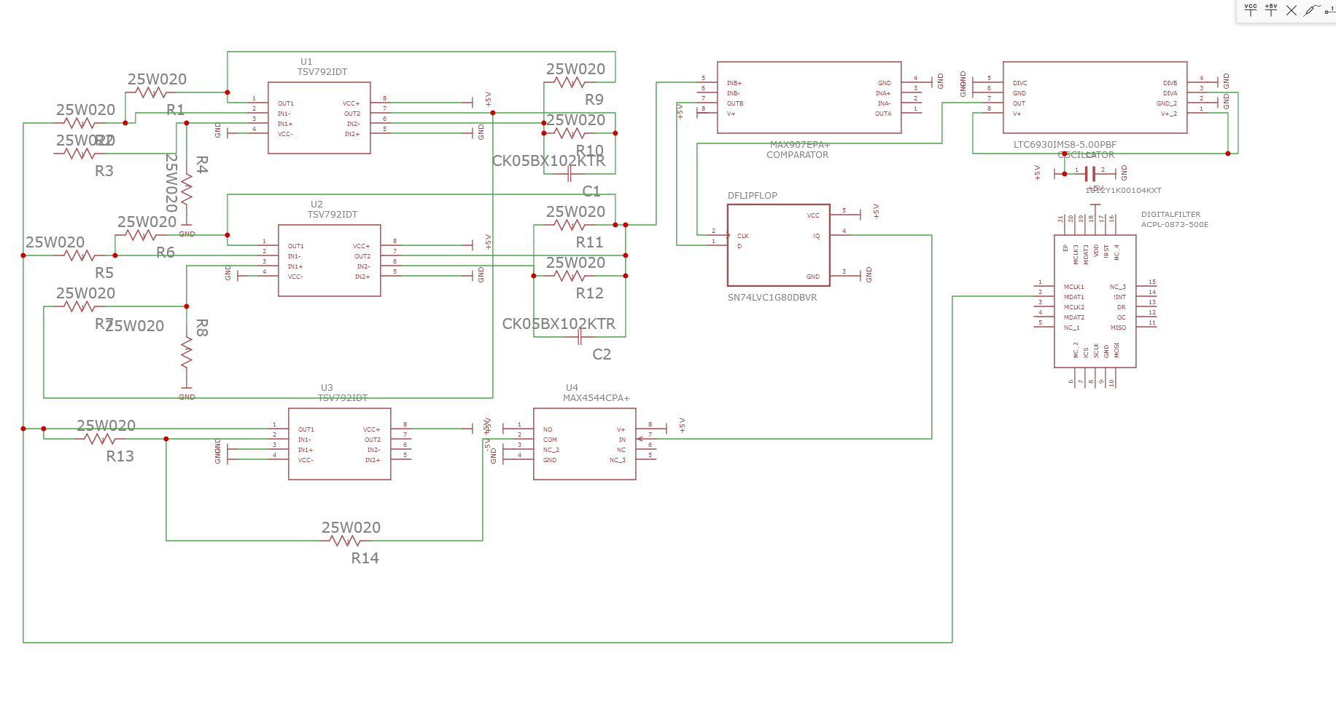
Analog-to-Digital Converter (Original)
Notes:
This is the first design attempted which was designed by our team. It was designed based on the basic building blocks of a Sigma-Delta ADC.Such as a Difference Amplifier, integrator, Clock, Comparator, and Digital filter with i2c to communicate with the PI. It is also second order so it repeats the difference amplifier and integrator stages to achieve a higher resolution with less oversampling. The difference amplifier subtracts the feedback from the signal coming in. The integrator then does noise shaping to push the noise to higher frequencies that will be removed by the filter at the output to result in very low quantization noise. The comparator which acts as a 1-bit ADC outputting a 1 if its greater than 0 and a 0 if its less than 0. Then through the D-FF to add the clock signal into the output and a switch to invert the D-FF’s signal as the component we bought only had Q-bar. The digital filter then decimates the signal to bring the output of the signal to a usable frequency and filters out the high frequency noise as we only need up to 20kHz as that is as high as the human ear can hear. Most signals that we expect from the mic will be much lower than 20kHz as well.

Slide 18
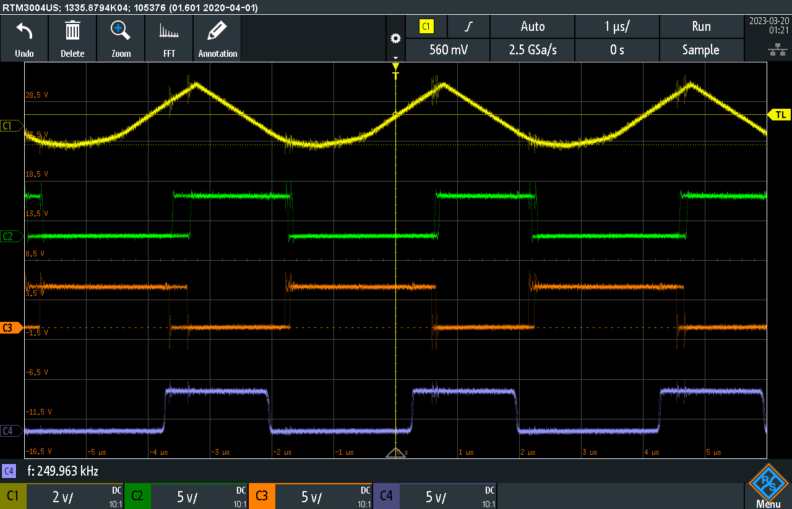
Analog-to-Digital Converter Testing (Original)
Notes:
This is the outputs of the original ADC when bypassing the op-amps used for the difference amplifiers and integrators. The input signal of a triangle wave is in yellow, the comparator is shown in purple, the switch in green, and the D flip-flop in orange. These were all working as expected from the simulation. The op amps however, were not this is most likely due to the simulation using ideal op amps. When testing this one we also were not using bypass capacitors on any of the power supplies on the op amps which may have added noise and contributed to them not working. Another reason that was learned when testing the next revision was that we needed to use different op amps suited to each function which was not done for this attempt. We just used the THS4222DGK however throughout testing we tried 4 different op amps and none of them worked as simulated. We also had to use a different D flip-flop then originally bought as it was a 16 pin D-latch because when originally buying parts as we hadn't used digikey and were not able to find where the smaller D flip-flops needed for this application were on digikey. We also could have not been using a high enough clock signal as the second circuit used a frequency 8 times greater than the 5 MHz tested with this design. The original comparator of the MAX907EPA+ also did not work as expected however when testing with 4 other comparators the TLC3702CP worked much better, Overall we were not able to find the conclusive problem with this circuit as there were too many factors and it could have been the design itself. We were recommended to find a design that had been used and tested before.

Slide 19
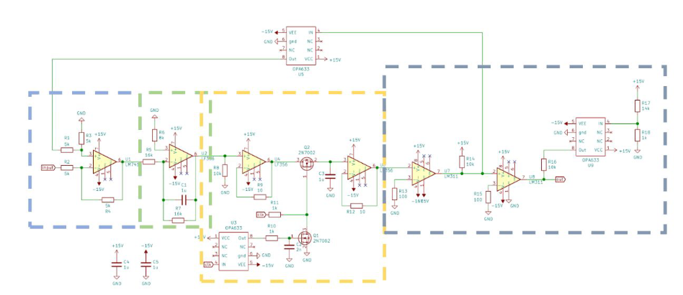
Analog-to-Digital Converter (Attempt 2)
https://web.mit.edu/6.101/www/s2020/projects/colinpc_Project_Final_Report.pdf
Notes:
This is the second design attempted as this one was a project previously done at MIT and had worked before. We misunderstood the advice given to us from Dr Wei which was to find a project that was previously done to find a reference design to build. This would have guaranteed it worked as there would have been exact parts and test data to reference. This uses the same concepts we used previously on the first design with a difference amplifier, integrator, and comparator however instead of a D-flip flop and switch they used a sample and hold circuit with MOSFETs instead. It also added voltage buffers to prevent the circuit from breaking.

Slide 20
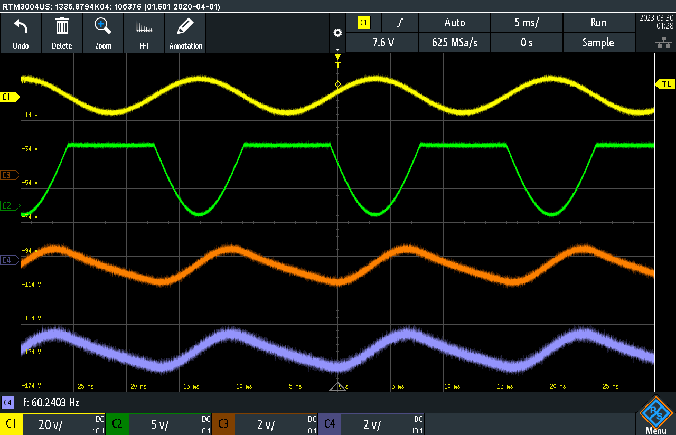
Analog-to-Digital Converter Testing (Attempt 2)
Notes:
This design had the opposite problem of the first attempt the op amps worked and the comparator and clock didn't. This oscilloscope reading shows a sine wave of 20Vpp at 60Hz in yellow, the difference amplifier in green, the integrator in orange, and the output of the sample and hold circuit in purple. The difference amplifier’s output was different as the feedback loop was incorrect. This is due to the clock not being inputted into the system as none of the buffers were working as expected. The clock buffer outputted nothing so the output of the sample a hold circuit which should've been at the oversampled rate of 66MHz was only at the 60 Hz. This caused the rest of the circuit to output incorrect voltages. This could've been because the buffers used in the schematic were discontinued so they were replaced with the BUF643AIDR as recommended by Digikey and research. It had a minimum bandwidth of 35 MHz which made it much harder to test as the oscilloscope and function generator only goes up to 20 MHz. We tested if the clock was the issue and it outputted a signal closer to a triangle wave but after testing and more research we discovered that is how clock signals look when in the 66 MHz range and it was indeed correct. Since the deadline was quickly approaching we asked Dr Chan and he recommended to just buy an ADC and use that instead.

Slide 21
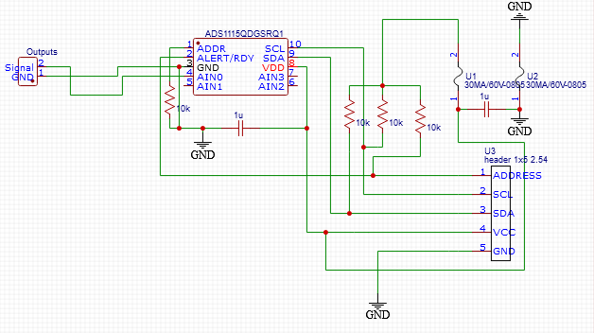
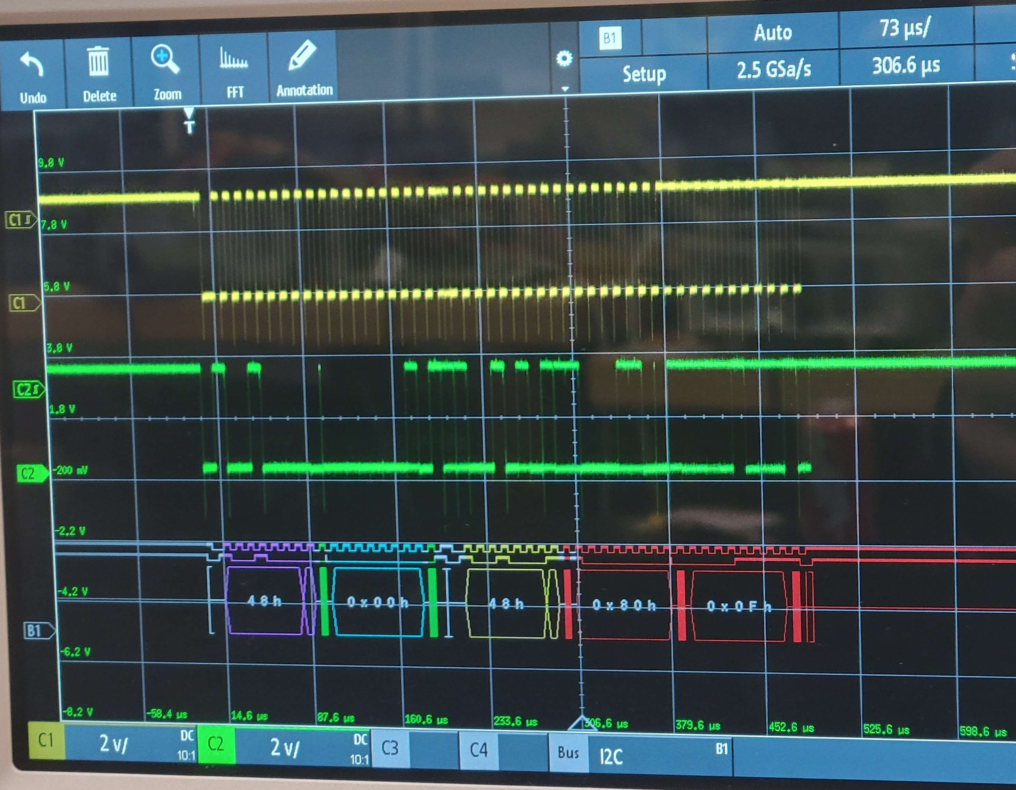
Analog-to-Digital Converter (Final)
Notes:
This is the ADS1115QDGSRQ1 which is the ADC we ended up using for this project. This decision was due to the fact that this ADC has a library for the PI and a prebuilt module we could test it against. This was important as the only output was through the PI using the I2C pins and the previous problems we had tested the other two ADC circuits. We originally were using 5V for the power supply but upon further research learned that the PI’s GPIO pins only take up to 3.3V so we are powering it with the 3.3V from the PI and amplifying the microphone’s signal about 15 times to the 3.3Vpp. As shown in the right picture the yellow is the clock coming from the PI SCL pin and the green is the digitized PCM signal from the analog microphone input being communicated to the PI using the SDA pin.

Slide 22
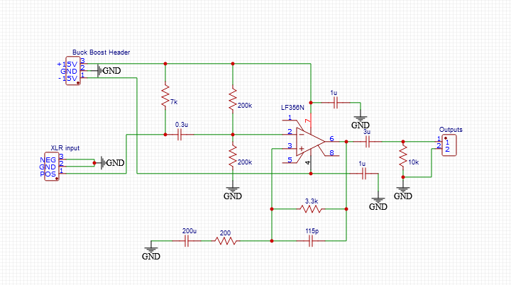
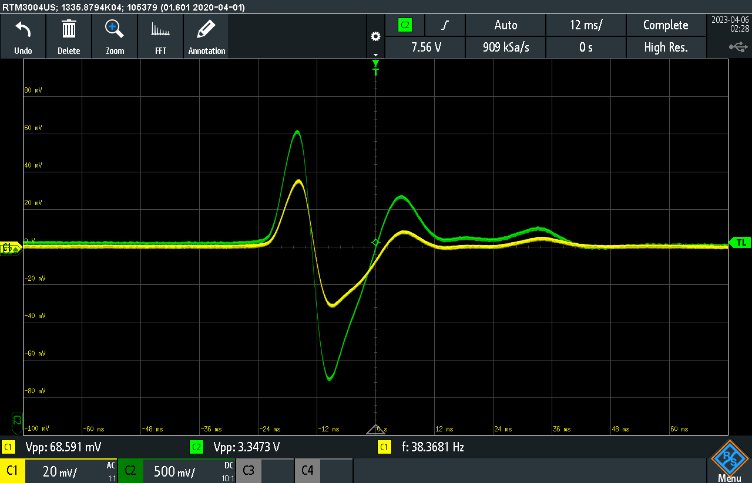
Pre-Amplifier
Notes:
The pre-amplifier schematic was based on the reference design for a non-inverting microphone preamp from Texas Instrument. With the microphone and gain specifications calculated, we got the design on the left figure. This design raises the output of the microphone from mic level to a voltage that the ADC can use.
As mentioned previously we originally were using a gain of 50 to bring the microphone up which originally we estimated to have a max voltage of 100 (mVpp) up to 5 Vpp.
However we had to bring that down to 3.3 Vpp based on the accepted voltage of the GPIO pins on the PI when doing that and remeasuring the microphones output we realized the peak voltage could go higher than the originally tested 100mVpp.
This caused us to redo the calculations and go with a much more conservative gain of 15 which avoids any chance of clipping.
We originally thought to increase the signal as much as possible so that the ADC would have a higher accuracy as there would be less of a question on if it was above or below the reference voltage. However through testing we learned clipping was happening too frequently so we went with a smaller gain when redoing the calculations.
Thankfully the gain is controlled by the positive feedback resistor which was changed to 3.3k Ohms.

Slide 23
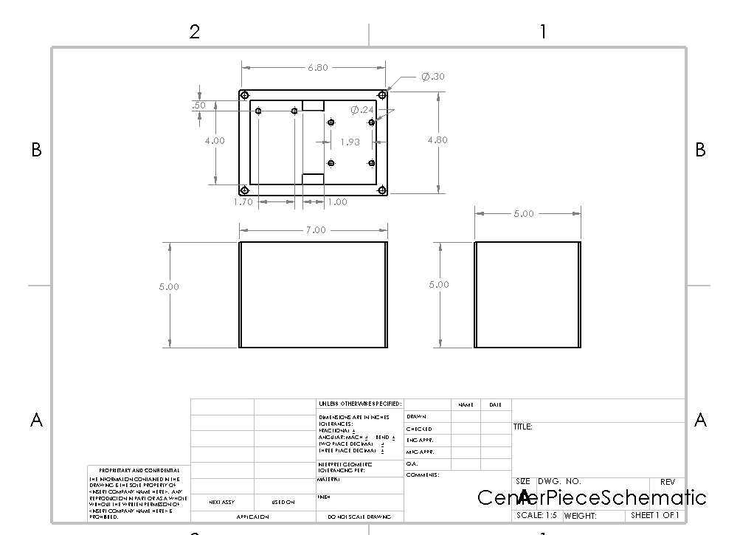
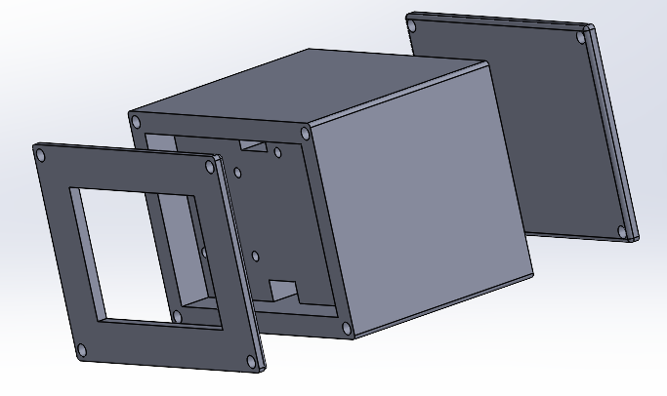
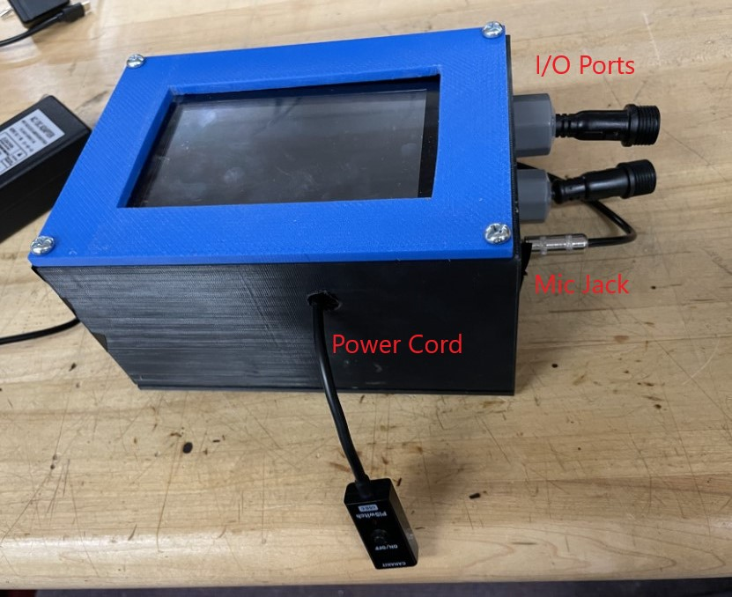
SolidWorks Design
Notes:
Our project included the use of a 3D-Printer, with PLA material, in the fabrication of our design the team’s hopes were to secure the sensitive components within the project’s designed box in the most efficient manner to ensure the project’s performance to be in accordance with the design specifications.
In the case of this project it was desired to be lightweight and compact enough for a user to move at ease. As the project experienced changes over the course of Senior Design, so has the overall schematic as seen the box is no longer a one to one copy of the original solid-works design.
Reason being that the original design was no longer compatible with the current version of the project.
With the introduction of new circuit boards and connections needed. This created the need for adjustments on the design of the container, such as port openings, drilling holes, and proper mounting of screws on the container to secure the hardware and electronics.
This was all done to ensure that the device can be moved around in any vector without the concern of electrical disconnections or short circuiting of components.

Slide 24
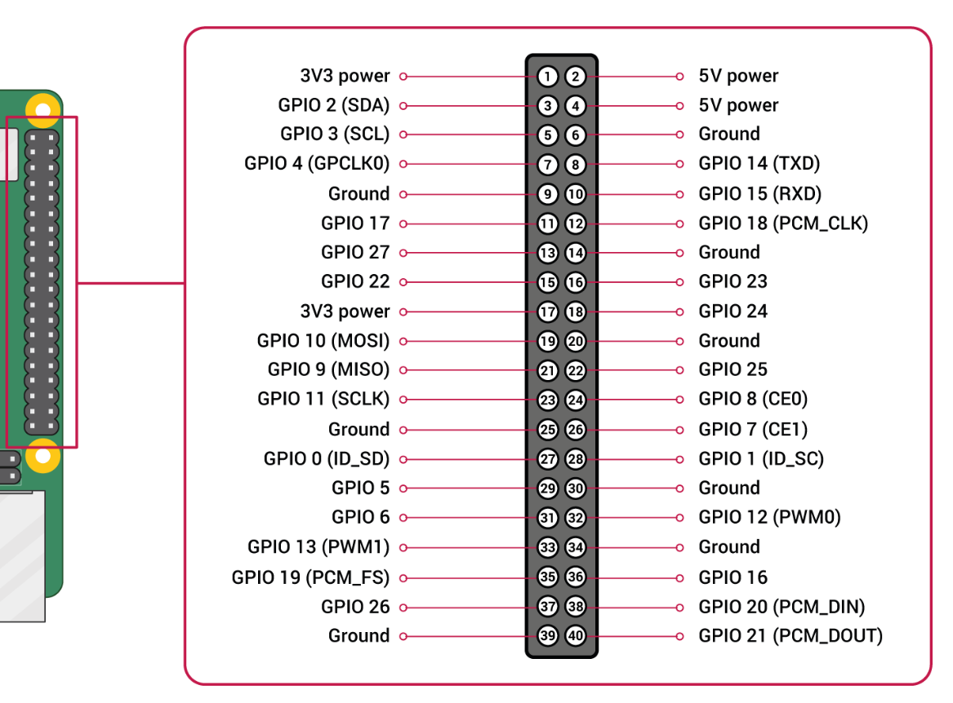
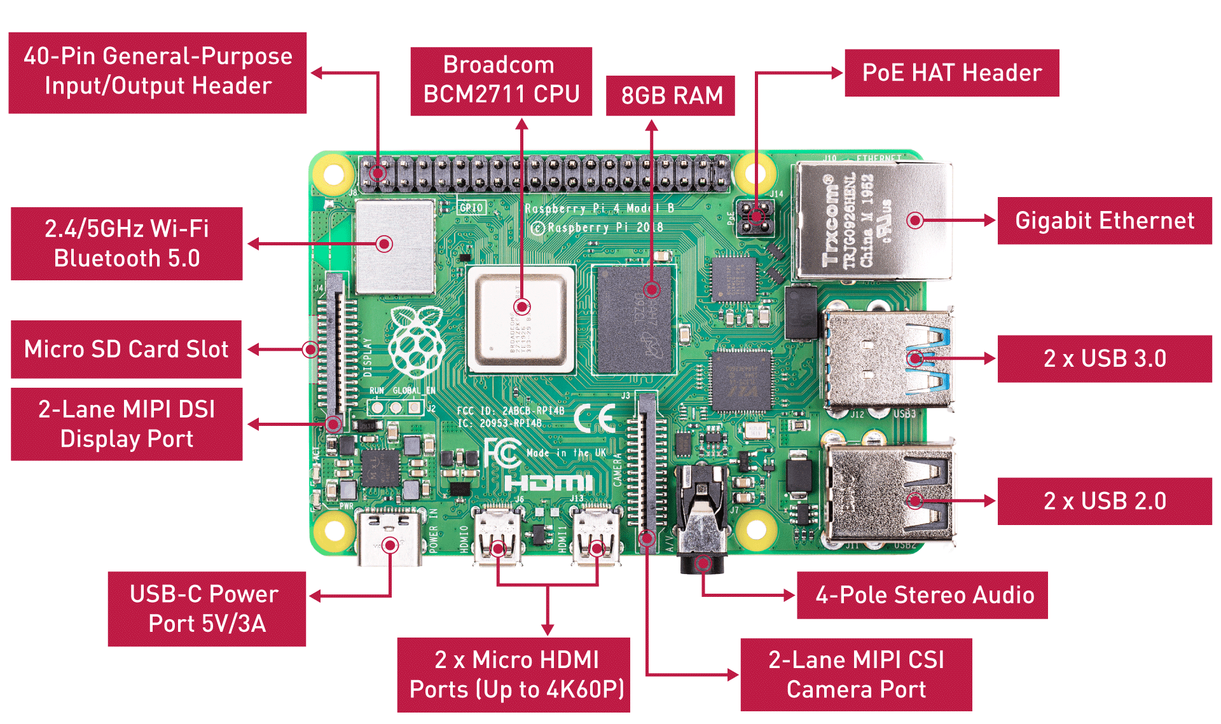
Raspberry Pi 4 Layout
Pins
3V3 Power
GPIO 2 (SDA)
GPIO 3 (SCL)
GPIO 18 (PCM_CLK)
2x Ground
Ports
1x USB 3.0
USB-C Power Port
2-Lane MIPI DSI Display Port
Notes:
Here, we have the layout of the raspberry pi 4b and its pinouts. For our project, we needed to us 3 ports and 6 pins. The required ports we used are one USB 3.0 port for the microphone connection, a USB-C Power Port to power the system, and a 2-lane MIPI DSI Display port for the LCD screen. The required pinouts are the 3.3 Volt Power pin to power the Analog-to-Digital converter, the GPIO2 SDA pin and GPIO 3 SCL pin to connect to the ADC to transfer the data, the GPIO 18 PCM_CLK pin to send data to the LEDs, and two ground pins. All of these connections are hidden away behind the touch screen of our box. (~45s)

Slide 25
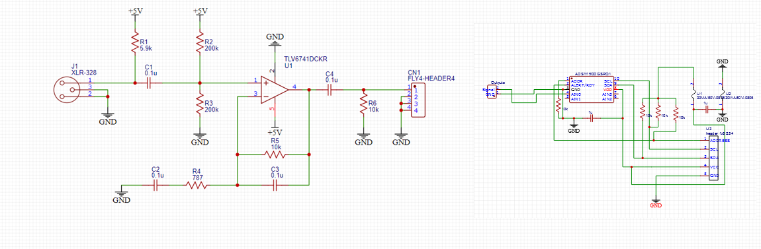
Overall Schematic
Notes:
This project consisted of two circuits to achieve its main objective as shown in the two figures displayed. The pre-amplifier and the ADC, are key components for the project.
The Schematic on the top left is the Pre-Amplifier, which receives signals from the instrument, amplifies the voltage with a gain of at least fifteen and then sends the boosted signal to the Analog-to-Digital Converter, which is the Schematic on the top right.
The ADC converts the signal produced from the pre-amplifier to a digital signal that can be received by the raspberry pi 4 microcontroller.
The Raspberry Pi 4 is also receiving a direct current of 5 volts which is being supplied by a wall outlet.
The Raspberry Pi 4 is acting as the heart of project which does all the mathematical calculations once the signal is received and then sends desired output data to LEDs strips which will cause a change of brightness and color.

Slide 26
Software Implementation
GUI (tkinter)
Python code
Console output
Software demo

Slide 27
Fourier Transforms
Algorithm designed to interpret repeating patterns
Applied in sound, optics, electrical engineering, etc.
Sound can be defined as the fluctuation of air pressure over time
FT finds the frequency of the fluctuations
Converts a sound into a list of frequencies
A note is a specific frequency range
Most sounds are made of several frequencies
Application uses fft.js library to implement fast Fourier Transforms
Fast Fourier Transform is an algorithm made for quick computer calculations

Slide 28
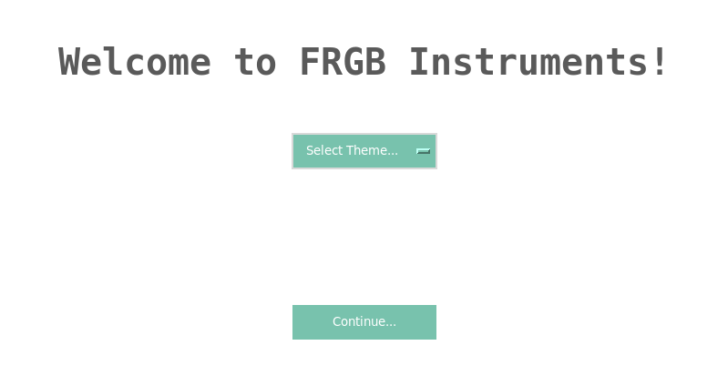
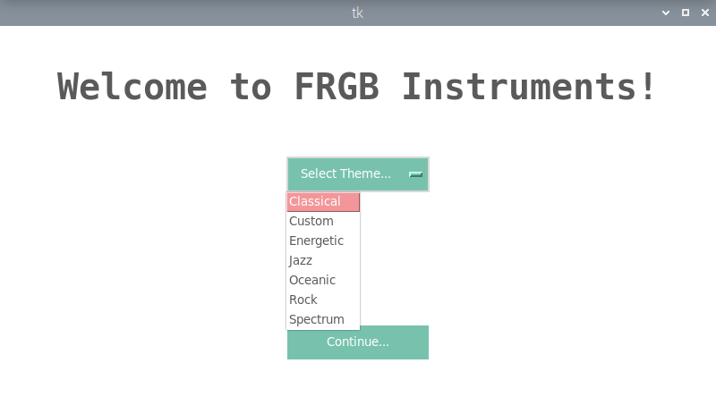
Python Gui Using tkinter
Notes:
This is the current iteration of the GUI of the python program

Slide 29
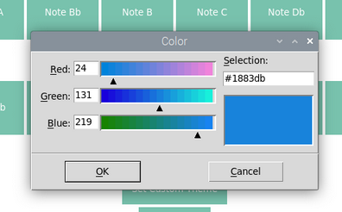
Python Gui Custom Theme Running

Slide 30
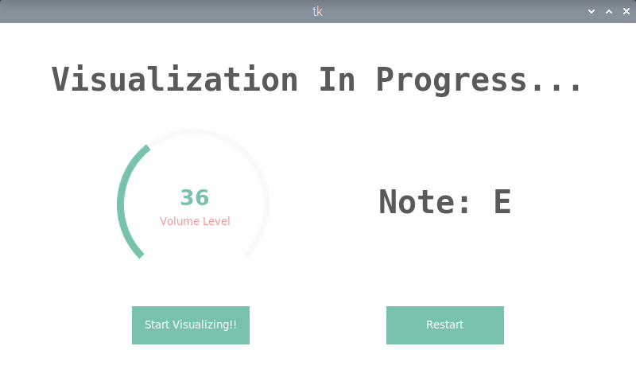
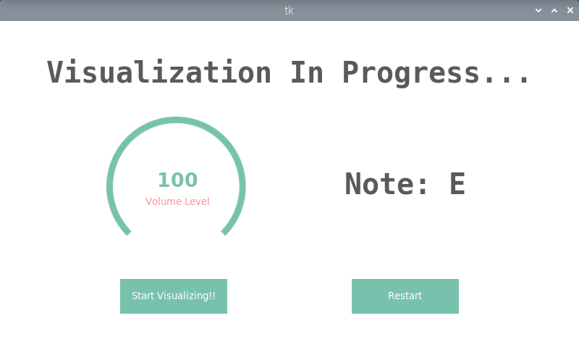
Python GUI Visualization Screen

Slide 31
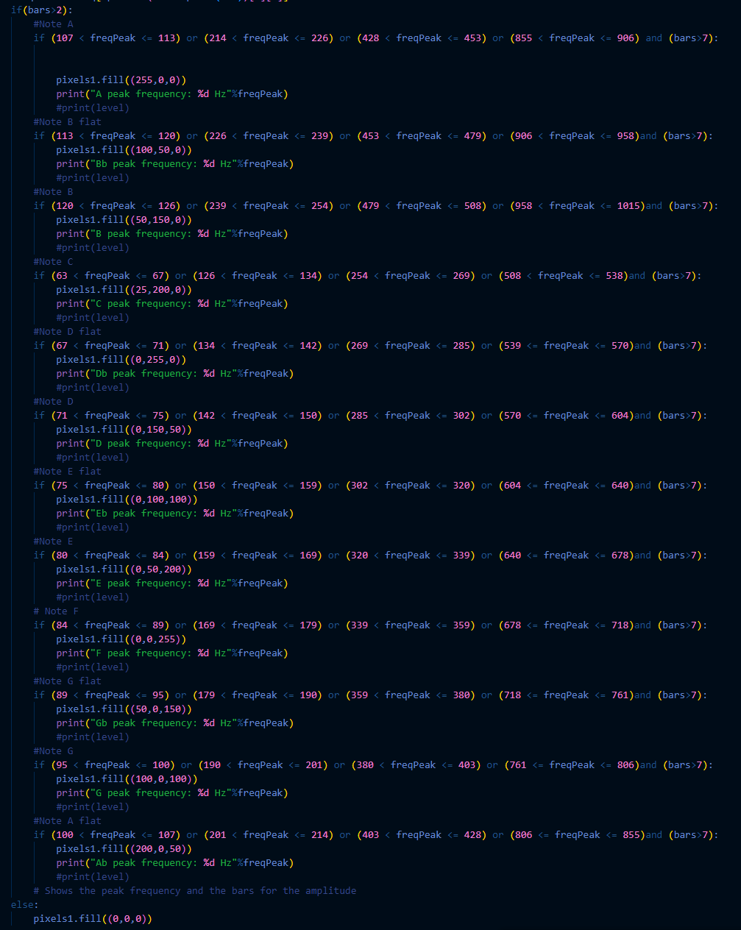
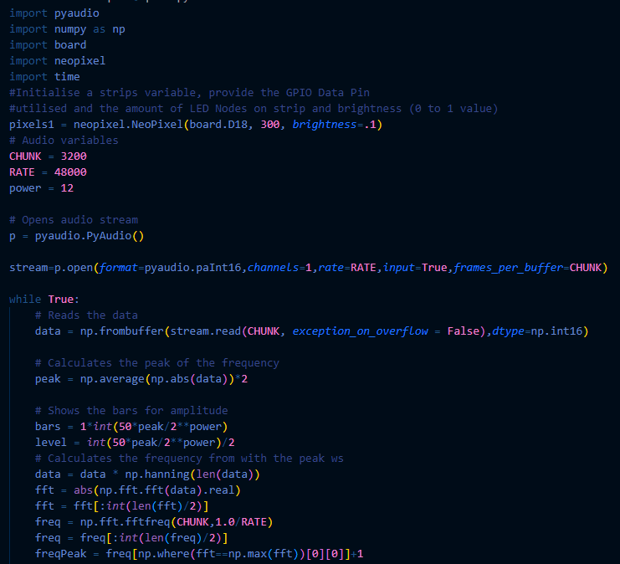
Python Code
Notes:
The following images represent one of the classes in our python program that we had written to test our product throughout the development phase of our project. Since we were meant to be working with another Computer Science team, our program is a simplified version of what they had created despite us having written our respective programs in different languages. You can see in the image on the left that we utilized the pyaudio and neopixel python libraries.These libraries allowed us to read in the sound frequencies and control the output of the lights, respectively. We then read the data, conduct a few calculations, and then (as seen in the image on the right) assign each frequency to a specific musical note. The final version of this code also included setting the gain, a few more mathematical calculations, and the GUI. We also needed to use the Tkinter and ADS1115 libraries. These libraries helped us create our GUI and communicate with our ADC which is the first thing the program does. The program does many calculations, including the fast fourier transform shown in the image, in order to obtain the volume and convert it to an integer value from 1-100. This value also determine the brightness of the LEDs. (~65s)

Slide 32
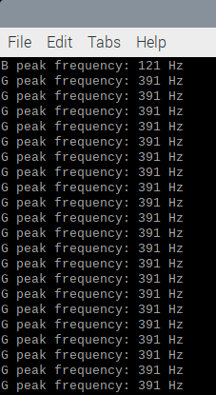

Python Code Tests (Console Output)
Single Note:
Multiple Notes:
Notes:
The following two images represent an early test of the python code shown in the previous slide. The image on the left shows the microphone reading the same note over an extended time period while the image on the right represents the microphone reading multiple different notes over a short time period. You can see how the output tells us the frequency of the noise emitted along with the musical note it corresponds to. In future tests we also used the terminal in the same way to have the program tell us the volume of the noise being read by the microphone. This allowed us to confirm that we were reading the correct musical note and volume without needing to connect and run the entire project. Another test we used was using speakers to output a specific musical notes frequency and comparing the frequency we were outputting with what our program was displaying. Once we saw that they were the same, we had the confidence to move forward with our project without worrying that our software could have been the issue. (~50s)

Slide 33
Challenges Faced With Hardware
Problem | Solution
Aimed too highly for course PCB requirements. | Building an ADC from scratch proved far too difficult and time consuming when paired with the rest of the project.
Shipping delays with PCB components. | Paid extra for 4-6 day shipping.
Component failure. | Purchased multiple backups of each component.
Issues with understanding component datasheets | Experience from time in the lab testing components as well as research
Finding recommended parts | Using replacement parts
Notes:
The first challenge faced was the goal of designing an ADC to build. In the fall semester we hadn't realized how hard of a feat this actually was to do as well as the nuances with the different parts of a sigma delta ADC. We spent the first 3 months testing the first ADC which we designed ourselves. However it was eventually decided that goal was not able to be reached within a single semester and with the experience level we are currently at. The second challenge was shipping delays with the PCBs as we spent so much of the semester testing the first ADC when it came time to order the PCBs used for this project we had less than 2 weeks before the deadline. Therefore we had to pay for the fastest option of 4-6 day shipping and that still got slightly delayed. The third challenge was component failure this was due to problems while testing such as misplace wires or errors in the circuit design which cause overheating on multiple occasions. This was solved by ordering extra of every component to use as back ups so testing wouldn't be delayed further. The fourth challenge was understanding datasheets when beginning this project we didn't have the experience to know what values we should be checking for each component to ensure they would work for the application we were using them for as well as how to problem solve testing issues using the data in the datasheet. This was discovered through trial and error while testing each version of the ADC. The final challenge faced was finding recommended parts as they were sold out or discontinued. This was solved through researching replacement parts and learning how to compare the important values between the options.

Slide 34
Challenges Faced With Software
Problem | Solution
Corrupt Python Libraries on Raspberry Pi that stopped the program from running | A clean Raspberry Pi OS install (Seemed like a one off corruption)
How to Implement a GUI with Python | Utilized the Tkinter and ttk bootstrap Python libraries to implement GUI with widgets
Sample Rate issues resulting in reading incorrect frequencies between the musical notes being played. | Trial and error until the correct gain and sample rate values were found.
Debugging Issues with Raspberry Pi | Research and Trial and Error
Inability to have more than one person work on code while away | More time spent together in Senior Design Lab and phone calls
Notes:
For the software side of the project, we also ran into a few tough obstacles. The first of which was that because we were coding directly onto the raspberry pi, we couldnt have more than one person writing code at a time and it made working together extremely difficult. The best solution we found to this was to simply spend more time together in person and coding the program while sitting side by side. The next biggest issue was that some of our python libraries became corrupt. This set us back an entire day due to debugging, research, various installations and uninstallations, and finally an entire reinstall of the raspberry pi OS. Thankfully, this was a one off issue and we did not need to go through it a second time. The last obstacle I will speak of was the sample rate. If the sample rate was too low, it would not read all the musical notes being played. If the sample rate was too high, it would read the noise that would occur between musical notes. The approach we took to fix this issue was trial and error. We simply kept going through different values for sample rate and gain until we found the sweet spot where it was picking up all the notes we played while still turning the lights off when nothing was being played. (~65s)

Slide 35
Work Distribution
Name | Stefan | Anja | Leith | Carson
Software Design |  |  | P | P
Hardware Design | P | P
ADC | S | P
Pre-Amplifier | P | S
RGB Integration |  |  | P | S
GUI |  |  | S | P
Legend: P = Primary
S = Secondary
Notes:
The distribution of work for our project was fair from the beginning. We wanted to give each member an equal amount of work. The software design was left to the computer engineers while the hardware design was left to the electrical engineers. We had Anjas primary task be the ADC and stefans primary task was the pre-amplifier with each person's primary task being the others secondary task. Next we had the RGB integration as my primary task and the GUI was Carsons primary task. Once again, each members primary task was the others secondary task. For the computer engineers, we had originally planned to create an entire application with more features however, because there was a second team in the computer science department already making it, the plan became to integrate their application into our product. This goal unfortunately ended in failure because the Raspberry Pi 4 has an ARM CPU which is not compatible with the program that the other team had made. (50s)

Slide 36
Future implementations
Note Intervals (i.e perfect fifth).
Bluetooth module and lights.
Merging software application with physical product.
Training mode
Polyphonics
Notes:
We had many more ideas to implement into our project that we could not complete due to the time constraint and trouble with the ADC. Some of these are updating the program to include note intervals such as perfect fifth which the computer science team had already implemented. A bluetooth module to connect to and control a bluetooth light strip in order to give the user more freedom of mobility instead of needing to stay within 5 feet of the box. Merging the computer science teams application into our product. This will likely need to be done by rewriting their entire program directly onto the raspberry pi. A training mode that simply displays two colors, red and green, that listens to the music being played and displays green if they are hitting the correct note and red if they hit an incorrect note. And finally, the most difficult feature to implement, polyphonics. This is giving the project the ability to continue to function as intended when multiple instruments are being played without picking up the sound from the other instruments. This may be possible using much higher end microphones however, they were too far out of our budget for us to test this theory. (60s)

Slide 37
Any Questions?

