Slide 1


Slide 2



Slide 3



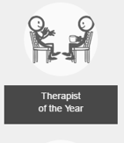


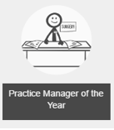




Slide 4

The winner of this category will:
Work in a care home, in any job role or position
Have made a real difference to the residents in their care home, in the last 12 months
Will be someone who doesn’t often get the recognition they deserve for the fantastic job they do

Slide 5

The winner of this category will:
Work in a nursery or other early years establishment, in any job role or position
Demonstrate a passion for the early years sector and be dedicated to improving the quality of nursery care
Have made a real contribution to their establishment in the past 12 months

Slide 6

The winner of this category will:
Have worked as a practice manager within the last 12 months
Have demonstrated commitment to the improved quality of care in their practice
Have, in the last 12 months, evidence of putting the needs of patients first

Slide 7

The winner of this category will:
Be in some way involved in foster care, including but not limited to: a foster carer; working in a fostering agency or local authority; a social worker or someone in foster care
Demonstrate a passion for foster care
Have made a real contribution to improving the quality of care for foster children during 2016

Slide 8

The winner of this category will:
Have volunteered for a charity or not-for-profit organisation in the last 12 months
Have demonstrated a passion for supporting a charity by giving up their own time to help raise funds and awareness
Have shown commitment to the long-term success of a charity or not-for-profit organisation

Slide 9

The winner of this category will:
Work in the home care sector, in any job role or position – which can include shared lives and private care
Have made a real difference to the life/lives of the person/people they provide care to in the last 12 months
Will be someone who doesn’t often get the recognition they deserve for the fantastic job they do

Slide 10

The winner of this category will:
Be any type of therapist, including but not limited to: talking, alternative or complementary
Be someone who has demonstrated creative ways of supporting their clients
Have used their experience in the field to develop a new or improved technique for helping and supporting clients

Slide 11

‘Towergate Care Awards Winner of 2017’
Judges will award to just one of our finalists and the winner will be revealed on the day! The winner of this special award will receive a £2,500 Virgin holiday voucher to pay for a well-deserved break.

Slide 12


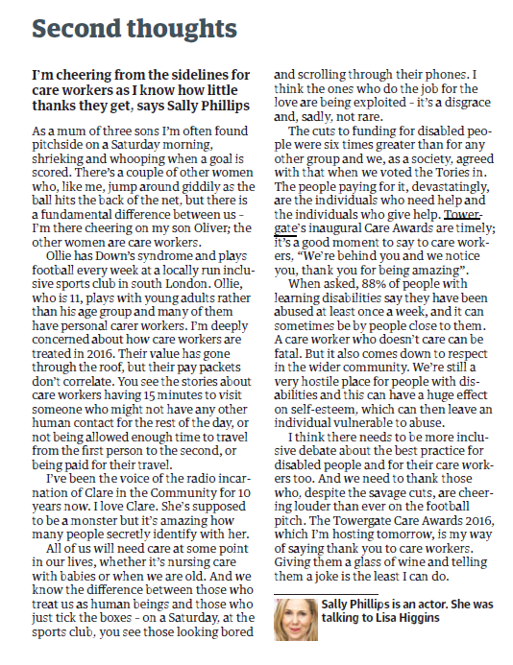

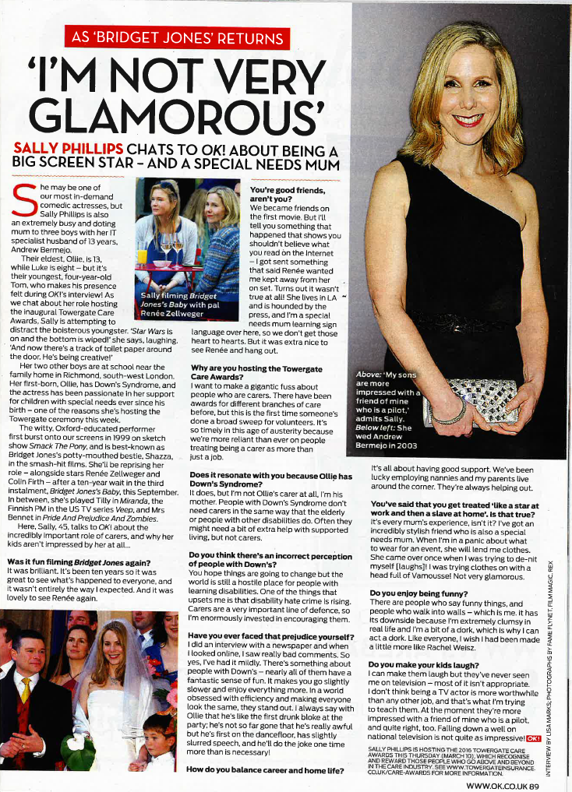

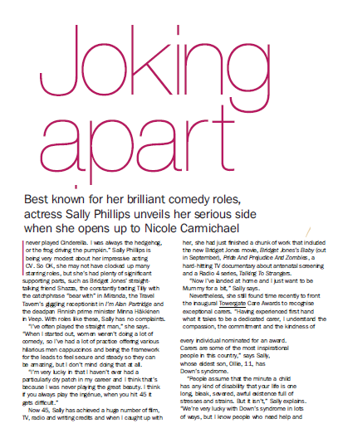
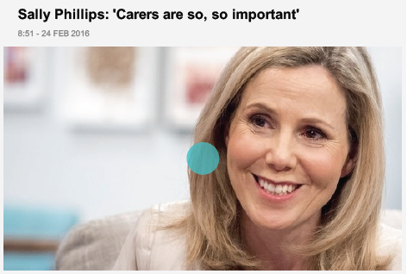
2016 National Coverage

Slide 13
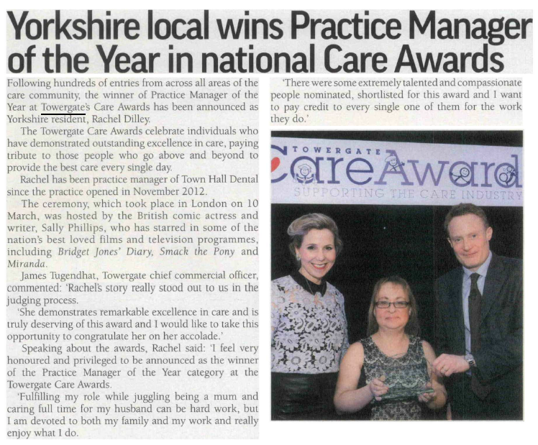
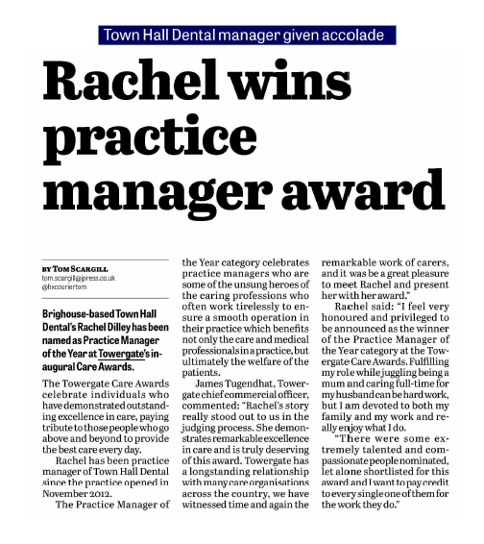
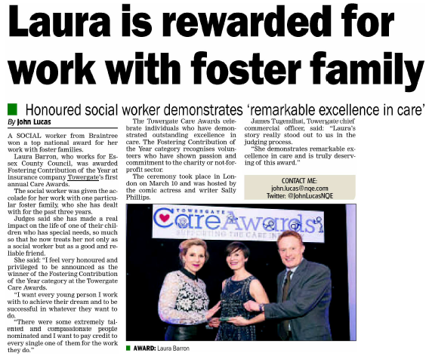
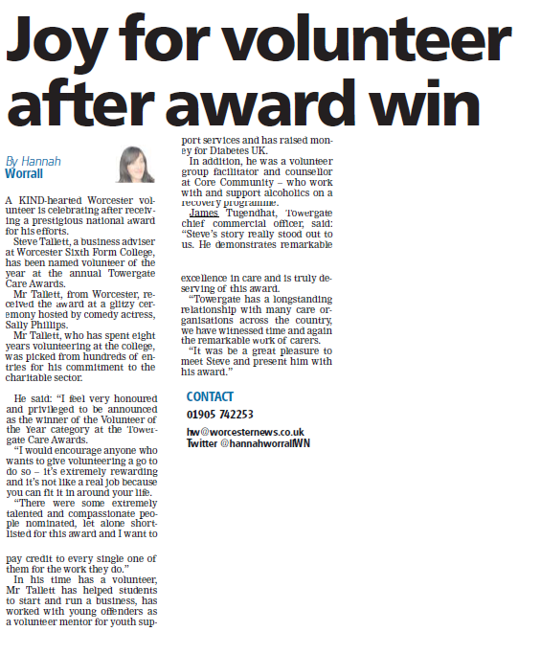
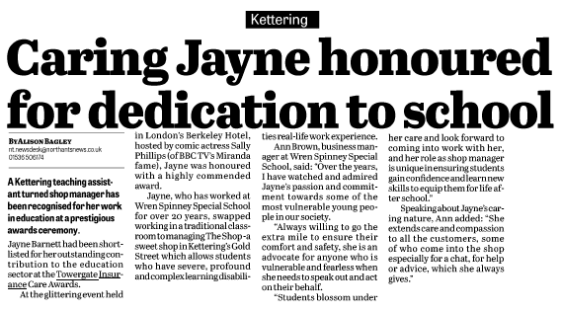
2016 Regional Coverage

Slide 14
For more information on the Towergate Care Awards 2017
Visit: www.towergateinsurance.co.uk/care-awards

Slide 15



