Slide 1
Explore The Never-ending Jaunting Spot - Dubai Desert Safari

Slide 2
Dubai Desert Safari is known as the city of excess and you can have anything here that you want. Further, there are a ton of paid sites that assist you with getting the visits at the limits of great Desert Safari Dubai. Likewise, Dubai is a formal spot for any nomad due to its splendor. The shopping stores, and the mid-night parties event shows its entirely rousing desert safari from the Dubai experience.

Slide 3
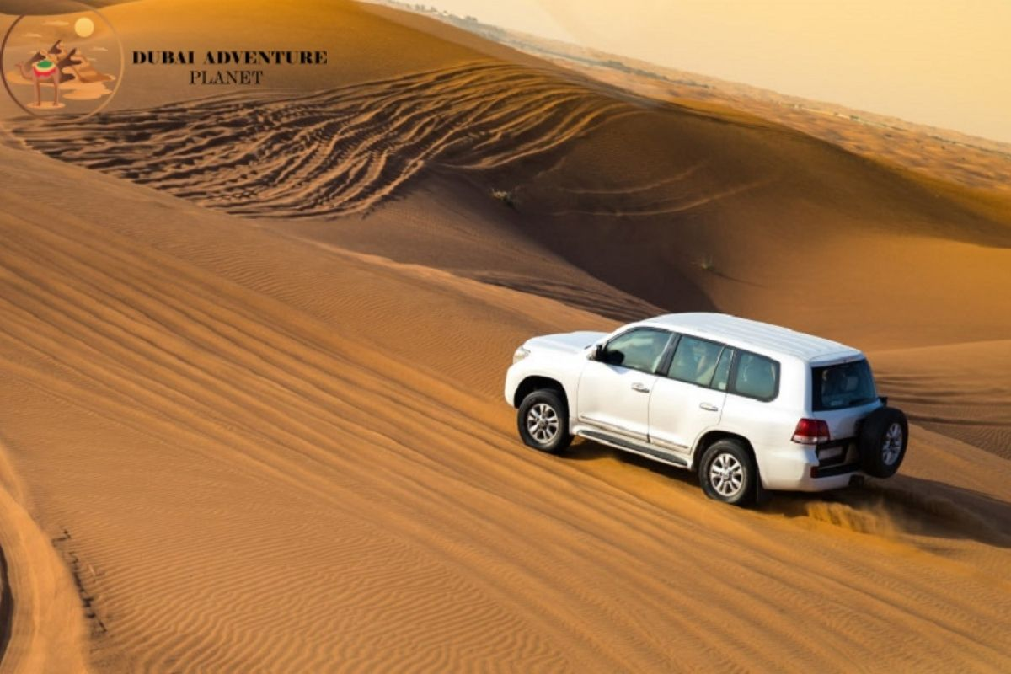

Slide 4
On the off chance that you are spending a few days in Dubai and you didn't visit the Desert Safari Dubai Location then you haven't seen anything at this moment. The further this isn't just the Desert in Dubai this is the cosmos of the class and its estate. The heritage has exhorted no sort of class when contrasted with any treat. There are a ton of things exposed in this Safari Desert Dubai and the rides are known as the best safari rides.
Book Desert Safari: desertsafaris-uae.com

Slide 5
Later, the camp wakes up with pounding amazing Arabic beats and incredible Belly Dancing shows, and these are well known worldwide as the nightfalls. Male craftsmen in Desert Safari Tour will play out an Arabic Tanura Dance as well as exciting light or Fire Show. However, our great Desert Safari from Dubai staff would set up the supper buffet and live grill counter while the joy is on.

Slide 6
The hill buggy is one of the most impressive buggy rides in Safari Deals further you can travel blissfully in the entire desert. The buggy will haul you from the car behind on the ridge of the desert with the 4x4 car. The quad bike in safari is the ride best for hustling and dining in the hills of the Desert in Dubai for up and downhills. Individuals love the rides with their husbands in the entire incredible Desert Safari Dubai Tour with the best tracks of the safari Dubai rides.

Slide 7
The safari drivers are very much shared for Dubai Safari Desert. They have a total thought of the Desert Safari Tour and where they take you. Indeed, the Safari Deals driver takes a total liking in any event, when you get down on stoppages. Desert Safari Tour is the entire bundle that is for rides in the desert. Just like the Dune slamming is well known and nicest for riding on the tough sandhills.
Book Evening Desert Safari: bestdesertsafaridubai.net

