Slide 1

Remodel Your Home by Home Renovation in Cambridge

Slide 2

As you know, home is more than just a place to sleep; it's a place to unwind, get comfy, entertain friends, and feel safe with your family. Renovation necessitates extensive planning to ensure that professionals address all areas of your house.

Slide 3
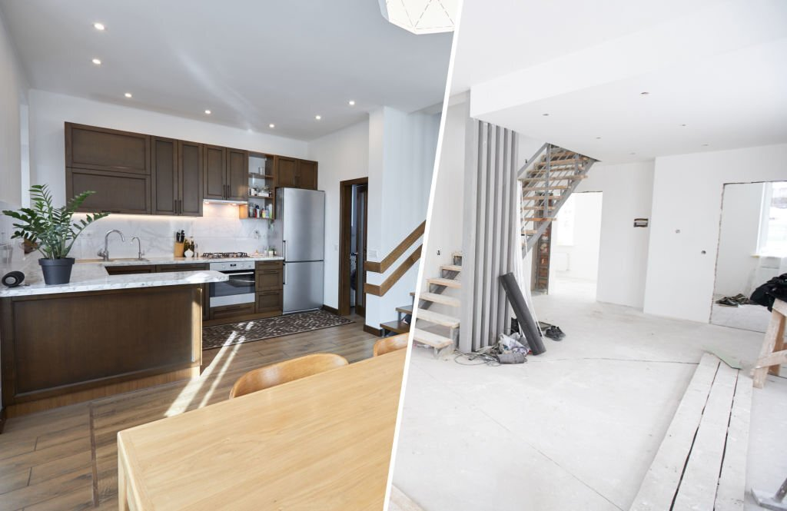
A home remodeling project can be complex and intimidating. Still, it can also be exciting and full of surprises, especially when you are in the process of selecting the best renovation services and working with the top home renovation businesses for home renovation in Cambridge.

Slide 4
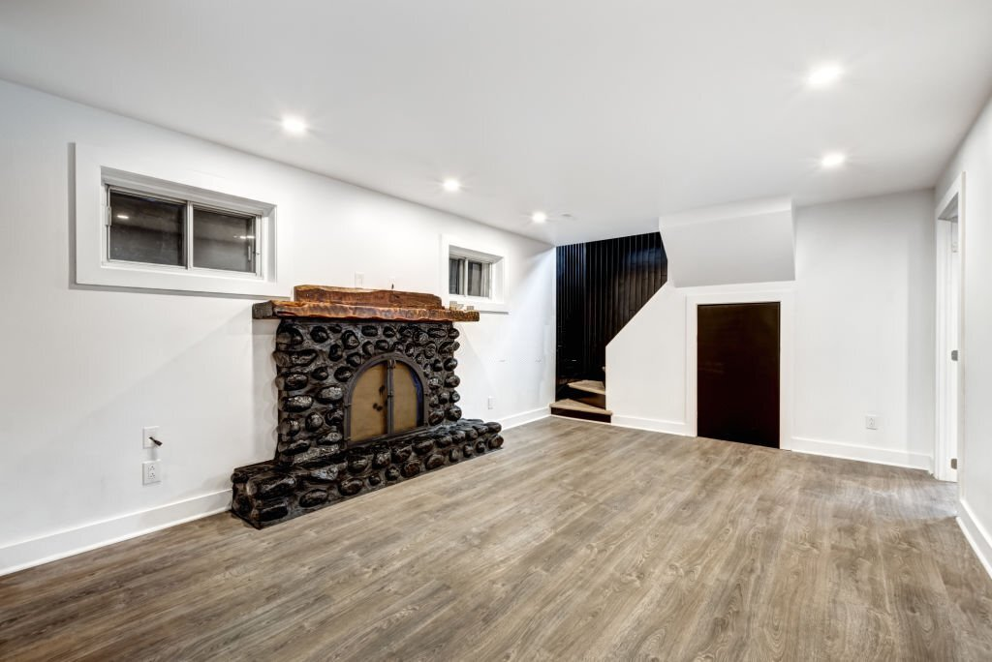
Why Should Your Basements be Well Maintained?
Basements are a vital element of any home and should be well-maintained. Basement improvements can increase the value of your home while also making it more comfortable and pleasurable. Moreover, you can convert basements into additional living space, storage, or a home office.

Slide 5
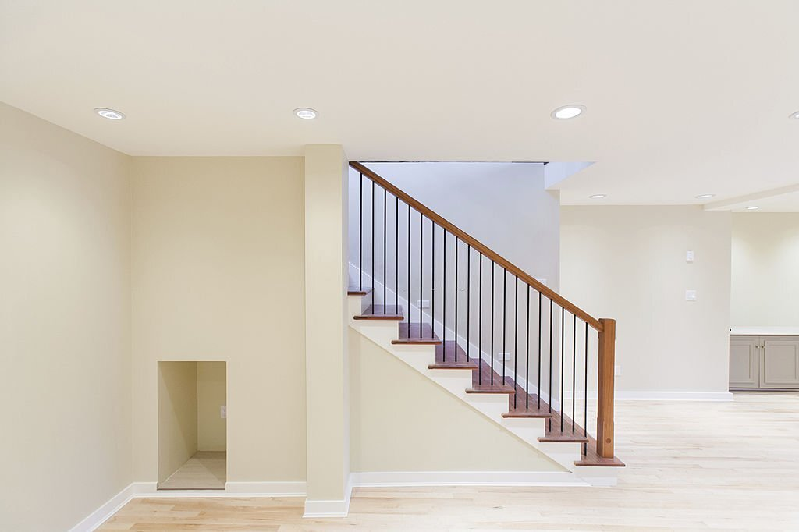
There are a few things to consider if you plan a basement renovation in Cambridge. To begin, ensure that your basement is adequately insulated and waterproof. Second, you must select the best contractor for the project. A skilled contractor will be able to assist you in planning and carrying out your basement remodeling in a way that matches both your needs and your budget.

Slide 6
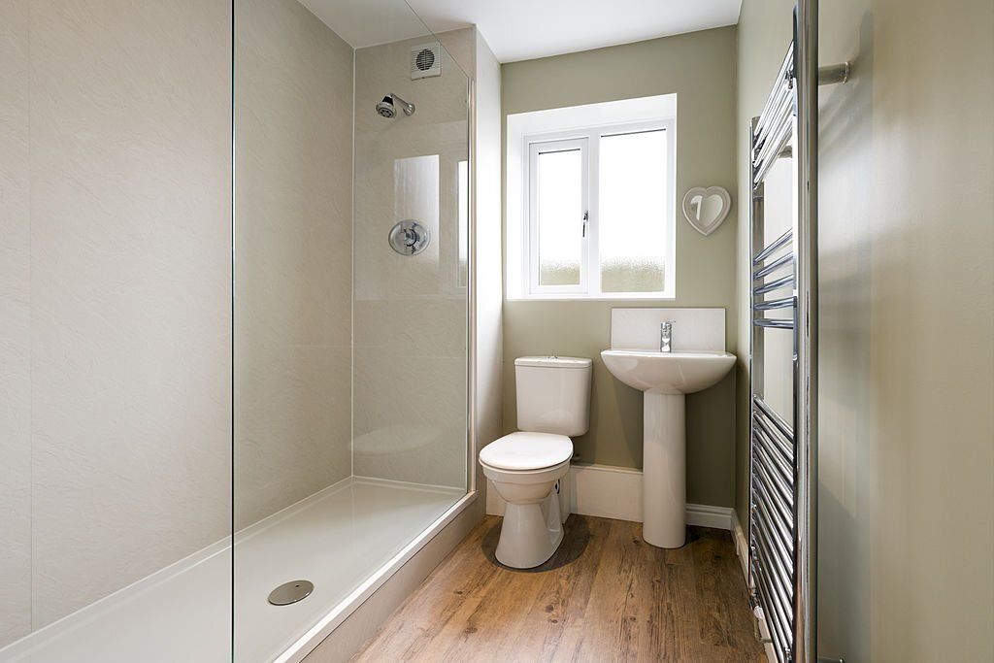
Bathroom Renovation Helps to Increase the Functionality of Your Home
Bathroom remodeling is crucial for a variety of reasons:
Hiring professionals for bathroom renovation in Cambridge can increase the functionality of your bathroom.
It can make your bathroom more pleasant and comfy.
It has the potential to raise the value of your home.
It can give you a sense of accomplishment and pride in your home.

Slide 7
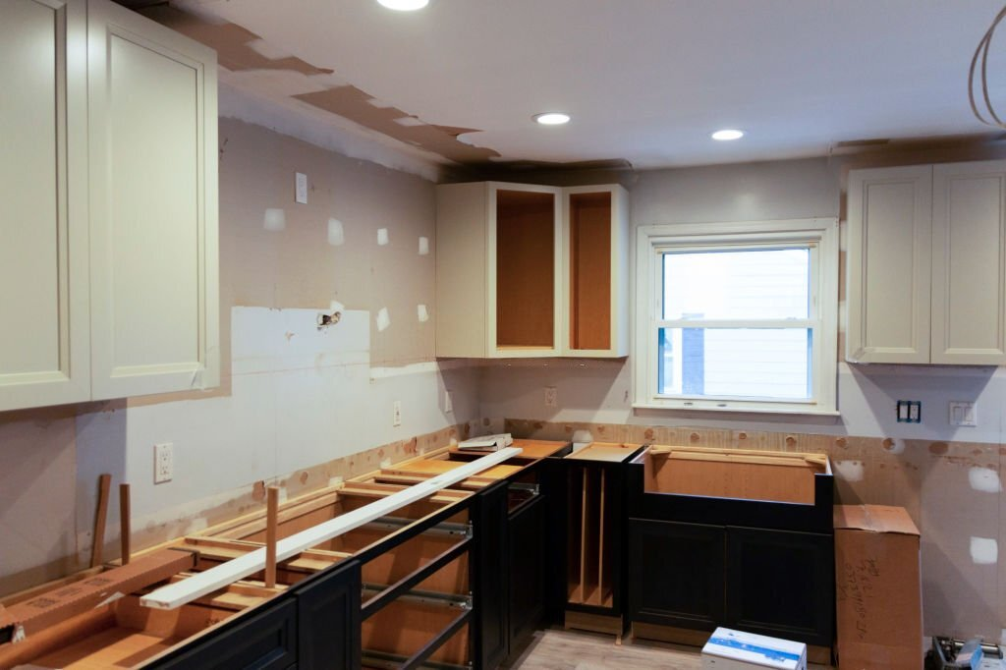
Hire Experienced People for Kitchen Renovation
As the kitchen is one of the most significant rooms in the house, it makes sense to have it renovated by a professional. Suppose you hire knowledgeable professionals for kitchen renovation in Cambridge.

Slide 8
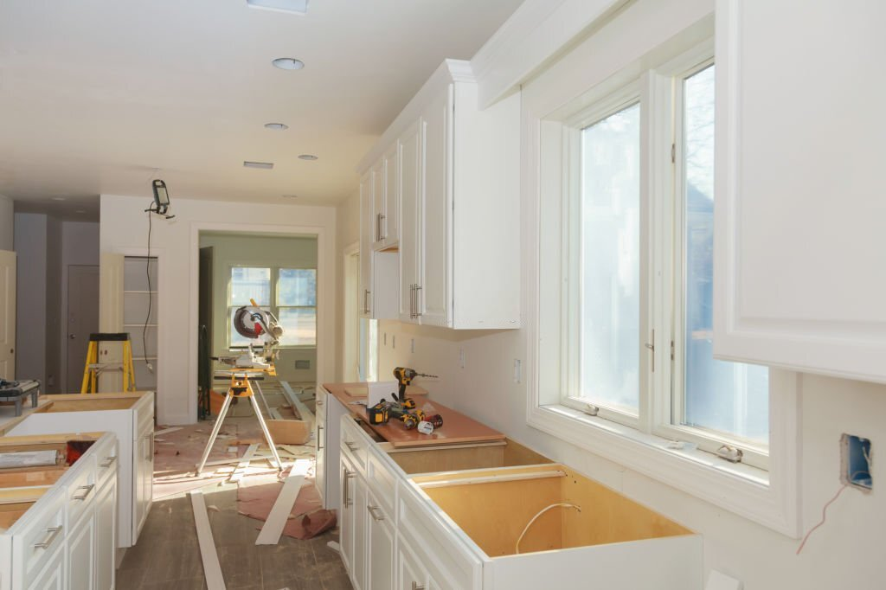
In that case, they will properly assess the space and devise a strategy that matches your requirements, but they will also be able to implement it flawlessly.

Slide 9
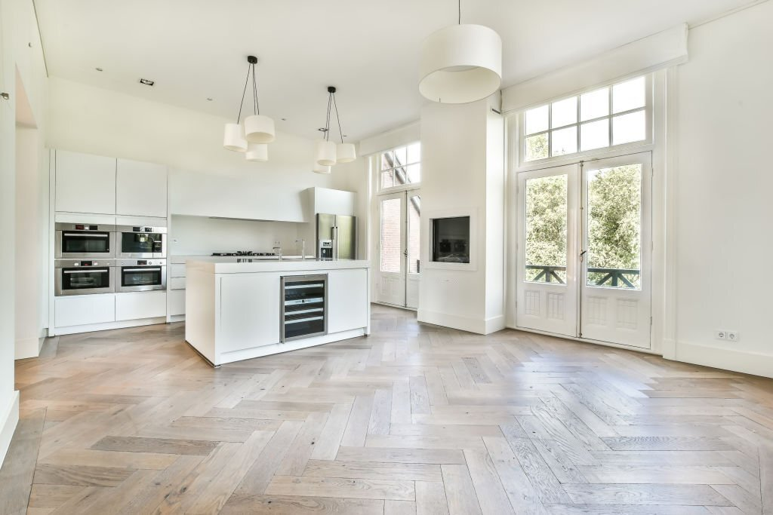
Furthermore, they can handle any unexpected complications that may develop along the route. Ultimately, you'll have a kitchen that looks and operates precisely how you want it to, which is well worth the expense.

Slide 10

Do You Want to Get the Best Outcomes for Flooring?
Regarding flooring, it is critical to engage professionals to ensure they do the job correctly. Flooring is a significant investment for any house or business, so you want it done well the first time. Professionals have the knowledge and skills to install many types of flooring, including hardwood and carpet.

Slide 11

Professionals providing flooring services in Cambridge can advise you on the best flooring for your room based on your requirements and budget. Furthermore, professionals can give you a warranty on their work, ensuring that your floor will last for years.

Slide 12

Bathroom renovation is a large project, but it is well worth the work. You will be able to reap all of the benefits of renovating your bathroom if you take the time to hire Kinnaird Contracting professionals.

Slide 13


