Slide 1
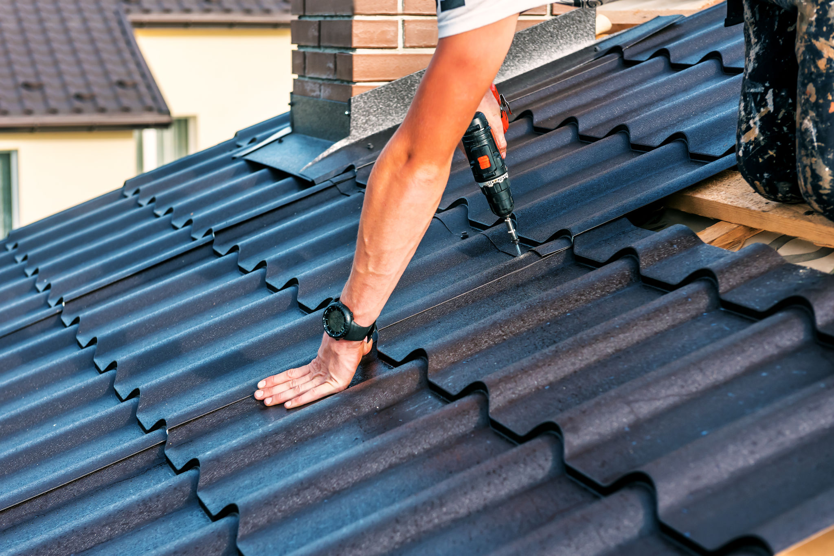
Prevent leaks in your roofing by hiring roofing specialists in Edmonton

Slide 2
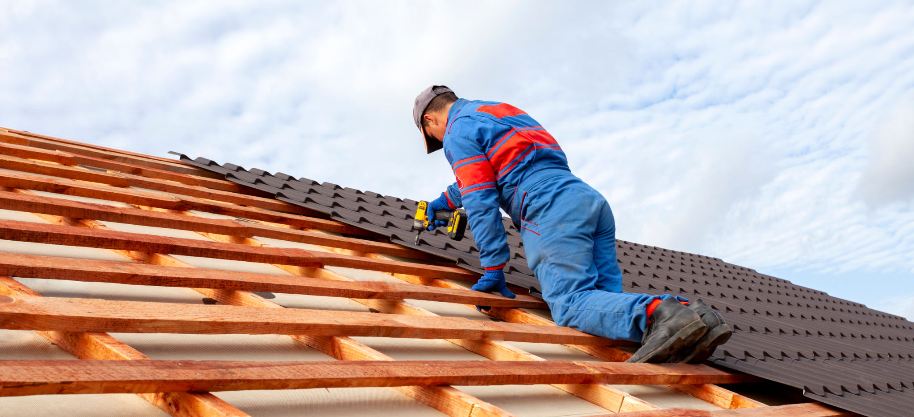
You need to understand that residential roof replacement in Edmonton is a significant investment, and you should replace your roofs when there is a good reason. You need to consider a roof replacement if there are large cracks in the top

Slide 3
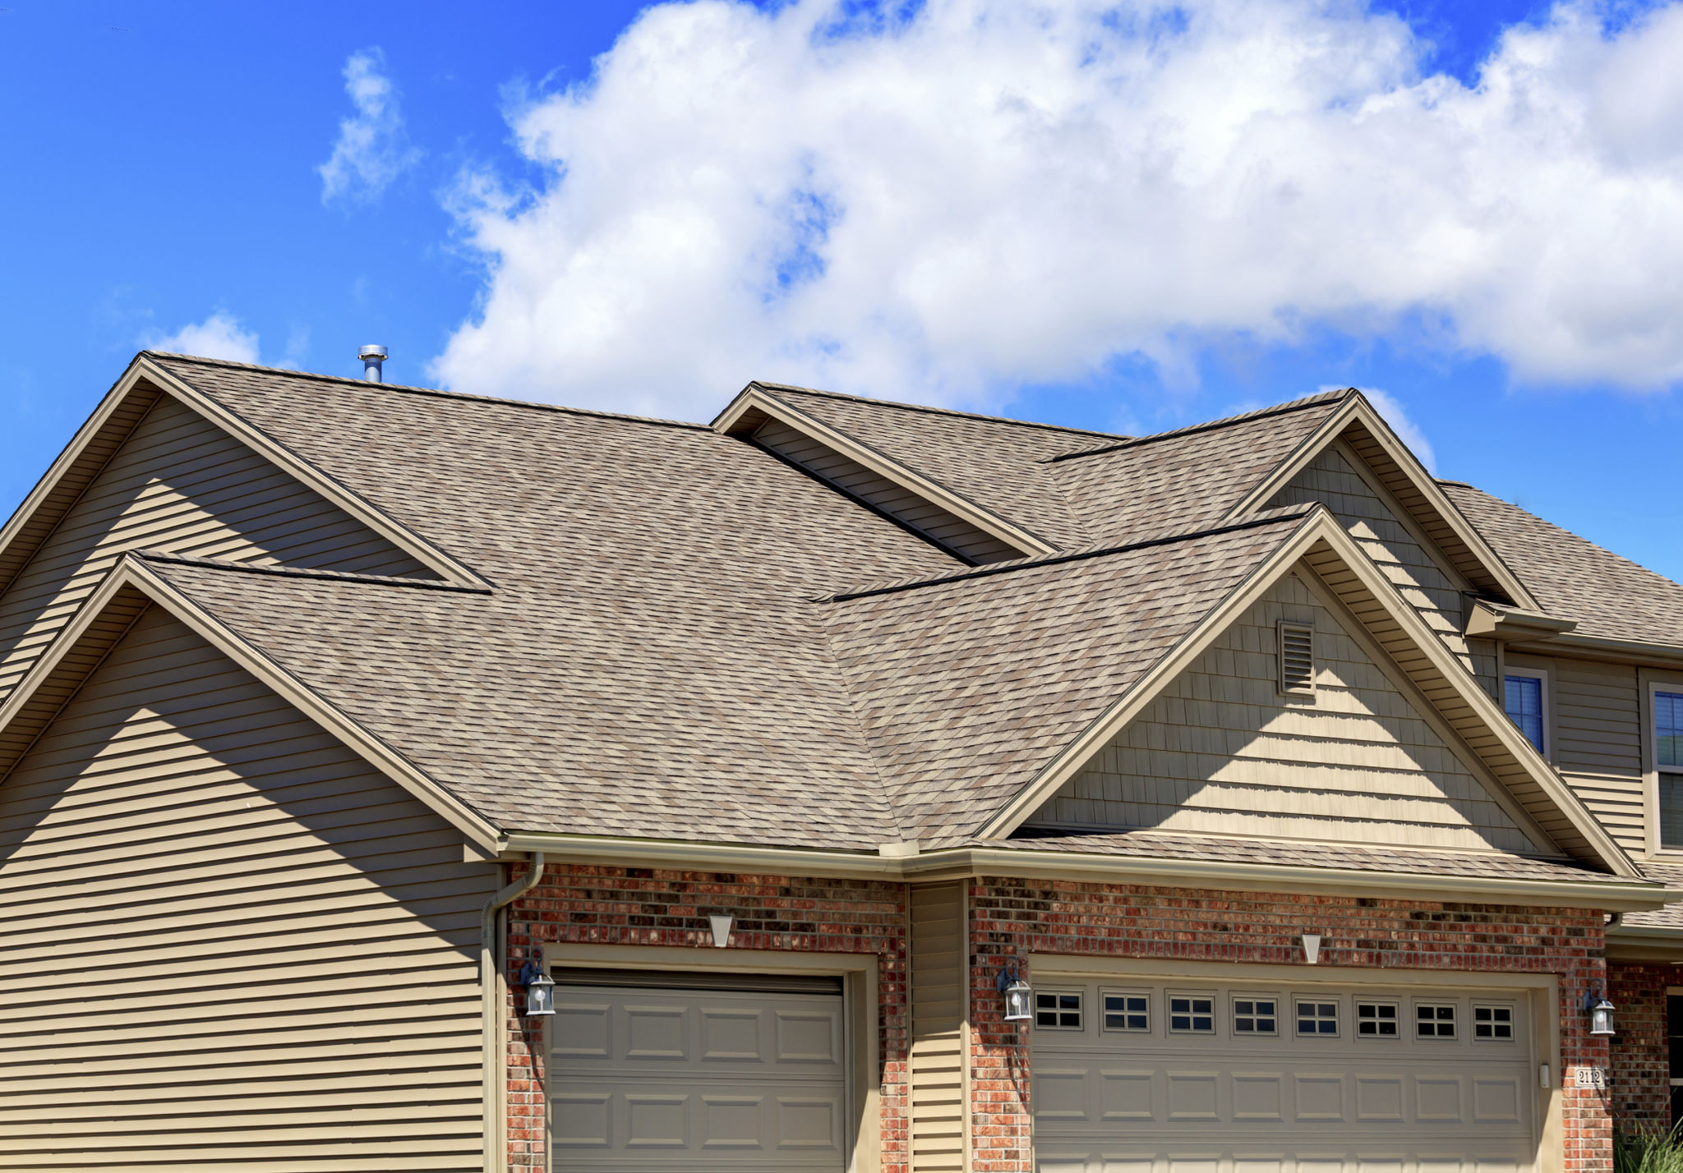
the roof gets damaged in a storm, or the roof is starting to leak. Residential roof replacement is a necessary process for homeowners. It is not only about the cost of repairs but also about the family's safety. Hiring professionals from the best roofing company in Edmonton is essential to any home.

Slide 4
They help to protect the structure of the building and keep it safe from various weather elements. However, roofing companies can be challenging to find and reach out to when you need them.

Slide 5
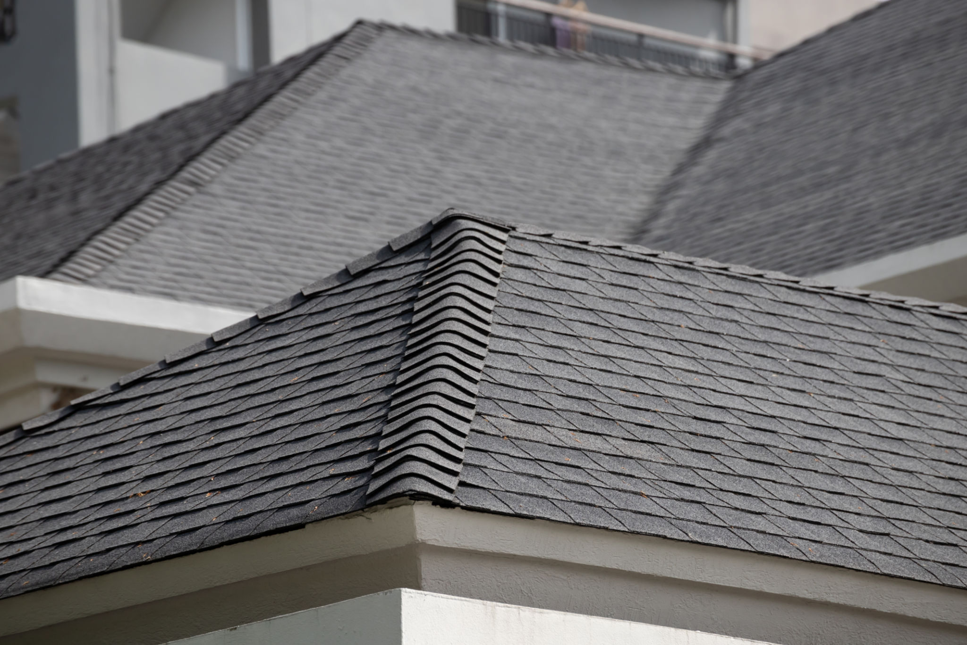
Are you familiar with the significance of roofing in your home?
You may not be aware of the importance of roofing in your home. It is one of the essential parts of your house, so you should not be overlooked. Roofing specialists are needed to provide expert advice on the best roofing material for your home or business.

Slide 6
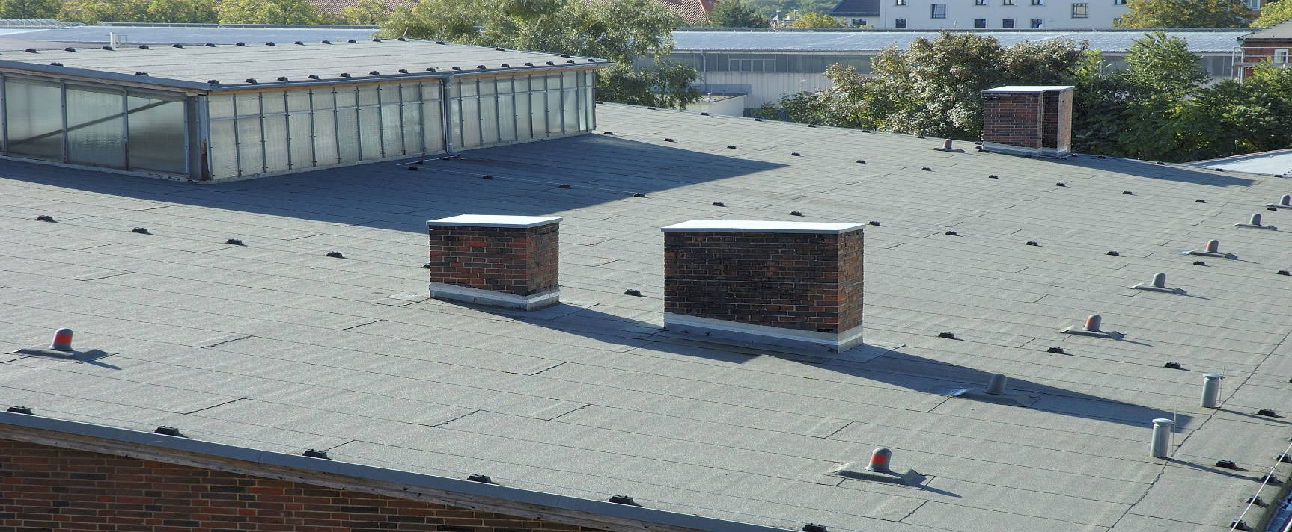
Hiring roofing specialists in Edmonton is essential because it can help prevent leaks and save money on your energy bill; it will also protect your home or business from damage caused by storms and other natural disasters. There is a lot of work involved in roofing. It consists of the work of many professionals who specialize in different areas.

Slide 7
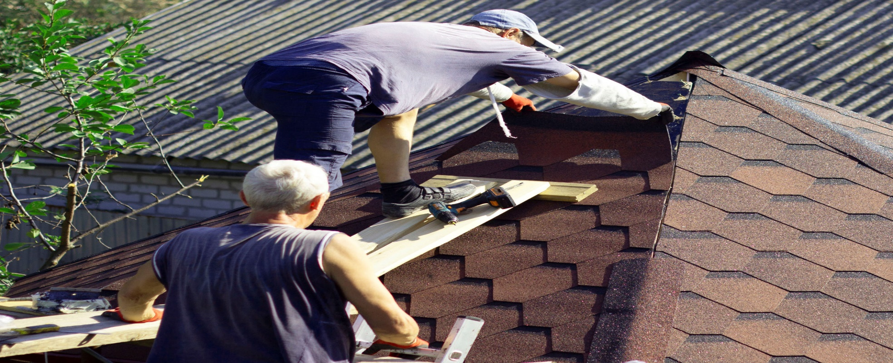
How roofing specialists can provide you with effective roofing services
Roofing specialists in Edmonton know how to handle the different types of materials and tools that they use. They also know how to get their roofs done promptly and at a reasonable cost. Some of the benefits of hiring a rooftop specialist are:
They can perform inspections for property maintenance.
They can renovate roofs based on construction needs and improve the property's looks at once!

Slide 8
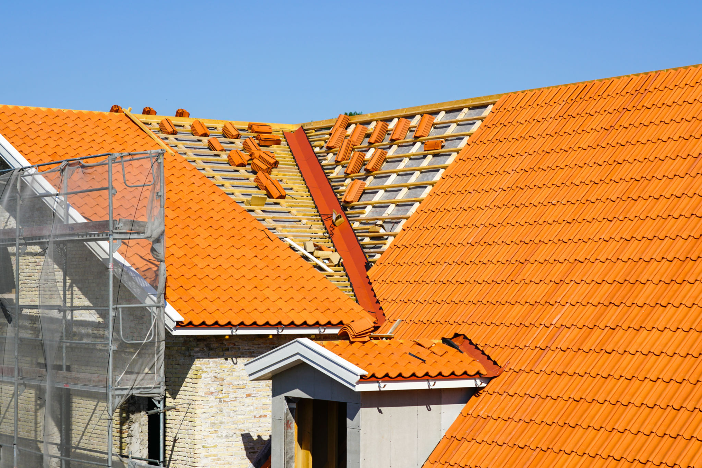
All you should know about flat roofing
It is better to hire experts for flat roofing in Edmonton. Flat roofs are safer than sloped roofs and have a longer lifespan. A flat roof is not just aesthetically pleasing; it is safer and lasts longer.

Slide 9
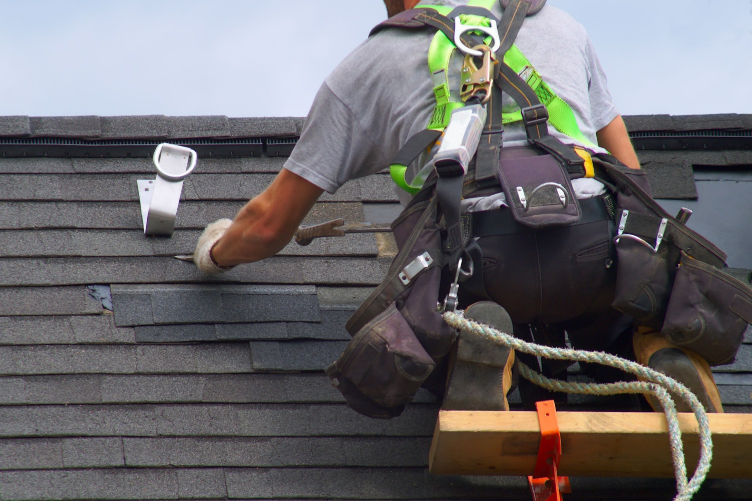
The top doesn't leak because water can't pool on it, so you won't have to worry about mold or mildew. Hence, flat roofs are easy to maintain, have fewer leaks, and are more energy-efficient than other types of roofs. Additionally, professionals install them in a variety of architectural styles.

Slide 10
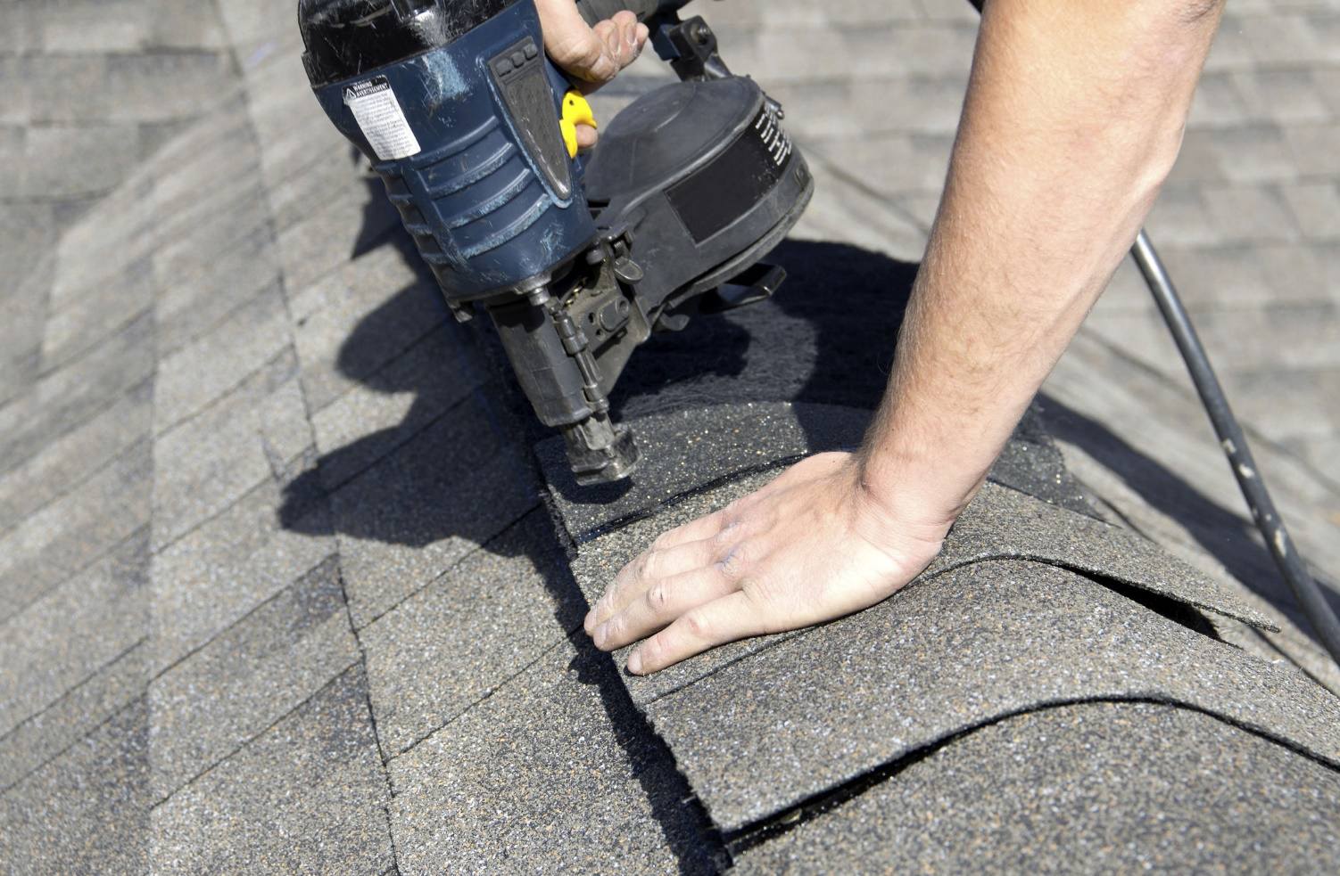
Flat roofs are also great for homeowners who want to install their own solar panels or solar windows. Flat roofs are an effective way to add additional living space in the attic or roof itself.

Slide 11
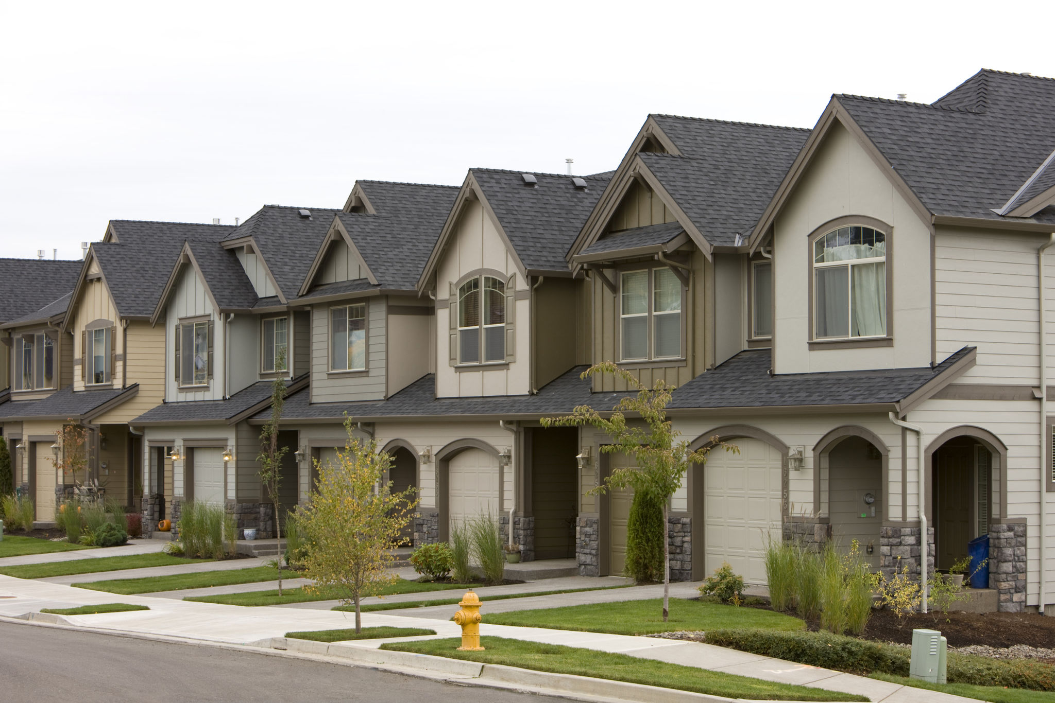
A residential roof replacement is a significant construction project that can be expensive and difficult to complete. With the help of Anco Home Improvements Ltd professionals, homeowners can save money and get professional results.

Slide 12
Related Articles
Hire knowledgeable professionals for residential roofing in Edmonton
Add aesthetic value to your property by getting Roofing in Edmonton
Do you want professional new roof installation in Edmonton?
Why should you not neglect Roofing Services in Edmonton?
When does a Roof Replacement in Edmonton make sense?
Where is the Best Residential Roofing in Edmonton?

Slide 13
Contact Info
Business Address: 16533 105a Ave NW, Edmonton, AB T5P 0V6, Canada
Business: Phone: 780-439-5553
Business Email: ancoroof87@gmail.com
client name: Dave Pullin

Slide 14
Social Media Info
Twitter Tumblr Pinterest Google Map

Slide 15


