Slide 1
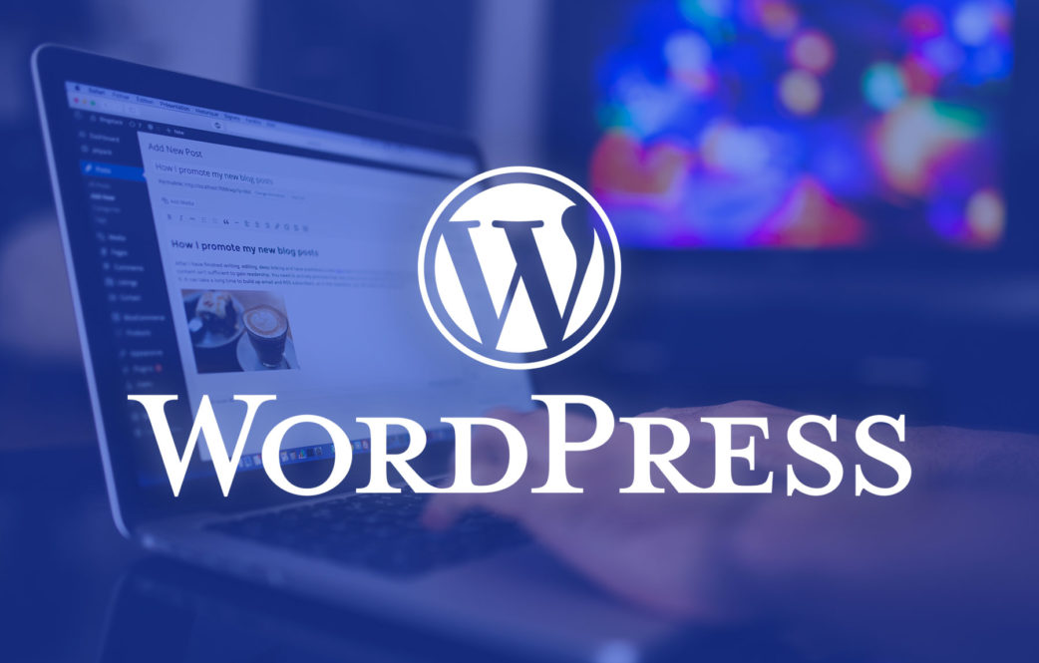

What is WordPress All About?

Slide 2
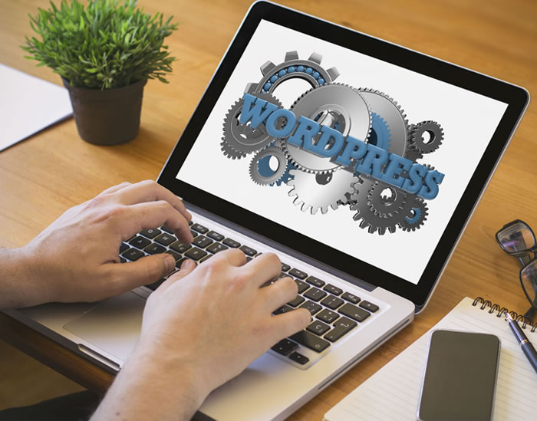
Understanding WordPress
WordPress is undoubtedly the most easiest and popular way to build your perosnal blog or website. As a matter of fact, a whopping 43% of websites that you see on the internet are powered by WordPress. So, it is the most popular website design tool. A lot of people prefer WordPress website development as it is user-friendly and cost-effective. This open-source content management system is licensed under GPLv2. So, this means any person can both use or modify the software without any hassle-free of cost.

Slide 3
Types of Websites Made By WordPress
Initially, WordPress was used to create blogs rather than making websites. WordPress website design in Dubai has become extremely sought after. There are so many different kinds of websites are made by WordPress. These include:
Portfolios
eCommerce websites
Business websites
Blogs
Resumes
Social Networks
Forums
Membership Sites

Slide 4
What is the Difference Between WordPress.com and WordPress.org?
WordPress.org is most commonly referred to as self-hosted WordPress. It is a free-of-cost, open-source WordPress software. This can be easily installed on your web host. It is used to build a website that is yours 100%. So, it is your ownership without any contention.
WordPress.com is a paid service. It is powered by WordPress.org software. Even though it is extremely easy to use, you end up losing a lot of flexibility that comes with self-hosted WordPress.
Majority of the cases, when people use the term “WordPress”, it means the self-hosted WordPress that you get at WordPress.org. For superb Website design in Dubai hire the best custom website development service, providers.

Slide 5
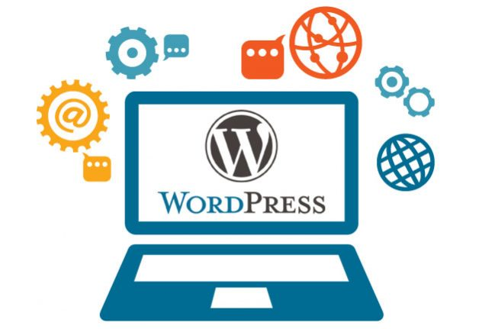
Who Can Use WordPress?
WordPress can be used by big business concerns, individuals, and just about anybody that wishes to use it. Even several well-known entities make use of WordPress such as whitehouse.gov is a WordPress site and then Microsoft also uses WordPress to power blogs for its products such as Skype, Windows, etc.

Slide 6
Why Should You Use WordPress?
There are several reasons why the use of WordPress is encouraged.
1. WordPress is open-source and free of cost- One of the biggest advantages of WordPress is that it does not cost anything. There is no money charged for the
WordPress software. You just have to pay a small sum for hosting. You will also find several themes and open-source plugins that will change the functionality and look of your website.
2. It is Extensible- Even if you are not a developer you can alter your website by using themes and plugins offered by WordPress. Themes change the whole look of your site whereas plugins alter the way how your website works.
3. Easy to Install- You do not have to be a tech guru to build your website and this is because of WordPress. With just a click of a few buttons, the entire work is done.

Slide 7
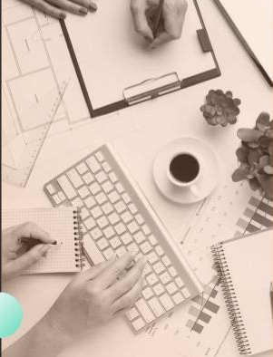
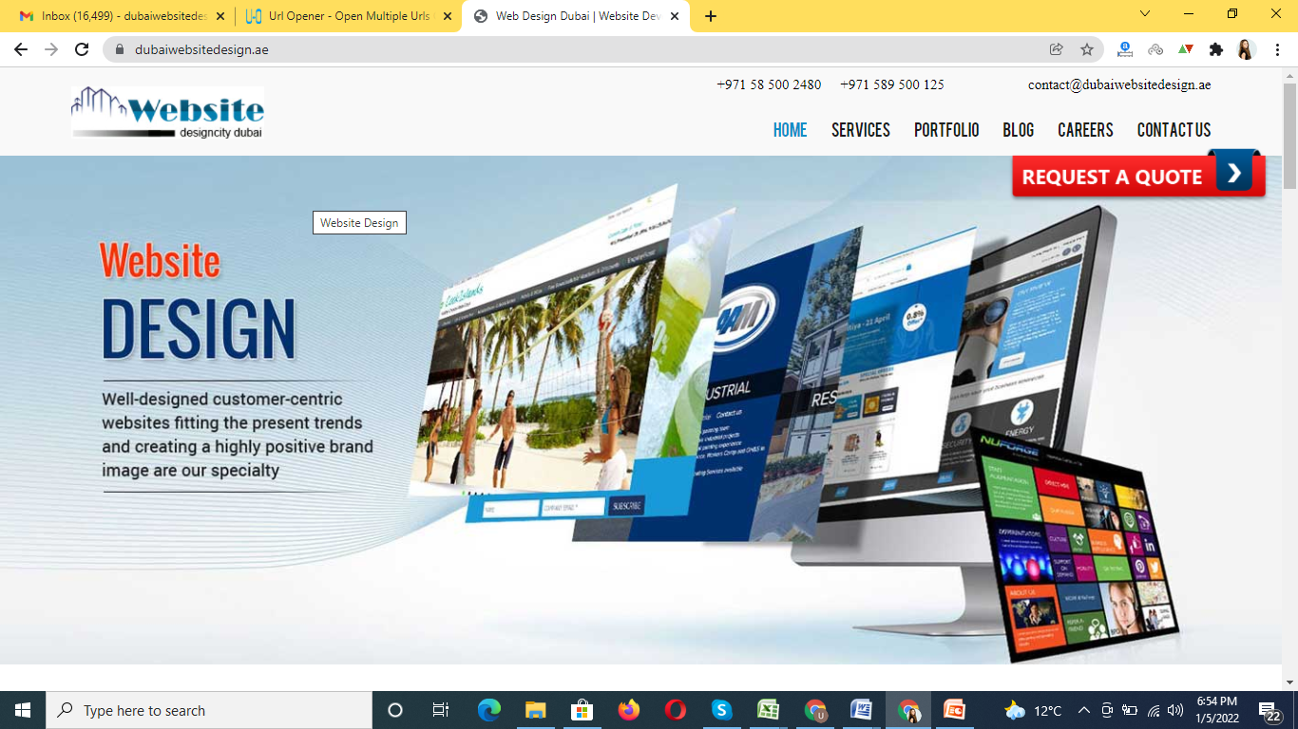

Thank You
https://www.dubaiwebsitedesign.ae/

