Slide 1
Dhow cruise tour sketch

Slide 2
Dubai tours are well Known. There the best part of tour is going towards the Dhow cruise. This side of Dubai is specially known. The tours are really going to give you ideal tour. There is the proper managing team to handle this. The tours are going to make your day more attractive. With full of facilities this point is best. The tour includes all of the perfect visiting facilities. This tour is involving different types of setups. A proper guideline related to tour is also available for you. This is the type of tour you will not be going to miss. There is the proper arrangement for your comfort.

Slide 3
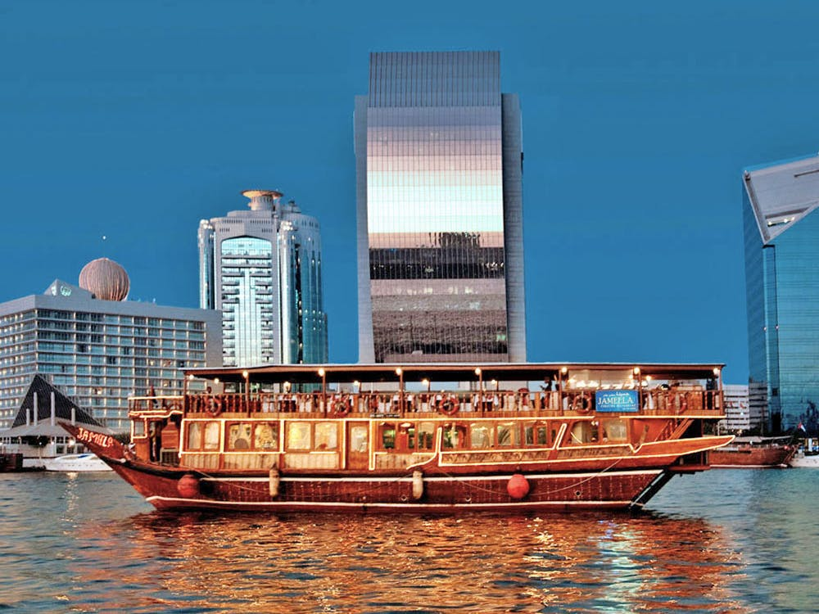

Slide 4
There the Dhow Cruise Dubai options are available in different routines. The amount of these dreams are surely making the best invited shows in this. This dhow cruise version is the most known quality type tour here. The tours are available within this special routine. Enjoyment is the confirmation step here. The naturally available scenes are going to meet your type of excitement. The Dhow cruise excited option of experiences can be enjoyed there.

Slide 5
Dhow cruise is the touring point. This side of city is admired by many people. When you are going some where this side of tour you should need to keep on mind. This is the tour which will be going to announce best kind of shows. This tour point is introducing new sense to tours. The absolutely new dhow cruise features you will be going to find it amazing. This Dhow cruise option is known due to the feature. This is this magnificent boat.

Slide 6
The rare combination of the two decks are found in it. The popular function of this is to make you more comfortable. The upper one deck is going to make your tour more relaxing. There dhow cruise decks are ready to make your day more enjoyable. This purpose of the dhow cruise is to maintain your tour here. The decks are found to make your routine life easier. The planing through the decks are finally invented in this. These are going to make your plan perfect in this Dhow cruise.

Slide 7
The dancing and the other shows versions are really involved in this. The purpose of the show's is to make your time amazing. The shows ars really the perfect type of excited firms in this. The right option of the best inspiring moments in this. These dhow cruise acts are putting the latest modes of entertainment. The options are showing the right entertaining views.
Visit our website: dhowcruisedubai.org

