Slide 1

Make your home comfortable by getting heating services in Clapham

Slide 2
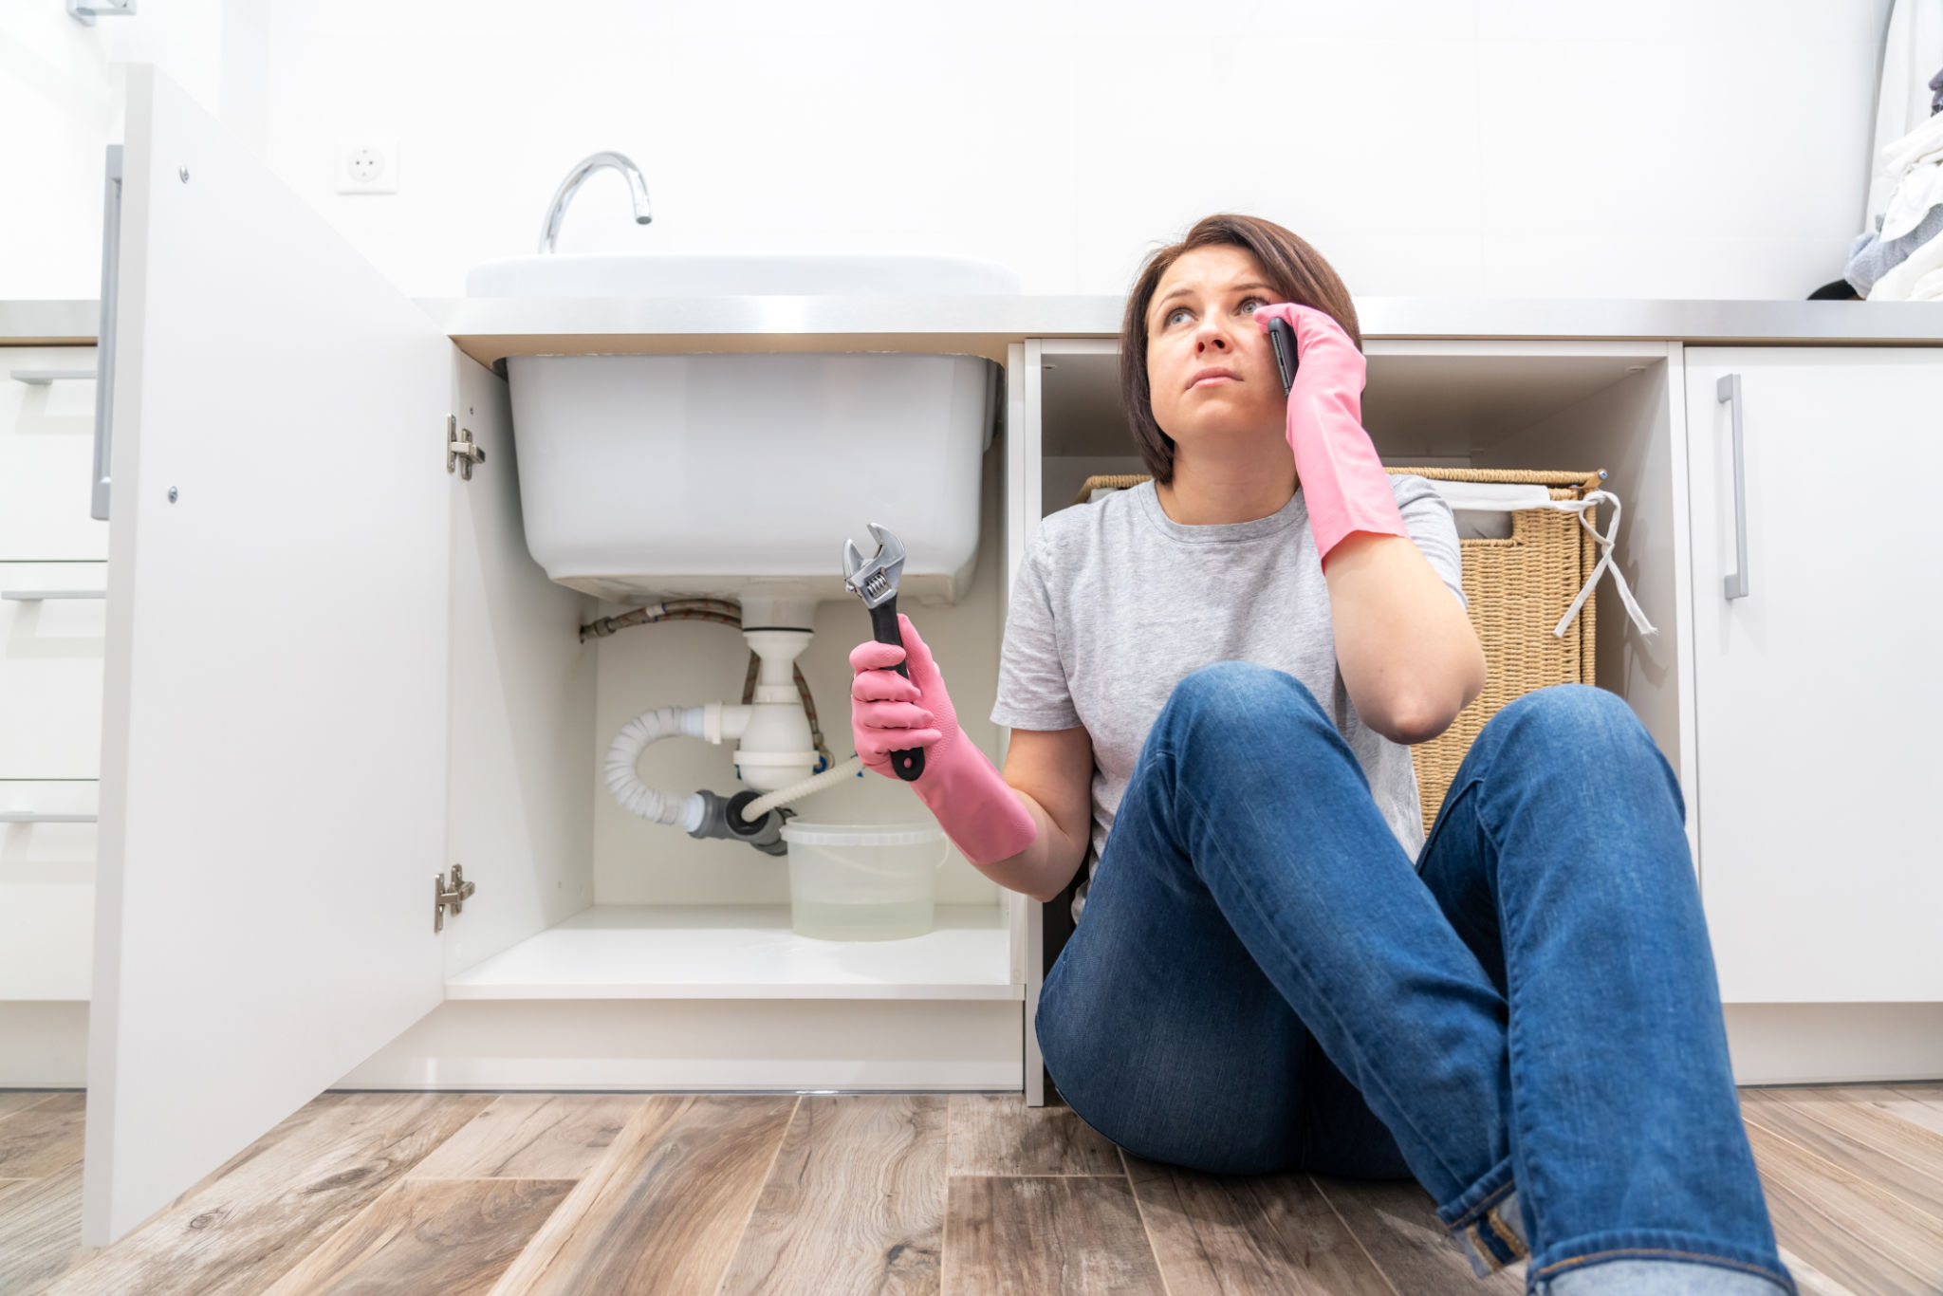
Getting plumbing services in Clapham is highly demanded these days. A house is only as good as the plumbing that runs through it. Without proper drainage, toilets and sinks will overflow, causing damage and costing you money. Plumbing services are essential to keeping your home in good shape.

Slide 3
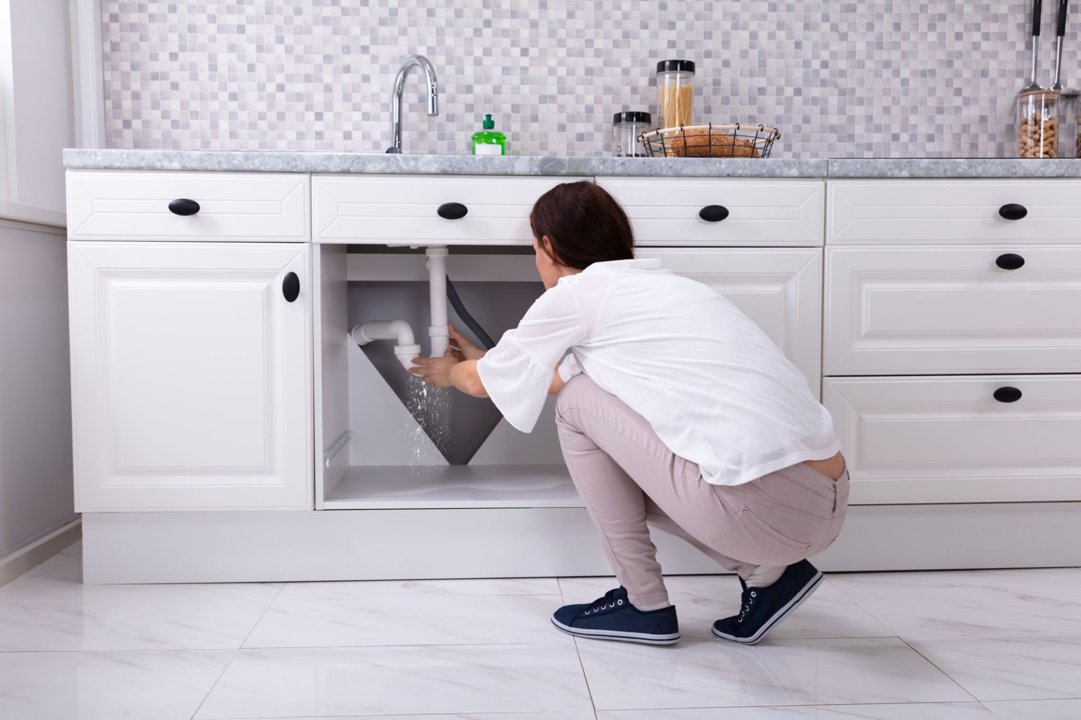
A plumber should be able to fix just about anything, and they can help solve household problems. By understanding the different plumbing types and understanding what can go wrong, you can get your home back to normal in no time.

Slide 4
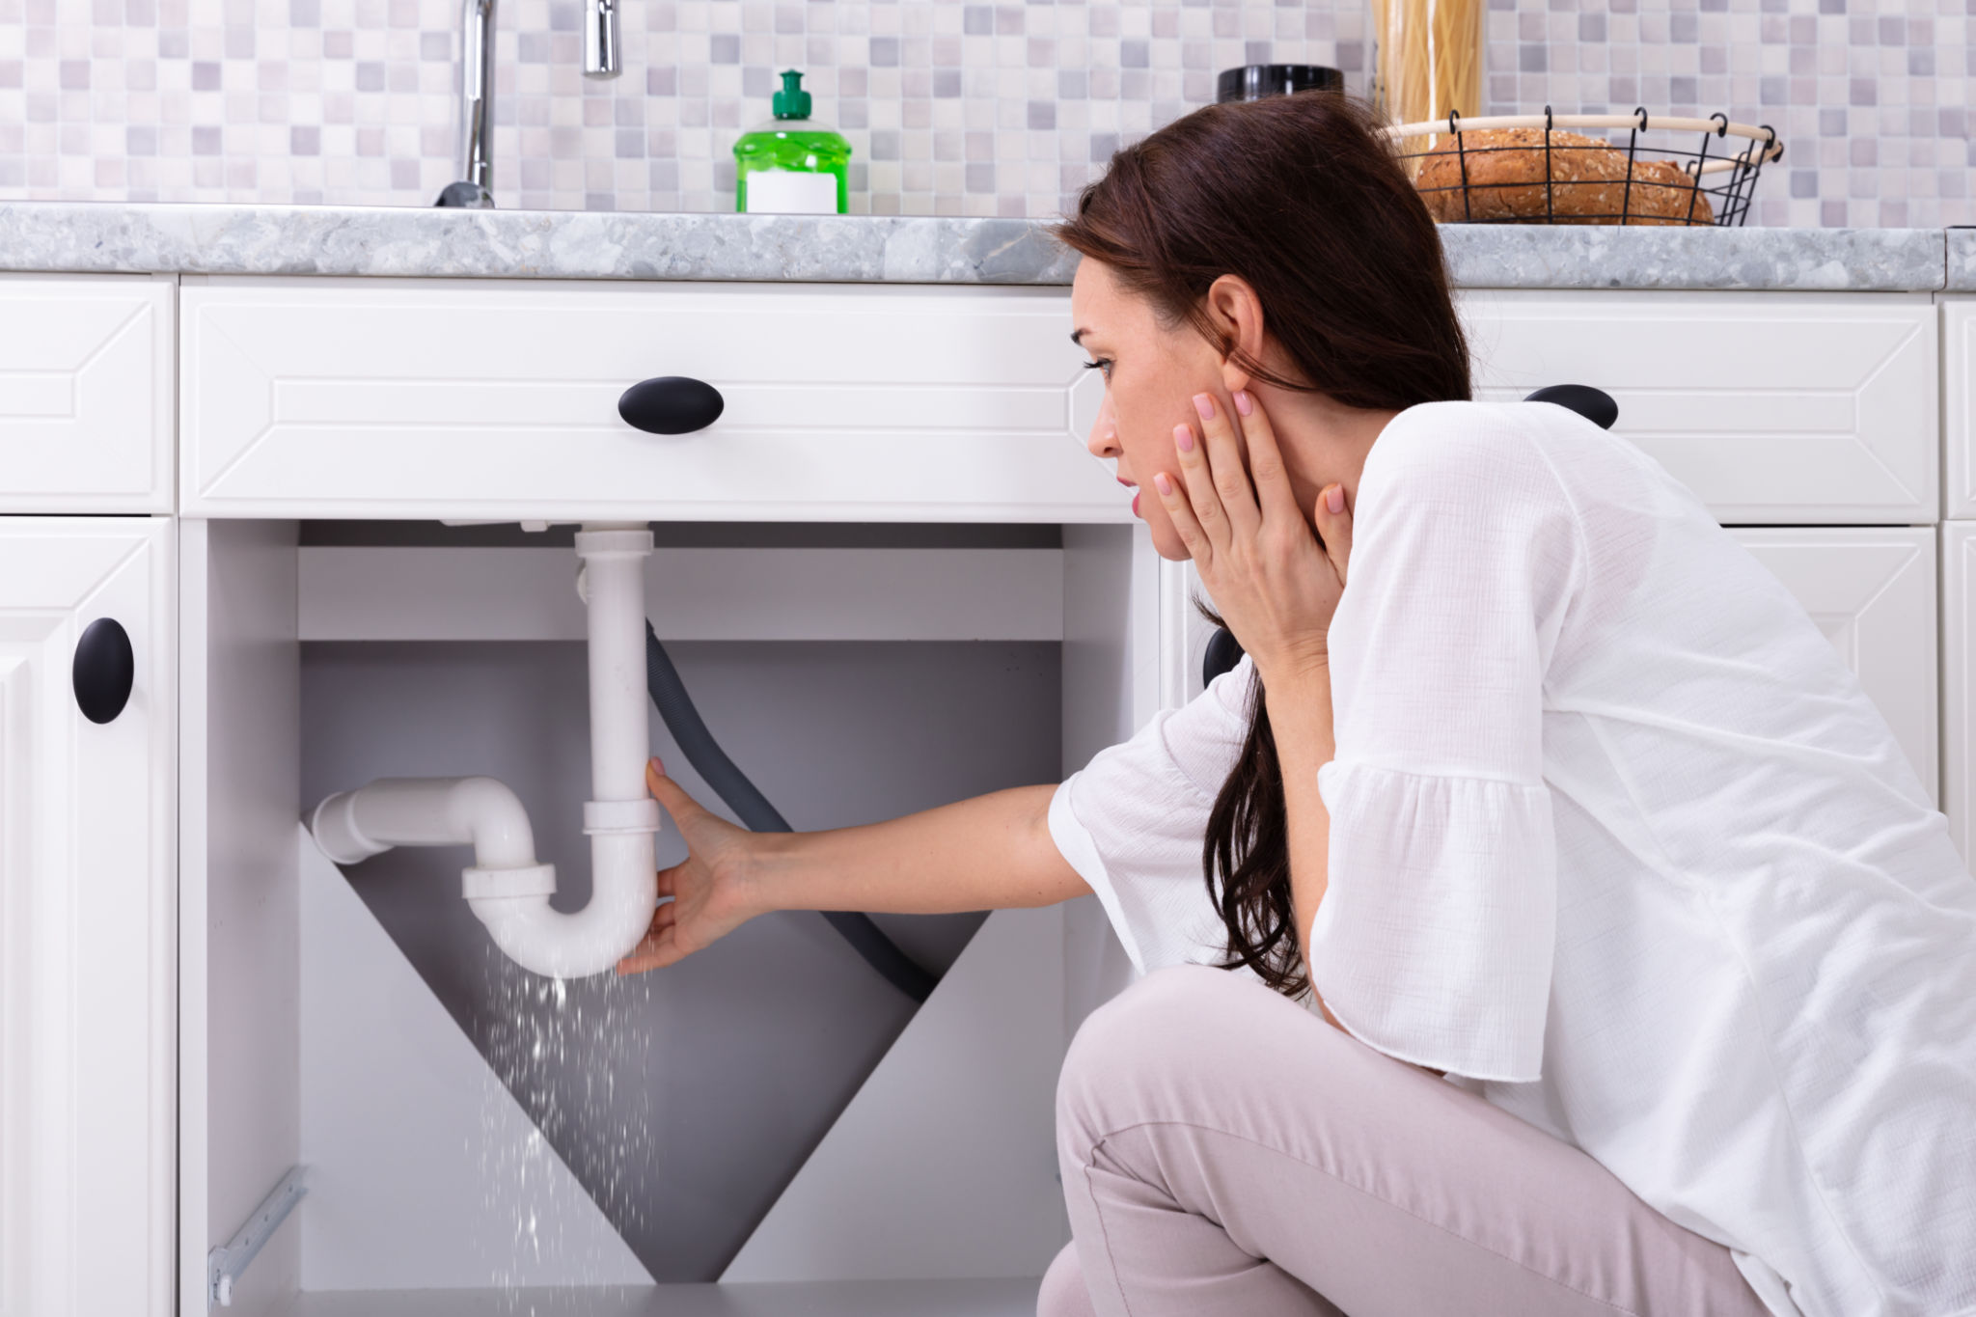
Need preventative maintenance of your plumbing system?
If you're looking for a plumbing contractor who can help you with all your needs, regardless of whether you're a first-time homeowner or an experienced homeowner, then you're in luck. You can find a wide variety of plumbing contractors in your area,

Slide 5

many of which offer services that cater to both new and experienced homeowners. Specialized service providers are delivering quality plumbing services in Brixton, such as installation and maintenance, repairs, and preventive maintenance, which are becoming more common.

Slide 6
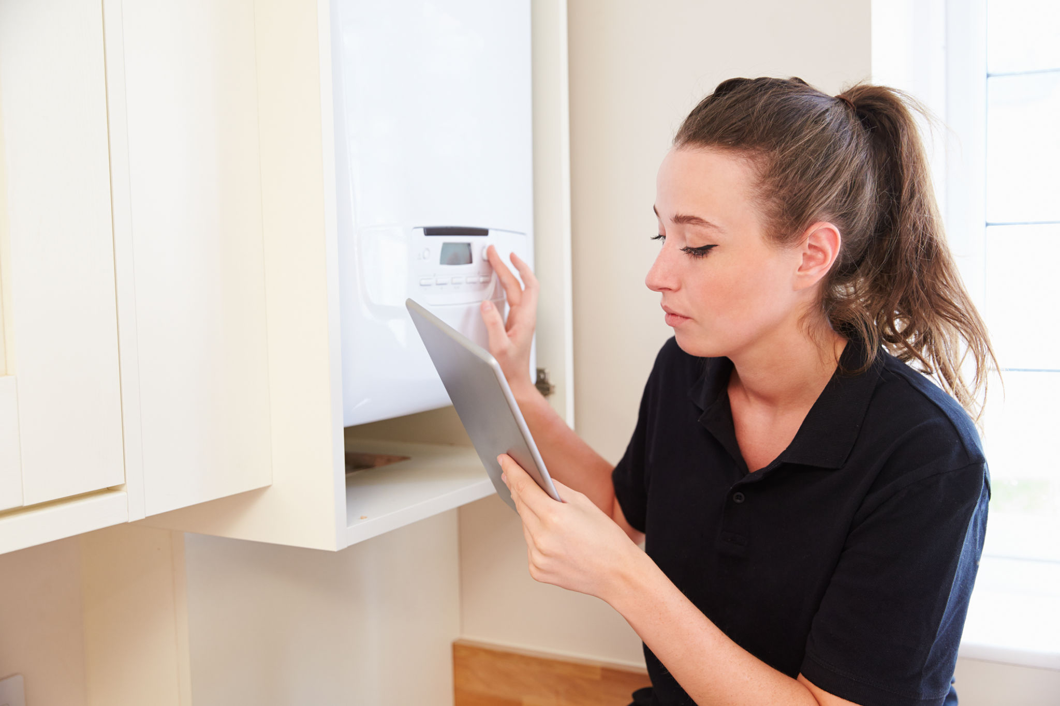
It is because they have the necessary skills to do a good job. The benefits of hiring professionals for emergency plumbing in Clapham include: They can focus on their core competency, such as installation and maintenance, instead of trying to develop new skill sets.

Slide 7
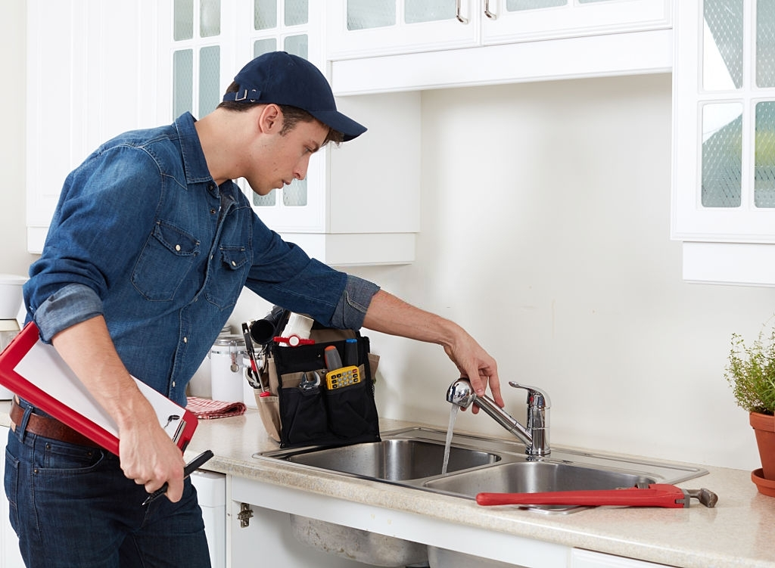
Their expertise is not limited to one job segment since customers need a wide range of tasks from installation and maintenance, repairs, etc., which these professionals can easily handle.

Slide 8
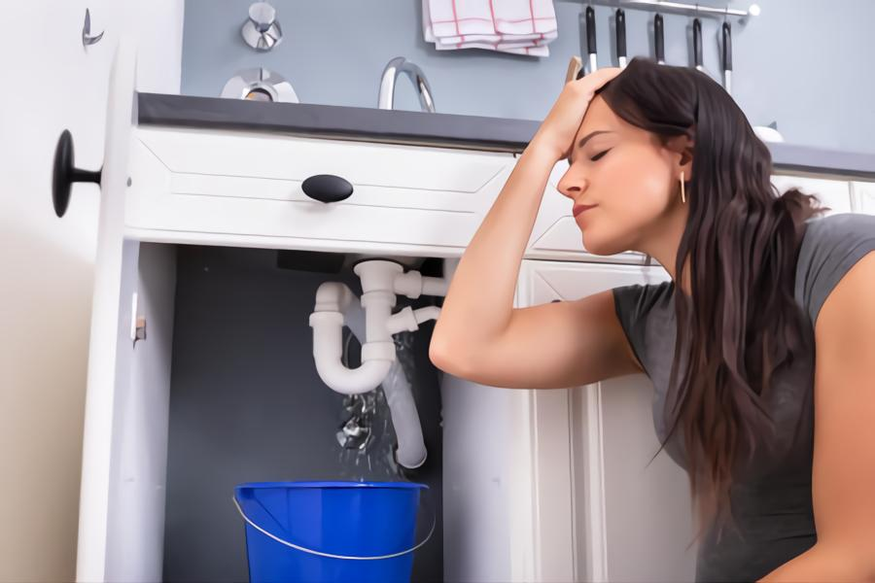
Make your home a castle by keeping it warm and comfortable.
Your home is your castle - so why not make it comfortable? Heating services can help make your home more inviting and comfortable, whether you live in a cold climate or want to make your home cozier during the winter months.

Slide 9

When the weather outside is frightful, and the temperatures inside are low, heating services can help to elevate the mood and make you feel more at home.This blog aims to teach you about the many benefits of heating services in Clapham.

Slide 10
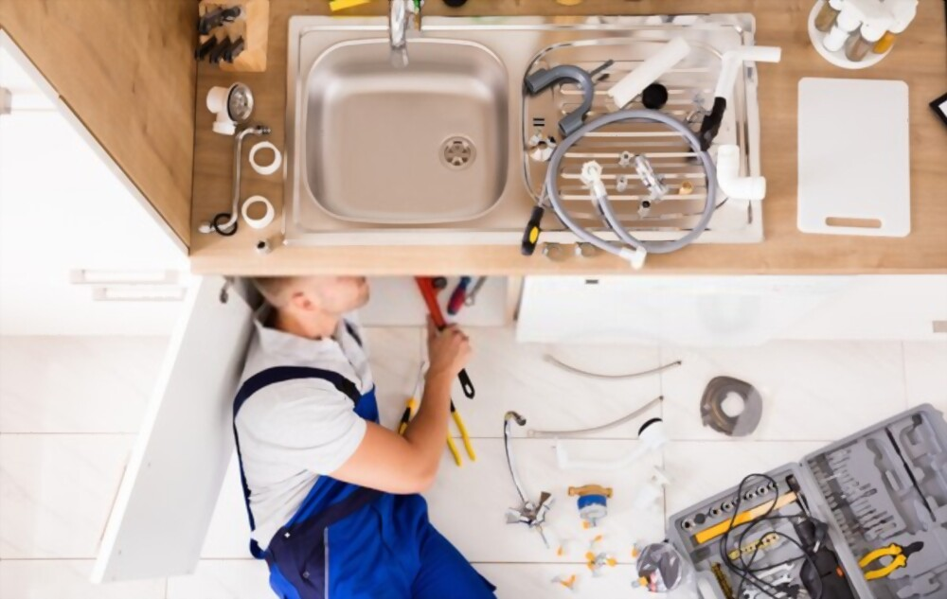
These services can improve the quality of life for those who use them and save money. There are several benefits to having heating services installed in your home, such as saving on energy costs, adjusting the temperature to your liking, and reducing the time you spend inside.

Slide 11
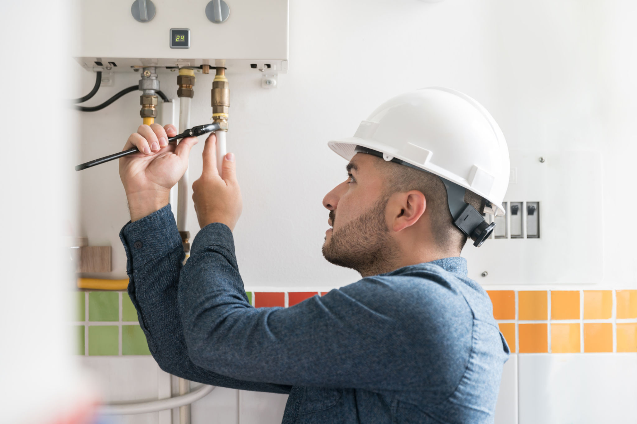
In addition to these benefits, installing heating services can be quite beneficial if you have elderly parents or friends who are especially susceptible to the cold.Connecting with a team of expert plumbers for boiler installation in Clapham is crucial.

Slide 12

The benefits of having a new boiler installation service, such as improved energy efficiency, longer boiler life, and reduced maintenance costs, are clear. When selecting a boiler installation service, ask the contractor about their warranty and licensing status.

Slide 13
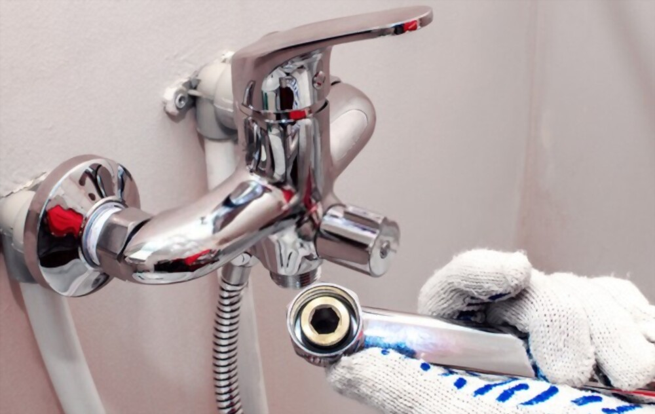
Having a contractor with boiler installation service experience can also reduce the amount of time you spend researching options.

Slide 14
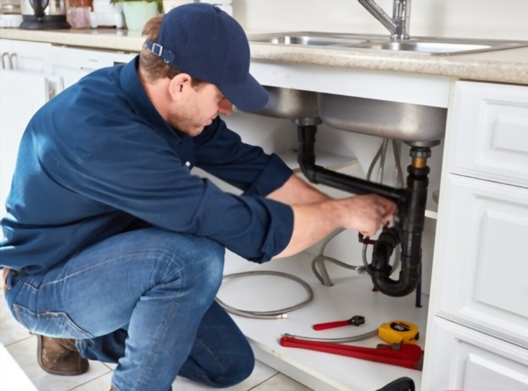
A clogged drain can be frustrating, and if not dealt with promptly, it can lead to more severe problems. Call an FL Plumbing and Heating Services professional when you have a plumbing emergency.

Slide 15
Related Articles
Get professional assistance for emergency plumbing in Tunbridge Wells
Are you wanting to get professional assistance for boiler installation in Clapham?
Are you seeking to get services for emergency plumbing in Clapham?
Get heating services in Croydon according to your needs
Get plumbing services in Clapham according to your requirements
Get plumbing services in Clapham with the aid of professionals
Why do you need services for boiler installation in Croydon?
Are you looking to get plumbing services in Brixton?

Slide 16
Contact Info
Business Address: Tradescant Rd, London, United Kingdom
Business Email: flplumbingandheating@aol.com
Business Phone: 7423594790

Slide 17
Social Media Info
Twitter Tumblr Pinterest

Slide 18


