Slide 1

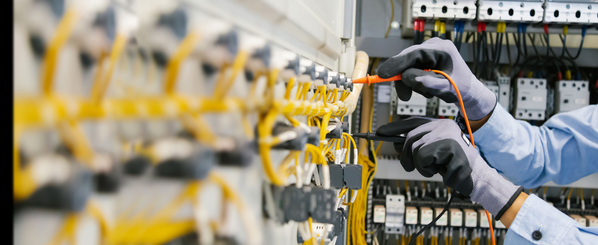
Hire electricians in Highgate for all your electrical work

Slide 2
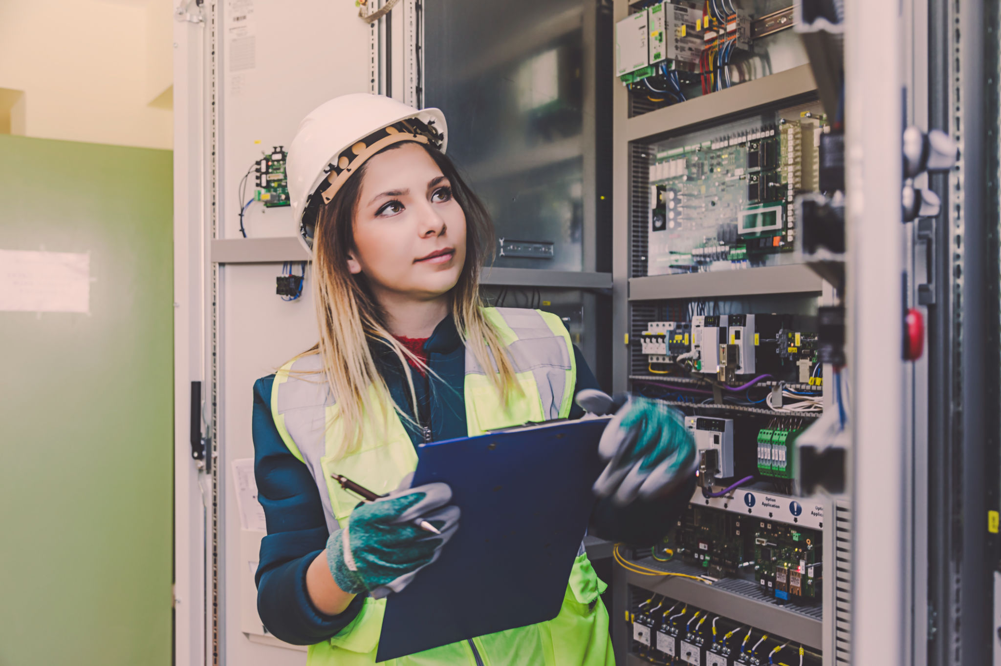
A lack of emergency lighting in Birmingham leads to increased incidences of crime. Not only does this put innocent people in danger, but it also draining government coffers and costing businesses time and money.

Slide 3

Businesses and individuals should have the proper lighting when an emergency arises to help evacuate and avoid injury. Hiring electricians in Birmingham is a good option when updating your electrical system and re-oriented.

Slide 4

He will get the job done quickly, but you will require his skills to create a successful and safe electrical system. That's why hiring an electrician with relevant work experience, and expertise is vital.

Slide 5
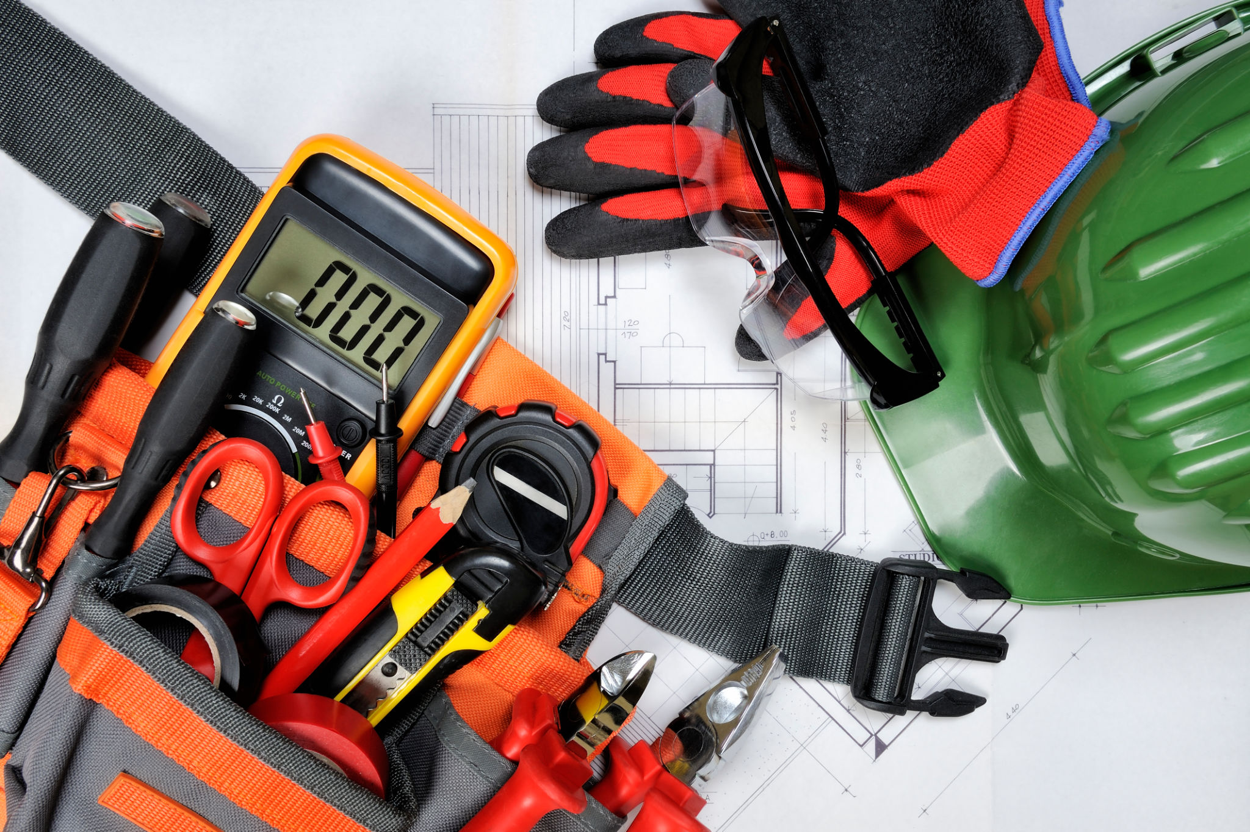
Many people don't realize they can hire professional electrical engineers to perform specific tasks for them. When it comes to building projects, many aspects have to be taken care of. One of them is the wiring.

Slide 6
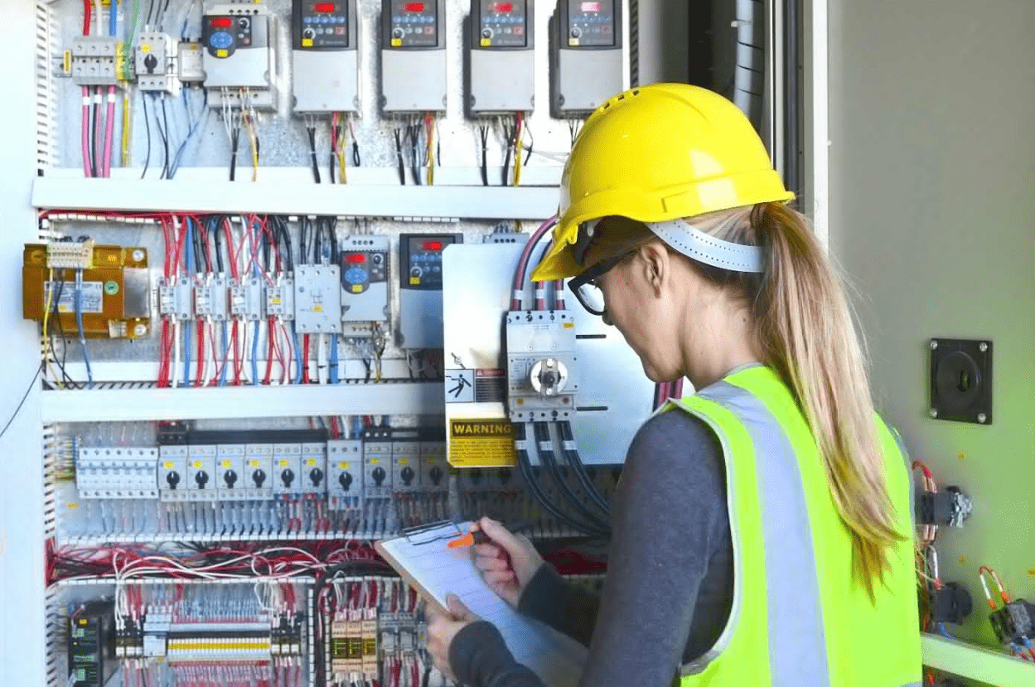
It is where professional electrician near me in Birmingham can come into play and do the work quickly and efficiently by patching holes in walls, tearing up old cables, shuttling heavy objects from one place to another, and more.

Slide 7
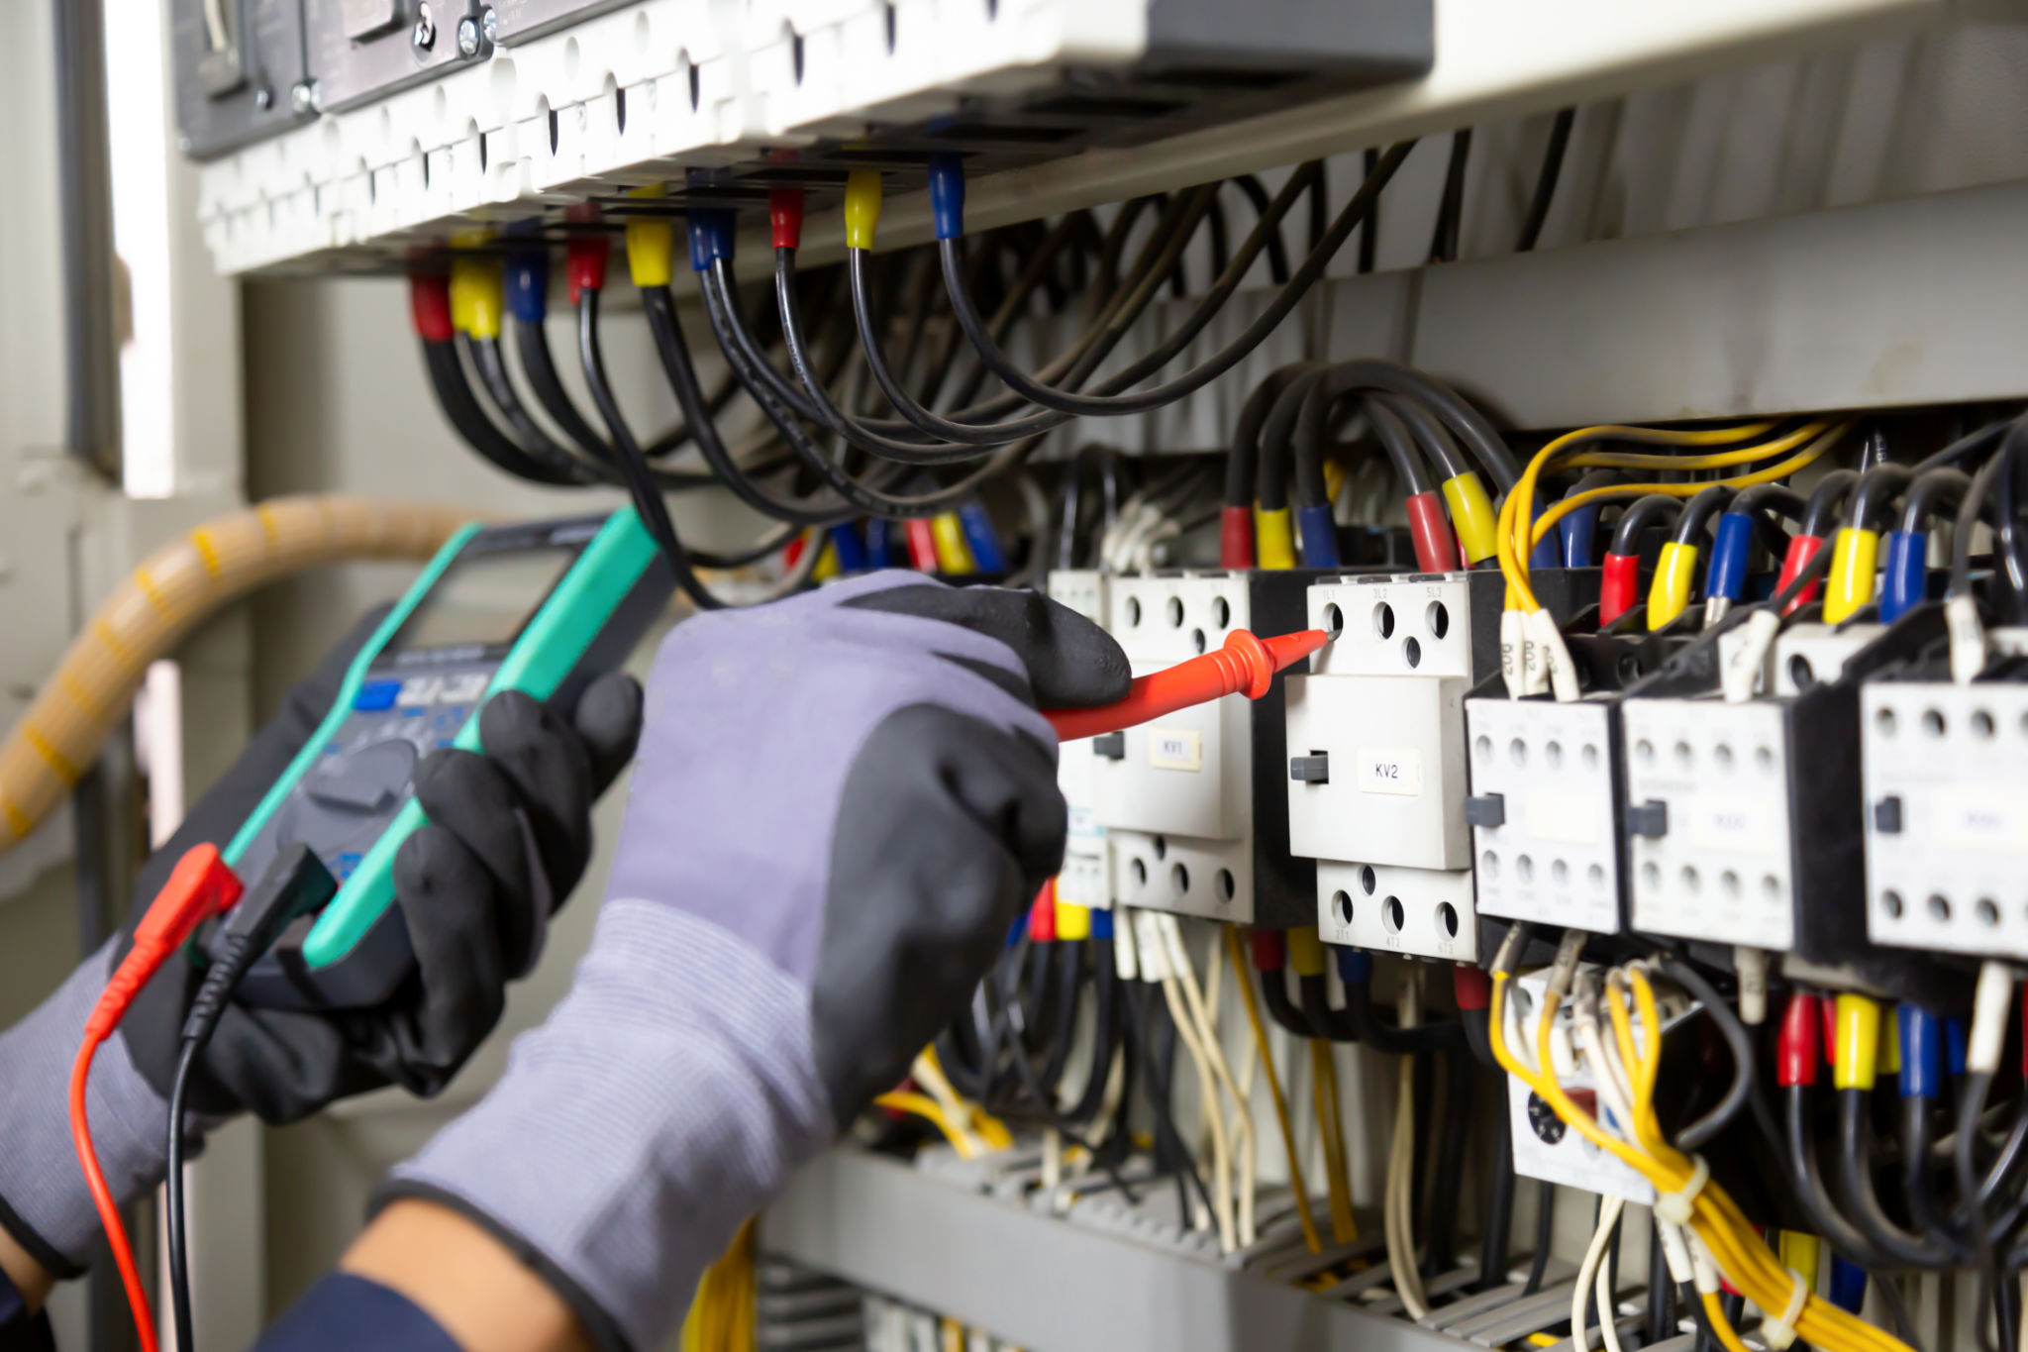
Electrical installation and maintenance
electrical installation and maintenance" refers to the treatment, protection, and servicing of electrical equipment. The term "electrician" denotes someone who can perform any work on electrical systems

Slide 8
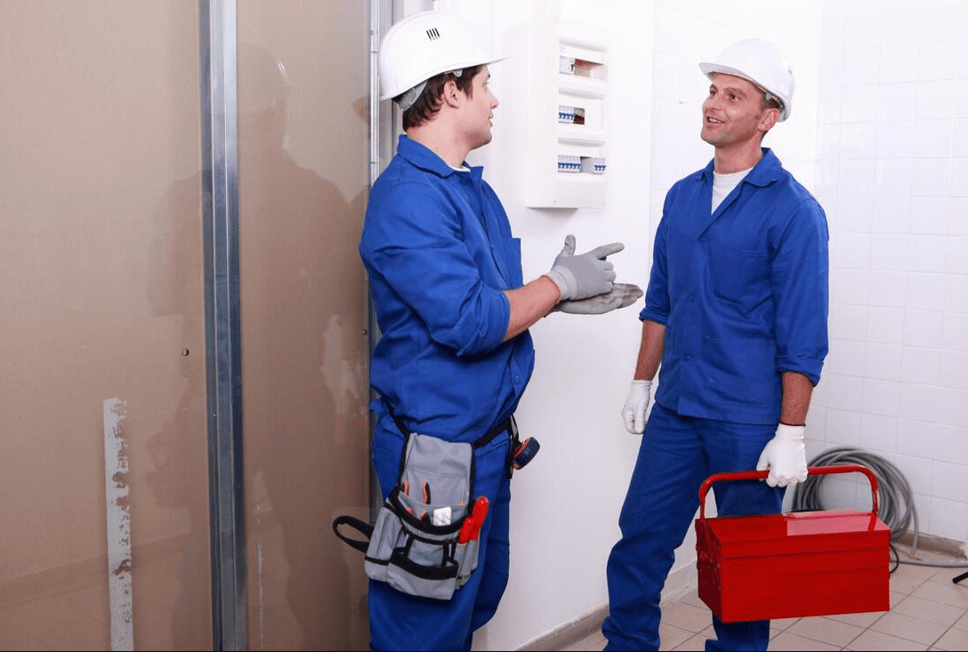
such as repair, installation, and maintenance. In the past, all electrical installations required some skill, but with the growing complexity of modern technology, professional electricians in Selly Oak managed several tasks.

Slide 9
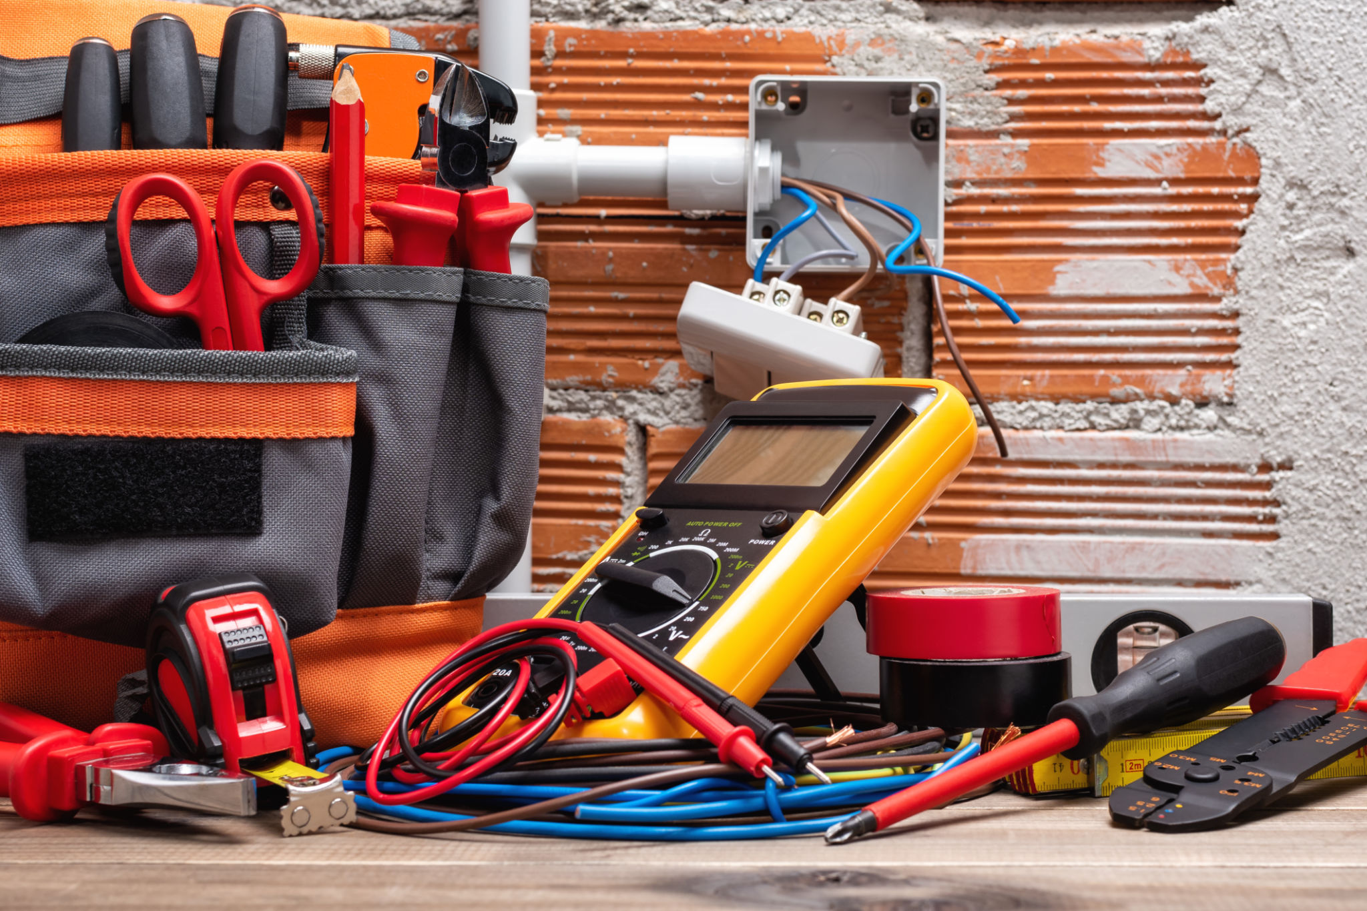
Is your electricity got cut off?
The top doesn't leak because water can't pool on it, so you won't have to worry about mold or mildew. Hence, flat roofs are easy to maintain, have fewer leaks, and are more energy-efficient than other types of roofs. Additionally, professionals install them in a variety of architectural styles.

Slide 10
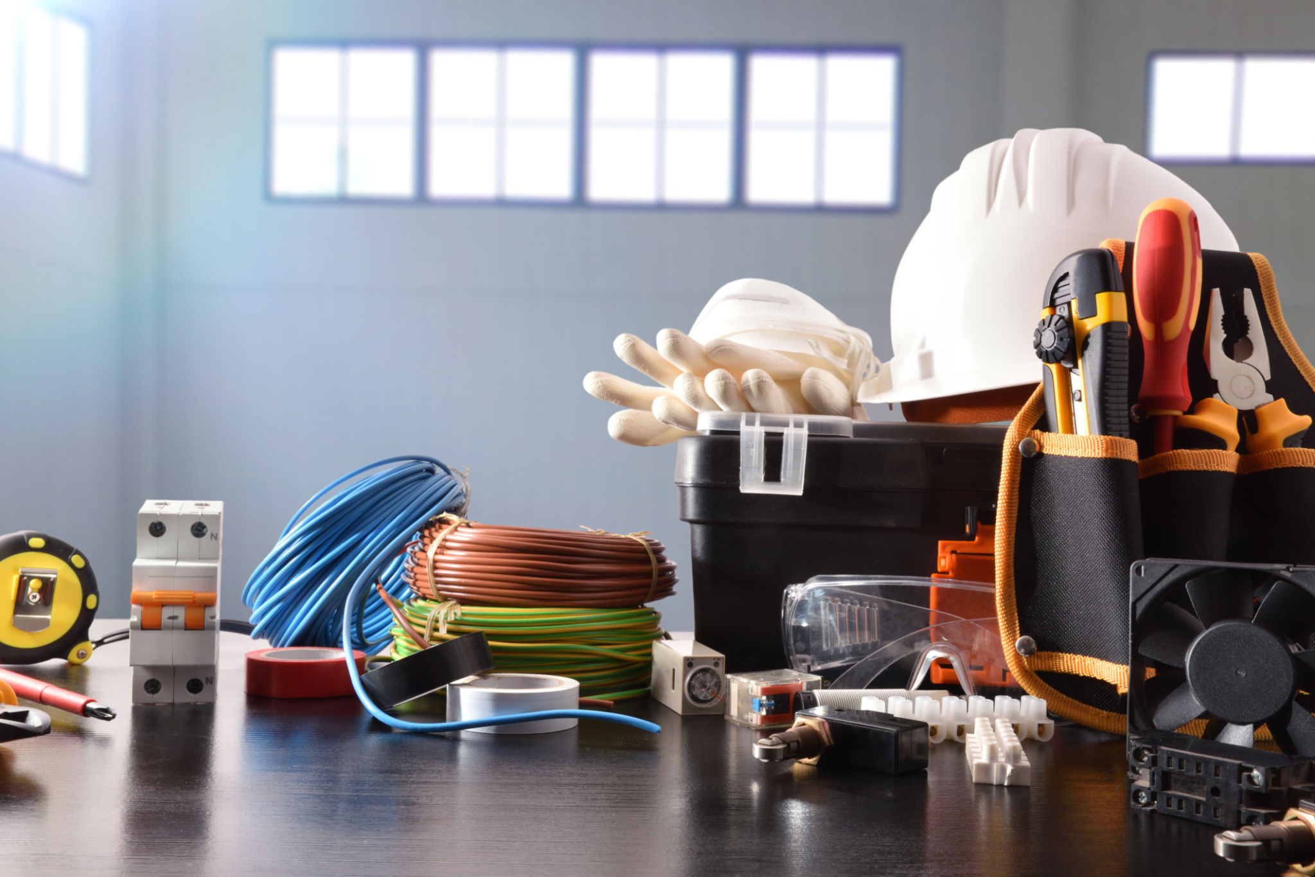
You don't want your business to be in the dark during this winter season. You want to know that you'll be safe and that your house will not burn down because the electricity is cut off. Electricians are available everywhere,

Slide 11
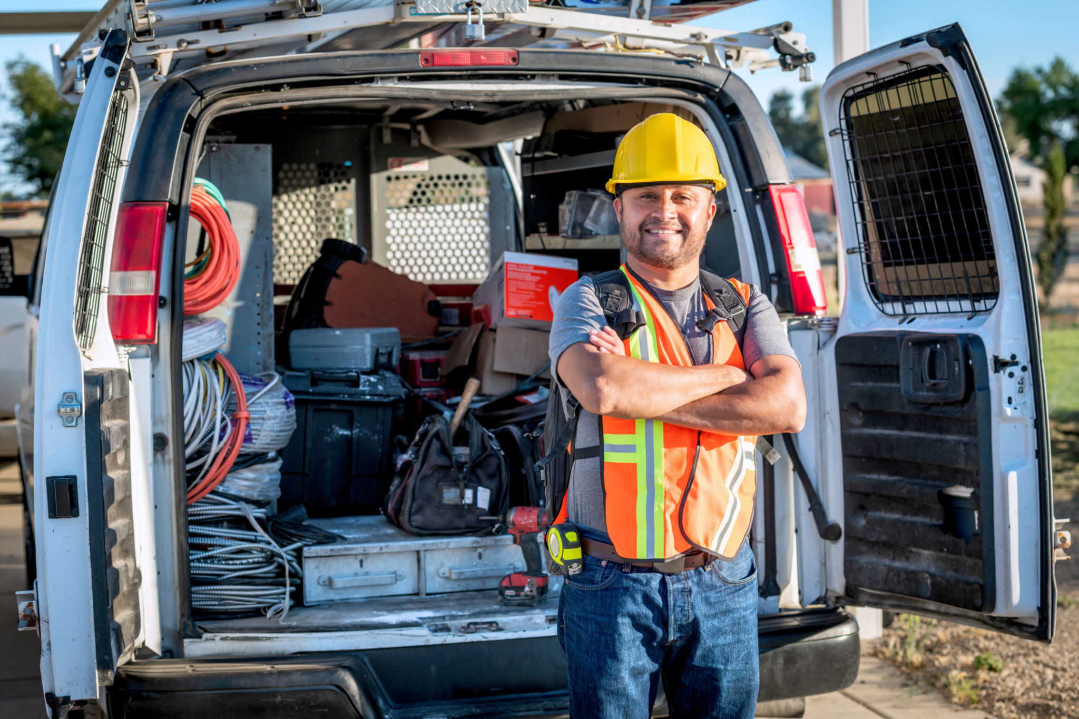
so how do you choose an electrician? There are many ways to get an electrician, and you must select the best one for your specific needs. You should pay attention to their references and ask which skilled electrician they've

Slide 12

found that's more helpful than others. An electrician's job includes installing many lamp sockets in a building or replacing windows and doors in an office.

Slide 13
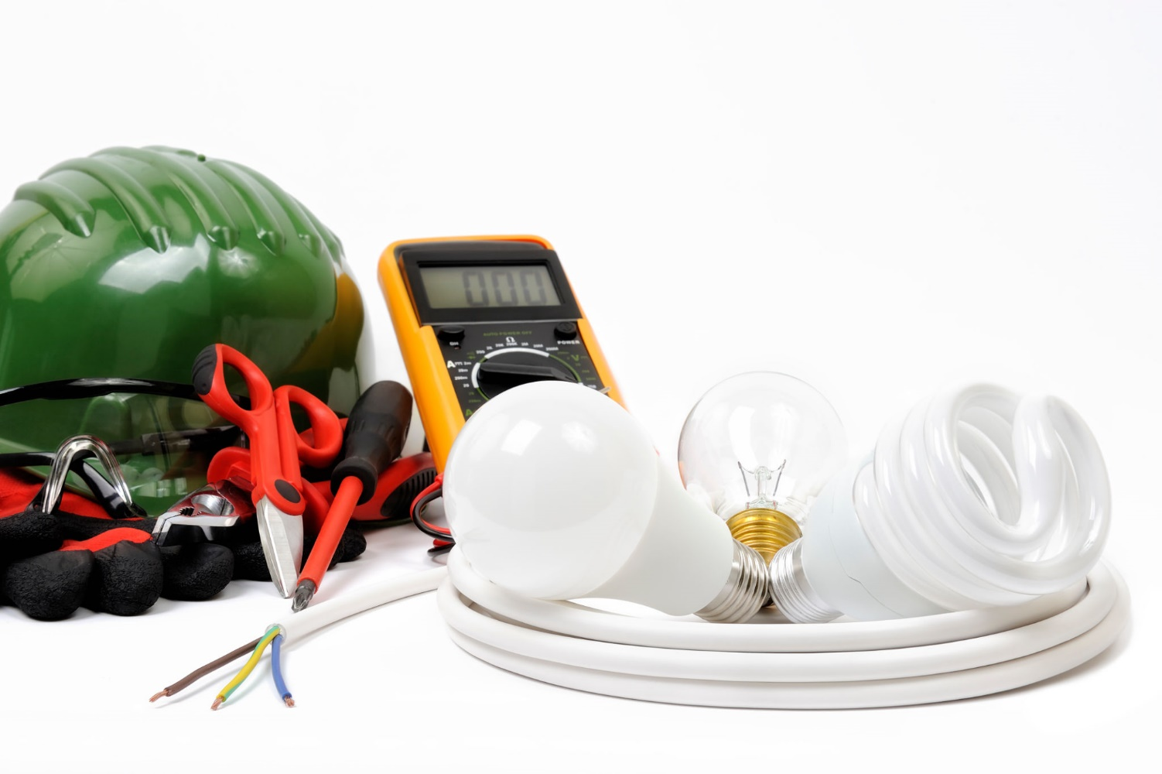
Benefits of electrical installation and maintenance
It saves the installation and maintenance costs on their systems. Professionals can also improve the quality of work by eliminating labor-intensive work around the building.

Slide 14
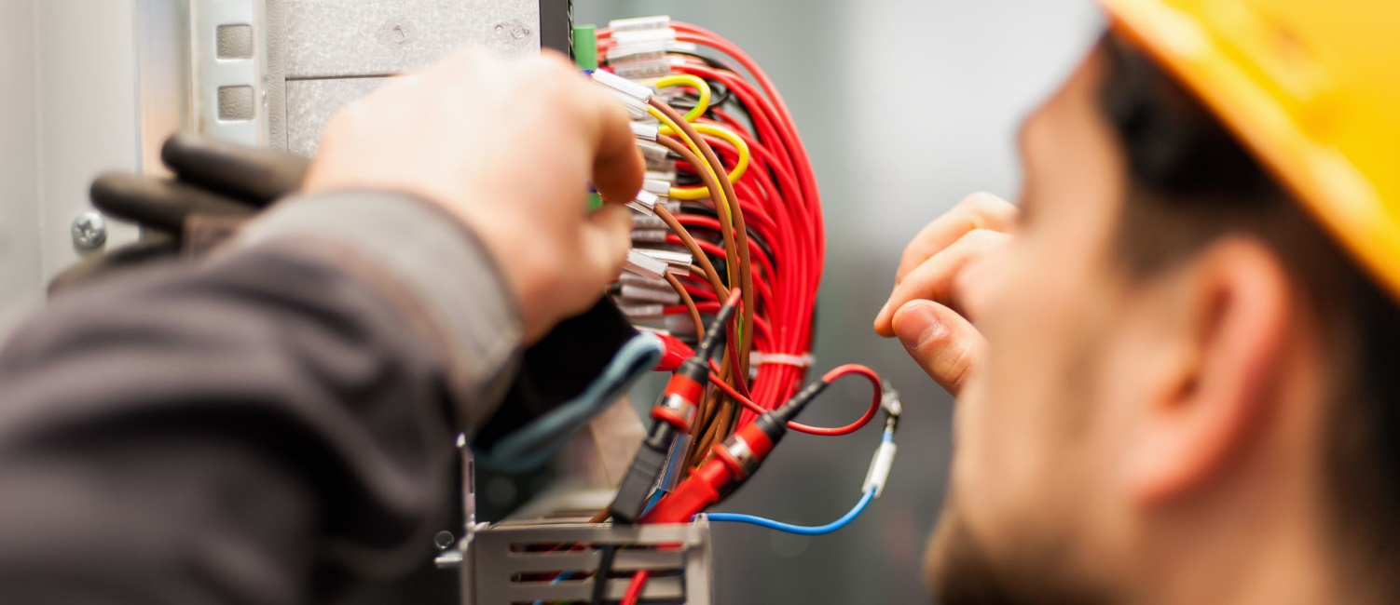
If you want your business to grow and thrive in the future, then hiring an electrician is essential for you. They know their stuff and can provide for your company's electrical needs at an affordable price.

Slide 15
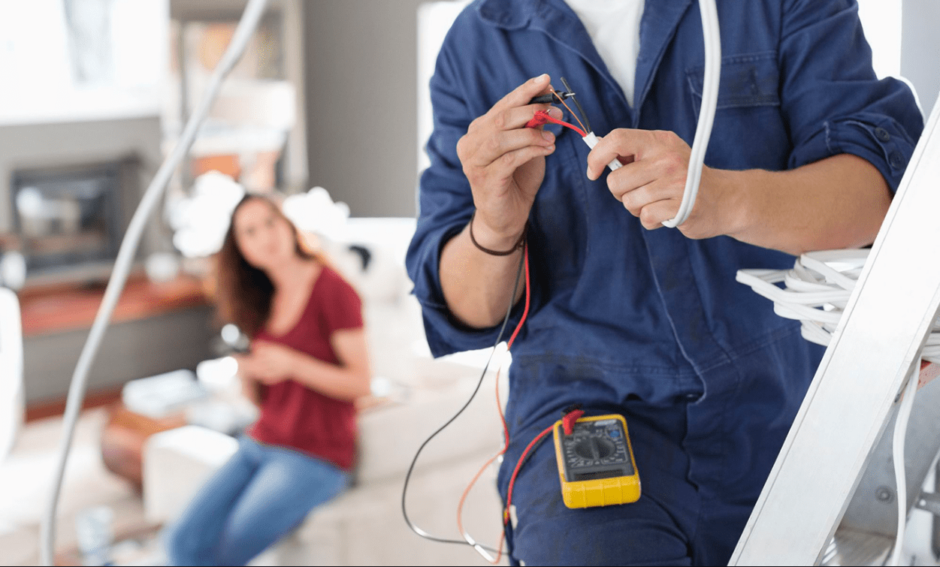
We are constantly moving from one place to another in the modern world. It is where Tech Fix Electric electricians come in. They power up buildings and, most importantly, keep them running.

Slide 16
Related Articles
Why should you connect with a team of professional electricians in Selly Oak?
Maintain your electrical appliances with the aid of electricians in Selly Oak
Do you know why you need to hire electricians near me in Birmingham?
Hire professional for top-notch electrical installation in Birmingham
Why you need professional electrical inspection in Birmingham
Do you need electrical inspection in Birmingham?

Slide 17
Contact Info
Business Address: APEX HOUSE, Edgbaston Rd, Birmingham B15 1TR, United Kingdom
Business Email: info@techfixelectric.co.uk
Business Phone: 44 1217690599

Slide 18
Social Media Info
Twitter Facebook Pinterest Google Map

Slide 19


