Slide 1
Desert safari Dubai important things for the beginners:

Slide 2
Dubai is famous for its fantastic lifestyle and nightlife. The most incredible thing is the Arabian desert. Because of this, it is considered the most popular tourist destination globally, and for a good reason – it has something for everyone.

Slide 3
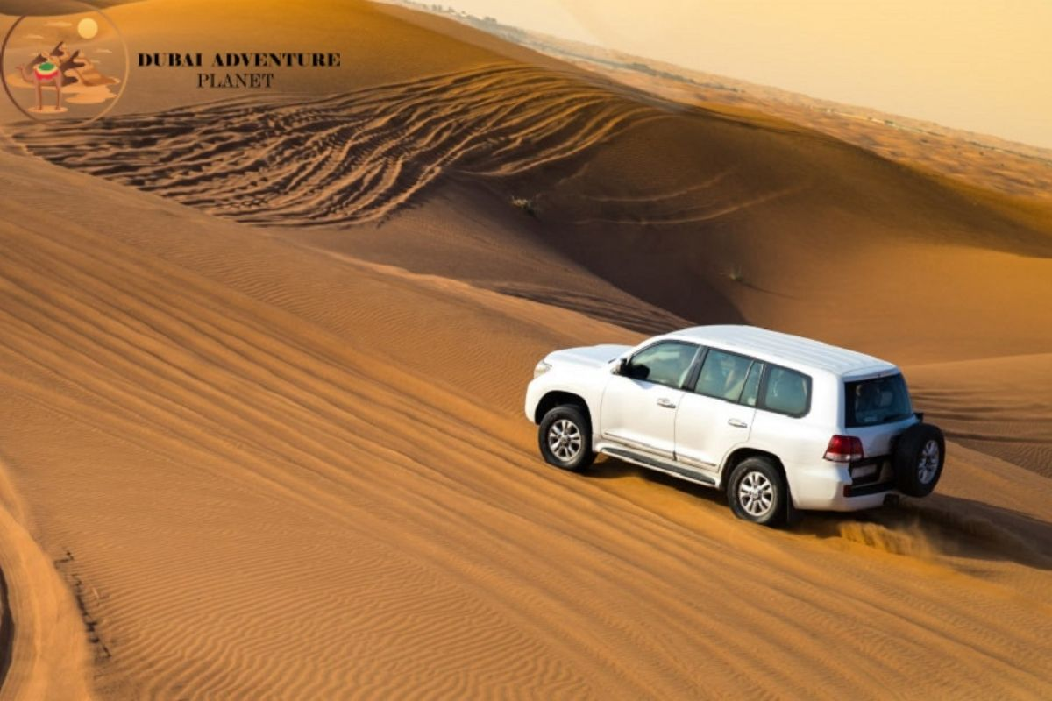

Slide 4
Desert Safari Dubai?
Dubai's Desert Safari is an exciting adventure that takes you deep into the desert. You'll experience everything the desert offers, from the dunes to the wildlife.
Desert safari is the most fantastic method to experience Dubai's desert landscape. Many desert safaris to choose from, each offering a unique experience.

Slide 5
Cost of the desert safari Dubai?
The cost of desert safari Dubai varies depending on the package you choose. Many different companies offer desert safari packages, so it's essential to do your research before booking. After completing the research, you should select the package according to your needs and budget.

Slide 6
Night Tours:
Night tours are also popular. They usually start in the late afternoon so you can watch the sunset over the desert. This tour will continue until the entire night. You'll get to experience all the desert offers and enjoy some traditional Arabic hospitality.

Slide 7
Little thatched houses:
The desert safari experience is not complete without spending a night in a desert camp. These desert camps are made up of tiny thatched, very comfortable houses. You will be able to enjoy the desert night sky and relax in these desert camps. These camps are the best way to experience desert life.
Click here to book Desert Safari: dubaidesertsafaris.com

