Slide 1
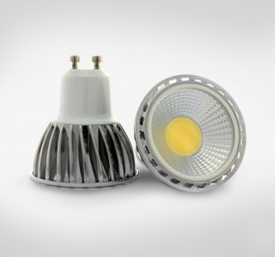

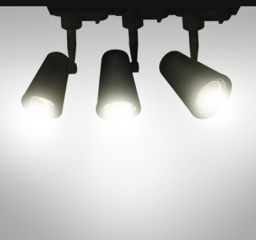
down light singapore
LED Downlights are a preferred choice of light fixture for false ceiling lighting. LED Downlights in Singapore is quite common, especially in new BTO houses as it can really change the perspective of the house and at the same time play with the spaces around it. Check out our LED Downlights on display in our showroom today!

Slide 2
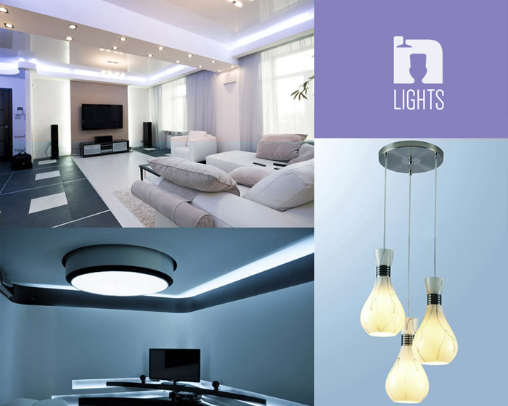
led downlight singapore
At Lights N Showers, our motto is to provide the highest quality, most efficient bathroom, kitchen and lighting accessories for all your home makeover experiences.

Slide 3
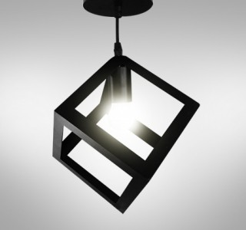
led singapore
When installing lights into a room it is worth carefully considering what lighting solutions will best suit your need. A very popular choice of lighting for the modern day home is the LED downlight. It is often a common choice for home owners to install LED downlights in their kitchens, bathrooms or even bedrooms, to give the room a very stylish and modern feel that other lights just don't give.
Established in 2013, Although we are a young and vigilant team, our team is equipped with the necessary interior design creativity and concepts, and of course with the mission of bringing only the finest products and accessories finishing for your interior. Understanding the competition of this industry, Lights N Showers pledge to provide our clients with the most competitive price of our products, utmost excellent and unforgettable customer service experience.
Having our own groups of in-house professional plumbers and electricians, we provide a one stop full service for your accessories consultancy and warranty.

Slide 4
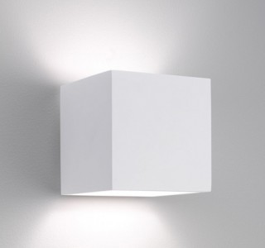
downlights singapore
An LED downilght is not only an attractive light source for your kitchen, bedroom or bathroom but it is also a powerful and efficient source of light that often tends to operate at very low heat levels. This not only make it an attractive light but it also makes it an ideal item to ensure that your lighting fixture will not be a fire hazard whilst left on for an extended period of time in the home.
LED downlights come in many varieties so it is recommended that you speak to a sales assistant about your specific needs before you purchase the said lights. Such things to consider will be what colours fit your room, how strong you want the light to be, and if you prefer it to light the room in the style of a spotlight of a floodlight.

Slide 5

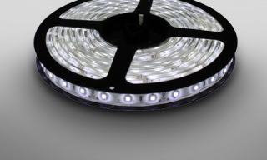



down light singapore
For inquiries please visit :
baths.sg

