Slide 1

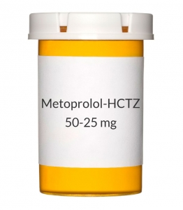
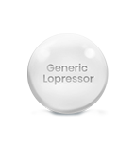
Basic Information of
Lopressor Generic drug

Slide 2

About Lopressor Generic
Lopressor Generic version equivalent to the branded drug called Lopressor.
Widely recommended to treat any heart-related issues.
Active ingredient is Metoprolol.
It falls in the category of drugs called beta-blockers.

Slide 3
Therapeutic Uses of Lopressor Generic
Lopressor Generic can be used for the below-mentioned conditions:
Cardiac arrest
High blood pressure
ischemic chest pain
Migraine
Hyperthyroidism

Slide 4
How to take Lopressor Generic aptly?
• Take Lopressor Generic oral drug after having a meal, usually, it is advised twice or thrice in a day.
• Do not stop suddenly to take this drug. Take the pill as prescribed regularly.
• Do not miss a dosage.
• Take this medicine on a regular basis to obtain the utmost benefits

Slide 5
How it acts?
• Lopressor Generic acts on specific chemicals in the body, including epinephrine.
• The effect of Metoprolol on the active component
helps in lowering the blood pressure and heart rate.
• It helps to provide relief from the stress on the heart.

Slide 6
Interactions with other drugs
Avoid taking this drug with other medicines. Lopressor Generic is known to interact with the following drugs-
• Amlodipine
• Ergotamine
• Diltiazem
• Aminophylline

Slide 7
Common Side effects of Lopressor Generic
• Pain in the chest
• giddiness
• Shortness of breath
• Skin rash

Slide 8
Buy Lopressor Generic at lowest price
MedExpressRx offers variety of generic drugs
It also offers Lopressor Generic at the lowest price
Also, it provides free delivery on bulk orders

Slide 9
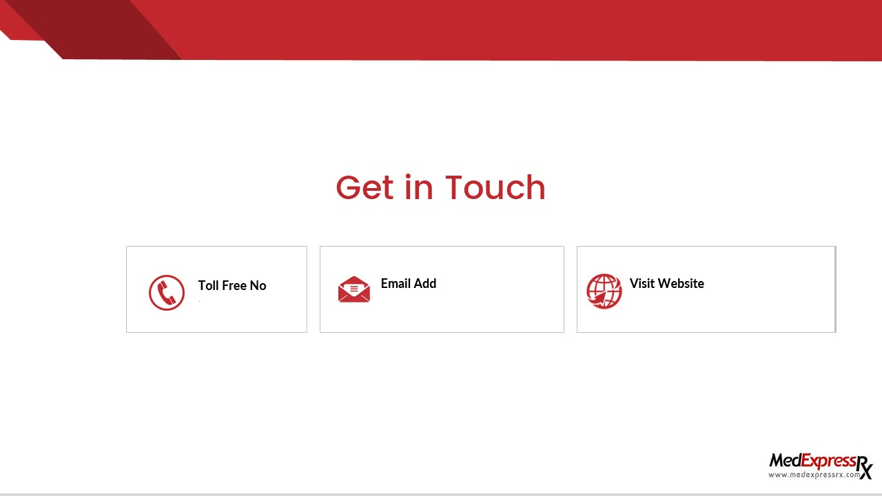
+1-800-808-3375
customersupport@medexpressrx.com
https://www.medexpressrx.com

Slide 10


