Slide 1
Nose surgery in islamabad
This careful methodology is focused to change the size and figure of the Nose surgery in islamabad for practical and tasteful reasons both. Through Nose Reshaping or Rhinoplasty in Islamabad, Rawalpindi and Pakistan you can shape the nose simply the manner in which you need it.

Slide 2
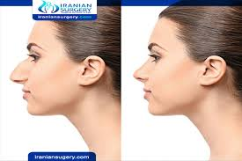
Nose surgery in islamabad

Slide 3
Nose surgery in islamabad
The Basic Cost Factors
The biggest section of rhinoplasty costs comprises of the specialist's expense and medical clinic charges (counting sedation, uphold staff, supplies and gear). Every one of these charges join to establish the absolute expense of a nose work. Normally, a nose surgery acted in an emergency clinic will cost more than one done in a plastic specialist's office.
Sedation likewise represents tremendous expenses - particularly on the off chance that you will stay under sedation for an all-inclusive timeframe. The more you remain calmed, the higher will be the expense of the sedation as well as the charges of the anesthesiologist, the office and the care staff.
Notwithstanding, the expense of surgery will be extensively lower if your surgery can be performed just with neighborhood sedation. At that point there are rhinoplasty specialists who will cite a solitary bundle cost that is comprehensive. It is fine to take the plunge as long as you are OK with the expense cited. Nonetheless, on the off chance that you need to know the individual expenses, the rhinoplasty specialist should have the option to offer the subtleties. Whichever bundle you pick, consistently ensure you understand what you are paying for.

Slide 4
Contact us
ADDRESS:ISLAMABAD
PHONE:03325488777
WEBSITE :Skncosmetics.com

