Slide 1
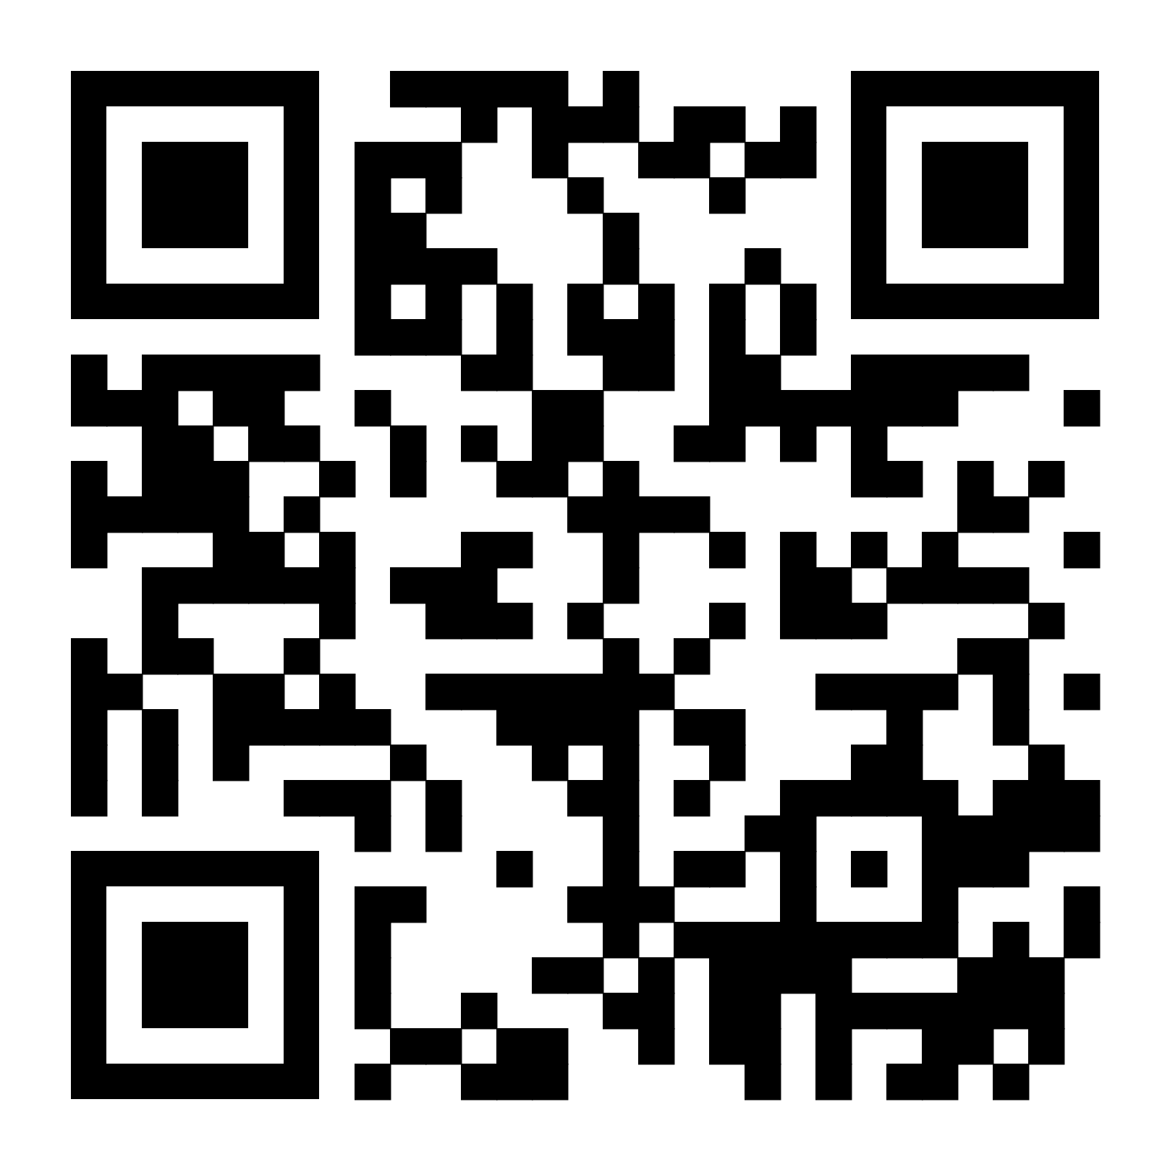



Exploring diversity perceptions in a community through a Q&A chatbot
Peter Kun*, IT University of Copenhagen / Aalborg University Copenhagen
Amalia De Götzen, Aalborg University Copenhagen
Miriam Bidoglia, , London School of Economics and Political Science
Niels Jørgen Gommesen, Aalborg University Copenhagen
George Gaskell, London School of Economics and Political Science
peter@peterkun.com
https://doi.org/10.21606/drs.2022.807
WeNet project is funded by the EU’s Horizon2020 programme under Grant Agreement number 823783.

Slide 2
Diversity is widely discussed, we have seen much scholarly criticism.
Bardzell. (2010). Feminist HCI: taking stock and outlining an agenda for design. In Proceedings of CHI2010.
Costanza-Chock, S. (2020). Design Justice: Community-led Practices to Build the Worlds We Need.
Dankwa N.K., Draude C. (2021) Setting Diversity at the Core of HCI. In: Universal Access in Human-Computer Interaction. Design Methods and User Experience. HCII 2021. Lecture Notes in Computer Science, vol 12768.
Fletcher-Watson, S., De Jaegher, H., Van Dijk, J., Frauenberger, C., Magnée, M., & Ye, J. (2018). Diversity computing. In Interactions, 25(5), 28-33.
Himmelsbach, Schwarz, S., Gerdenitsch, C., Wais-Zechmann, B., Bobeth, J., & Tscheligi, M. (2019). Do We Care About Diversity in Human-Computer Interaction: A Comprehensive Content Analysis on Diversity Dimensions in Research. In Proceedings of CHI2019.
Keyes, O. (2019) Counting the Countless: Why Data Science is a Profound Threat for Queer People. In Real Life Magazine.
Matzner, T. (2019) The Human is Dead – Long Live the Algorithm! Human-Algorithmic Ensembles and Liberal Subjectivity. Theory, Culture & Society, 36(2):123–144
Schelenz, L.; Reinhardt, K.; and Gjuraij, D. (2019) WeNet Deliverable 9.1: Developing a Conceptual and Ethical Framework of Diversity.

Slide 3
What do we mean with diversity?
Beyond surface-level attributes: deep diversity
Harrison, D. A., Price, K. H., & Bell, M. P. (1998). Beyond Relational Demography: Time and the Effects of Surface- and Deep-level Diversity on Work Group Cohesion. Academy of Management Journal, 41(1), 96-107.

Slide 4
But, what are positive use-cases for diversity?

Slide 5
And, what do people actually expect from diversity? How do they perceive it?

Slide 6

Approach

Slide 7
We deployed a technology probe as a research instrument.
(Research through design)
Hutchinson, H., Mackay, W., Westerlund, B., Bederson, B. B., Druin, A., Plaisant, C., Beaudouin-Lafon, M., Conversy, S., Evans, H., Hansen, H., Roussel, N., & Eiderbäck, B. (2003). Technology Probes: Inspiring Design for and with Families. In Proceedings of CHI2003.
Zimmerman, J., Forlizzi, J., & Evenson, S. (2007). Research Through Design as a Method for Interaction Design Research in HCI. In Proceedings CHI2007.
Stappers, P. J., & Giaccardi, E. (2017). Research Through Design. In The Encyclopedia of Human-Computer Interaction (pp. 1-94). The Interaction Design Foundation.

Slide 8
Fully functional chat application – a Telegram chatbot.

Slide 9
(Leading question)
RQ1: What do people expect from being presented with diversity? How do people interpret diversity in use?
(Contextual knowledge)
RQ2: How do people perceive a chatbot that connects community members through diversity attributes?
(Contextual knowledge)
RQ3: What do student communities ask from others through a chatbot?
Research questions

Slide 10
Developing a Q&A chatbot

Slide 11
Q&A chatbot – a “light interface”
As a probe, enabled us to focus our research to the core
Q&A – simple interaction: asking questions, giving answers
Not a conversational agent, but a social recommendation system
Emphasize diversity in focus and copywriting
Klopfenstein, L.C., Delpriori, S., Malatini, S., Bogliolo, A.: The Rise of Bots: A Survey of Conversational Interfaces, Patterns, and Paradigms. In Proceedings of DIS2017. Conference on Designing Interactive Systems. pp. 555–565. DIS ’17Seering, J., Luria, M., Kaufman, G., Hammer, J.: Beyond Dyadic Interactions: Considering Chatbots as Community Members. (2009). In Proceedings of CHI2019.

Slide 12
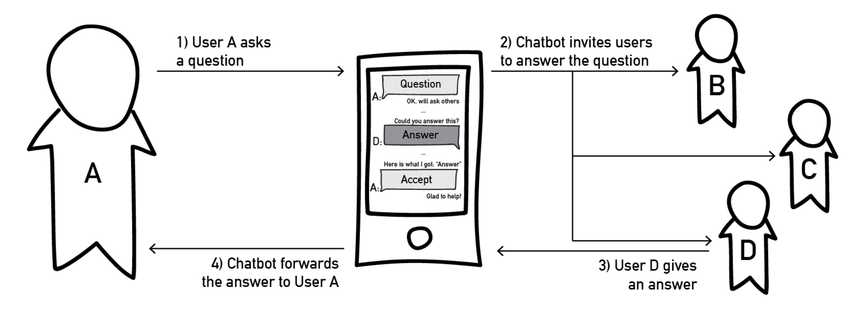
User interaction

Slide 13

Method

Slide 14


Two pilot sites
Two weeks engagement with the chatbot in two pilot sites
N = 80 students participating overall
Total 669 questions asked and 2400 answers sent.

Slide 15
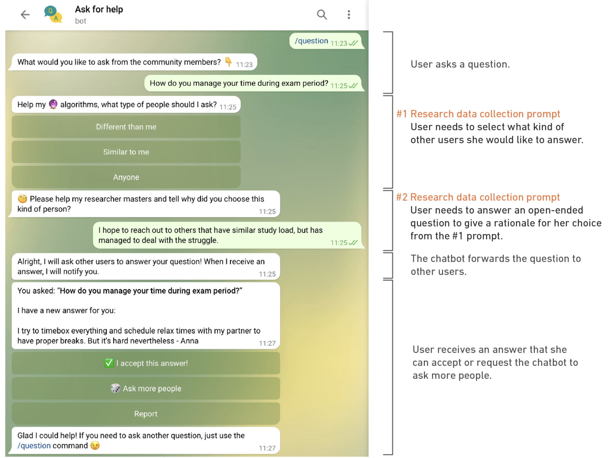
Overview

Slide 16
Data collection and analysis
Thematic analysis from the log files (what did people ask and what answers they gave)
In-conversation research prompts
Exit survey and UTAUT2 instrument (technology acceptance)
Focus group interviews for qualitative support of interpretation of the quantitative findings
Venkatesh, V., Thong, J. Y., & Xu, X. (2012). Consumer Acceptance and Use of Information Technology: Extending the Unified Theory of Acceptance and Use of Technology. In MIS Quarterly.

Slide 17
Results 🧑‍🔬

Slide 18
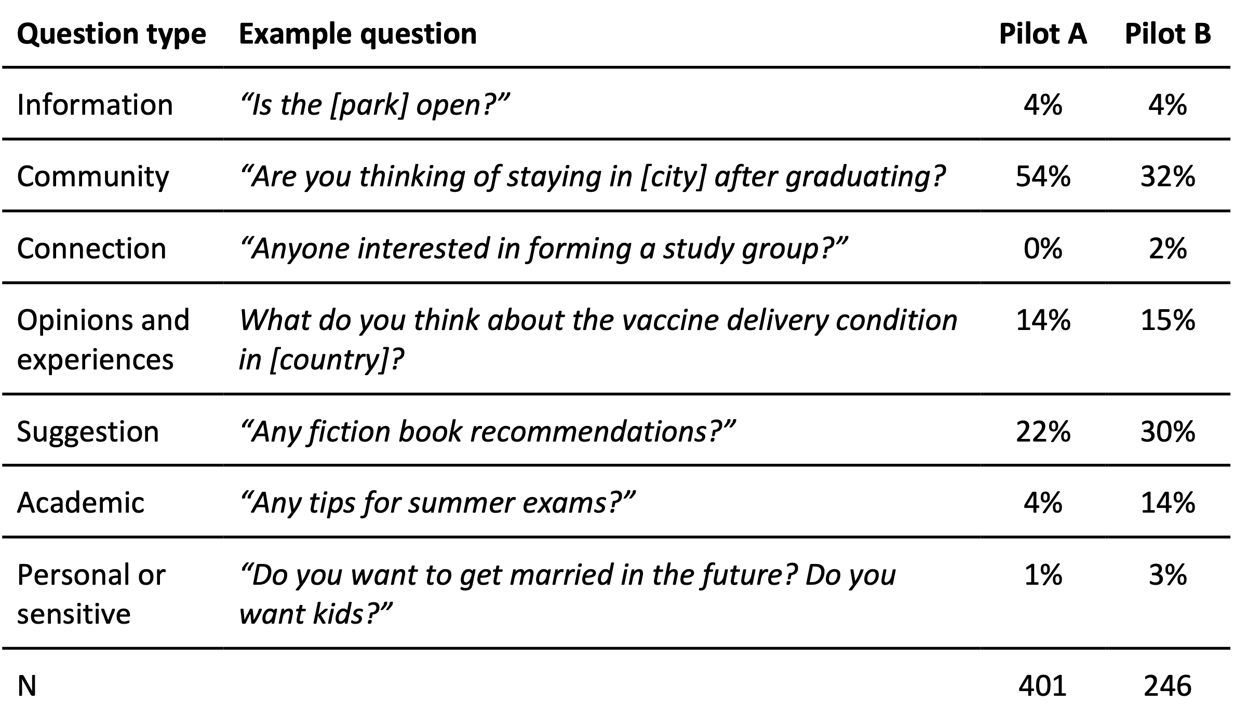
RQ3: What do student communities ask from others through a chatbot?

Slide 19
RQ2: How do people perceive a chatbot that connects community members through diversity attributes?
From a social networking perspective, the one-shot interaction is very uncommon, clearly a polarizing topic.
People liked it because enabled “more private”, “refreshing” not to engage in a longer conversation (eager to help someone, not to engage)
People minded it, because annoying and interruptive for “real conversations”

Slide 20
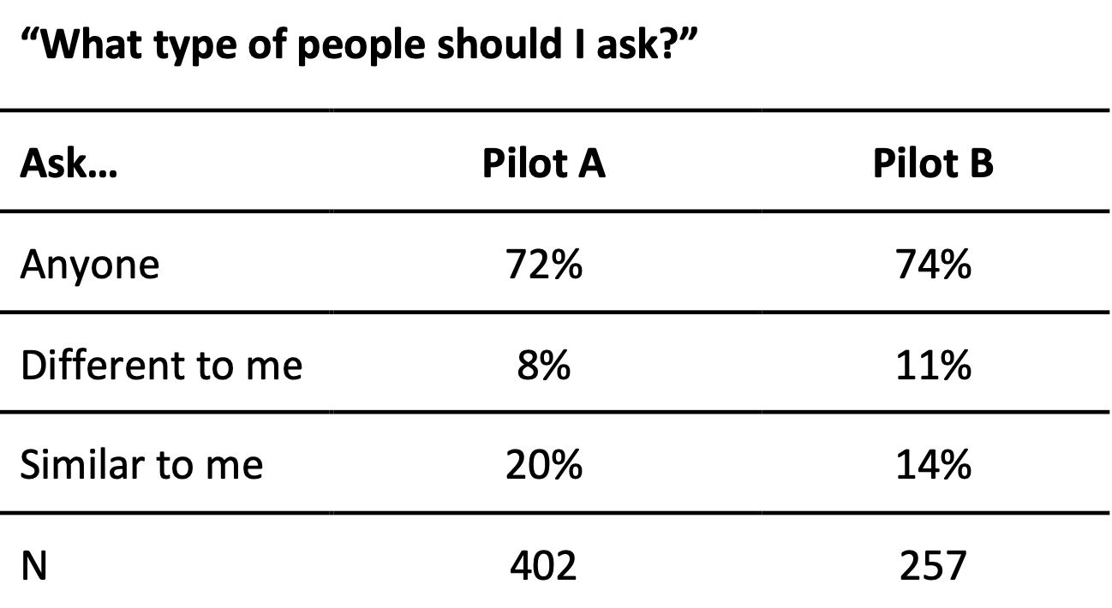
RQ1: What do people expect from being presented with diversity? How do people interpret diversity in use?
From the in-conversation research prompts
Content analysis of open-ended answers for prompts

Slide 22
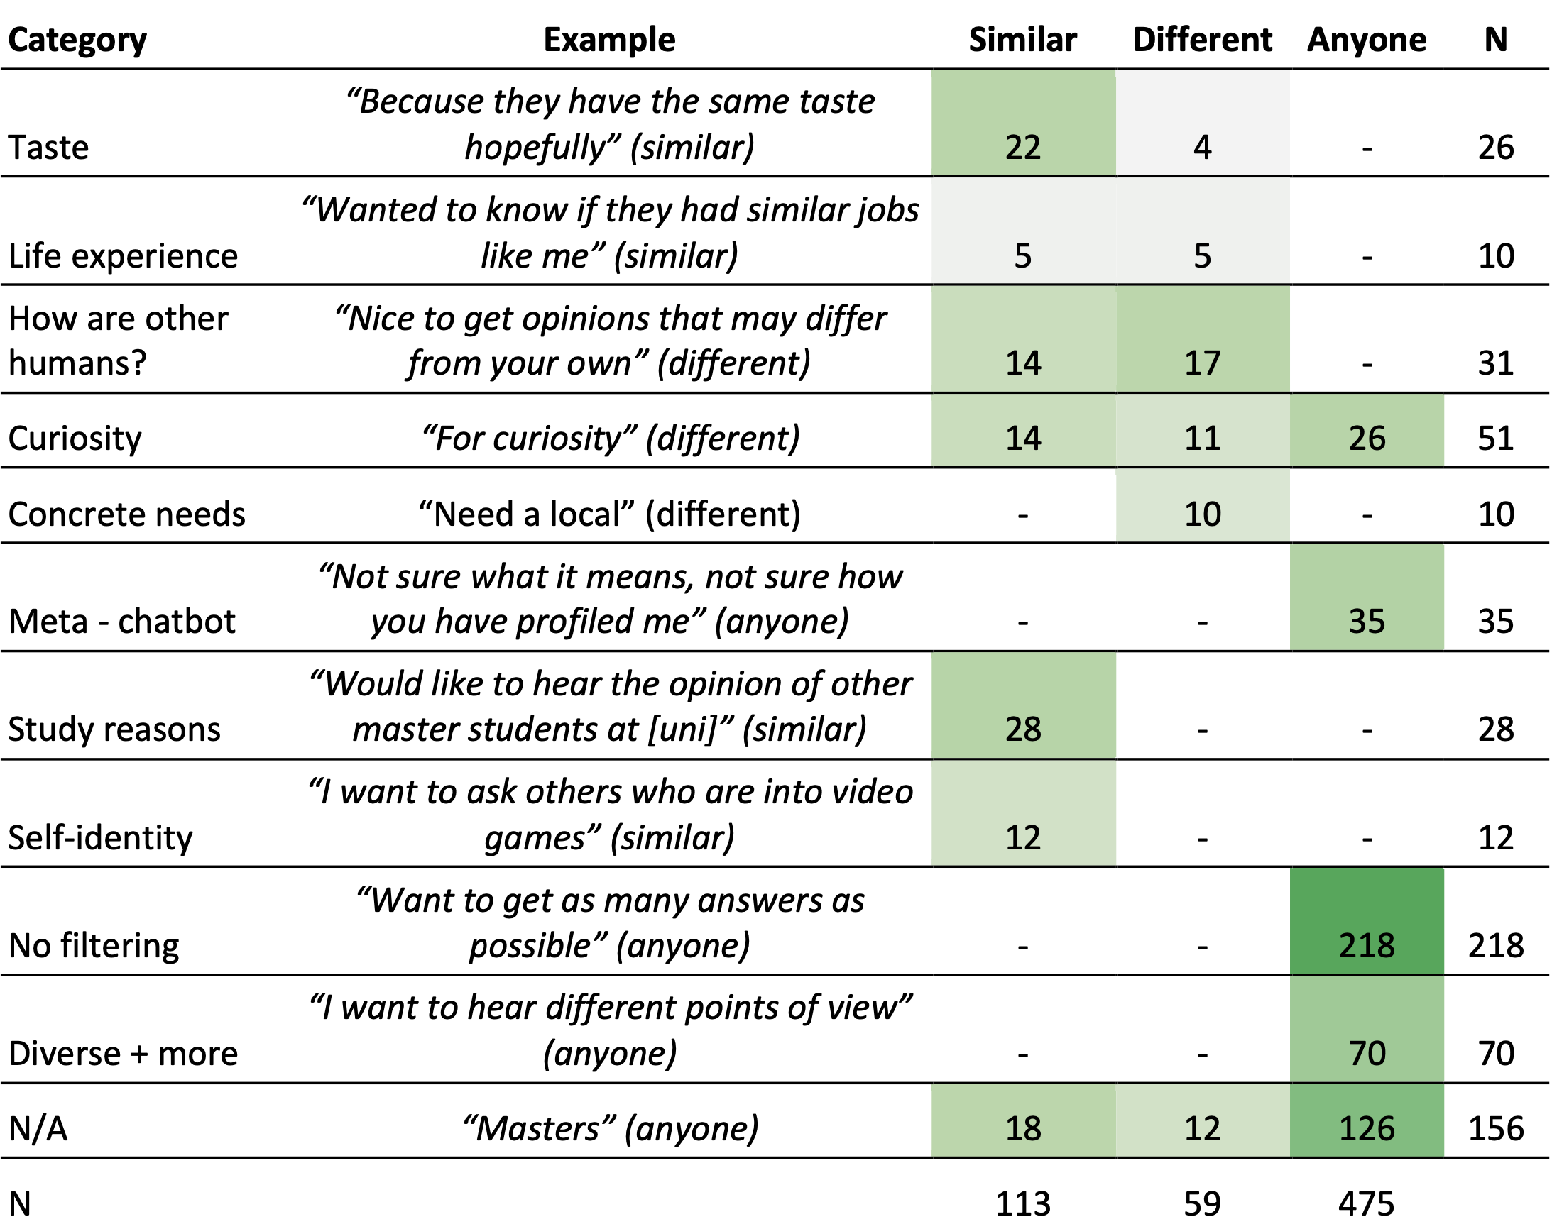
RQ1: What do people expect from being presented with diversity? How do people interpret diversity in use?
Lots of “useless data” --> Choosing anyone, giving generic answer
Qualitatively interesting when someone made a “polarized rationale”

Slide 23
Findings 🤔

Slide 24
People seek out to similar people, “their tribe” with niche interests.
When exposed to a system that targets diversity,

Slide 25
People seek out to different people driven by curiosity and serendipity
When exposed to a system that targets diversity,
(and not necessarily people with opposing views, as we expected)

Slide 26
Diversity-aware systems need user profiling. This is paradoxical with not wanting to normatively profile how people are different.

Slide 27
Future work 🚀

Slide 28
Next version of the chatbot implements a diversity-driven algorithm based on the findings.
Instead of a randomized algorithm, resembling wizard-of-oz.

Slide 29
Next version of the chatbot is an improved version based on the findings of this study.
Among these are user profiles with attributes for the algorithm, user agency in guiding the algorithmic matchmaking, asking sensitive or anonymous questions, etc.

Slide 30
Next study with the chatbot takes place with five pilot sites around the globe.
Including global south cultures, such as Paraguay and Mongolia.

Slide 31
Thank you! Questions?
Peter Kun, IT University of Copenhagen / Aalborg University Copenhagen
peter@peterkun.com
https://twitter.com/kuniiii
https://www.linkedin.com/in/peterkun/
https://doi.org/10.21606/drs.2022.807
WeNet project is funded by the EU’s Horizon2020 programme under Grant Agreement number 823783.

