Slide 1
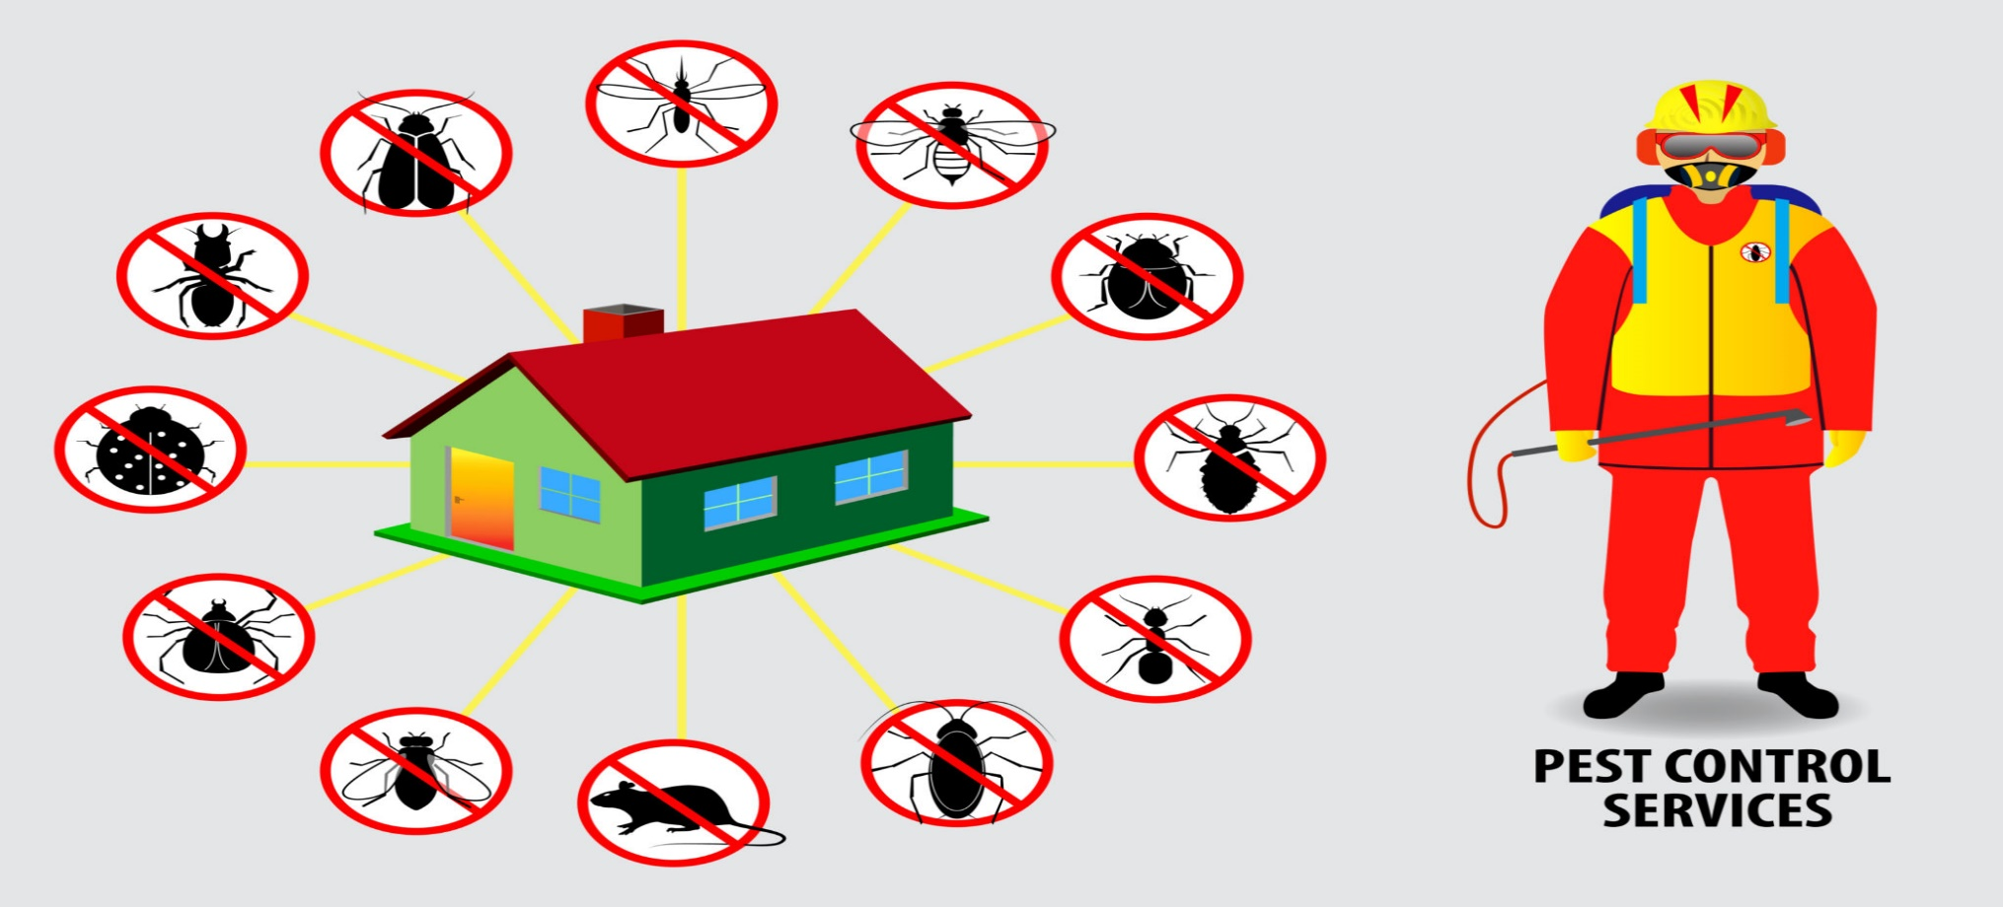
Get pest control services in Notting Hill to prevent that suits your requirements

Slide 2
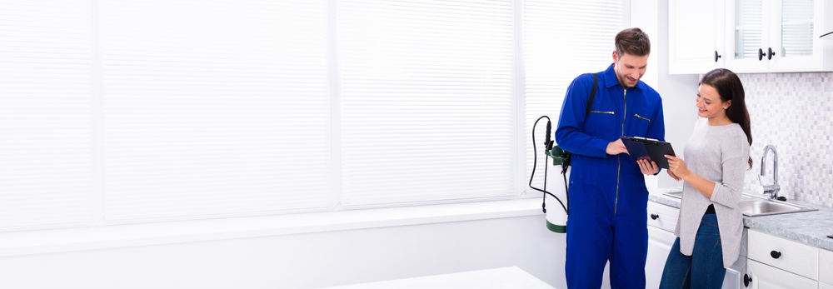
Pest management is a critical issue for any business. If you haven't considered hiring professionals for pest control in Hampstead, you're passing up many opportunities. In this section, we will go through the advantages of pest management in depth.

Slide 3
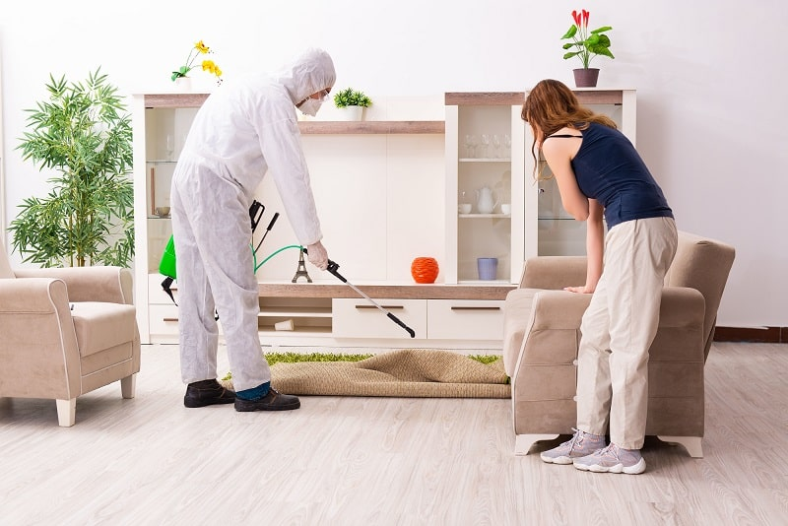
Are you getting bothered with a lot of pests in your home?
Pest control is an essential aspect of our everyday lives. It would help if you took precautions to protect yourself from pests. You don't want them to be a bother in your homes or offices. You need effective pest control services in Notting Hill for this purpose.

Slide 4

Pest control businesses supply us with instruments such as pesticides and pest controllers that we can employ for the work. A pest controller can kill spiders or ants to keep them out of the home or office. This blog aims to provide a comprehensive overview of pest control and the various sorts of pests that you need to treat.

Slide 5
Why is efficient pest management necessary?
You need pest control services in Hampstead, which are critical for ensuring physical and financial security. Without efficient pest treatment, you may encounter difficulty or impossible to eradicate pests.

Slide 6
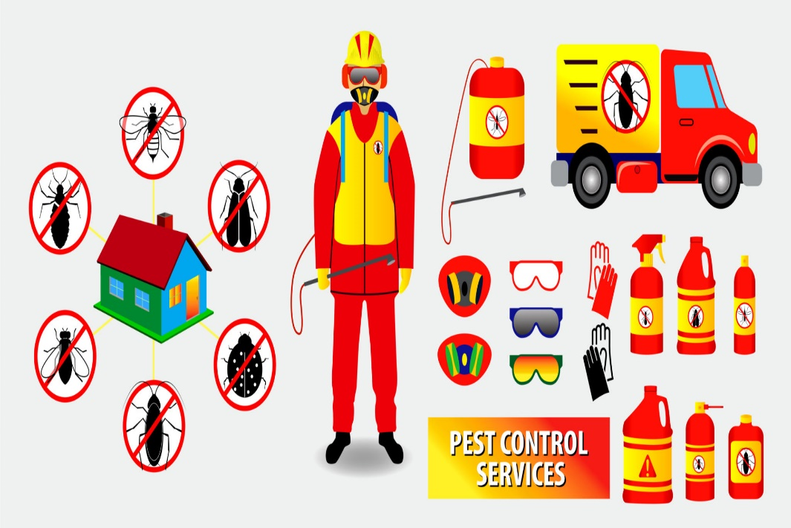
Pest control services can assist you in avoiding costly damage caused by a wide range of problems, such as rats, insects, and spiders. This blog's goal is to outline what pest control services can do to help you stay pest-free.

Slide 7
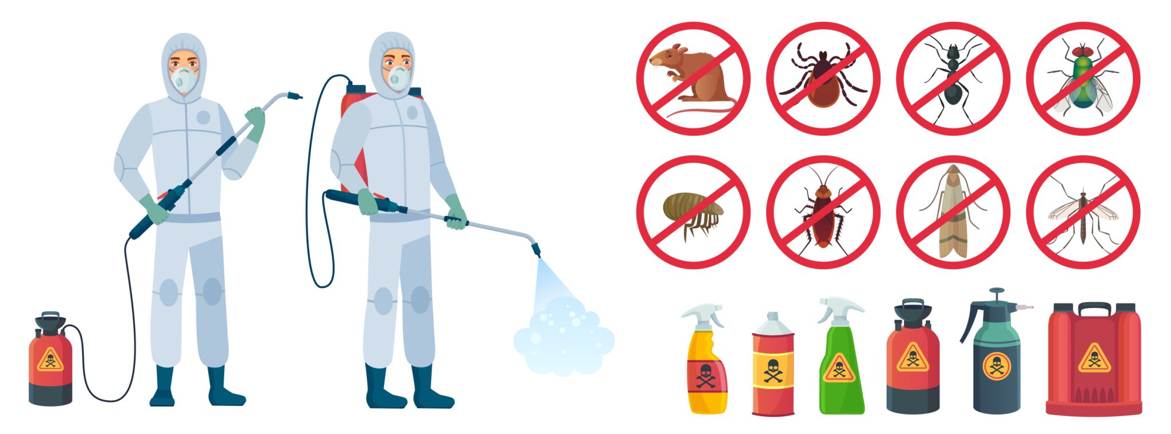
Pest control services can help you achieve your goals by eradicating undesirable pests from your home and assisting you in identifying and managing problems. Whether dealing with termites, cockroaches, spiders,

Slide 8
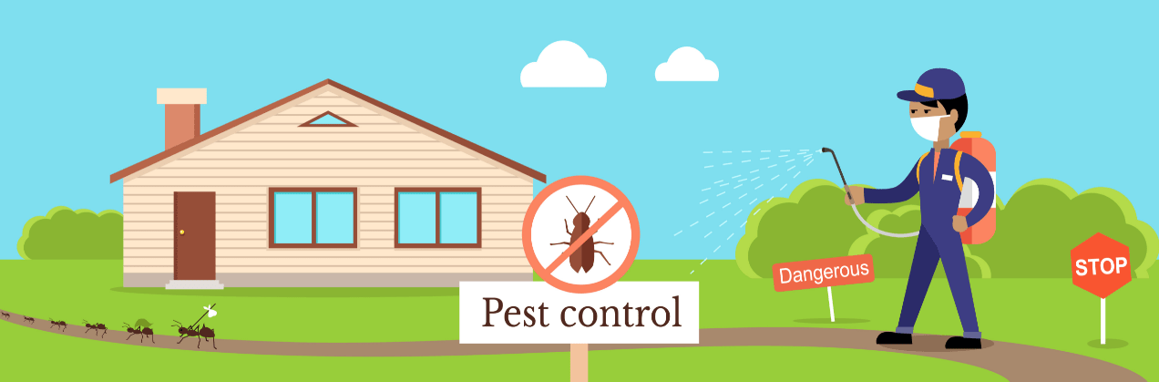
or other pests, you must take the necessary precautions to protect your property and belongings. Cockroaches, rats, and mosquitoes are just a few of the problems that might infiltrate your home. Hiring professionals for pest control in Notting Hill offer many advantages for organizations,

Slide 9
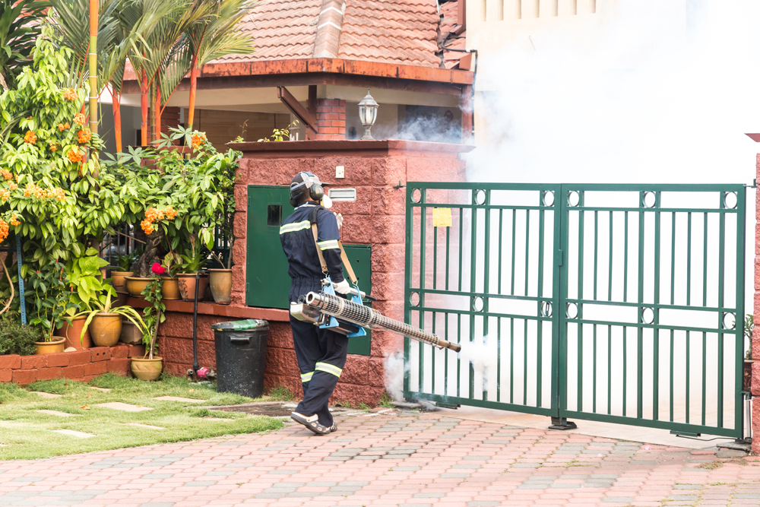
including preventing property damage, lowering repair costs, and protecting staff health and safety. Engaging professionals for residential pest control in Hampstead is integral to environmentally friendly gardening and landscaping.

Slide 10
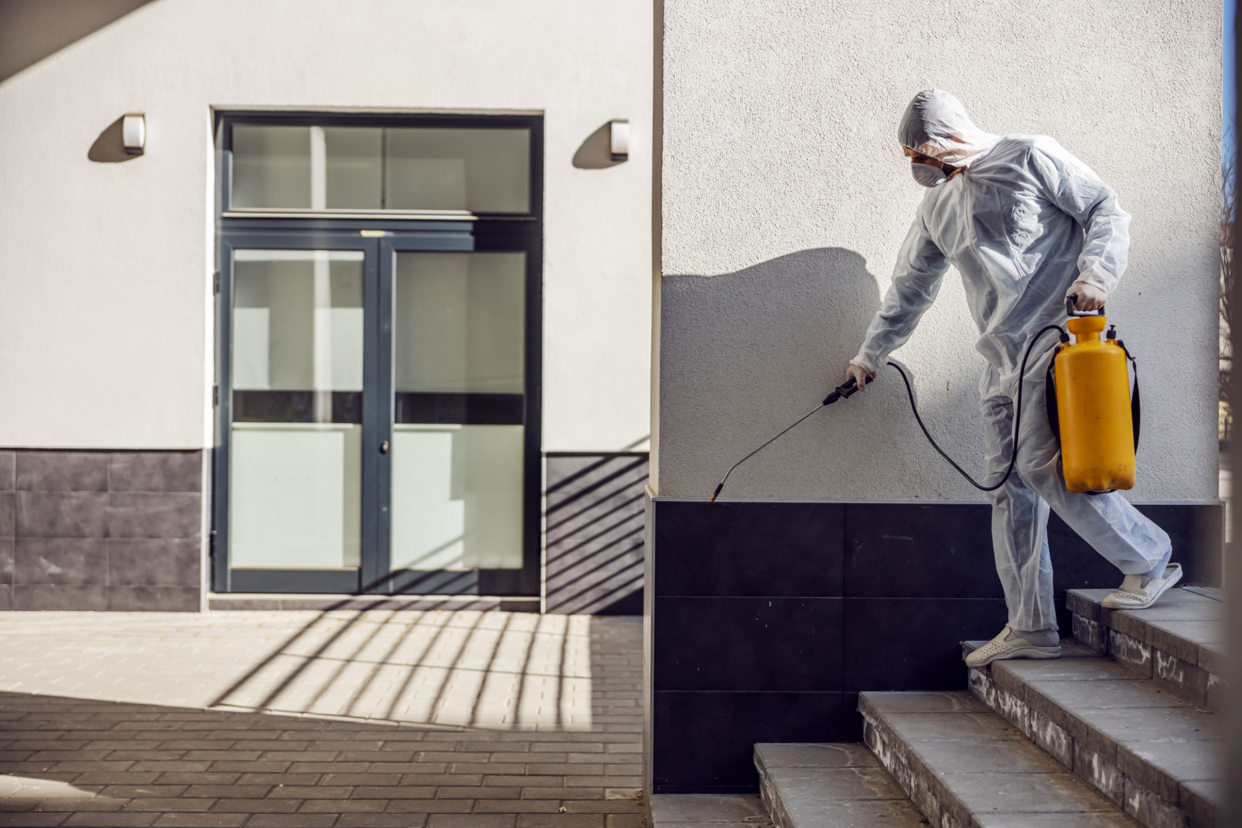
Without it, your plants will suffer, and pests may move in to take advantage of the vulnerable region. Pest control has become integral to many people's daily lives in recent years. Whether you're dealing with an ant, a rodent, or a cockroach, pest control can make your life easier.

Slide 11
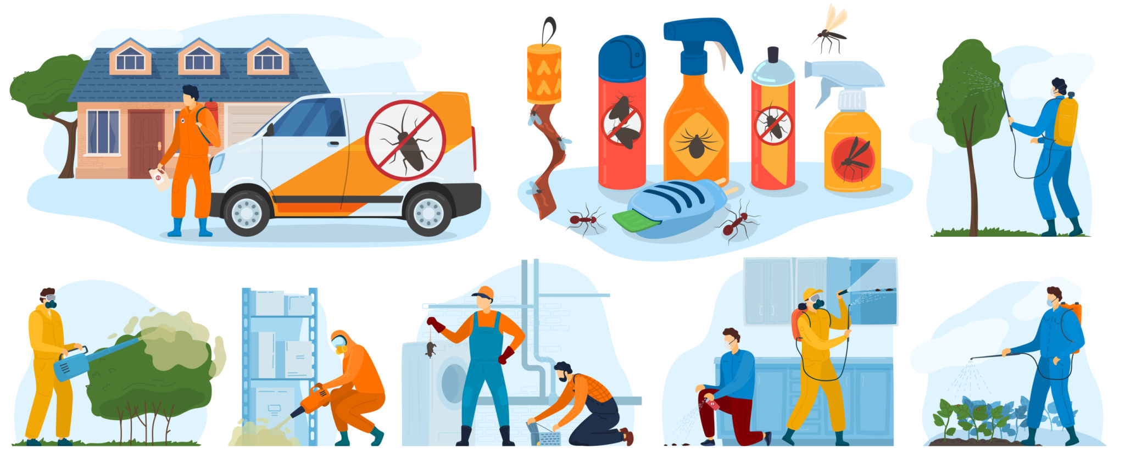
There are several methods for getting rid of pests, each with advantages and disadvantages. Engaging pros for the work is usually a big decision. Without pest control services, your property may face various issues, including infestations, damage, and loss.

Slide 12

Pest control services can help to alleviate these problems. It is critical to have specialists manage pest control so that you may live your life free of dread of them. Hiring a reputable pest control company such as pest link ensures that your house and business are treated with the most advanced technology.

Slide 13
Related Articles
Deal with pests in your home by getting pest control services in Notting Hill
Reasons why Households consider Pest Control a Tough Task!
5 reasons to hire residential pest control in Notting Hill
Avail the best services of pest control in Notting Hill

Slide 14
Contact Info
Business Address: 25 Dragonfly court, Heybourne Cres, London NW9 5UW, United Kingdom
Business Email: pestlinks@gmail.com
Business Phone: 020 3667 7226

Slide 15
Social Media Info
Twitter Facebook Google Map

Slide 16


