Slide 1
Liposuction in Dubai
If you are looking for look like smart and sexy then Liposuction in Dubai, Abu Dhabi & Sharjah Clinic Providing the best treatment want to know more click here.

Slide 2
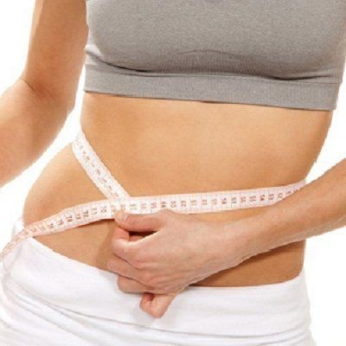

Slide 3
Liposuction in Dubai
In case you're doing combating a lump that just won't move, liposuction medical procedure may have entered your thoughts. By eliminating undesirable stores of abundance fat, liposuction improves body appearance and smoothes unpredictable or contorted body shapes. Safe liposuction medical procedure requests a meticulousness and care for the patient. Additionally, liposuction is for the most part a type of body shaping and not a weight reduction technique.
Liposuction, The Facts
The liposuction in Dubai method has changed significantly since it was first presented in 1979. The old medical procedures for fat and skin expulsion, for example, the "stomach fold", are essentially more unsafe than liposuction alone. Settling on an educated choice about having liposuction medical procedure necessitates that you have a sense of safety in your insight and comprehension of the method.
In the event that appropriately done, the liposuction shrivels the skin and results in a sensibly decent lower midsection shape, however this requires an accomplished specialist. The best possibility for liposuction are ordinary weight individuals with firm, versatile skin who have pockets of abundance fat in specific territories.

Slide 4
Liposuction in Dubai
Prior to medical procedure, the specialist may stamp circles and lines on the zones of your body to go through liposuction.
You should see completely the pre-employable arrangements, the liposuction technique, and the exact post-usable consideration. A liposuction cannula is a tempered steel tube embedded through an entry point in the skin that is utilized to attractions the fat.
Ultrasonic Liposuction
Ultrasonic helped liposuction (UAL) is a two-advance method that utilizes the vitality from sound waves to melt fat stores before they are suctioned. A few specialists may exhort ultrasonic liposuction for enormous volume extractions, particularly in intense zones, for example, the back, flanks and hips.

