Slide 1
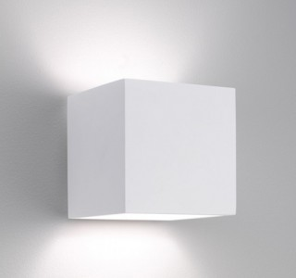
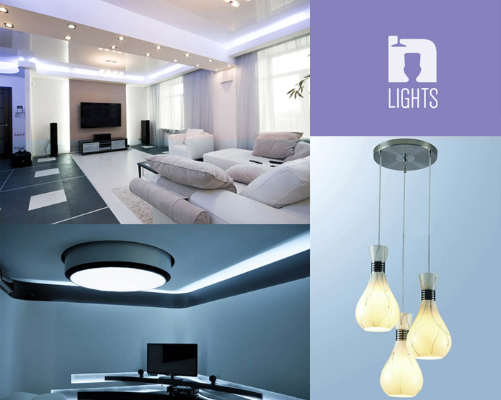
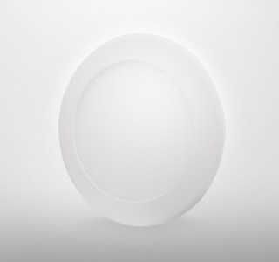
Wall Light Singapore
Decorating with wall lights is a great way to add an intimate or cozy look to a room. They tend to provide a softer look as compared to overhead lighting and they add interesting pools of light as well as mood-enhancing shadows.

Slide 2
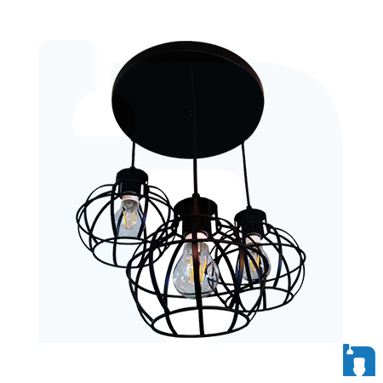
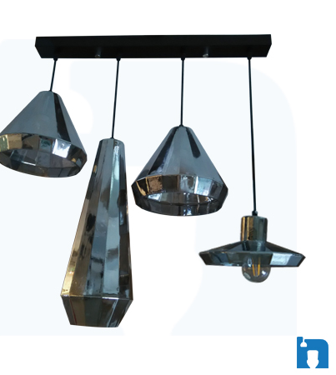
Chandeliers Singapore
At Lights N Showers, our motto is to provide the highest quality, most efficient bathroom, kitchen and lighting accessories for all your home makeover experiences.

Slide 3
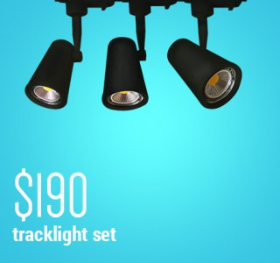
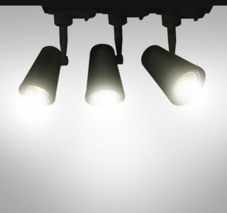
Track Lighting Singapore
Home track lighting can be used in virtually any room in the house. A popular room to use it in is a recreational room or game room. These are larger than normal home areas like the family room and benefit enormously from a flexible and configurable track lighting system. Billiard tables and ping-pong tables always need focused lighting from multiple directions so that body shadows are minimized.
Replace Your Old Boring Lights With Modern Track Lighting

Slide 4
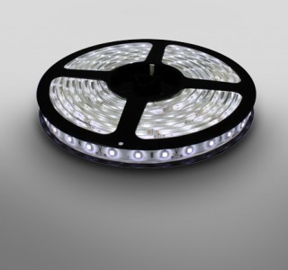
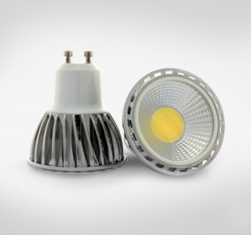
LED Lamp Singapore
With energy conservation on the minds of most people, using a LED lamp is one responsible and easy way to conserve energy. LED lamps can be used anywhere in the home and have many advantages over incandescent lighting. They do not use traditional light bulbs, but instead use a LED array or light stick, which lasts much much longer and never needs replacing.

Slide 5
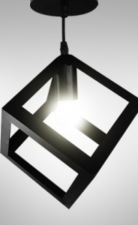




baths.sg
Wall Light Singapore
For inquiries please visit :

