Slide 1
Gambhir Cosmetic Medicine
https://www.drgambhir.com/ FOCUSED ON ELEGANCE IN REJUVENATION

Slide 2
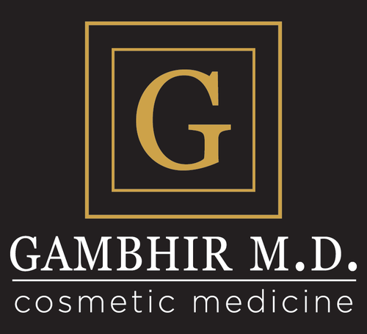
About Gambhir Cosmetic Medicine
Gambhir cosmetic medicine offers state of the art cosmetic procedures including Latisse, Platelet Rich Plasma (PRP), under eye fillers, coolsculpting, sculptra butt lift, thermage, miradry, radiesse, vitamin b12 injections, dark spot treatment, acne treatment, sclerotherapy, Botox for tmj & migraines, laser resurfacing, coolmini, cellulite reduction, collagen induction therapy, kybella for jowls, ultherapy, brotox, vein therapy, lipodissolve, fine line wrinkle treatment in Philadelphia, Exton, King of Prussia, PA. These treatments are for both men and women.

Slide 3
Our Address
668 W Lincoln Hwy, Exton, PA, USA 19341
491 Allendale Rd Suite 120A, King of Prussia, PA 19406

Slide 4
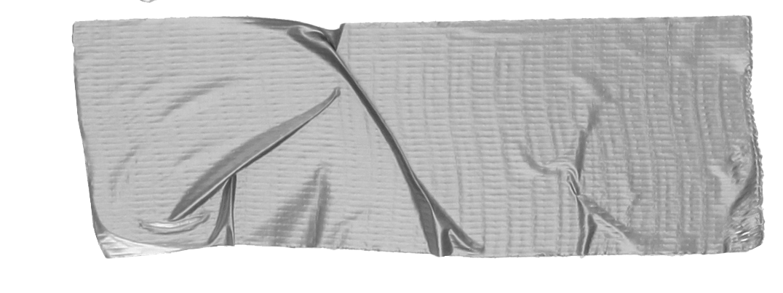

Our Phone #
📞 610-518-SKIN (7546)
Call us during office hours at
610-518-7546

Slide 5
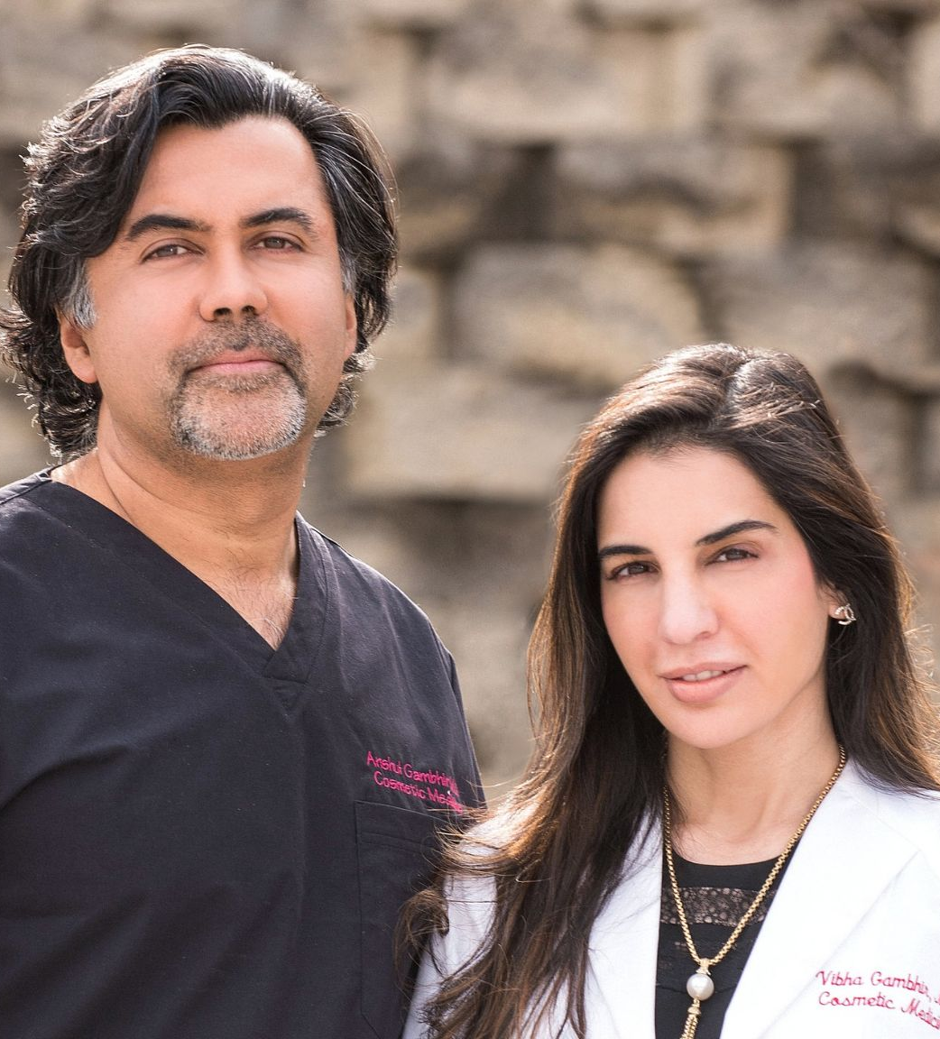
Our Doctors
Dr. Anshul Gambhir
&
Dr. Vibha Gambhir

Slide 6

PROUDLY TOP 10 IN THE NATION, #1 IN THE PHILADELPHIA AREA!
Youtube
We have tons of videos on Youtube already that explain some of the the procedures in detail.

Slide 7
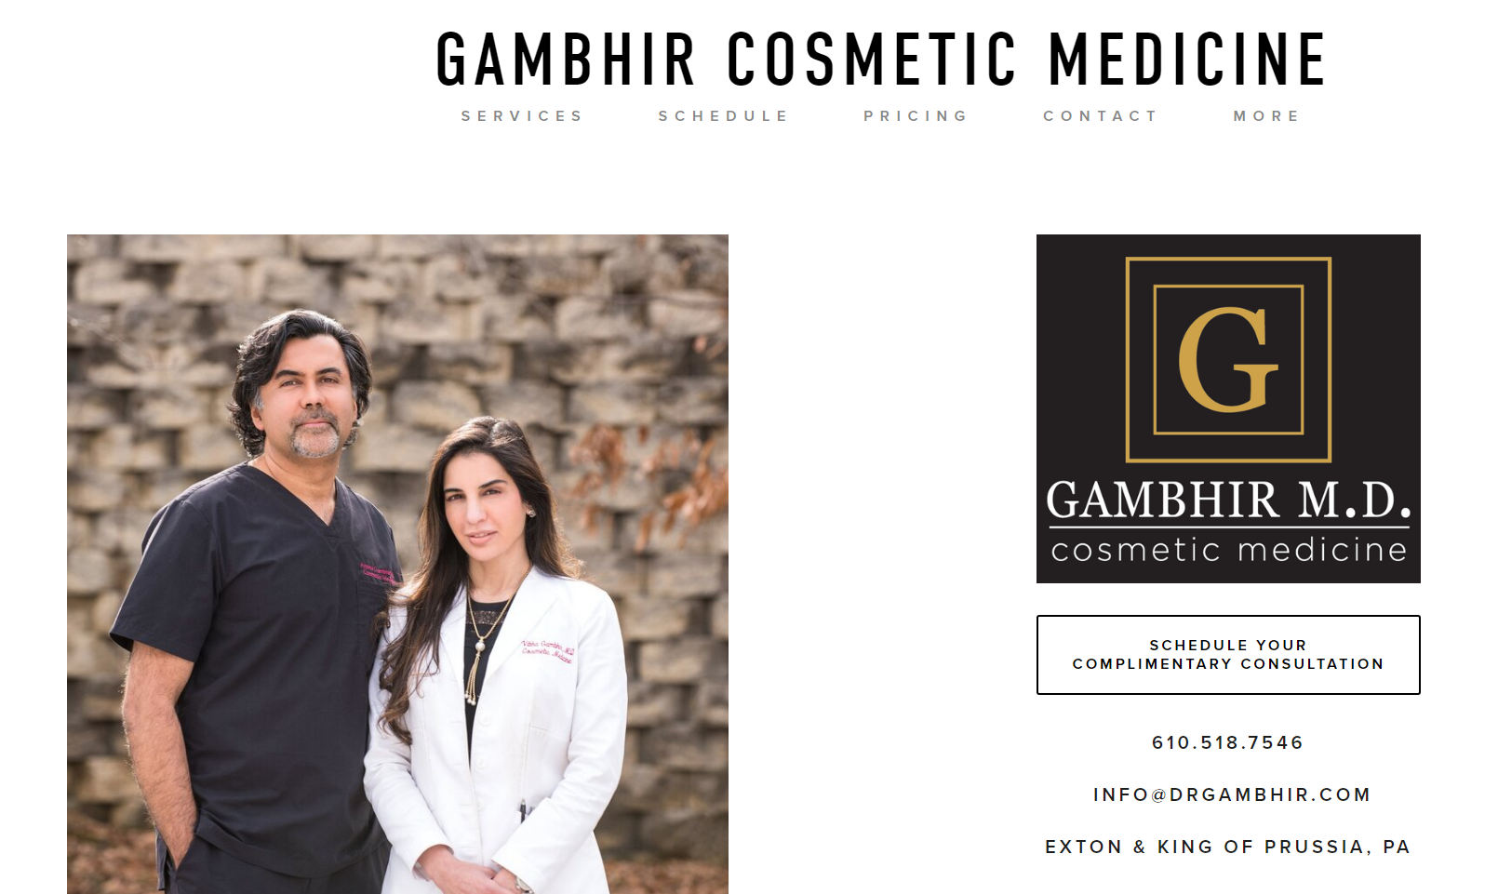
Follow us on social media
Facebook
Instagram
Twitter
Pinterest
Linkedin
Vimeo

Slide 8
Services we provide :
bellafill Exton
botox King of Prussia
cannula filler exton pa
Cannula filler king of prussia
coolmini King of Prussia
Hyperhidrosis King of Prussia
juvederm Exton
juvederm exton pa
juvederm King of Prussia
microneedling Exton
miradry Exton

Slide 9
Services we provide :
Ultherapy Exton
Ultherapy Kind of Prussia
Ultherapy Philadelphia
photorejuvenation Exton
platelet rich plasma Exton
prp exton
radiesse Exton
sculptra butt lift exton pa
sculptra butt lift King of Prussia
thermage Exton
thermage King of Prussia

Slide 10
Services we provide :
under eye filler King of Prussia
vollure Exton
vollure King of Prussia
botox Exton
coolmini Exton
dermal fillers King of Prussia
kybella Exton
latisse King of Prussia
miradry King of Prussia
platelet rich plasma King of Prussia
prp King of Prussia

Slide 11
Services we provide :
sculptra butt lift philadelphia
sculptra Exton
sculptra King of Prussia
volbella Exton
voluma Exton
collagen treatment king of prussia
hyperhidrosis exton
latisse Exton
radiesse King of Prussia
volbella Philadelphia
voluma King of Prussia
bellafill King of Prussia

Slide 12
Services we provide :
Collagen induction therapy exton pa
coolmini Philadelphia
dermal fillers Exton
hyperhidrosis exton pa
prp exton pa
under eye filler exton
volbella King of Prussia
coolsculpting Exton
fat reduction exton pa
kybella King of Prussia
thermage Philadelphia

Slide 13
Services we provide :
cellulite reduction exton pa
photorejuvenation Philadelphia
vollure Philadelphia
coolsculpting King of Prussia
collagen treatment exton
fat reduction King of Prussia
sculptra Philadelphia
laser hair removal King of Prussia
miradry Philadelphia
under eye filler exton pa

Slide 14
Services we provide :
laser hair removal Exton
laser treatment exton
tattoo removal Exton
hyperhidrosis philadelphia
med spa King of Prussia
tattoo removal King of Prussia
dark spot treatment exton pa
latisse Philadelphia
med spa Exton
Collagen induction therapy philadelphia
collagen treatment exton pa
collagen treatment philadelphia

Slide 15
Services we provide :
laser treatment King of Prussia
collagen treatment philadelphia
coolsculpting Philadelphia
microneedling King of Prussia
laser treatment exton pa
microneedling Philadelphia
laser hair removal Philadelphia
voluma Philadelphia
acne treatment exton
fat reduction philadelphia
collagen treatment philadelphia

Slide 16
Services we provide :
lipodissolve Exton
tattoo removal Philadelphia
under eye filler philadelphia
juvederm Philadelphia
kybella Philadelphia
acne treatment exton pa
acne treatment King of Prussia
acne treatment philadelphia
bellafill Philadelphia
botox Philadelphia
collagen treatment philadelphia

Slide 17
Services we provide :
Cannula filler philadelphia
cellulite reduction King of Prussia
cellulite reduction philadelphia
chemical peels Exton
chemical peels King of Prussia
chemical peels Philadelphia
Collagen induction therapy king of prussia
dark spot treatment exton
dark spot treatment King of Prussia
dark spot treatment philadelphia
dermal fillers Philadelphia
collagen treatment philadelphia

Slide 18
Services we provide :
laser resurfacing Exton
laser resurfacing King of Prussia
laser resurfacing Philadelphia
laser treatment philadelphia
lipodissolve King of Prussia
lipodissolve Philadelphia
med spa Philadelphia
photorejuvenation King of Prussia
platelet rich plasma Philadelphia
prp philadelphia
radiesse Philadelphia
collagen treatment philadelphia

Slide 19
Services we provide :
sclerotherapy exton pa
sclerotherapy King of Prussia
sclerotherapy philadelphia
vein therapy Exton
vein therapy King of Prussia
vein therapy Philadelphia
For full services list visit : https://www.drgambhir.com/services/treatment

Slide 20
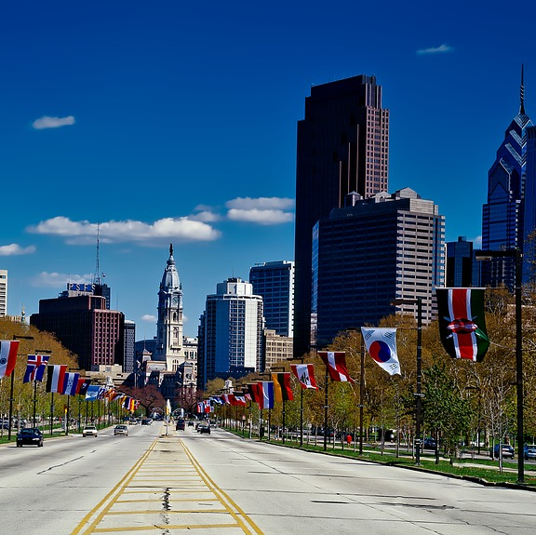
Gambhir Cosmetic Medicine
On the web:
https://nimb.ws/pdbCSP
https://nimb.ws/t1EHl3
https://nimb.ws/4Bfs0T
https://nimb.ws/Y4oylZ
https://cutt.ly/hl1cG9w

