Slide 1
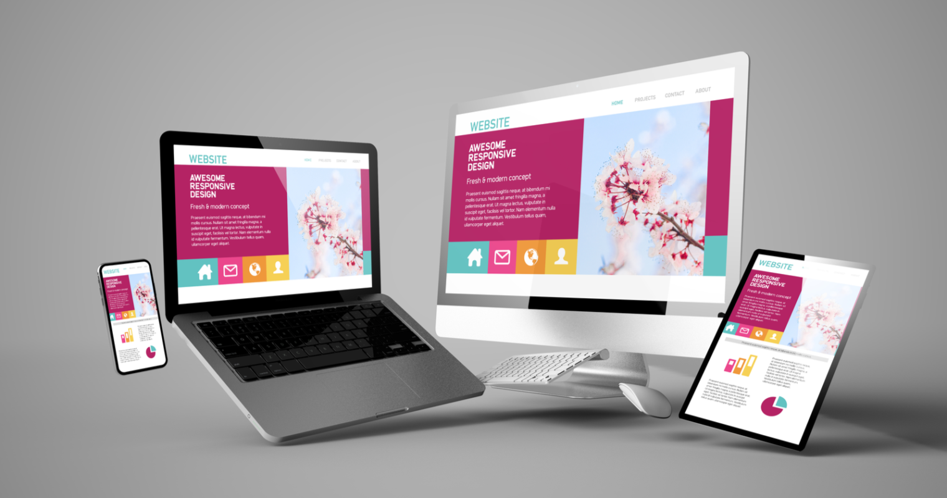

Understanding Difference Between the Custom Website and Traditional Website

Slide 2
What Kind of Web Design is good?
A template cannot be misunderstood for a custom website. So, with most of the traditional websites, a set pattern is followed and this is the reason why both of them are not alike. Many web design companies in Dubai profess to offer custom website development, however, this is far from true. They are essentially passing custom WordPress website templates at an inflated price. This can be hugely detrimental to the success of your site.

Slide 3
What Sets Custom Website Apart From Traditional Website
A template is in no way a custom website. There are several Web Design Agencies in Dubai that offer custom web design services at competitive rates. Only when a website meets the following criteria can it be considered custom-designed.
1. The website design is original right from the start 2. There is no use of any kind of template in its formation 3. Website is unique in itself and is not copied from anywhere
No this does not connote that any Concept Management System like Drupal, WordPress, Magento, etc cannot be used at all. You can use custom WordPress Development to create a website from scratch.

Slide 4
What is Custom Web Design
In a custom website, there is an amalgamation of corporate strategies with the goals of your company, and this is used to create something that is translated to a visual medium. It is a translation of your vision in form of a business website. You can easily use things such as the address of your company, its logo, etc to make the website design appealing to the eye.
Content is of paramount importance in a website design. So, make sure that it is such that it draws the attention of the user immediately and is informative at the same time. Good Website Development in Dubai ensures that icons, images, and videos are placed in a way to address the target audience.

Slide 5
Custom Website & Improvement Phase
A customer website keeps changing because the users desire something new now and then. Changes need to be made to make the website relevant as per the latest trend. The logo must have got outdated or the visualization needs to be changed. Customer web design facilitates website change in lieu of the growth of the business. Also, the younger generation is always on the lookout for something new and this is offered by custom webs design.

Slide 6
Custom Web Design V/s Website Template
Several Web Designers in Dubai offer custom website design services. Templates sites are made for all kinds of post-market alterations. On the other hand, a custom design site is synced to fulfill your needs and what you want. As the code is written primarily for a company the SEO value of the custom site is also better as compared to that of a template site. This is the reason why custom web design is more popular and costly.

Slide 7
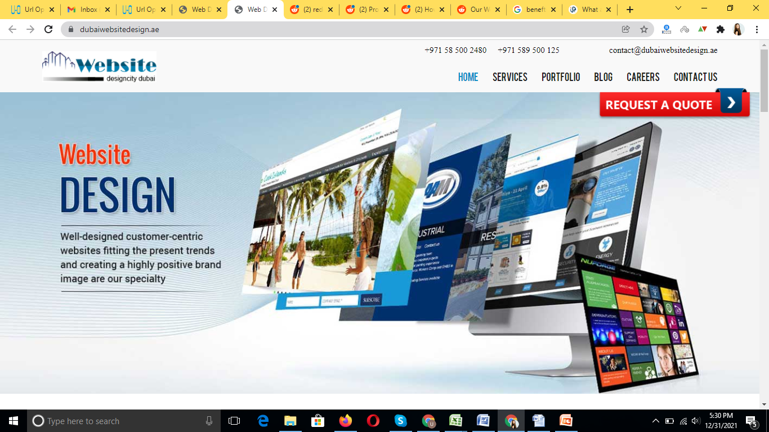
Thank You
Dubai Website Design
https://www.dubaiwebsitedesign.ae/

