Slide 1

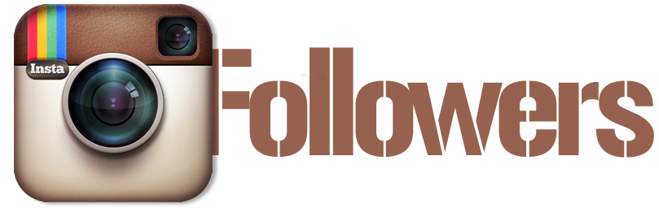
Get Free pokecoins in pokemon go http://negopolis.tv

Slide 2
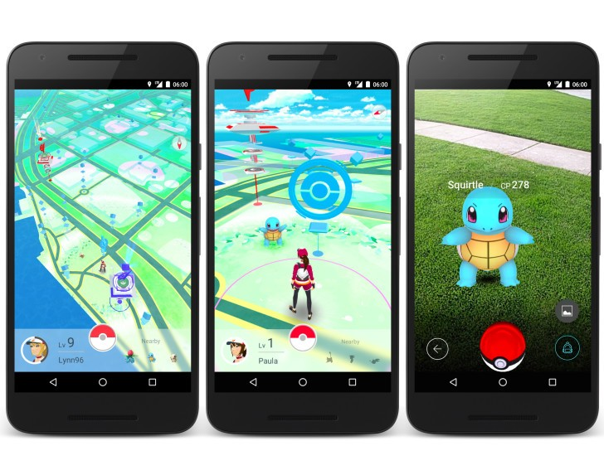

First download Office Mix, a free PowerPoint add-in
Tip:. Getting free Instagram followers is easy
Follow below steps:
1
Go to this website and check for the Instagram service.
Enter your username of Instagram and choose the amount of followers you want.
Choose your country.
Share our website for more followers.
2
CLICK TO DOWNLOAD
3
4

Slide 3
Kendall Jenner With 57.1m followers, Kendall Jenner - yet another of the Kardashian crew - is the ninth most popular Instagrammer. She also boasts the Instagram photo with the most ever likes. Although she found fame arguing about handbags with other Kardashians, she is now a fashion model and part of a growing trend of models using social media to gain notoriety.
Disney star turned singer Miley Cyrus has an Instagram feed reminiscent of non-celebs. 42.4m people follow her feed, which is filled with funny videos, animal pictures and selfies of her smoking.
18. Miley Cyrus Disney star turned singer Miley Cyrus has an Instagram feed reminiscent of non-celebs. 42.4m people follow her feed, which is filled with funny videos, animal pictures and selfies of her smoking.
Check this pokemon go hack online generator

Slide 4
Free Pokemon go pokecoins and pokeballs
We are able to be certain that you will not be departing our website with no pretty smile in your face, we've 100s of daily clients and none of them leaves with no smile, yes many people do encounter problems but our support team will always be exist for. Our devoted support team performance night and day to help keep our clients happy and satisfied, should you encounter any problems don’t hesitate to make contact with us or you require faster support please leave a remark. We usually react to comments inside the hour and emails within 24.
Definitely not. Unlike another websites, Buzzoid uses just the safest and also the most dependable techniques to provide likes and supporters for your instagram account. Whenever we say safest and secure, we imply that our method of delivering doesn't break any rules and relation to Instagram, and for that reason your bank account will be safe!
Using more than 77.3m supporters, US popstar Taylor Quick may be the second most adopted person on Instagram. Getting began her career in new bands, she entered to play 2008 using the launch of her album Courageous. She's now among the best-selling artists ever, getting offered greater than 40 million albums and 130 million single downloads.

