Slide 1
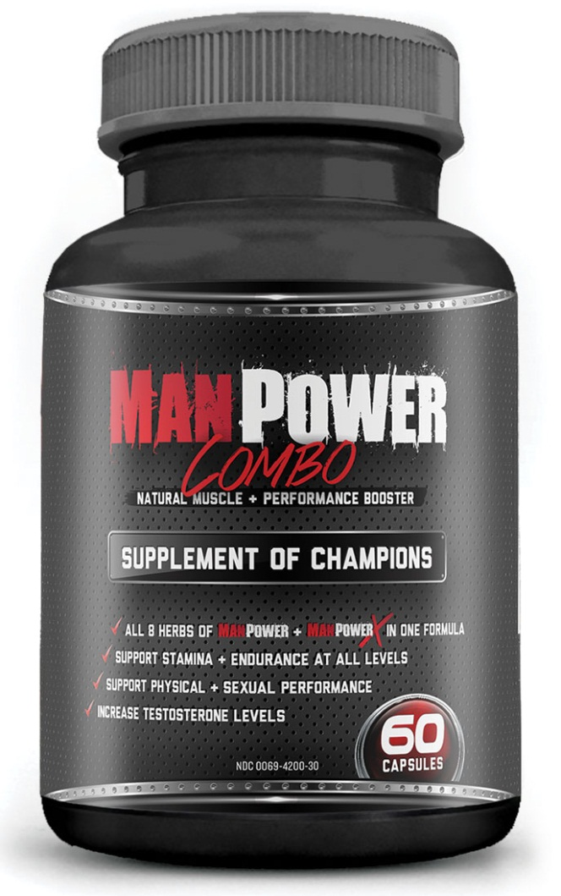
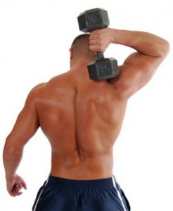
Natural Testosterone Boosters
This is a natural testosterone supplement formulated to be a powerful testosterone booster.
Natural testosterone boosters are a much healthier and safer option than artificial testosterone boosters. Because they are made from natural ingredients and are manufactured more carefully, natural testosterone supplements are a more sensible choice if you want to increase your physical performance, endurance and quality of life.

Slide 2
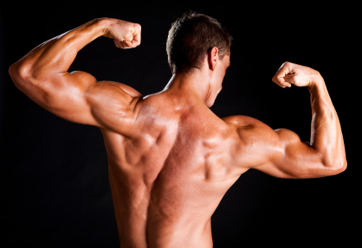
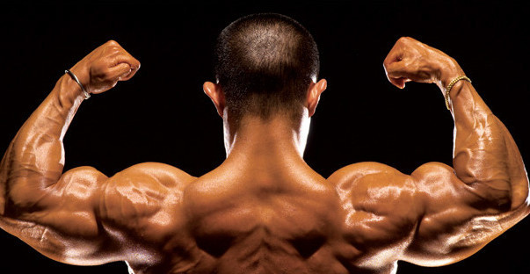
Natural Testosterone Supplements
Proprietary Blend (640mg per capsule):
Maral Root (Leuzea Carthamoides)
Golden Root (Rhodiola Rosea)
Siberian Ginseng (Eleutherococcus Senticus)
Five Flavor berry (Shisandra Chinesis)
Puncture Vine (Tribulus Terrestris)
Cordyseps Sinesis (Mycellum Extract)
Panax Ginseng root
Tongkat Ali root (Eurycoma Longiflora)

Slide 3
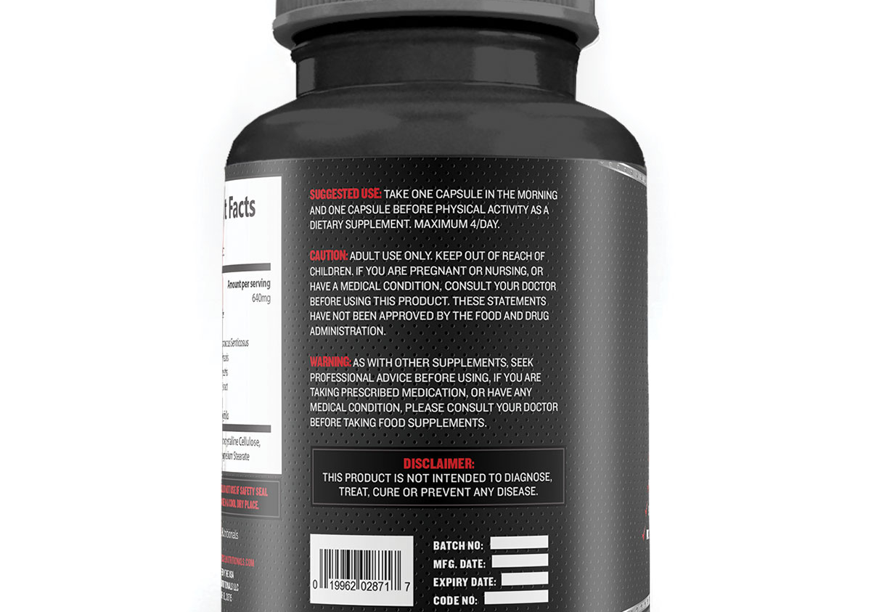
Best Testosterone Booster

Slide 4
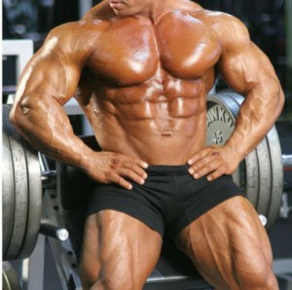
Testosterone Booster
Advantages Of A Natural Testosterone Booster
• Safer Than Artificial Testosterone Boosters
Because natural supplements are made from natural ingredients, they are obviously much safer than artificial ones. This is going to make the benefits more superior than the ones achieved using artificial testosterone boosters.
• Faster Recovery
Because a natural male booster is absorbed by the body much faster and much easier, you will be able to experience improved results. Your body will be able to repair itself more properly and more quickly. Your muscles will be able to mend faster, which will result to lesser muscle pain and faster recovery. Thus, your performance will be better and you will be able to improve your performance faster.

Slide 5
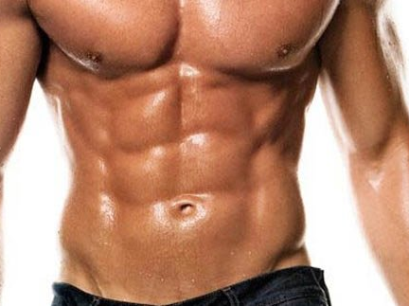





Natural Testosterone Boosters
www.phinaturals.com
For inquiries please visit :

