Slide 1
Trauma and silence in migration: lessons for politics, the media and the general public
Conference: The migratory experience: Adopting a three-generational perspective, Brussels, 26.4.2023
Wiebke Sievers, Austrian Academy of Sciences, Vienna
Notes:
Migrants have regarded literature as a means to make themselves heard in debates about migration for a long time.
Trauma and the resulting silence have been a central element of their writing.
In my talk, I will present selected works written by the Austrian writers Vladimir Vertlib and Julya Rabinowich to explain their take on trauma, silence and migration and discuss the lessons politics, the media and the general public can learn from their writings.

Slide 2
Silence as the voice of trauma
Silence is the common denominator found among all victims, signifying a state of survival functioning where words fail and verbal recollections may have destroyed a fragile ego. Silence in response to massive trauma constitutes also a self-protective, self-imposed firewall to avoid total psychic fragmentation.
(Maria Ritter: Silence as the voice of trauma, The American Journal of Psychoanalysis, 2014, 74, 180)
Notes:
Let me first say a few words about the link between trauma and silence.
Sigmund Freud described trauma as a void as early as 1896 in a letter to his friend and colleague Wilhelm Fleiß
This idea that trauma is an empty space has been taken up in more recent trauma research
Cathy Caruth for example speaks of trauma as a „gap that carries the force of the event and does so precisely at the expense of simple knowledge and memory“ (Caruth, Trauma and experience, 7)
So the event that led to the trauma leaves a trace in the memory of the person, but this trace is not the remembrance of the event, it is the absence of the event.
This is the reason why silence can be described as the voice of trauma – as Maria Ritter did it in an article
Press, Quote
She describes silence as a result of trauma because „words fail“. The person cannot form a narrative of what has happenend, at least not in the sense of a coherent story.
At the same time, this silence is also a form of „self-protection“, a „self-imposed firewall“, as Ritter calls it.
So how did Vladimir Vertlib and Julya Rabinowich translate „silence as the voice of trauma“ into novels?
And what lessons do these novels teach politics, the media and the general public?

Slide 3

Vladimir Vertlib
© Aleksandra Pawloff
Notes:
Vladimir Vertlib is an established Austrian writer of Russian Jewish origin.
Of the eleven books he has published thus far, three have been inspired by his own migration experiences.
Vertlib was born in Leningrad in 1966. Around this time, his parents became involved in an illegal Zionist movement that opposed the Soviet ban on emigration to Israel.
They suffered from repression, especially after they had applied for emigration in 1969 (Vertlib, 2007, 20-22).
In 1971, they were permitted to leave for Israel but moved on within a year.
This was the beginning of a ten-year odyssey to find a new home.
Their continuous migrations took the family, amongst others, to Rome, Vienna, Amsterdam, and Boston.
After their deportation from the United States in 1981, they eventually settled in Vienna where Vertlib completed his education.

Slide 4

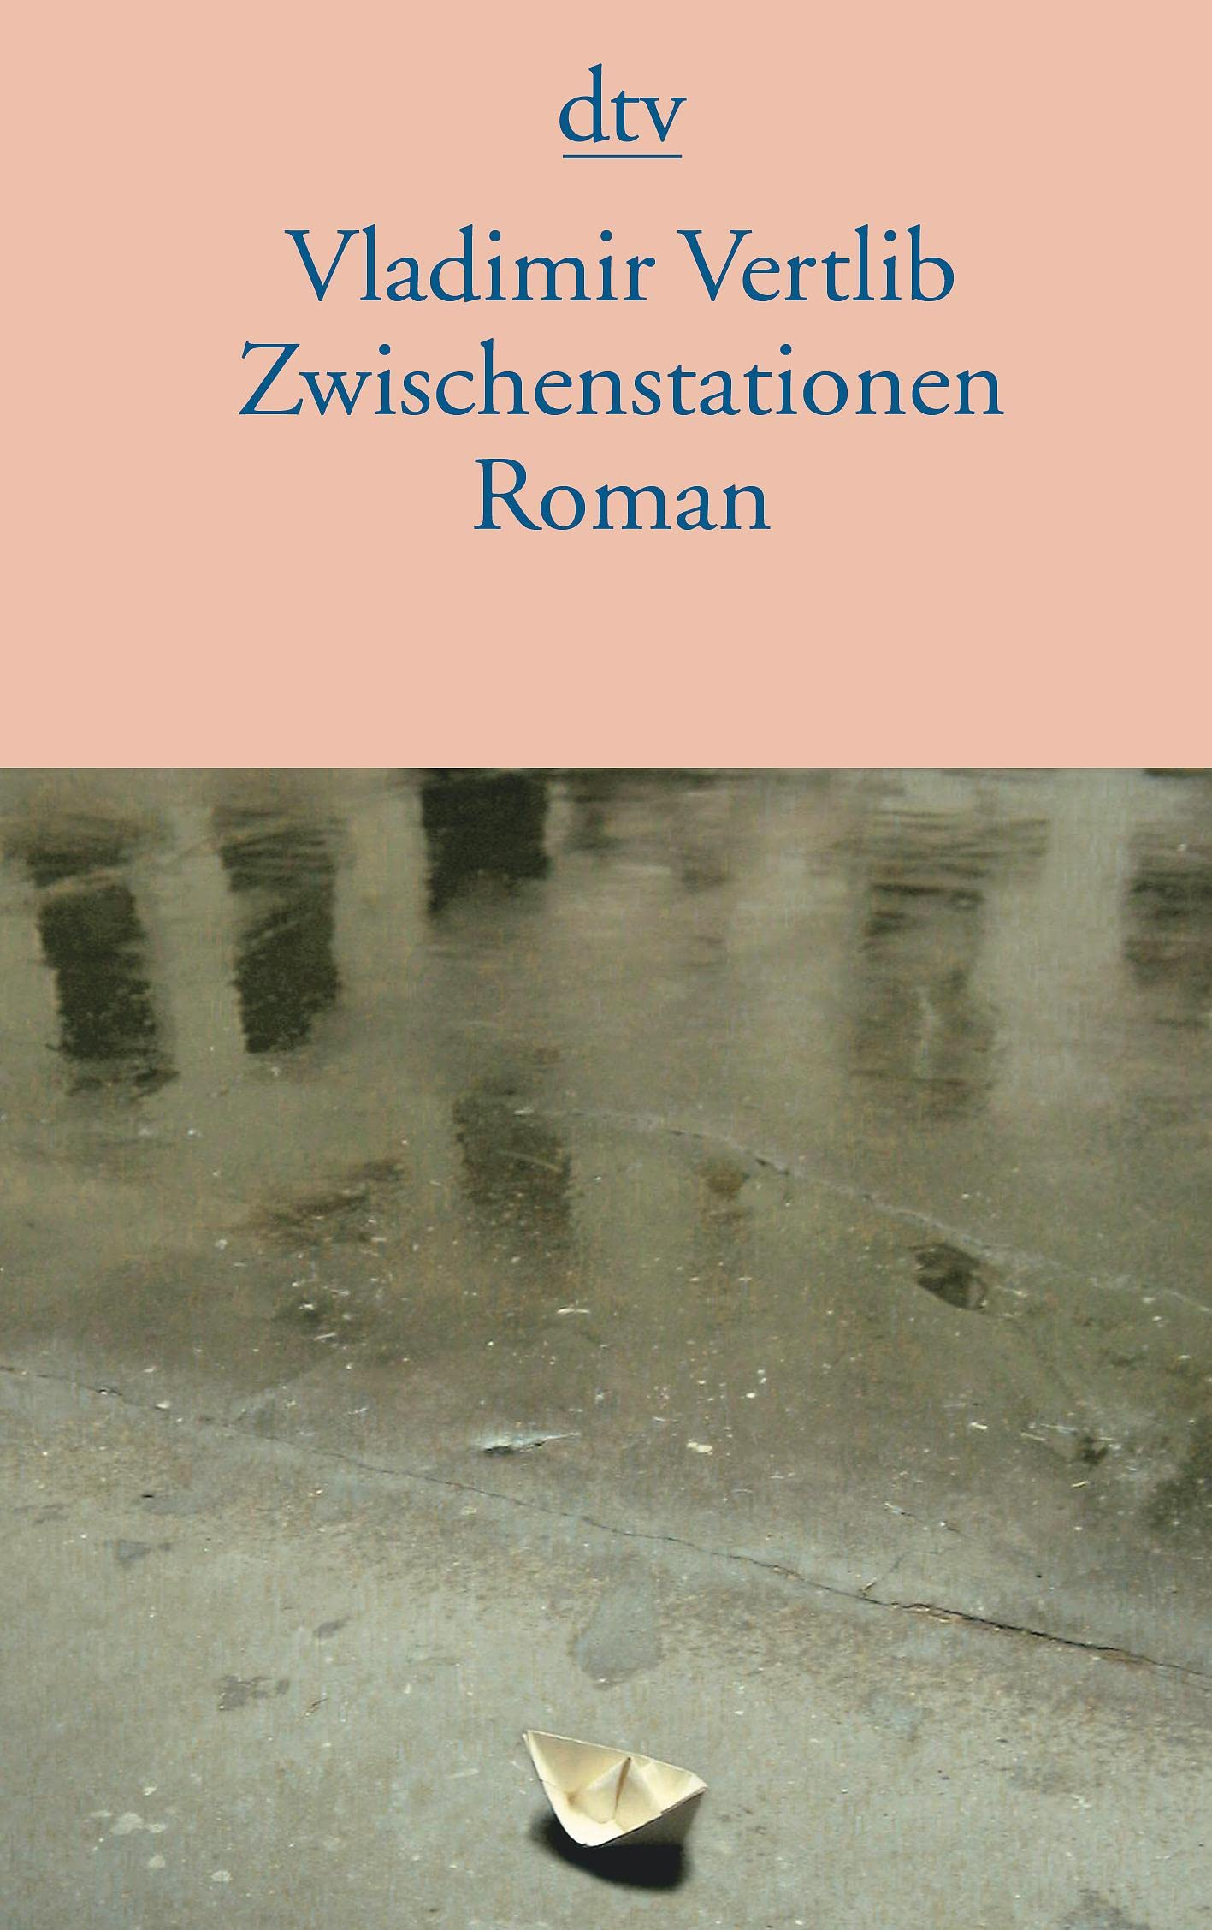
Silence as a protective mechanism
Notes:
Vertlib began to explore the danger of speech and the habitus of silence in his literary works in the early 1990s.
His debut Abschiebung (in English: Deportation), published in 1995, deals with the deportation of a Russian-Jewish family from the United States to Germany. The narrator retrospectively grapples with the trauma that he may have been responsible for their deportation because he told the immigration officers the true story behind their illegal immigration to the US.
Vertlib’s second book, Zwischenstationen (in English Transit Stations), published in 1999, relates the ten-year long odyssey of a Russian-Jewish family in search of a home. In this long process, the son learns from his parents to remain silent.
Both texts draw on the author’s own experiences but should not be misread as telling solely of an individual fate.
Rather, they reveal the societal mechanisms that silence refugees and illegalised immigrants and cement their exclusion.
They portray how silence becomes a strategy against the fear of a world whose “deep-seated and horrible hostility never sleeps”, as Didier Eribon wrote in his study La société comme verdict. “This fear,” he continues “urges all those whose ‘stigma’ is not visible to hide it.” (47)
One of the consequences of this silence is that the host society learns little about what it means to be an illegalised immigrant or a refugee and has little understanding for the stories migrants tell once they decide to speak.

Slide 5
Inheriting silence
Few people know that my parents and I lived in Israel and Austria. No one is allowed to know that we came to America on a tourist visa, let alone that we bought it. My father told me that if I told anyone, we would all go to jail. But first he would tear my head off.
(Vladimir Vertlib, Zwischenstationen, München, 2005, 202)
Notes:
In Deportation we learn that silence as a protective mechanism has a long history in the family.
The young protagonist is the descendant of two Jewish families whose ancestors were murdered in the Holocaust.
The very few photos and artifacts left of these ancestors were destroyed by their surviving descendants at the height of anti-Semitist repression in the Soviet Union in the 1950s.
The protagonists’ parents have inherited the trauma from their ancestors.
It is the father’s paranoia that explains the family’s constant migrations.
Furthermore, their anti-Semitist experiences in the Soviet Union have taught them to keep silence about the past and the fact that they are Jews.
The novel Transit Stations tells the story of how this habitus of silence is transferred to the next generation.
The young protagonist learns from his parents to hide his roots. But unlike his parents, he does not only hide his Jewish heritage.
For him silence becomes a mechanism of protection in migration.
I will give you one example of how he learns the mechanisms of silence from his parents in his childhood.
When the young protagonist is 6 years old, he learns from his mother that “Speech is silver, but silence is golden”
This first parental lesson in silence follows a conflict with the mother’s boss in Austria where they reside after their second migration.
The boy’s mother is a mathematician and knows German, but could only find work as a cleaning woman.
Her Austrian boss savours her little bit of power over her foreign subordinates to the fullest. She emphasizes her superiority by giving them orders in pidgin German.
The mother silently accepts her boss’s racist behaviour, but the boy inadvertently questions her power when he asks why she uses incorrect German (Vertlib, 2005, 71).
In her anger, the boss demands that his mother should not be allowed to bring her child to work. Since she has no-one to look after him, this would have meant the loss of her job and her income which is absolutely necessary for the survival of the family.
That is why the mother teaches her son his first lesson in silence.
He has to learn not to question the majority, to accept the derogatory behaviour of the native population in order to survive in a society that rejects migration.
It takes him several years to accept this.
Only when they live in the United States as illegal immigrants does he fully understand the importance of silence
QUOTE

Slide 6
The vicious circle of silence
He was sorry that I had to leave, but otherwise he was completely uninterested in my fate and even more so in the circumstances in which our family had found itself, because he didn't really understand a word. How could he?
(Vladimir Vertlib, Abschiebung, Salzburg, 1995, 169)
Notes:
All of this does not mean that Vertlib’s protagonists do not have the desire to speak.
However, when they break the habitus of silence, there is little understanding among their listeners for what they have to say.
A scene from his first work Deportation illustrates this vicious circle of silence. When the young protagonist tells a friend in the United States about his precarious situation shortly before he and his family are deported, his friend shows no interest in what he has to say.
Quote
The protagonist’s friend cannot link his story to his own reality. All that counts in his young life are the latest musical trends and his current love object. He does not spend his days translating documents for his parents, ringing immigration offices to make appointments or asking consulates for support. This world is foreign to him. He cannot make sense of what his friend tells him. That is why he remains silent when the protagonist has completed his story.
Vertlib’s works provide insight into a vicious circle of silence that explains why it is so difficult to overcome the societal lack of knowledge about immigration. Illegalised immigrants and refugees do not dare to speak. This leads to a lack of knowledge even among their closest friends who do not understand what they have to say when they finally decide to break their silence.

Slide 7
Lessons to be learned
Create an atmosphere in which migrants dare to speak
  Cp. antisemitism
  Prohibit anti-migrant mobilisation
  Implement measures against xenophobia and racism (e.g. reporting, education)
Provide platforms for migrants to make themselves heard
  Facilitate the publication of their writing in newspapers, magazines
  Support literature, films etc.
Listen to what they have to say
  Learning process
Spread the word
Notes:
So what are the lessons to be learned from Vertlib‘s novels?

Slide 8

Julya Rabinowich
© Rudolf Gigler
Notes:
Julya Rabinowich‘s migration history is very similar to Vertlib‘s
She was born into a Jewish family in Leningrad in 1970 and fled from the Soviet Union with her parents and grandmother when she was 7 years old

Slide 9


Splithead as the silent voice of the trauma
Notes:
Trauma and silence are at the centre of her writing from her very first publication Spaltkopf, also available in English translation under the title Splithead
Her debut uses a very convincing narrative form to describe how trauma works in individuals, how events are repressed and how they come back to haunt the individual
She invents the figure of the splithead who tells the story of the trauma that the family members cannot tell
In the novel, a woman uncovers the trauma haunting her family and herself.
The protagonist’s great-grandfather was murdered in a pogrom. Her grandmother witnesses the murder of her father and is traumatized for the rest of her life.
She transfers the trauma to the protagonist’s mother who denies her Jewish roots and does not explain to the protagonist what being Jewish means.
The family flees from the Soviet Union to Austria.
This migration leads to a change in the response to the trauma in the protagonist.
When they migrate, the young girl leaves behind her very first love, a Russian boy who never responds to her letters
She does not know that his silence is due to her being Jewish
So she reacts by denying her Russian roots.
Splithead then is a novel about overcoming traumatic silence and turning the trauma into a narrative that allows to make the traumatic event part of individual memory and official history

Slide 10


Trauma and silence in asylum procedures
Notes:
The Earth Eater (2013), by contrast, is a novel about a character who denies her trauma and in the end dies
Central to the novel is the idea that we cannot clearly differentiate between economic migrants and refugees
- On one level, the novel tells the story of an economic migrant, a woman called Diana from the Russian republic of Dagestan who has entered the EU illegally to work in Vienna as a sexworker and finance the lives of her mother, sister and sick son back home; but the exhausting job and the fact that she is constantly under threat of deportation lead to a nervous breakdown; she receives psychological treatment, but the fact that nobody can help with her desperate situation ultimately leads to her death
- At the same time, this economic migrant is also a member of a persecuted minority: Diana was present when her Jewish father was killed, but she has suppressed the memory of this traumatic experience; this implies that she cannot tell this story because she is not even aware of it herself; so the trauma prevents her from claiming her right to asylum – the economic migrant who dies is in fact a refugee who did not receive the support granted by the Refugee Convention

Slide 11
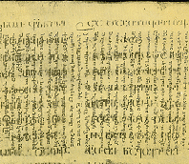
Traces of trauma
Mother was mopping our doorstep with her bare hands even in the freezing cold. Her skin cracked and popped, little red lines in the dark brown. The fingernails red and the fingers. She washed the doorstep every day to keep it clean and fresh for father, so that when he returned he would find a cosy home.
A Georgian palimpsest from the 5th or 6th century. www.opentext.ge.
Notes:
The novel is intentionally written in a style that makes it difficult to grasp the suppressed trauma of the protagonist.
This is meant to show us how difficult it is to identify a trauma in a person, how easily we fall for the story that the person tells us instead and how easily we therefore condemn a person to illegal status and the constant threat of deportation even if this person should be granted the right to asylum
I want to show you one example to illustrate how the author hides the story of the traumatised refugee in her novel
PRESS
In a way, you can read the text as a palimpsest – one story is told on the first level, another story is told on the second level!
In the first chapter, the woman tells us about her mother who is absolutely convinced that her husband will return. That is why she washes the doorstep every day.
PRESS Quote

Slide 12
Traces of trauma
Mother was mopping our doorstep with her bare hands even in the freezing cold. Her skin cracked and popped, little red lines in the dark brown. The fingernails red and the fingers. She washed the doorstep every day to keep it clean and fresh for father, so that when he returned he would find a cosy home.
A Georgian palimpsest from the 5th or 6th century. www.opentext.ge.
Notes:
However, the image includes unconscious traces of the traumatic event – the murder of the father on the doorstep.
The narrator refers several times to the colour red - the red lines in the dark brown, the red fingernails and nails. She links this to the cold, but in fact the red colour is the father’s blood.
The mother washes the doorstep every day because her father was killed on the doorstep. It is a compulsive disorder linked to the trauma. Cleaning the doorstep from the blood is her way of convincing herself that the murder has never happened.
At some stage, the woman has a breakdown, is taken to a hospital and has psychotherapy – but the therapist does not manage to make her talk about the traumatic murder of her father
Similarly, the critical reception of the book does not see the second possible reading of the story
There is a lot of sympathy for the economic migrant
But nobody realises that she is not an economic migrant, but has the right to asylum
So the novel successfully shows how difficult it is to identify that a person has a trauma and that the event behind the trauma may make the person eligible for refugee status

Slide 13
Lessons to be learned
Involve therapists in asylum procedures
Raise awareness of what trauma means among those deciding on refugee status
Notes:
So what are the lessons to be learned from this novel?
Asylum procedures demand that people can tell the story of the persecution in a logical narrative that makes sense to those judging their case
But in fact, it is exactly this kind of storytelling that is difficult if not impossible for a traumatized person
So the EU member states may be breaking the Refugee Convention on a daily basis basis without even realising it
What could help:
FOLIE

Slide 14

The political relevance of literature
Uncover the mechanisms that lead to the silencing of migrants
Provide insight in trauma and its effects for those claiming asylum
Notes:
Literature can tell tell stories that are difficult to tell!
Silence is not something that is easy to capture in interviews.
How can you talk about the mechanisms that silence you?
But literature can move beyond this silence and uncover the mechanisms that lead to the silencing of migrants
Literary forms also lend themselves to make people understand how trauma works and how it affects the lives not only of those traumatized but also of their families
As such, it has much more than informative value – it demands changes not only in how migrants are perceived in politics and the media, but also in concrete legal and administrative procedures, such as the recognition of refugees

