Slide 1

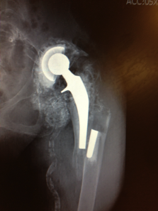

Periprosthetic fractures
Kathryn Schabel MD
November 2018, OAOS

Slide 2
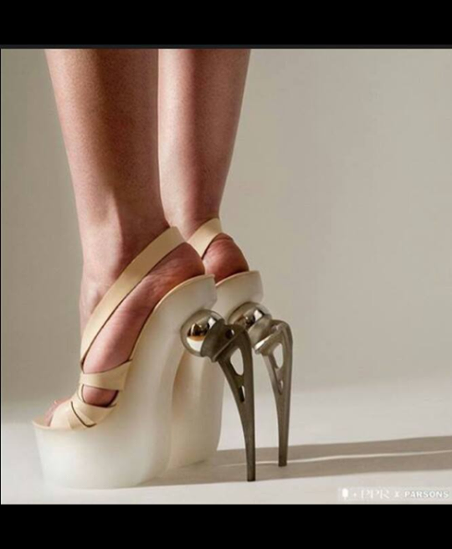
How joints fail
Instability
Infection
Loosening
Osteolysis
Metallosis
Fracture

Slide 3
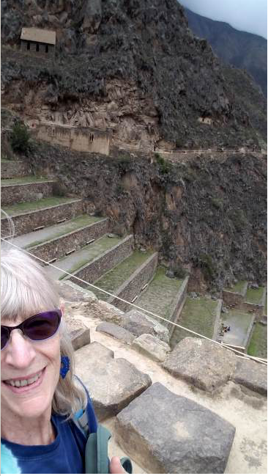
Incidence
Peitgen et al JOA 2018
Periprosthetic femur fracture
Uncemented, tapered, titanium stems
1.6% at 10 years
13.2% at 29 years
THE major mode of failure in long term for cementless THA
Notes:
Cumulative percentage probability
350+ patients, 26-29 year f/u
Half died, 5 lost.

Slide 4
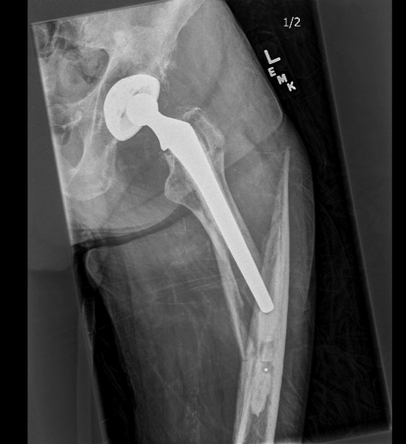
Causes
Falls!
Implant design
Rethink Cement?
Surgical approaches
Osteolysis
Osteoporosis

Slide 5
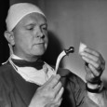
Classification
Periprosthetic hip fractures
Vancouver
A: Pertrochanteric
B1: Fixed stem
B2: Loose stem
B3: Poor bone
C: Distal to implant

Slide 6
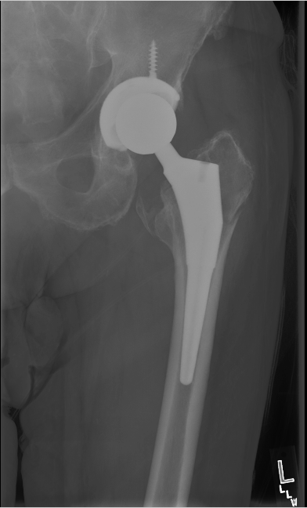

Slide 7
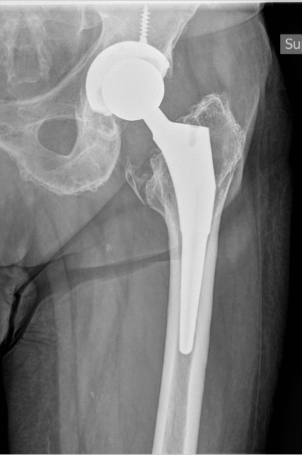

Slide 9
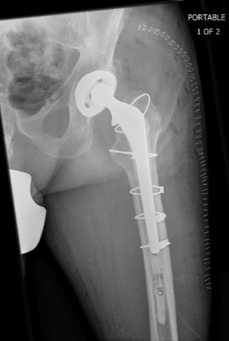
Notes:
Surgical goals: fix fracture, stabilize limb, promote mobilization, ‘damage control’

Slide 10
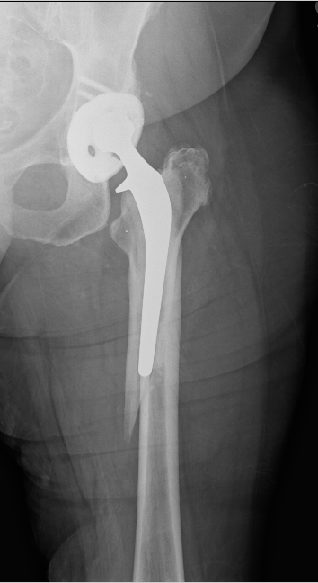
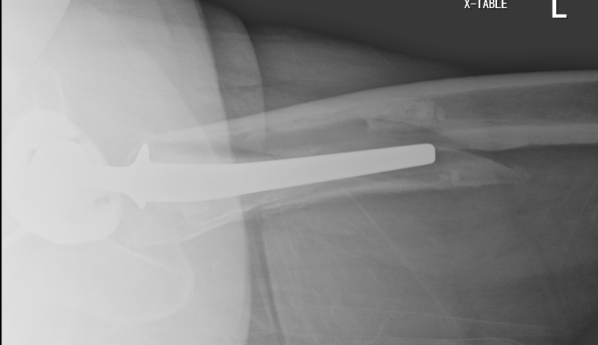

Slide 11
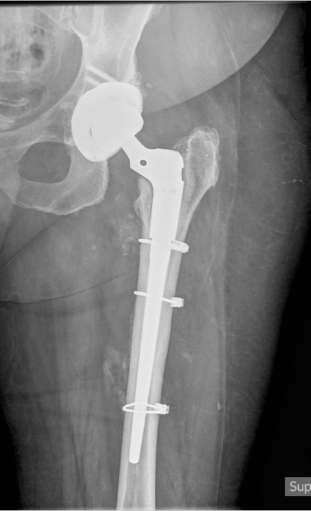

Slide 12


Slide 13
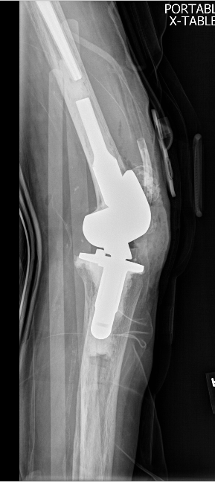
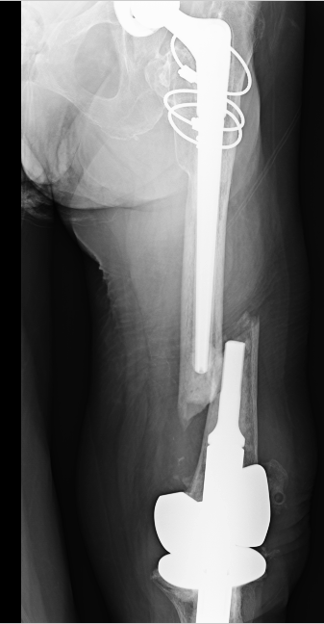
Interprosthetic fractures

Slide 14
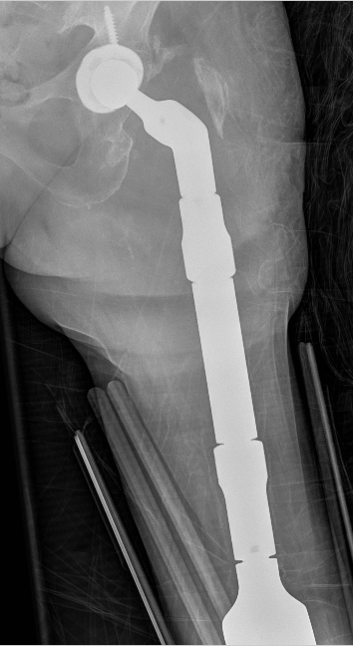
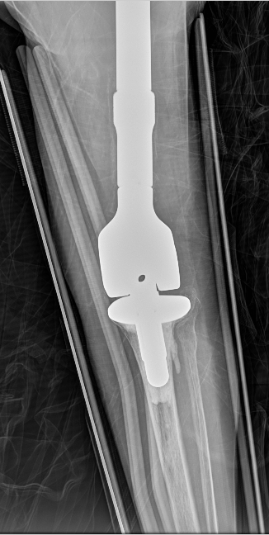

Slide 15
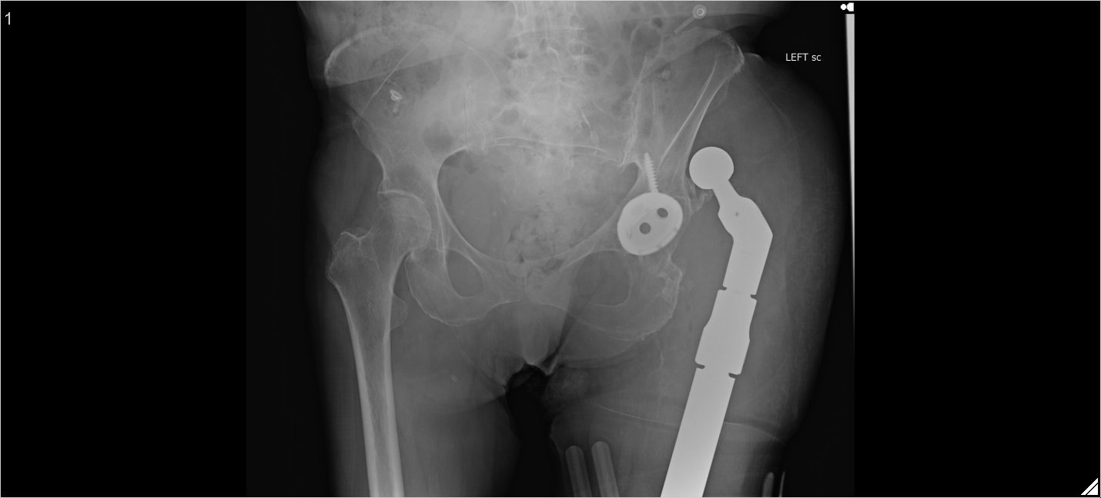

Slide 16
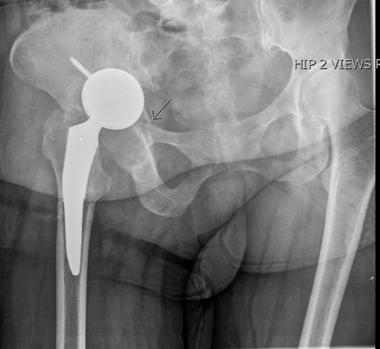
Not just the femur

Slide 17
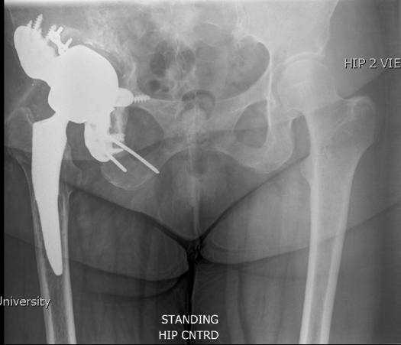
fracture
Add image of Jack Hayre
Victory miller
Discuss surgical goals of Implant stability and early mobilization
Notes:
Surgical goals: fix fracture, augment bone. Stable implant, restore leg lengths

Slide 18
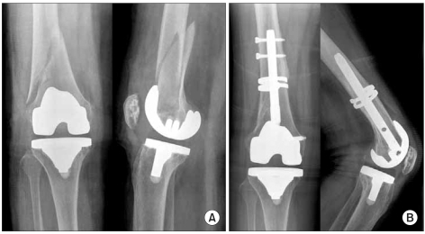
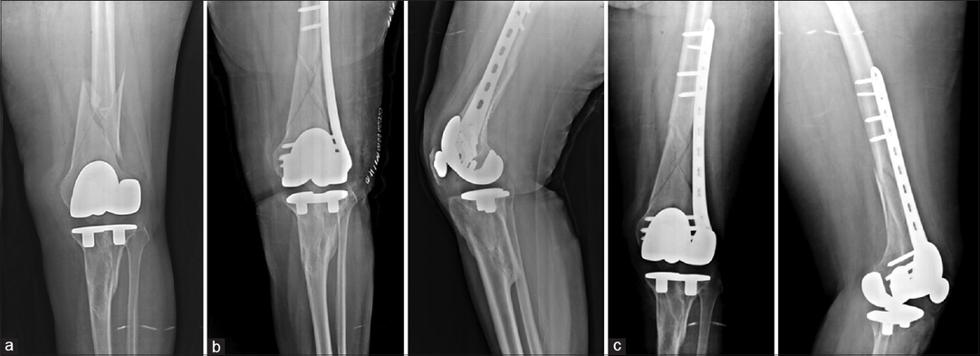
Not just hips

Slide 19
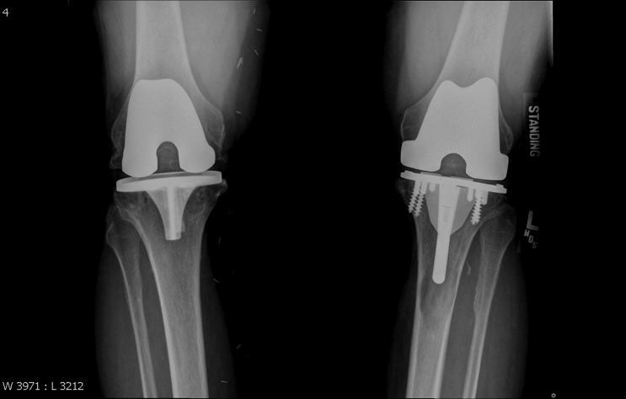
Not just trauma Left ‘knee’ pain, May

Slide 20
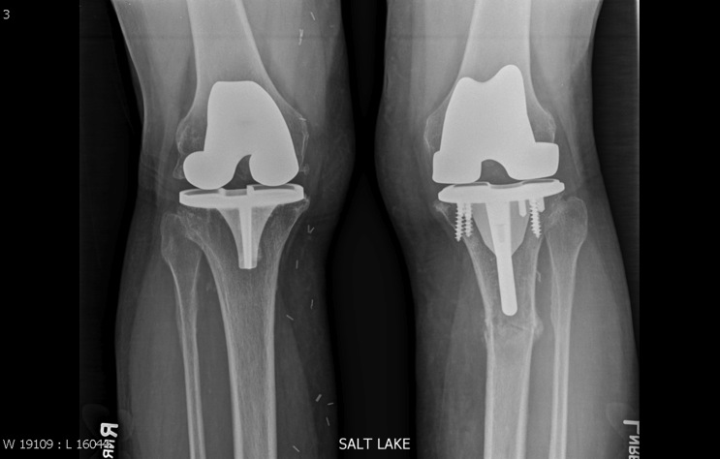
August

Slide 21
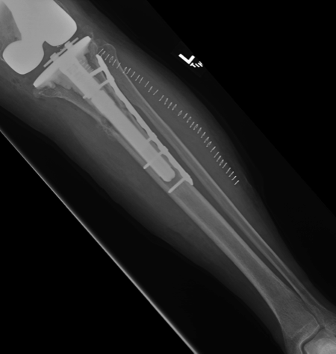
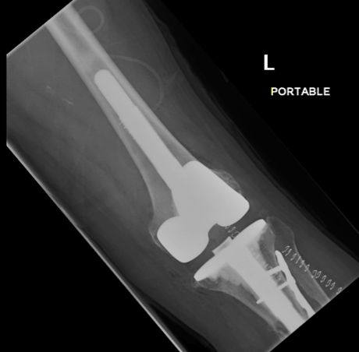
Notes:
Surgical goals to remove source of osteolysis, enhance bone stock, stabilize implant and fracture, promote early mobilization

Slide 22
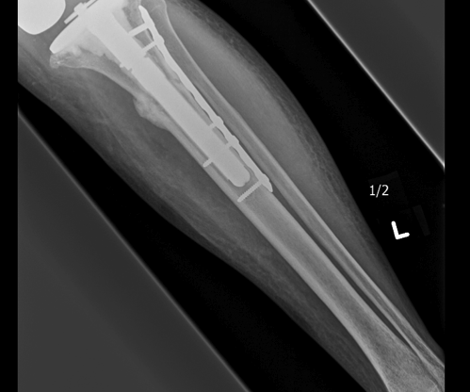
December

Slide 23
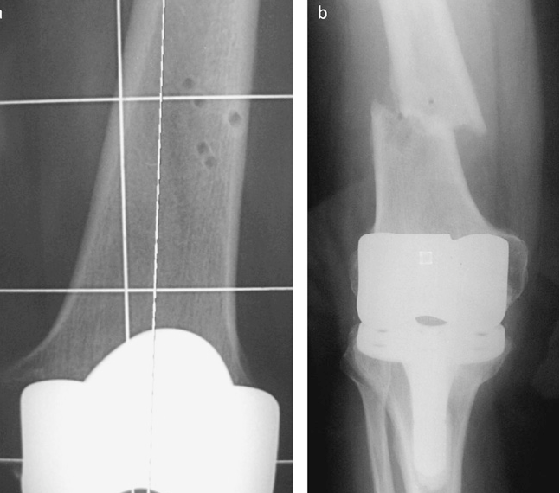
They’re back!

Slide 24
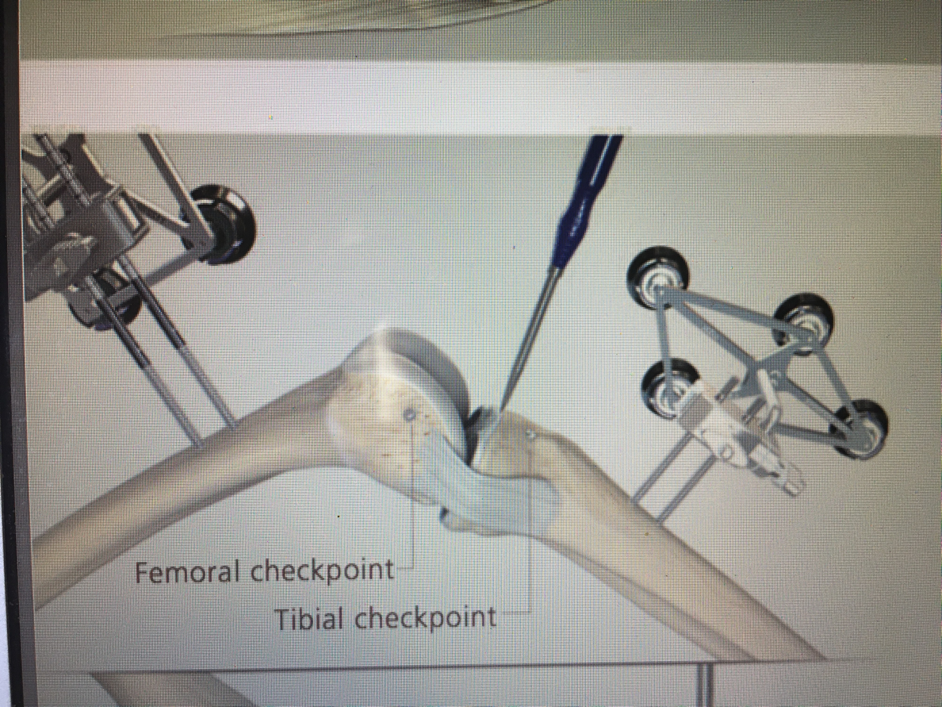

Slide 25
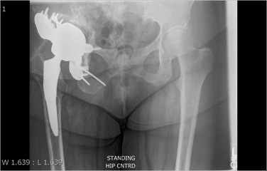
Periprosthetic fracture Summary
Technically challenging
Procedures range in complexity
Cables only to total femur replacement
Surgical goals
Stabilize fracture
Restore alignment
Promote early weight bearing
Poly exchange?
Extensive contingency planning
Implant identification

Slide 26
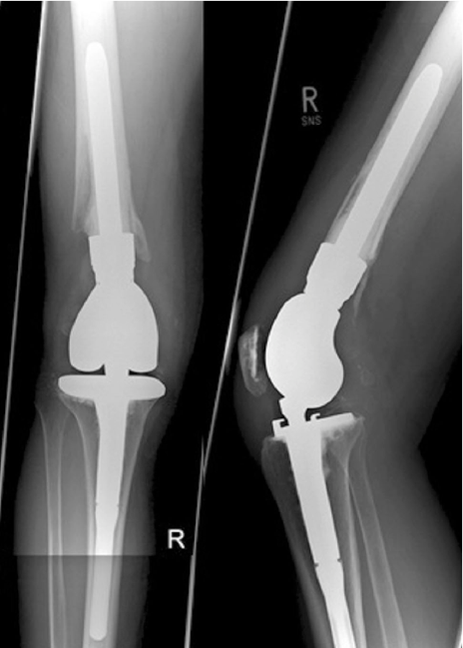
Periprosthetic Fracture Summary
Urgent
General anesthesia
Not minimally invasive
Recovery
Not like a primary joint
Age
Mode of failure
Extensiveness of procedure
Patients older, more frail, medically complicated

Slide 27
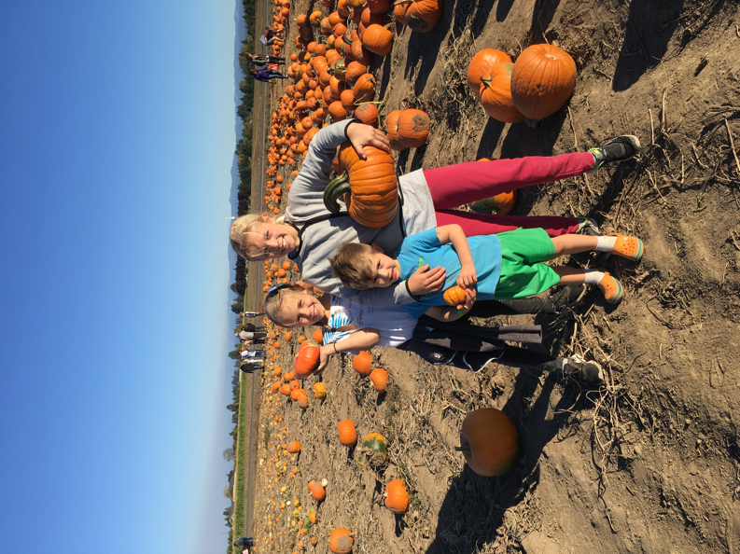
Thank you!

Slide 28

Thank you!

Slide 29
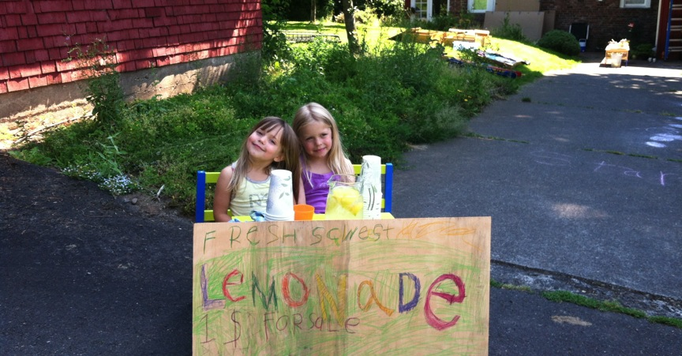
Thank you

