Slide 1


Top Reasons to Start In Free Zone Business Setup in Dubai

Slide 2
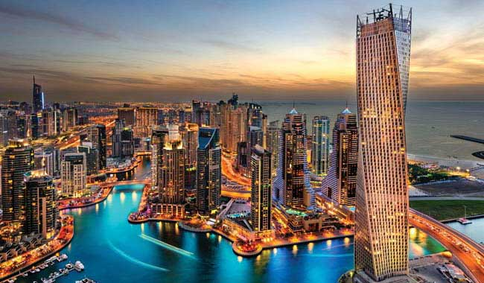
There's no denying that the United Arab Emirates has become a popular location for international business people in the recent past. This is fundamental since the native jurisdiction promises low taxes along with a strategic location (right at the core of the world's fastest emerging markets) and a supportive government. These are essentially the headlines that dominate why more and more people are rushing to the UAE to do business. However, digging deep will help you comprehend the more significant reasons that make Free zone’s business setup in Dubai tick.

Slide 3

If you are a first-timer, you must realise that Dubai's free trade zones are economic areas where you can trade goods and services- typically at preferential tax and customs rates. This is primarily due to boosting international business in the Middle East. They do it by promising rewarding benefits such as absolute foreign company ownership.
It is essential to mention that the free zones in the UAE have evolved over the years to provide ever-increasing advantages to businesses. They essentially cater to specific industries or business types to bring down the cost of setting up a company in the Dubai-free zone.
The UAE's free zones

Slide 4

Easy setup
It is essential to mention that most free zones in the UAE promise an extremely simple Free zone business setup in Dubai. You must realise that the specific application process will largely depend on your business activity and free zone selection. However, in many circumstances, you may ideally provide basic proofs, such as business paperwork and passport copies.

Slide 5

Tax and duty
As per the experts, the lenient tax regime is the most persuasive reason for choosing a business in Dubai free zone. It essentially brings down the overall cost of setting up a business in the Dubai free zone under budget.
Dubai's business setup in Free zone promises profit from 0% corporate and personal tax and exemption from VAT. And there's more- you will enjoy relief from import and export taxes, as well as currency limitations. Do you need more?

Slide 6

Foreign ownership
More and more people are exploring the idea of company formation in Dubai free zones cost since it promises complete foreign ownership. Ideally, you must collaborate with a local partner if you wish to begin a business in the UAE mainland. However, that's not the case with the free zones in the UAE. You can expect absolute ownership if you establish a company here.

Slide 7
Trading within the UAE
Detailed research will help you realise that the free zone business setup in Dubai don't have permission to trade directly with the local market. However, you can negotiate this, essentially working with a locally appointed distributor. They can essentially sell your goods and services for a separate fee.
Otherwise, you can consider establishing your private free zone corporation and then establish branch offices across the Emirates. You can use these branch offices for selling your product and creating trade relationships with the mainland of the UAE.

Slide 8
Thanks !
Dubai Business Setup
Website - https://www.dubaibusinesssetup.ae/

