Slide 1

Cogat Android App

Slide 2
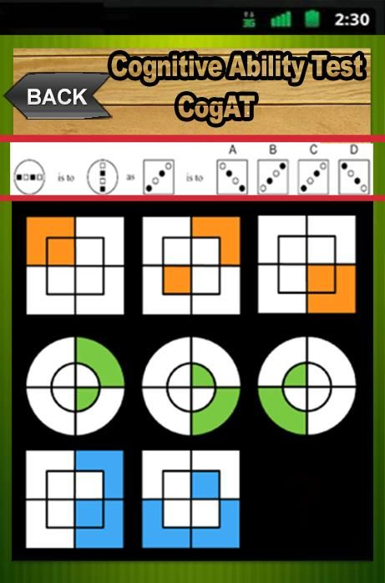
A Cognitive Abilities Test is something that is unlike other tests. Cogat is a learning abilities evaluation that says little about what they actually already know and more about what they are capable of figuring out.

Slide 3

The Cogat test is a way to determine which skills your child is using to reason through a problem and to come to a conclusion.

Slide 4

How Important Are The Results Of A Cogat Test

Slide 5
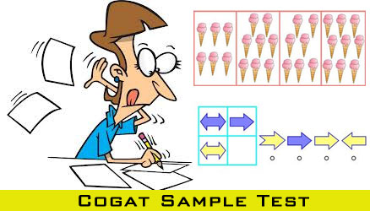
What To Do If You Are Questioning Your Child’s Cogat Scores

Slide 6
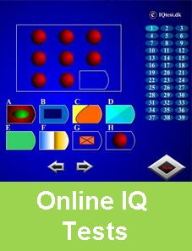
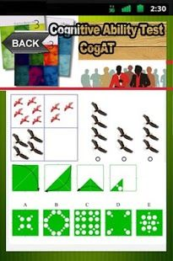
Download Cognitive Abilities Test CogAT Android App for free!!

Slide 7


Visit Us at : http://passcogat.com/
Follow Us
https://www.facebook.com/cogATapp
https://twitter.com/cogATapp

