Slide 1
Topic – Trace the evolution of computing over the centuries
Computer is an electronic device for storing and processing data, typically in binary form, according to instructions given to it in a variable program.
No one think of modern life without computers.

Slide 2
From early calculating to modern generations can be classified into following categories
Mechanical Calculating Devices
Electromechanical Calculating Devices
Electronic Computers

Slide 3
Mechanical calculating devices
Manual calculating device
Semi-automatic calculating device

Slide 4
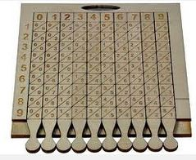
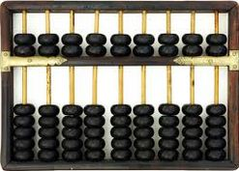
Manual Calculating Devices
The abacus – It was the first manual calculating device which was developed in 14th centuries. It was an instrument for performing calculations by sliding counters along rods or in grooves.
The Napier Bones – It was used in the 17th centuries for multiplication and division. Even square roots (√) and powers can be calculated. The Napier Bones were rectangular strips of wood or bones with figures marked on one side .

Slide 5
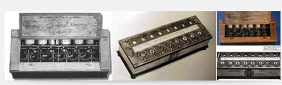


Semi-automatic Calculating Devices
Pascal’s adding machine ( Pascaline )- It was the first semi-automatic mechanical device which was made by Blaise Pascal. This device is known as Pascal’s pascaline.
Joseph jacquard’s loom - a loom programmed with punched cards invented by Joseph Marie Jacquard

Slide 6
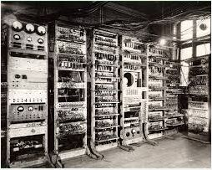
Electromechanical Calculating Devices
Mark 1 – Howard H. Aiken , a Harvard Engineer working with IBM ,succeeded in producing an all-electronic calculator by 1944 . The purpose of the computer was to create ballistic charts for the U.S. Navy .

Slide 7
Electronic computers
First generation
Second generation
Third generation
Fourth generation
Fifth generation

Slide 8
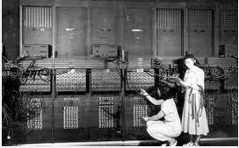
First generation
ENIAC – As the time changed , scientists developed the first electronic computer called Electronic Numerical Integrated And Calculator [ENIAC].
The speed of the ENIAC was very high in comparison to other previous machines.

Slide 9
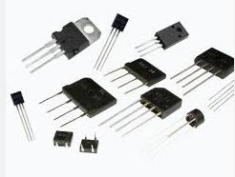
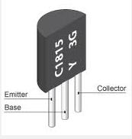
Second generation
Transistors replaced vacuum tubes and ushered in the second generation of computers. The transistor was invented in 1947 but did not see widespread use in computers until the late 1950s. The transistor was far superior to the vacuum tube, allowing computers to become smaller, faster, cheaper, more energy-efficient and more reliable than their first-generation predecessors. Though the transistor still generated a great deal of heat that subjected the computer to damage, it was a vast improvement over the vacuum tube.

Slide 10
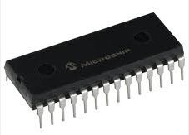
Third generation
The development of the integrated circuit was the hallmark of the third generation of computers. Transistors were miniaturized and placed on silicon chips, called semiconductors, which drastically increased the speed and efficiency of computers.

Slide 11
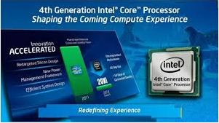
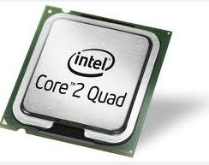
Fourth generation
The microprocessor brought the fourth generation of computers, as thousands of integrated circuits were built onto a single silicon chip. What in the first generation filled an entire room could now fit in the palm of the hand. The Intel 4004 chip, developed in 1971, located all the components of the computer—from the central processing unit and memory to input/output controls—on a single chip.

Slide 12
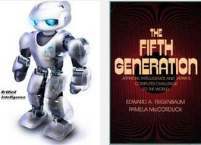
Fifth generation
Fifth generation computing devices, based on artificial intelligence, are still in development, though there are some applications, such as voice recognition, that are being used today. The use of parallel processing and superconductors is helping to make artificial intelligence a reality. Quantum computation and molecular and nanotechnology will radically change the face of computers in years to come. The goal of fifth-generation computing is to develop devices that respond to natural language input and are capable of learning and self-organization.

Slide 13
Thank You
Have A Nice Day

