Slide 1
All options of dhow cruise Dubai that you should know:

Slide 2
What could be a perfect way to spend an afternoon or evening than taking a cruise down the Dubai Creek on a traditional dhow boat? There are many different options for dhow cruises in Dubai.

Slide 3
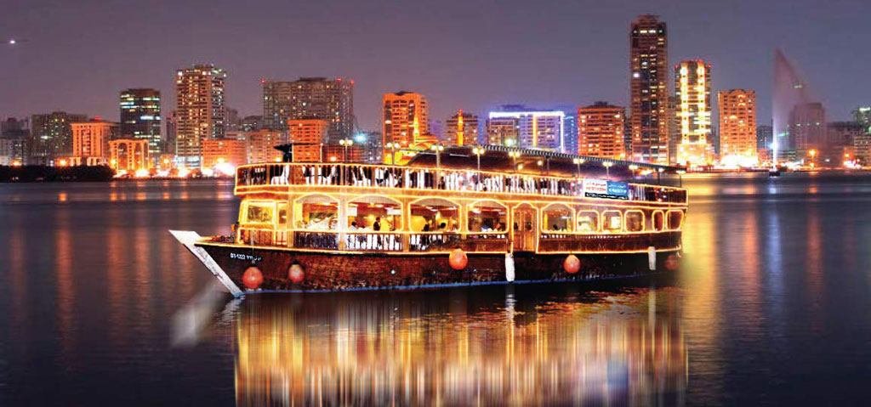

Slide 4
So it is very difficult to find which dhow cruise option is best for you. Here is an overview of the different types of dhow cruises available in Dubai and some tips on what to look for when choosing a cruise.

Slide 5
If you're looking for an unforgettable experience that will show you a side of Dubai you never knew existed, booking a dhow cruise is the way! So please sit back, relax, and let us show you everything this amazing city has to offer.

Slide 6
Which dhow cruise should you take?
The best dhow cruise in Dubai is the one that's right for you. There are many different dhow cruises available, so choosing the right one for your needs is important.
Here are some things to keep in mind when choosing a dhow cruise in Dubai:
Duration: Dhow cruises typically last for 1-2 hours. But there are also longer cruises available that last for 3-4 hours. These longer cruises usually include a buffet dinner, making them perfect for a romantic evening out or a special occasion.

Slide 7
Conclusion:
Now you know all about dhow cruises Dubai. So, what are you waiting for? Book your cruise today and experience the city from a whole new perspective.

