Slide 1
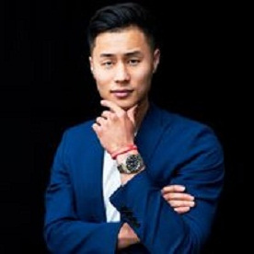
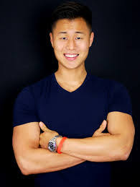
TIM HAN
CEO of Success Insider

Slide 2
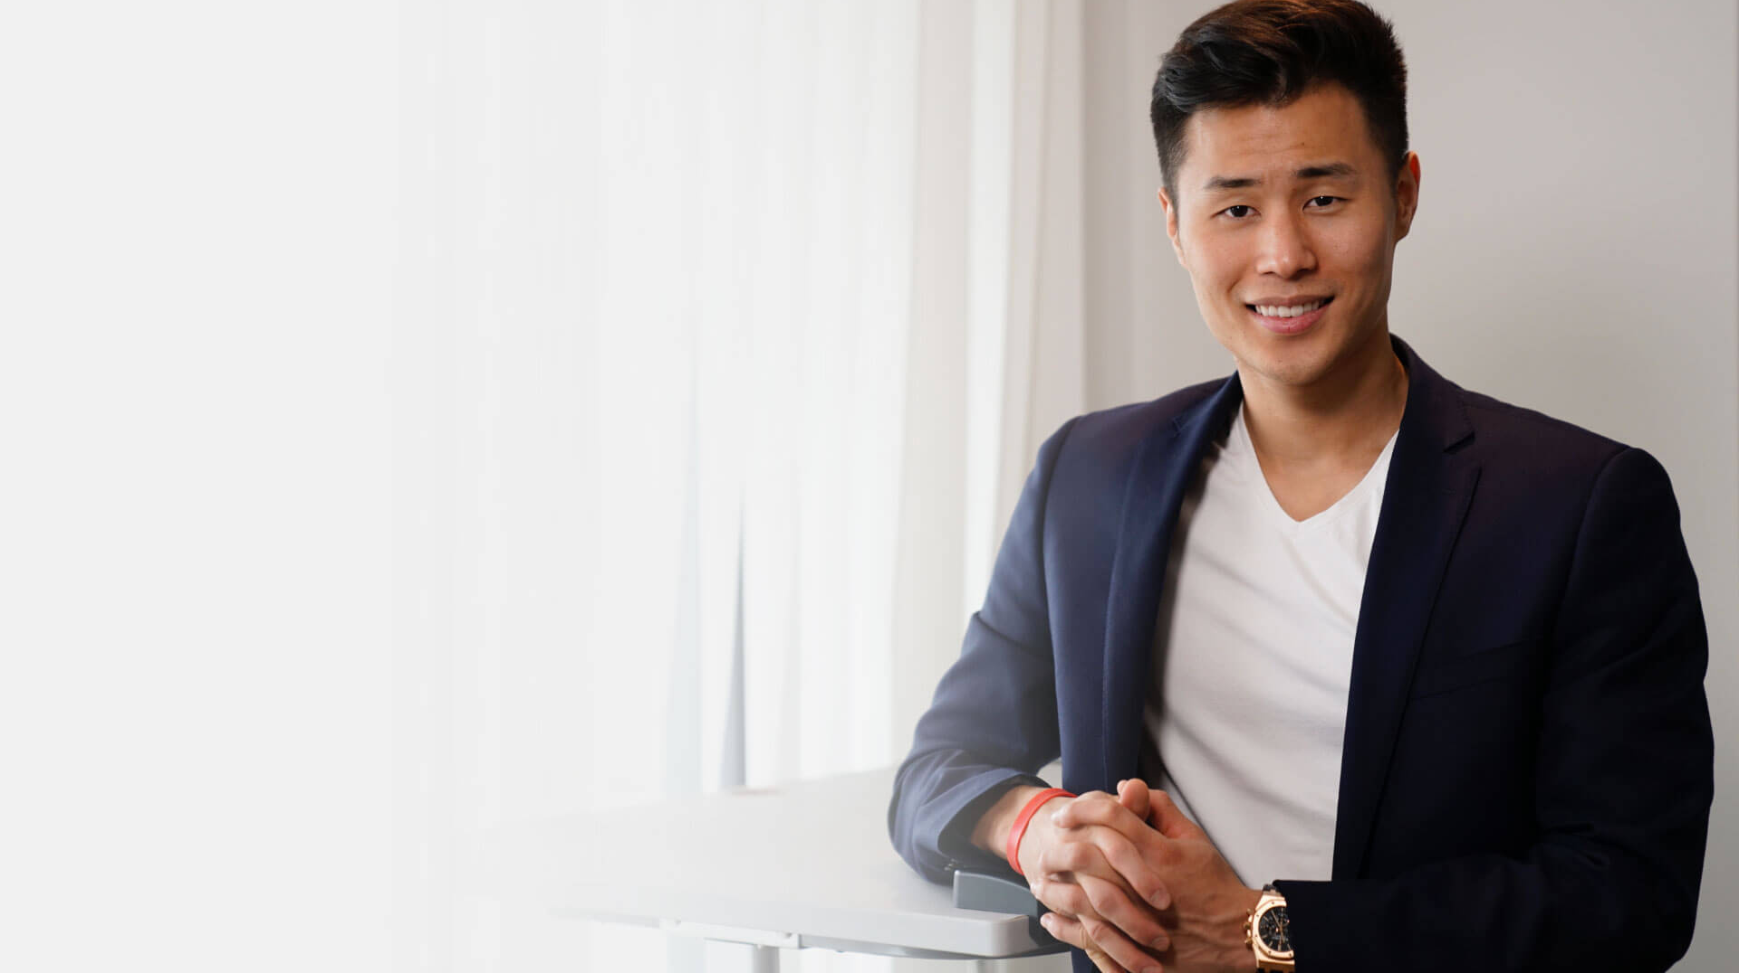


Slide 3

d
Tim Han
World-Renowned Human Behavior Expert
The Founder and CEO of the company Success Insider, Tim Han is an international speaker and world-renowned human behavior expert. He was born on the 14th of May, 1991 in Seoul, South Korea.

Slide 4

Tim Han
About Life
Tim Han was born in a middle-class family, he did not have too many facilities to avail. That is why, always, he believed in making the right use of every
opportunity and time. As the CEO of Success Insider, his major aim is to help people in becoming their best version. His working principles and ethics have
made him an inspiration for everyone.

Slide 5
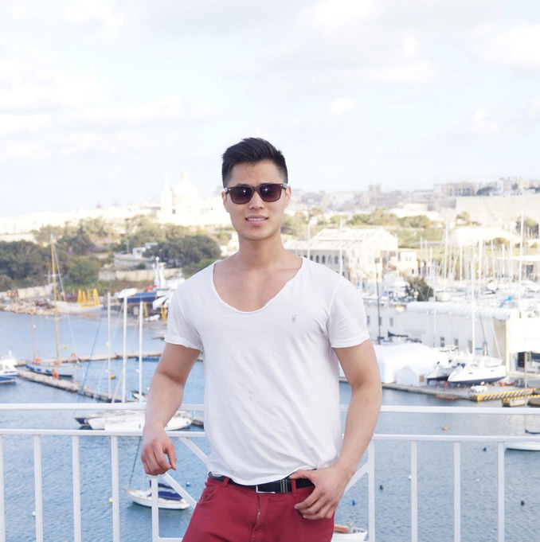
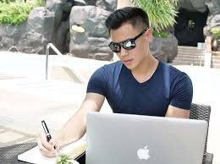
Tim Han
Journey of Success
Tim Han is a world-renowned coach, author, entrepreneur and international speaker and the founder of Success Insider. What started as the world’s fastest growing personal development YouTube channel in 2016 has transformed and today represents a community of experts helping people like you, rapidly reach success in their own lives.

Slide 6
Contact Us
For general inquiries, please e-mail us at support@successinsider.com or use the contact form below and we'll respond within 48 hours.
24
Website
https://www.successinsider.com/

Slide 7



Social Media Links

