Slide 1

AES (India) Engineering Ltd.

Slide 2
About us
AES India Engineering Company is one of the best engineering service provider. It is a joint venture between Motherson Group and T-NET JAPAN Co., Ltd. The company provides consultation, engineering, turnkey supply, Manufacturing Line Automation , agriculture equipment, locomotives, construction equipment, and general industries.

Slide 3
Services we offer
Engineering and Consultation
Turnkey Supply and Services
Project Management.

Slide 4
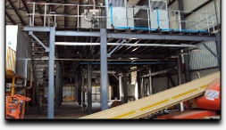
Engineering and Consultation
AES offers complete services in Engineering and Consultation from scratch like- design activities to feasibility study, basic conceptual planning to implementation, vehicle development phase and logistics planning. The services provided by AES also includes -
Digital Engineering
Logistic Planning
Manufacturing Engineering and Planning

Slide 5
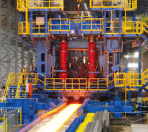
Turnkey Supply and Services
AES is one of the known engineering service providers in Noida. The company provides project management and services for Manufacturing Line Automation , turnkey supply, engineering, agriculture equipment, construction equipment and general industries. We have good experience in automotive manufacturing engineering. we support our customer’s demand from feasibility study to Turnkey Services.

Slide 6

Project Management.
AES have our expertise in Planning, Innovation, Scheduling, Project Control and Reporting which provides expected results in a cost-effective manner. Our project workflow includes many stages like:
Installation
Transformation
Equipment Manufacturing
Project Fundamentals

Slide 7
Visit us -
Website – http://www.aesindia.co.in/
Address – First Floor, B7, Sector7, Noida - 201301 India,
Mail id – info@aesindia.co.in
Contact no - +91-120-435-5338

