Slide 1
10 Secrets About Dhow Cruise Dubai You Should Learn

Slide 2
What does ‘dhow cruise Dubai’ conjure up for you? Images of a wooden vessel with billowing sails, plying the waters of the Arabian Gulf and taking passengers on a relaxing journey through Dubai’s iconic skyline? Well, that is precisely what a dhow cruise is all about! But there are some secrets about these cruises that many people do not know. Here are 10 secrets you should know before boarding your next dhows cruise in Dubai.

Slide 3
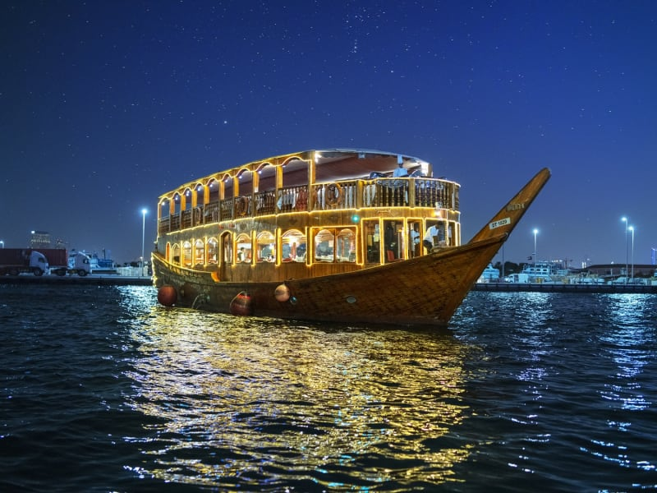

Slide 4
Dhow cruise Dubai is not just about the wooden vessel
When most people think of a Dubai Dhow Cruise, they imagine a traditional wooden vessel plying the waters of Dubai. However, modern dhows come in all shapes and sizes – from sleek and contemporary catamarans to luxurious yachts. So, if you’re looking for a more luxurious experience, be sure to check out the different types of dhows available before booking your cruise.

Slide 5
One of the best things about dhow cruises is that they offer a unique way to see Dubai. From the water, you’ll see iconic landmarks like the Burj Al Arab and the Palm Jumeirah in a new light. And, as the sun sets, you’ll be treated to a spectacular view of the Dubai skyline, illuminated by the city’s dazzling lights.

Slide 6
Whether you’re celebrating a birthday, an anniversary or any other special occasion, a dhow cruise is a perfect way to mark the occasion. Many dhows offer private cruises with champagne and canapés, making them ideal for intimate celebrations.

Slide 7
Dhow cruises are suitable for all ages and interests. Many dhows offer a range of activities and entertainment, from live music and dance shows to henna painting and Arabic calligraphy. There’s also plenty of delicious food on board, so you’re sure to find something to suit everyone’s taste.

Slide 8
If you want to experience the authentic culture of Dubai, then a Dhow Cruise in Dubai is a great way to do it. From the moment you step on board, you’ll be immersed in the city’s Arab culture. And, with plenty of traditional entertainment, you’ll get a real taste of what life in Dubai is like. However, it’s worth noting that many dhows now cater to a more international crowd, so you may not find as much Arabian culture on board as you’d expect.

