Slide 1
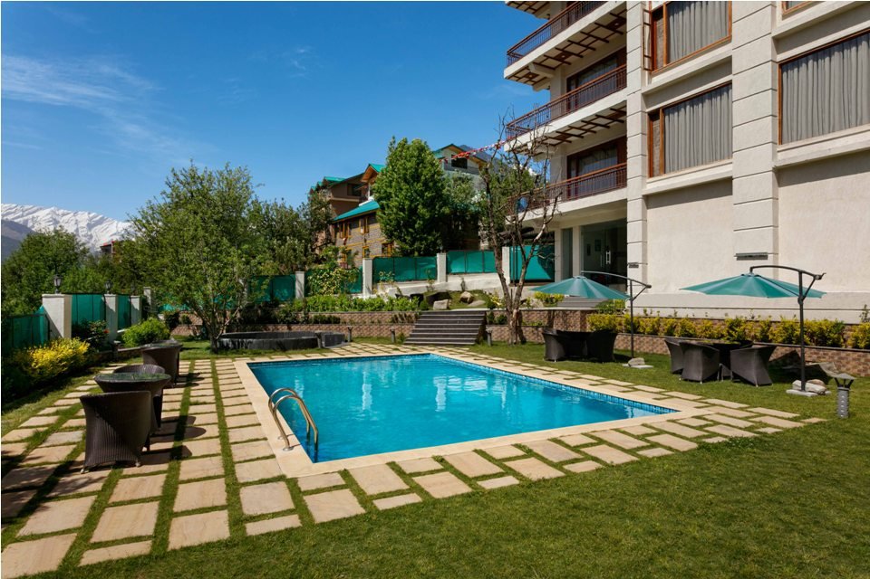


Alokik Resort In Manali

Slide 2
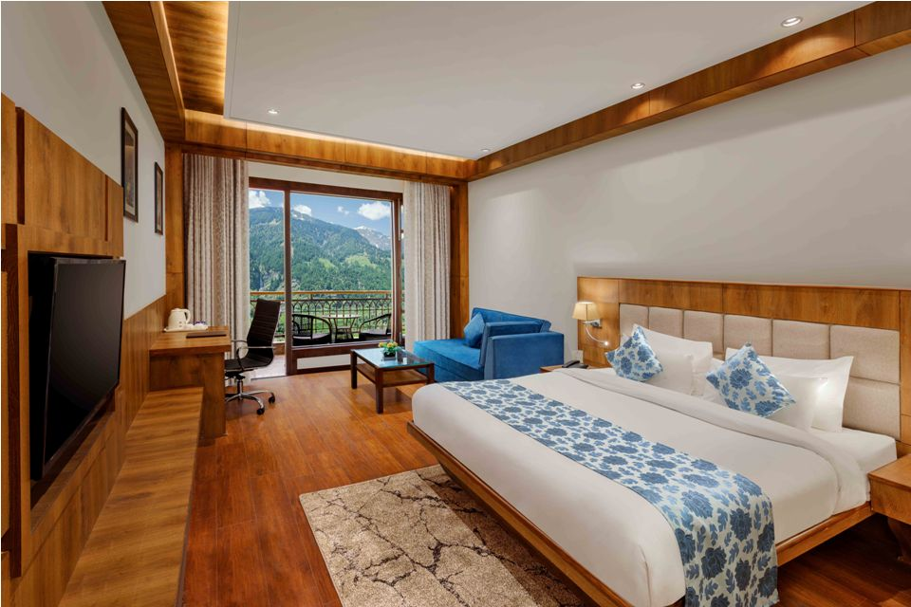
Alokik Is Best Budget Resort In Manali
Alokik is a 5 Star hotel in Manali.
Amidst mesmerizing environment of one of the famous hill stations of India. Every tourist comes and relishes the extraordinary beauty of the fresh environment. It is a perfect blend of royalty and simplicity that makes it a unique and attractive place to stay. Alokik resort offers plenty of rejuvenating amenities for a relaxing aura release the stress from the hectic journey. Being situated at an ideal destination, it is popularly loved as one of the best budget hotels in Manali.

Slide 3
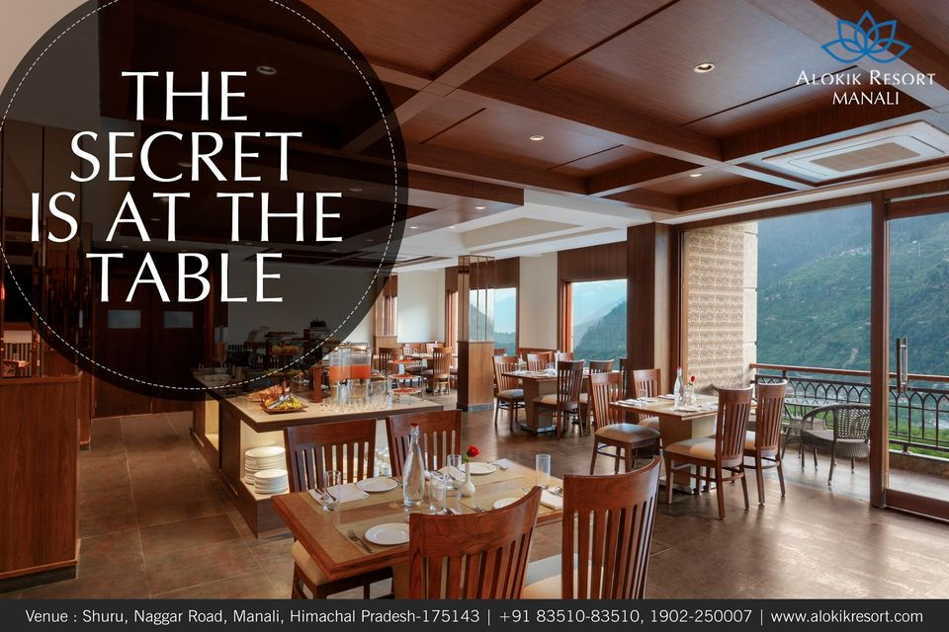
Pure vegetarian resort in manali
Under a single roof one can experience an abundance of modern facilities loaded with immense comfort. With its captivating surroundings, this splendid place makes people visit Manali again and again. Alokik resort offers shuttle service to visit all the breathtaking and charming places in Manali. It also has the Pure vegetarian resort in manali serving multi cuisines with a mini bar to get your hands on the best delicious food and drinks.

Slide 4
Thank You For Visiting
For more information contact us at 8351083510
Our Website :- https://www.alokikresort.com/
Instagram - https://www.instagram.com/alokik_resort/
Facebook - https://www.facebook.com/alokikresortmanali/

