Slide 1
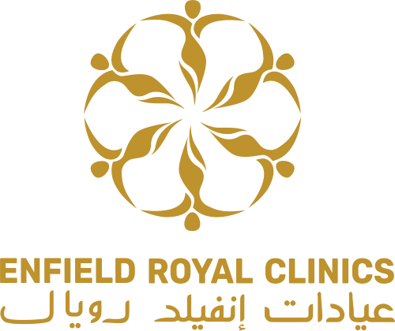
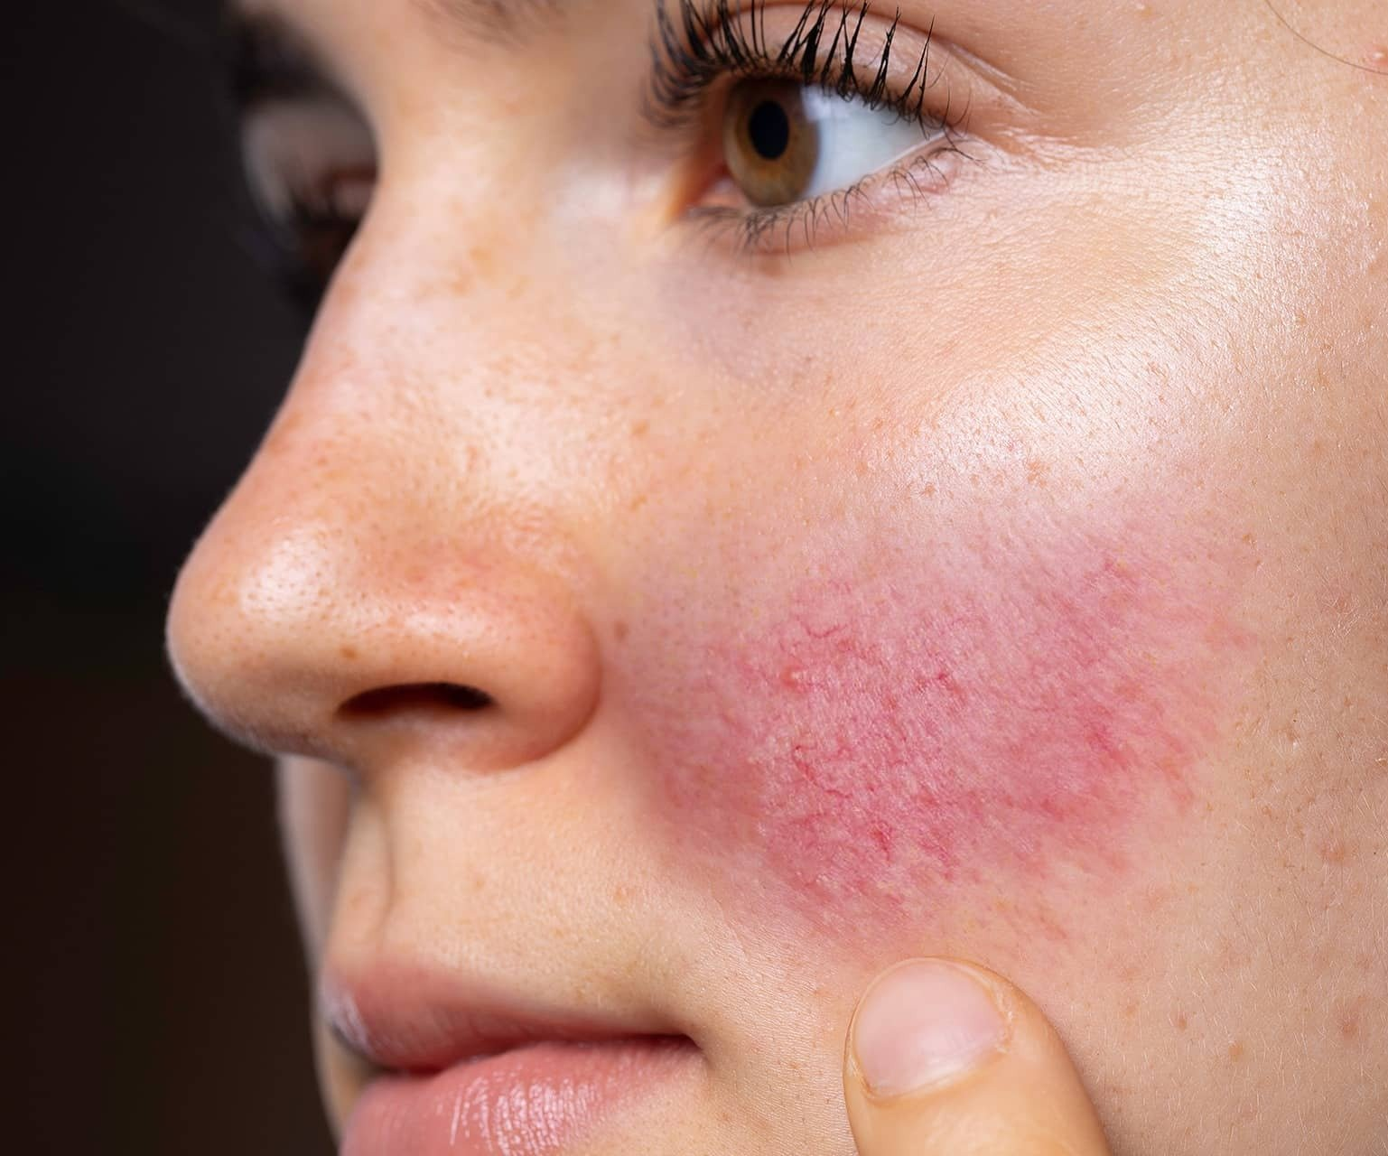
Rosacea treatment in dubai
Rosacea treatment in dubai is a common skin condition that causes redness and visible blood vessels in your face. It may also produce small, red, pus-filled bumps. While there is no cure for rosacea, there are various treatment options available in Dubai to manage and alleviate its symptoms. These treatments aim to reduce redness, inflammation, and prevent flare-ups.

Slide 2
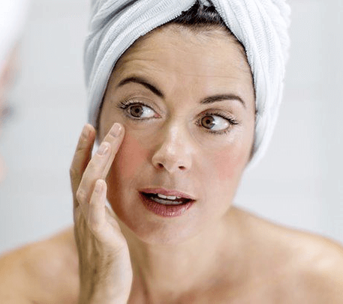
Clearing Rosacea: Dubai's Advanced Treatments
Laser Therapy:
Laser therapy is a highly effective treatment for rosacea in Dubai. Different types of lasers, such as pulsed dye lasers and intense pulsed light (IPL) devices, target the blood vessels causing redness and inflammation.
Topical Medications:
Dermatologists in Dubai may prescribe specialized topical medications containing ingredients like azelaic acid, metronidazole, or sulfur, which have been proven to reduce redness and inflammation associated with rosacea.
Oral Medications:
For more severe cases of rosacea, oral medications may be recommended. Antibiotics like doxycycline, tetracycline, or metronidazole can effectively manage inflammation and control bacterial growth on the skin's surface. .

Slide 3
Contact us:
WhatsApp : +971 544015744
Landline : +971 4333 0708
Email : info@royalclinicdubai.com
Address : Villa 1089, Al Wasl Road, Al Manara Area (On the junction of AlThanya & Al Wasl Road)

