Slide 1
10 Surprising Ways Dhow Cruise Dubai Can Affect Your Health:

Slide 2
When you think of Dubai, the first thing that comes to mind is probably luxury. This city knows how to pamper its visitors, from the fancy hotels to the opulent shopping malls. But what you may not know is that Dubai is also a great place for some healthy tourism. Check out these ten surprising ways dhow cruise Dubai can affect your health.

Slide 3
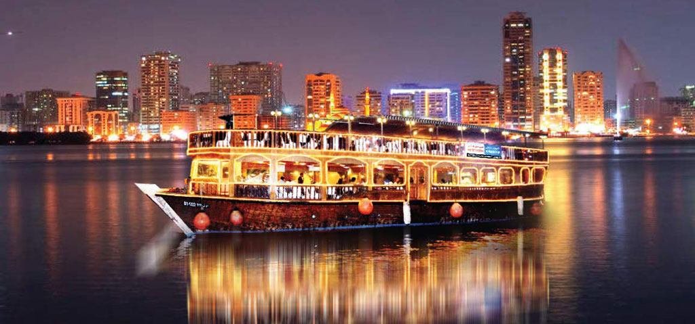

Slide 4
What is dhow cruise Dubai?
5 Star Dhow cruise Dubai is a unique form of tourism that allows visitors to experience the iconic city of Dubai in a whole new way. This exciting activity takes place on a traditional Arabian dhow or wooden sailboat. Visitors can sit back and relax as they cruise down the Dubai Creek, taking in the stunning skyline and architecture.

Slide 5
10 surprising ways to improve health:
Studies have shown many health benefits to spending time in the water. The gentle rocking of the dhow, combined with the fresh air and beautiful views, can help promote feelings of calm and relaxation. Additionally, spending time outside in nature has reduced stress levels, improved mental health, and increased energy levels.Here are ten surprising ways that dhow cruise Dubai can affect your health.

Slide 6
1. Boosts Immune System:
Visiting dhow cruise Dubai can give your immune system a boost. Part of this is due to the warm weather, and part has to do with the fact that you're getting out and exploring a new place, which keeps your body active. A cruise also means breathing in the fresh air, which is a great way to ensure your lungs are clean.

Slide 7
9. Reduces Asthma Symptoms:
Have you been dealing with asthma symptoms? If so, dhow cruise Dubai may be the solution you've been waiting for. With the help of dhow cruise fresh air, you can easily reduce the severity of your asthma symptoms. But before changing anything about your health, it's important to speak with a professional first.
Book Dhow Cruise : dhowcruisedubai.org

Slide 8
10. Strengthens Bones and Muscles:
Dhow cruise Dubai isn't just good for your mental health; it's also great for your physical health. If you want to strengthen your bones and muscles, dhow cruise Dubai offers a great opportunity to do so. The fresh air and the activities of the dhow cruise Dubai will help improve your overall fitness and health.

