Slide 1
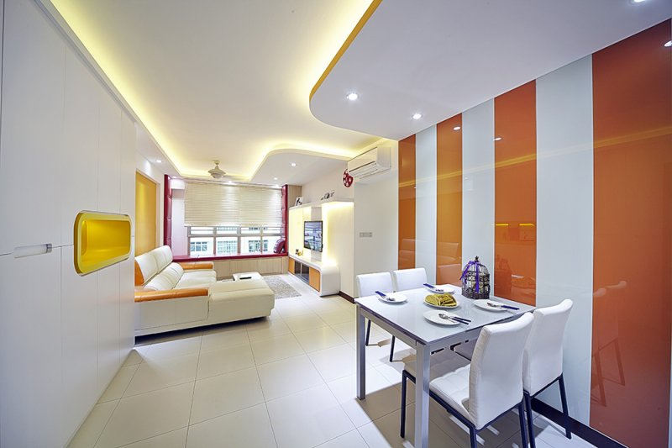
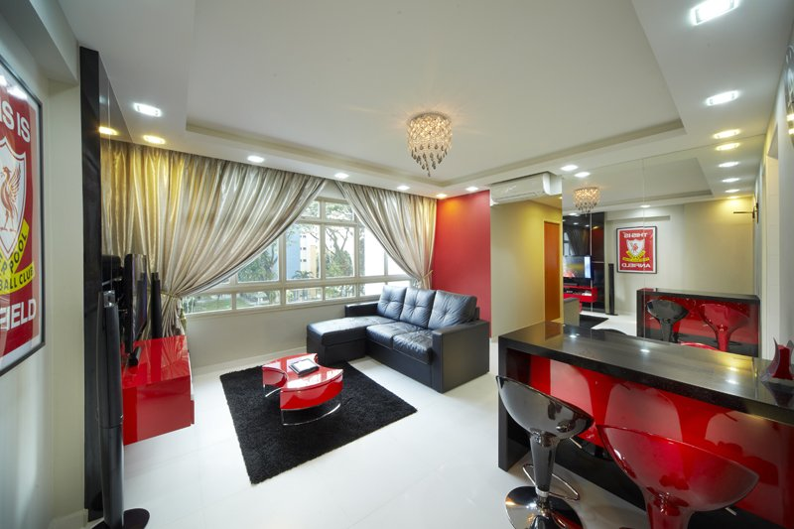
Hdb Home Design Renovation Singapore
When you invest in a home, it is normally a lifetime commitment that's why you need to maintain and improve it regularly to make sure it's still valuable. On the other hand, when people starts to think of expenses they need to face in maintaining their home and make the property value raise higher, they seem to lose hope and give up with their idea of starting luxury home renovations. There are some improvements you can make that won't break your bank and cost you your life savings.

Slide 2
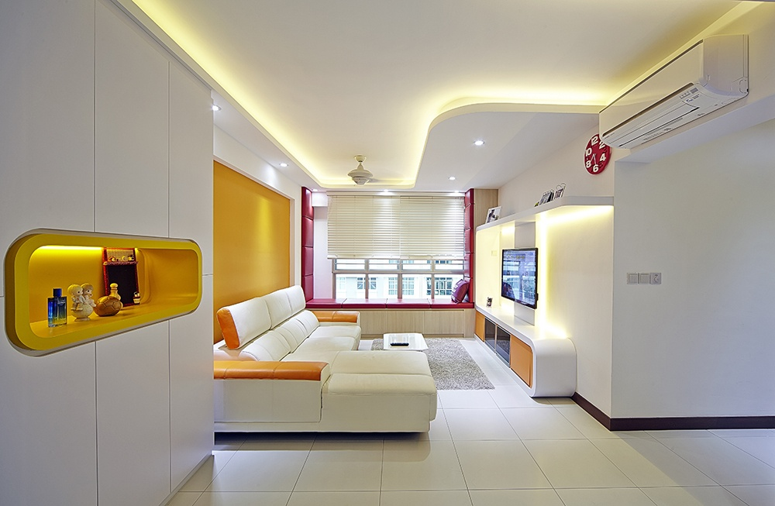
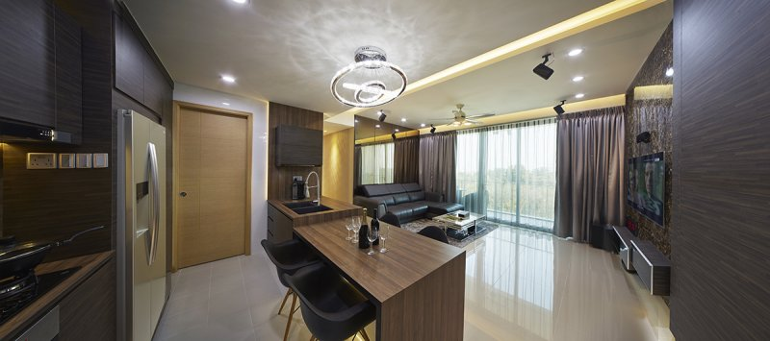
Home And Decor Singapore
Home renovation not only increases the value of your home, but it also enhances the appeal of your home and makes it a more comfortable place to live. In order to complete the renovation work done perfectly, you need to hire the service of a reliable home renovation contractor. As there are numerous contractors available in the market, it is important to choose the one who can deliver a successful home renovation project. You can get references and recommendations from your friends or colleagues who have hired a contractor in the recent past.

Slide 3
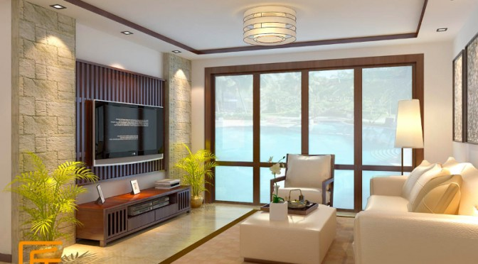
Home Renovation Singapore
Home renovation services include construction, renovation of a particular area within your home, addition or change in interior and exterior, changes in design as well as management of the entire project. The renovation companies provide design ideas based on your budget by comparing it to the implementation cost. In case you have just bought a piece of land; they can guide you about the structure and lay down the plans for your new home as well as plan your landscape for your new home. If you already have a house standing on the land, they can come in and demolish and further construct a house based on what you are looking for. This is done from scratch. They will advise you on the kind of structure, size as well as construction costs.

Slide 4
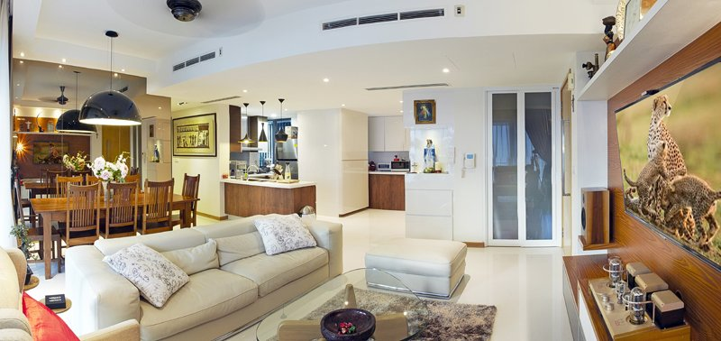
Hdb Home Design Singapore
Renovating your home may be a hassle but it can give you a nice sense of accomplishment when you see the results. It will also increase the resale value of your home. Just remember to be patient and have a thorough preparation ahead of time.
Home renovation can be pretty expensive and most often, is a big hassle for a lot of people. When you are planning to renovate your home and transform it to what you have always wanted, you will have to consider a lot of factors.

Slide 5
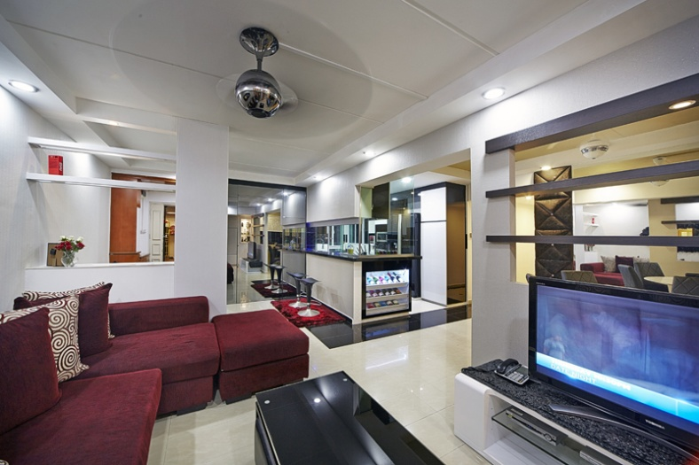
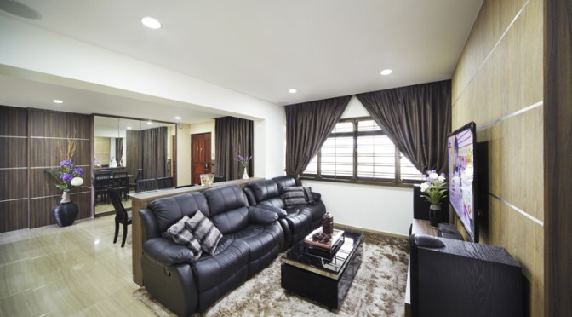
Kids Room Design Singapore
Each and every room of your home is undoubtedly very important and needs special care and attention in its decoration. But when it comes to your kids room then you need to be extra cautious as your kids bedroom design should go well with the likes and dislikes of your child. While decorating your kids bedroom due consideration should be given to all aspect like bedding, wall color, decor and other.

Slide 6
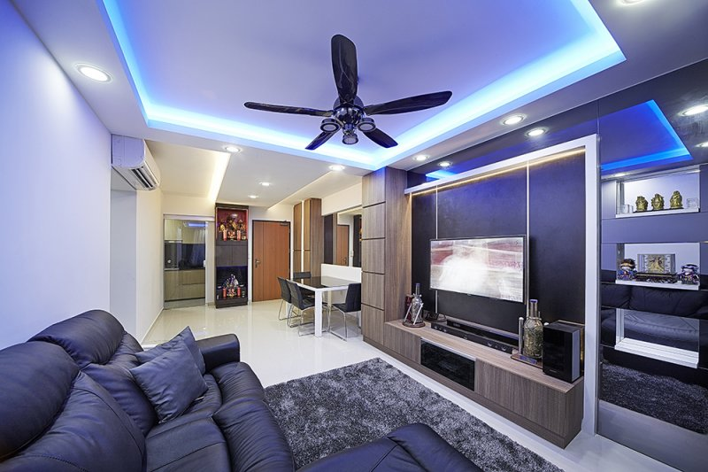
Hdb Home Design Singapore
Everyone dreams of the having most beautiful and unique place to live. Your home needs a lot of attention, proper care, and maintenance. You need to make various changes inside as well as outside so it looks beautiful and is well maintained. Many home owners consider renovations and additions to spruce up their living space.
A renovation can be a simply matter of adding a bathroom to a complete gut and rebuild of the home. A renovation you can give your home a whole new look and feel. Many people consider doing renovations on their own; however, it is advisable to hire a general contractor for any kind of renovations or additions. General contractors are professionals with great experience and will provide you with the best results on time and on budget.

Slide 7
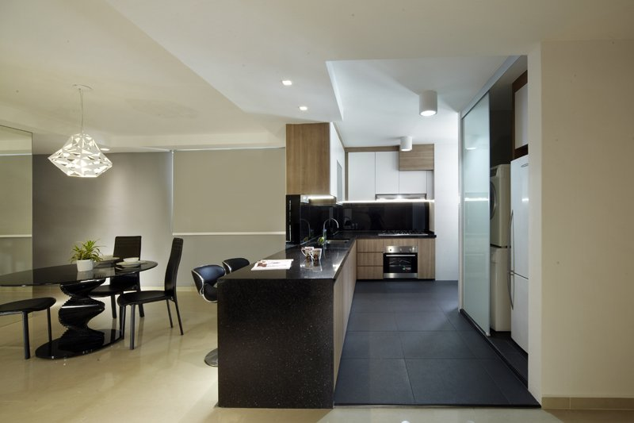
Home And Decor Singapore
Although many people still think of interior design services as a luxury that only the rich enjoy, the reality is that hiring an interior designer can be a good budgeting decision for anyone interested in changing their home decor. Interior designers can offer ideas to fit any budget, and they have access to a wide arrange of discounts and products that can save you even more money.
With all of the different options available for today's home improvement projects, many people find themselves overwhelmed with all of the details. Professional interior designers have seen many different projects over the course of their careers, and a good designer can easily kick-start your project and show you how to make planning your home decor a breeze.

Slide 8
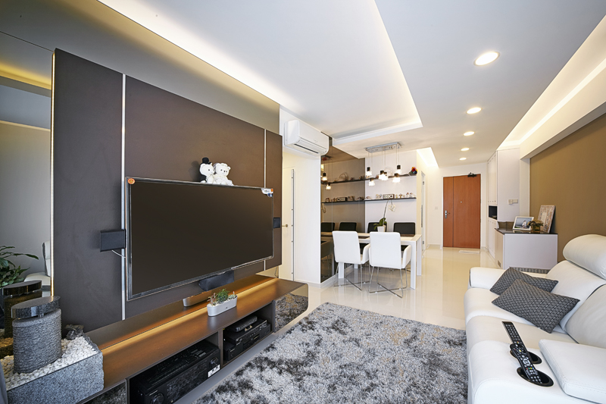
Home Renovation Singapore
Many families always want to change how their old house looks depending on their lifestyle and their needs; therefore, they gather home renovation tips they can apply. They may require a more spacious house especially if their family is growing. They may want to conform to the latest house designs and go for the minimalist look. Their children may want to have separate rooms. They may also demand a place in the house where they can entertain their friends.

Slide 9
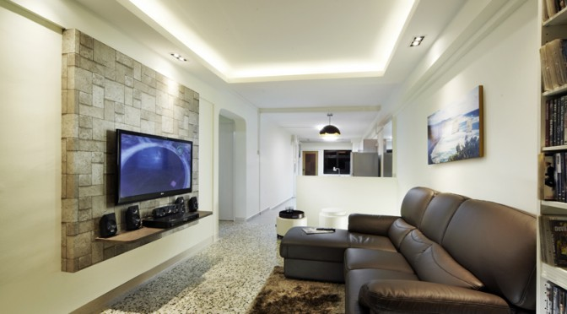
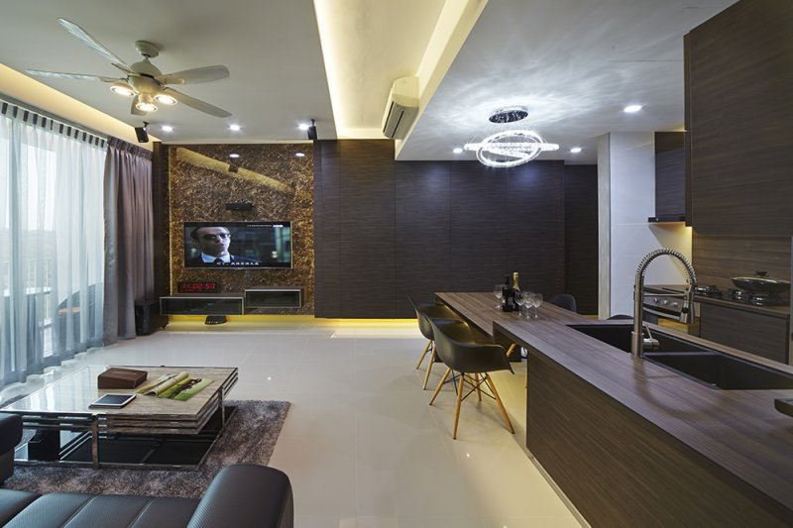
Hdb Home Design Renovation Singapore
Before you apply home renovation tips to your house, it is better to have a blueprint or a design to look at for proper guidance. This way, you will not depend on a trial and error project and will not waste money and materials.
There are also municipal building laws that the local housing authorities may require so before you undergo house remodeling, better familiarize yourself with these. Have an expert examine the structure of the whole house first, especially the exterior before going into the interior. The exterior structure must be sturdy so as to keep the interior safe.

Slide 10
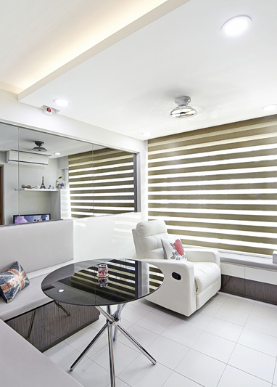





thecarpenters.com.sg
Hdb Home Design Singapore

