Slide 1
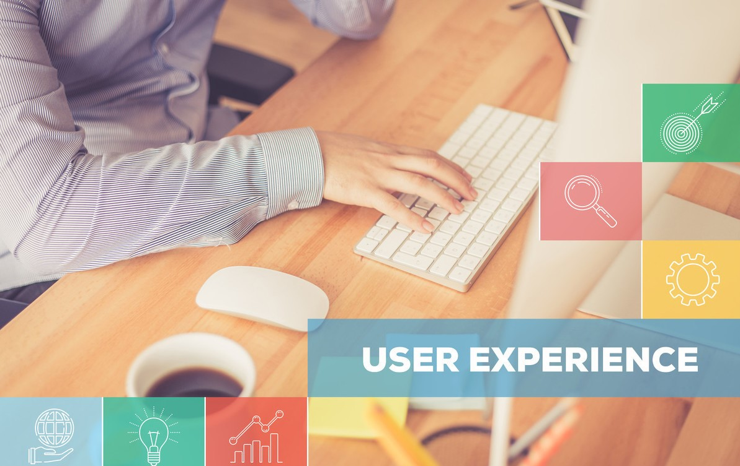
What to Know About Usability Testing

Slide 2

Have you ever purchased and tried a product that you just can’t help but complain about its flaws? If you did, chances are, this particular product may have never undergone any type of testing – such as unit testing, or in information technology, we call it usability testing. If the product is not tested, the company may face customer complaints and dig in some financial issues. They might even recall those products if not acted upon quickly. If they have already spent quite a considerable amount of money to launch it publicly, it may be a huge loss for the company.

Slide 3

It all boils down to how important usability testing could be for the future of the products and the company. But before the said testing could be conducted, it is important to know what purpose it serves, how important it is for a website or app, and how it works.
If you want to know more about how useful this is, then you should continue on reading this article in order to find out the information you need.

Slide 4

Brief Background on Usability Testing

Slide 5

It is defined as the process of evaluating a website, or testing the readiness of an app before it would be officially released to the public. The product, website or app will be first tested by a set of users who are part of the company’s targeted audience. The company and the UX design agency it partnered with, then, will conduct such tests to assess the users’ overall experience. This will be done through measuring the ease of use. After which, actual users will be asked to complete a particular set of tasks. The given tasks are similar to a regular, actual use of a website or app.

Slide 6

Benefits of Usability Testing
The purpose of the product is to be of use and solution to the consumers' needs. With that, this process will evidently ensure the product's functionalities, features and overall purpose, to be in line with the actual users' needs.

Slide 7

It helps the company save money.

Slide 8

Saving money has been one of the benefits that usability testing provides to one's company. Think about all of the costs associated with developing and launching the product – this includes correcting issues identified in the digital product as quickly as possible. Because the testing has been done, it would greatly help in identifying which of the functions and benefits of the product did the user like, for this will actually be critical to its success. The actual data that the test has provided will help in making decisions about the product. Saving money is achieved through fixing the UX problems before they happen.

Slide 9

It helps the company save countless hours.
Through usability testing, you will be able to assess the users’ reactions well before even beginning the product development. If you are trying to fix the UX pitfalls after it has already been coded and deployed, you might me wasting some valuable time. Wouldn’t it be better to test a product's feasibility and execute it at a very basic level? By doing so, you will be able to identify possible issues right away and make smart decisions and changes quickly.

Slide 10

Working with a UX consultant , your company will gradually understand the importance of usability testing. Testing the product and assessing the users’ experience are significant factors, as you could fully understand the product’s features and functionality, and prevent further errors after it has been launched.

