Slide 1
Evening Desert safari- Basic things to Know

Slide 2
There are high dunes in the desert, and you will pass through them while on the safari. For the entertainment of true lovers, there are camels and quad bikes. You can enjoy their ride and have fun. The sunset in the dunes of the desert gives a romantic view. Use your camera to capture the beautiful scenery.

Slide 3
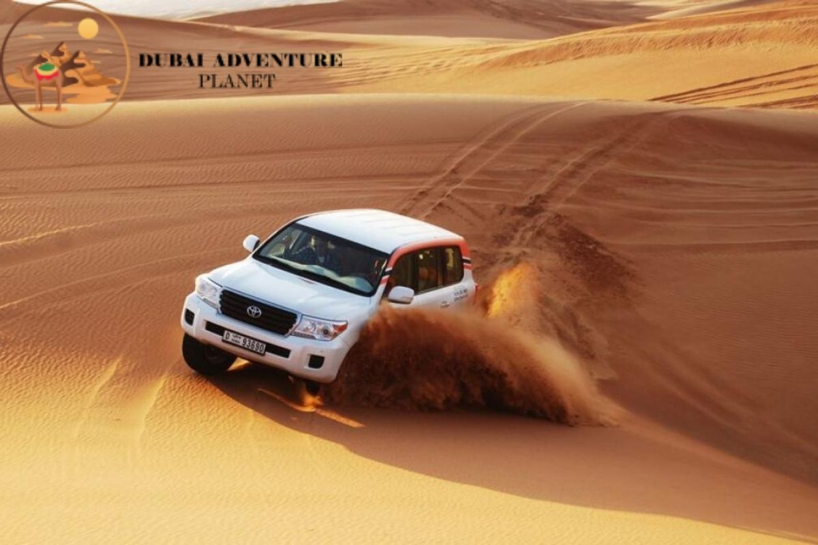

Slide 4
Get your SUV and start an unforgettable journey in the Dubai Desert Safari. Camels and quad bikes are waiting for you to ride on and boost your adrenaline levels along the desert journey. The camel rides will make you delighted, and you will enjoy the ride on the "ship of the desert" for sure.

Slide 5
Important to Know:
A 6-7 seater vehicle will pick you up from the destination for the Dubai desert safari. The best option is Toyota Land Cruiser 200. The standard tour cost is indicated for the tourists living in Ajman, Dubai, and Sharjah. And the tourists residing in Ras al-Khaimah, Fujairah and Abu Dhabi emirates, there is a separate indication of tour cost because the distance between the emirates is vast. Here, the order is accepted by at least three persons.

Slide 6
Dinner in a Bedouin village
Bedouin village will hold you in the evening and offer you some entertainment with Tanoura Show, Fire Show and The Arab special belly dance. You can get dressed in national Arab costumes and take pictures to save the fun. You will have a barbecue, national sweets, fruits, Arabic dates, and soft drinks for dinner under the dark sky with brightening stars. You can also have hookah, for which you have to pay separately.

Slide 7
After How Long the Evening safari ends:
The estimated duration of an evening desert safari in Dubai is 5 hours and 30 minutes. It’s enough time to enjoy the taste of desert and Arab tradition.
Book Desert Safari: dubaidesertsafaris.com

